Slide 1
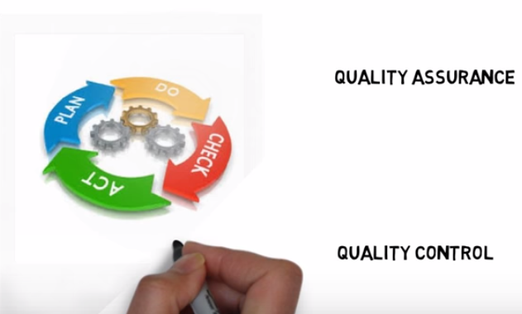
SFO LABORATORY : QC AND QA PLAN

Slide 2
QC and QA

Slide 3
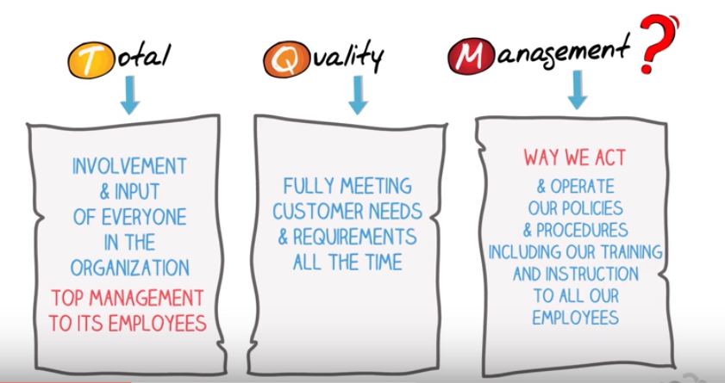
TQM: REAL MEANING : PROCESS IMPROVEMENT

Slide 4
QC : WHY IS IT PERFORMED??
To MAKE SURE THAT INSTRUMENT IS PERFORMING WITHIN PREDEFINED SPECIFICATIONS AND TEST RESULTS ARE RELIABLE.
QC RULES ARE SET UP TO AVOID INACCURATE PATIENT RESULTS WHICH LEAD TO PATIENT LOOK BACK.
VERIFY QC RESULTS IN URT BEFORE RELEASING PATIENT RESULTS. BENCH REVIEW BY INDIVIDUAL CLS RUNNING THE QC IS REQUIRED TO MAKE SURE ALL PATIENT RESULTS ARE ACCURATE.
SUPERVISOR WILL REVIEW WEEKLY QC IN URT. ANALYZE AND REVIEW MONTHLY REPORT OF ALL ANALYZERS INCLUDING MAINTENANCE LOGS FOR EACH INSTRUMENT.
DOCUMENTATION OF ACTION TAKEN IN URT OR RILIS FOR EACH AND EVERY OUTLIER IS REQUIRED

Slide 5
QC VALUES AND ACTIONS TAKEN WHILE TROUBLE SHOOTING SHOULD BE DOCUMENTED IN URT OR RILIS. REPEATING QC IS NOT THE ONLY SOLUTION. EVERY TIME QC IS OUT INVESTIGATE THE ROOT CAUSE .

Slide 6
WHAT ARE THE COMMON CAUSES OF OUTLIERS

Slide 7
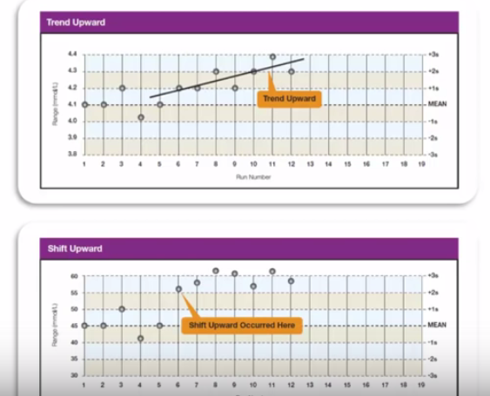

Slide 10
CAUSE OF THIS ERROR IS NOT DEFINED THEN IT IS RANDOM ERROR AND PATIENT RESULTS CAN BE REPORTED

Slide 11
REJECT THIS RUN.
DOCUMENT IN URT OR RILIS ACTION TAKEN FOR TROUBLE SHOOTING

Slide 12
REJECT THIS RUN.
DOCUMENT IN URT OR RILIS ACTION TAKEN FOR TROUBLE SHOOTING

Slide 13
REJECT THIS RUN.
DOCUMENT IN URT OR RILIS ACTION TAKEN FOR TROUBLE SHOOTING

Slide 14
INVESTIGATE AND DOCUMENT ACTION COMMENT in URT OR RILIS

Slide 15
TEAM EFFORT: LAB WILL SUCCED TOGETHER, LET US MAKE OUR LAB OUTSTANDING

