Slide 1
Unity RealTime Manual Data Entry
By: Trini Marinas
June 21, 2017

Slide 2
Objective
To manually enter QC results that did not successfully cross over to BioRad Unity RealTime or URT
To review manually entered results for clerical entry errors
Troubleshooting
*At the end of this presentation, CLS will be able to successfully demonstrate how to manually enter QC in BioRad URT.*

Slide 3
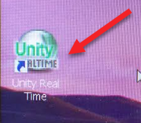
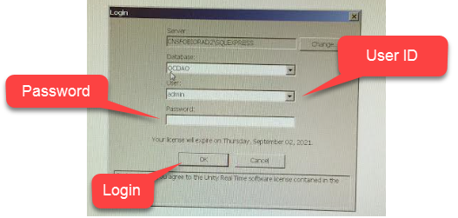
Logging on to Unity RealTime
Point and click on to Unity RealTime Icon
Choose your User ID in the User Field
Type your password in the Password Field
Click Login

Slide 4
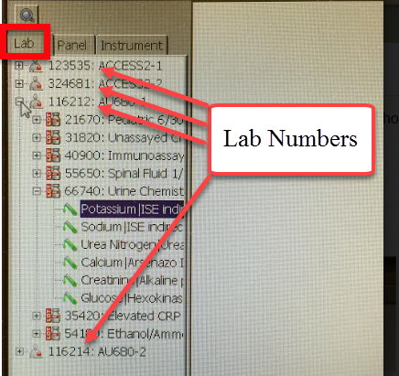
Choosing the Correct Lab Number
Select the appropriate lab number from the LAB LIST.
Access2-1: 123535
Access2-2: 324681
AU680-1: 116212
AU680-2: 116214
Click on MultiTest Point Data Entry

Slide 5
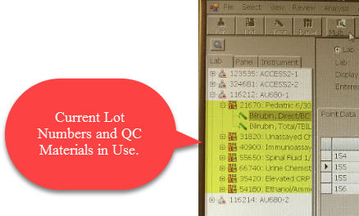
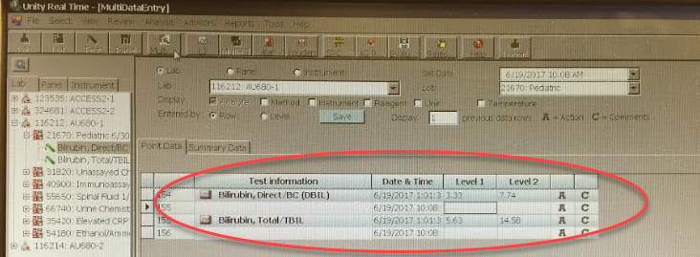
Choosing the Correct Lab Number
Once the correct lab number has been chosen,
click on the Lot Number/ Control Material
The Data Entry area will be accessible in the next window.

Slide 6
Data Entry Screen Overview
Defaulted to the following options:
LAB
DISPLAY: Analyte
ENTERED BY: Row

Slide 7
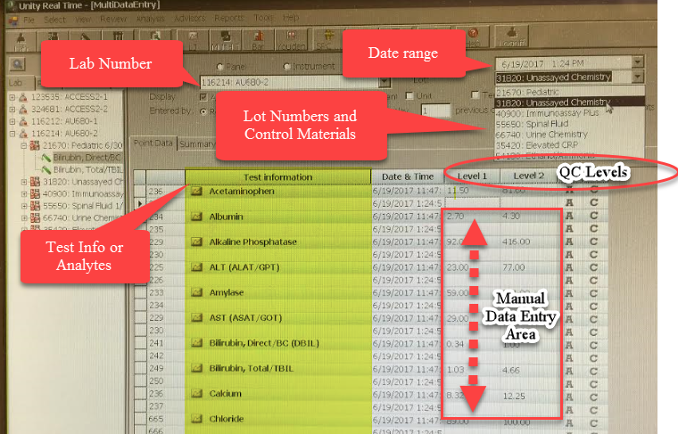
Data Entry Screen Overview
Screen Overview

Slide 8
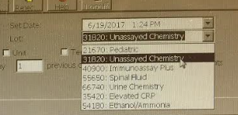
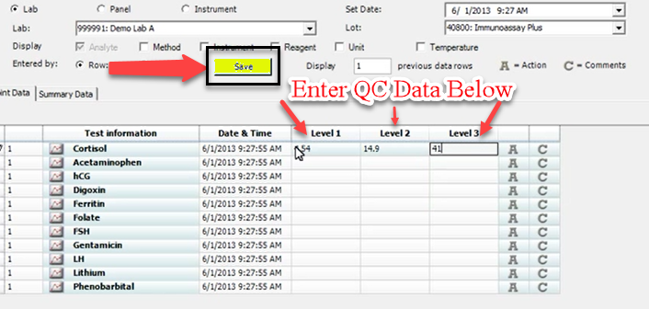
Entering QC Data
To be performed only when QC does not automatically transmit from the machine to BioRad Unity RealTime
Choose the lot number and control material
Enter QC Data adjacent to the analyte
Save frequently to avoid loss of data
Choose another set of lot numbers and
control materials; enter QC results
Repeat until all QC data has been entered

Slide 9
Reviewing QC Data
Review QC data after results have been manually entered in URT.
Go To:
REVIEW
Choose BENCH REVIEW
Lab #: Select ALL
LOT #: Select ALL
INSTRUMENT: choose an instrument
NOTE: If the instrument name/number is GREEN in color, QC has successfully crossed over.

Slide 10
Reviewing QC DATA for Shifts and Trends
QC result data entry must be reviewed by CLS working on the Bench. Reviewing LJ Charts and Z scores are mandatory. Follow the QC policy SFOSOP-0288 for accepting or rejecting QC run.

Slide 11
Reviewing QC Data
Results will generate and available for review
Click on REVIEWED and it will auto populate date, time, CLS initial, etc…
Accept/Reject results manually.
Yellow Highlight- WARNING
RED Highlight- REJECT; requires an ACTION/ COMMENT before verifying

Slide 12
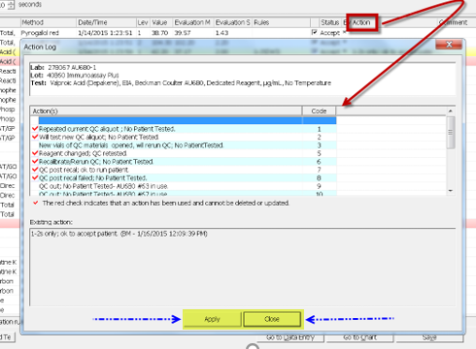
Reviewing QC Data
REJECTED results (QC that is out) requires to be acknowledged
ACTION- choose comments from pre-populated options
Choose APPLY then CLOSE

Slide 13
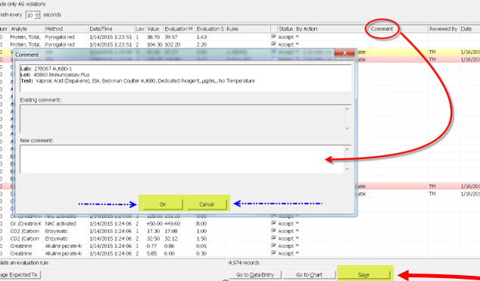
Reviewing QC Data:
COMMENTS- Freetext comments
Click OK
Click SAVE when done
NOTE: After hitting SAVE, another window will open- just click OK.

Slide 14
Reminders:
QC result data entry must be reviewed by CLS working on the Bench. Reviewing LJ Charts and Z scores are mandatory. Follow the QC policy SFOSOP-0288 for accepting or rejecting QC run.
Total number of QC to be reviewed is 82 entries for AU if a complete set of QC is performed; 14 entries for QC’s performed every 8 hours
Total number of QC to be reviewed is 13 entries for Access2-2 and 10 entries for Acces2-1.

Slide 15
Troubleshooting
When QC does not crossover to URT, do the following to troubleshoot:
Restart Unity Connect located in the supervisors office computer
Restart the instrument that is affected
Resend data
If problem persist, call BioRad hotline at 1-800-854-6737 option 3
Inform supervisor or manager of the problem

Slide 16
Resources and References
www.qcnet.com
Education Tab
Unity RealTime Training
Unity RealTime 2: Reference Guide for Expert QC Data Management
BioRad Training Notes

