Slide 1
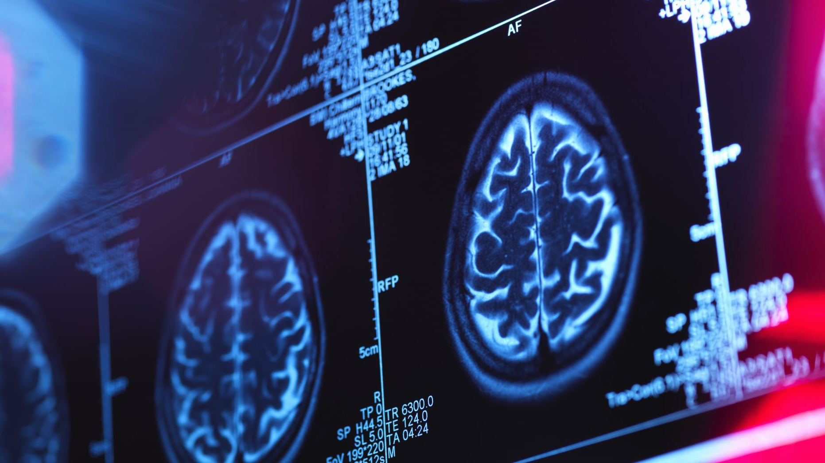
Kaiser San Francisco 2024 Annual Stroke Education General

Slide 2
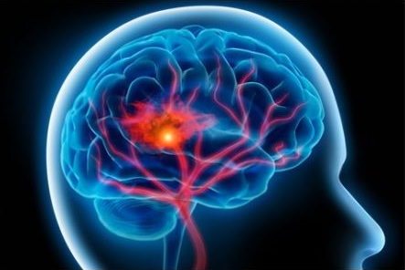
What is a stroke?
A stroke happens when there is a loss of blood flow to part of the brain.
Brain cells cannot get the oxygen and nutrients they need and they start to die within a few minutes.

Slide 3
The FACTS...
Stroke is the fifth major cause of death in the United States
According to the CDC
Someone in the United States has a stroke every 40 seconds, and every 3.5 minutes someone in the United States dies of stroke.
Every year, more than 795,000 people in the United States have a stroke.
About 87% of all strokes are ischemic strokes, 13% are hemorrhagic.
Stroke is a leading cause of serious long-term disability. Stroke reduces mobility in more than half of stroke survivors aged 65 and older.

Slide 4
Stroke Risk Factors
Non-Modifiable Risk Factors:
Age, family history, race
Gender
Hx of prior stroke/TIA
Modifiable Risk Factors/Conditions
Hypertension, smoking, diabetes, hyperlipidemia, atrial fibrillation, heart disease, carotid artery disease, sedentary behavior, obesity, sleep apnea, substance abuse and excessive alcohol intake

Slide 5
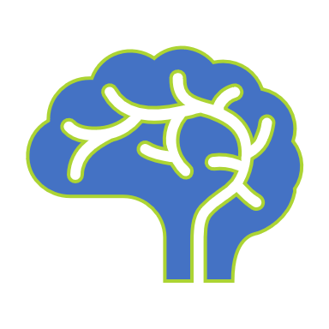
Ischemic Stroke – caused by blockage of a blood vessel that supplies the brain (87% of all strokes)
Hemorrhagic Stroke- occurs when a blood vessel that supplies the brain ruptures and bleeds
Types of Stroke
TIA (Transient Ischemic Attack)- a temporary blockage of blood flow to the brain

Slide 6
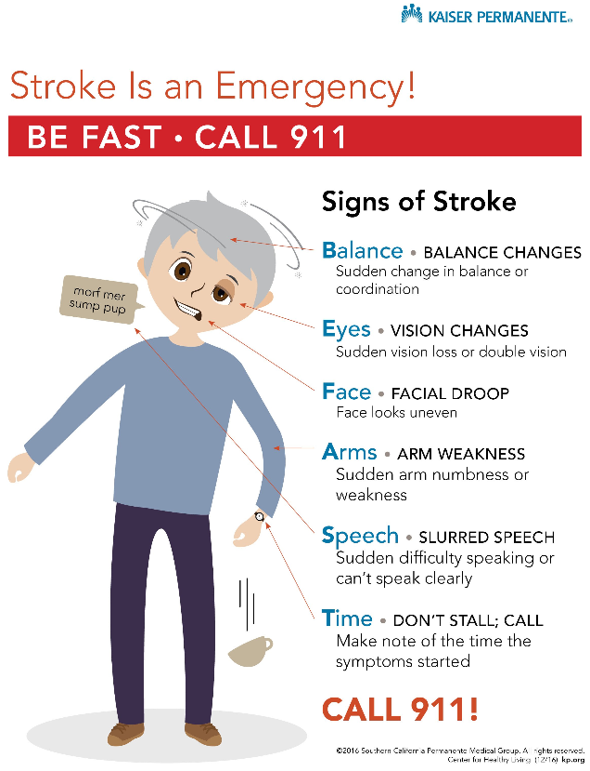
SIGNS OF STROKE
CALL a Stroke Alert
Sudden numbness or weakness in the face, arm, or leg especially on one side of the body
Sudden confusion, trouble speaking, or difficulty understanding speech
Sudden trouble seeing in one or both eyes.
Sudden trouble walking, dizziness, loss of balance, or lack of coordination
Sudden severe headache with no known cause
Mnemonic BEFAST- Balance, Eyes, Face, Arms, Speech, Time
CALL a Stroke Alert

Slide 7
Early Action is Important for Stroke
Knowing the warning signs and symptoms of stroke will allow you to act fast if your patient might be having a stroke. The chances of stroke survival are greater when stroke treatment begins quickly.
High Blood pressure, high cholesterol, smoking, obesity, and diabetes are the leading causes of stroke.
REMEMBER the signs of stroke
Balance: Sudden change in balance or coordination
Eyes: Vision changes, sudden loss of vision or double vision
Face: Facial droop, facial asymmetry
Arms: Sudden arm or leg weakness
Speech: slurred speech
Time: Act fast and initiate a Stroke Alert……remember TIME IS BRAIN!

