Slide 1
Immune Hemolytic Anemias
Overview of Immune Hemolytic Anemia in the Blood Bank Setting
Holly Charpentier MLS(ASCP)^{CM}

Slide 2
Introduction
Immune Hemolysis
Shortened Red Cell Survival of RBCs resulting from an immune reaction
Clinical Findings
Increased reticulocyte
Abnormal RBC Morphology
Elevated Bilirubin
Reduced haptoglobin

Slide 3
Classification of Hemolytic Anemias
Alloimmune
When the immune system produces antibody against foreign or non-self antigens
Drug-induced
When drugs stimulate the formation of antibodies against the drug itself or against intrinsic RBC antigens
Autoimmune
When the immune system fails to distinguish the difference between self and non-self antigens
Cold Autoimmune Hemolytic Anemia (CHD and PCH)
Mixed Type Autoimmune Hemolytic Anemia
Warm Autoimmune Hemolytic Anemia

Slide 4
Alloimmune Hemolytic Anemia (Antibodies against FOREIGN antigens)
Examples include:
Hemolytic Transfusion Reactions
Hemolytic Disease of the Newborn
Occur immediately or within days of a red cell transfusion.
Patient will have a positive DAT
Antibodies usually IgG

Slide 5
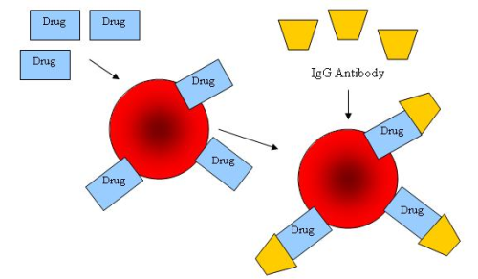
Drug Induced Hemolytic Anemia
Rare category of autoimmune hemolytic anemia
Antibodies produced in response to medication
May or may not have a positive DAT
Accurate medication
history is critical

Slide 6
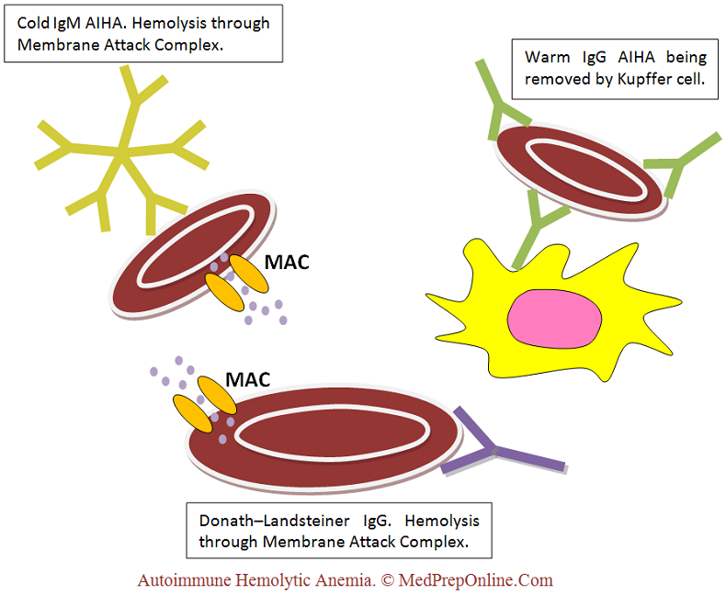
Autoimmune Hemolytic Anemia (Antibodies against SELF antigens)

Slide 7
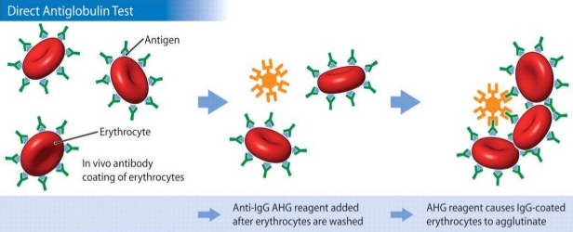
Autoimmune Hemolytic Anemia
Autoantibodies may complicate routine testing
ABO and Rh typing problems
Antibody screen problems
May be classified as cold-reactive or warm-reactive
Usually confirmed by a positive DAT and demonstration of the auto-antibody
in the plasma or
eluate

Slide 8
Autoimmune Hemolytic Anemia Classifications

Slide 9
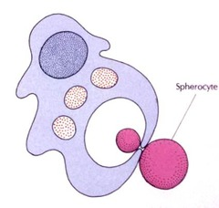
Autoimmune Hemolytic Anemia Patient Presentation
Patient Symptoms | Laboratory Findings
Fatigue | Decreased Hgb/Hct
Jaundice | Spherocytosis
Shortness of Breath | Reticulocytosis and increased NRBC
Hemoglobinemia | Decreased Haptoglobin
Hemoglobinuria | Increased Bili and LDH
Splenomegaly | Positive DAT
 | Positive Antibody Screen

Slide 10
Autoimmune Hemolytic Anemia Testing
Test | Use | Result | Comments
Antibody Screen | Determine the antibody present in serum/plasma | If there is reactivity with all cells tested, including an autocontrol, an autoantibody is likely. | The phase of reactivity can determine if it is a cold-reactive or warm-reactive autoantibody. If there is a specificity noted a more specific determination of the autoantibody can be made.
Direct Antiglobulin Test (DAT) | Detect in-vivo sensitization of red blood cells | Usually positive if an autoantibody is present | By using monospecific antiglobulin reagents (IgG and Complement AHG Reagents), can differentiate between IgM and IgG antibodies and determine if complement is involved.
Elution | Remove antibody from sensitized cells to determine antibody specificity | If warm-reactive, IgG autoantibodies are present, the eluate will be reactive with all cells | Red cells must be thoroughly washed with normal saline, buffered saline, or low ionic strength saline (LISS) prior to an elution procedure to ensure that the antibody recovered represents only that antibody bound to red cells, not “free” antibody in the plasma or serum.

Slide 11
Cold Autoimmune Hemolytic Anemia
Cold antibodies are generally not clinically significant, however they can cause difficulty during ABO/Rh and antibody screen testing.
Usually IgM reacting at 4ºC (Occasionally at room temp)
Usually Anti-I, Anti-i, or Anti-IH
Pathologic cold antibodies react at 30-32ºC and are seen in:
Cold Hemagglutinin Disease (CHD)
Proxysmal Cold Hemolglobinuria (PCH)

Slide 12
Cold Autoimmune Hemolytic Anemia
ABO Rh Typing in the presence of cold autoantibodies
Prewarm patient specimen and reagents to 37ºC prior to testing
Antibody Screen in the presence of cold autoantibodies
Prewarm all testing components to 37ºC. Cold autoantibodies will not react, only clinically significant antibodies will react
Cold Autoadsorption
Removes cold autoantibodies from the patient plasma
After adsorption is complete (if titer is high, may take several adsorptions) the plasma is tested against a panel of cells to determine if an alloantibody is present

Slide 13
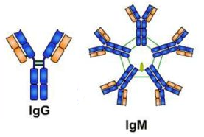
Mixed Type Autoimmune Hemolytic Anemia
Cold (IgM) and Warm (IgG) antibodies present
Both IgG and C3 detectable on patients cells
Reactivity in all phases of testing
May require both warm and
cold autoadsorptions

Slide 14
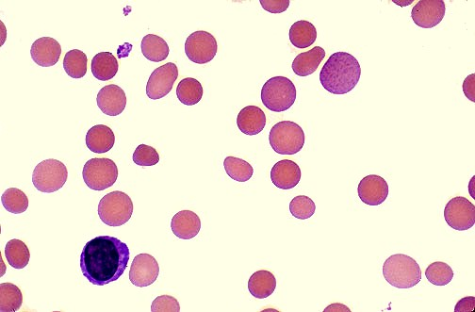
Warm Autoimmune Hemolytic Anemia
The most common type of AIHA
Usually associated with warm (37ºC) IgG antibodies
May be idiopathic or secondary to pathologic disorder

Slide 15
Warm Autoimmune Hemolytic Anemia Patient Presentation
Patient Symptoms | Laboratory Findings
Pallor | Abnormal RBC Morphology Polychrome, Spherocytes, Schistocytes, NRBCs
Weakness | Positive DAT – usually with both IgG and Complement
Dizziness | Strong Positive Antibody Screens Reacting with All Cells Tested
Jaundice | Positive Autocontrol
Shortness of Breath | Incompatible Crossmatches
Fever | Positive Eluates

Slide 16
Warm Autoimmune Hemolytic Anemia Elutions
Elution is the process by which antibodies bound to the patients RBCs are removed from the red cells and recovered
Assures that antibody reactivity is maintained so that antibody specificity can be determined.
Most commonly, a solvent like acidic glycine is used to dissociate the antibodies from the red cells. The resulting suspension is then centrifuged and the supernatant fluid (the "eluate") is removed. The eluate may then be tested to identify the antibody.

Slide 17
Elutions -Continued
A positive DAT with polyspecific AHG and monospecific C3 (negative with IgG) indicates that the cells are coated with complement components only. Therefore, the eluate will produce negative results.
If the DAT is positive with polyspecific AHG and monospecific IgG AHG reagent (negative with C3), IgG antibody is sensitizing the red cells.
This IgG antibody can be eluted from the red cells and possibly identified by testing the eluate against a panel of phenotyped red cells.
If the DAT is positive due to IgG sensitization, yet the eluate shows no reactivity against normal phenotyped RBCs, drug induced AIHA can be suspected or the antibody may be against a low incidence antigen.

Slide 18
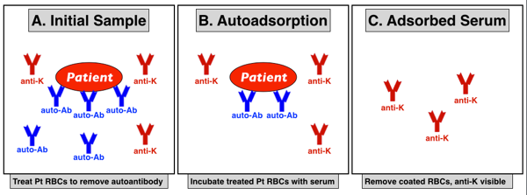
Warm Autoimmune Hemolytic Anemia Adsorptions
Because the plasma is reacting with all cells tested, the autoantibody must be removed without removing the potential alloantibody(ies). This is done by Adsorption.
Adsorption
More than one adsorption may be needed, depending on the strength of the autoantibody.
Testing the adsorbed serum with DAT-negative (treated) patient cells is a good way to determine if all the autoantibody has been removed.

Slide 19
Warm Autoimmune Hemolytic Anemia Autologous Adsorptions (Autoadsorption)
Autologous Adsorption (Autoadsorption)
use of enzyme or ZZAP-treated autologous cells facilitates the removal of autoantibody by removing membrane structures that interfere with antibody binding.
The presence of donor cells in the patient's circulation may result in unreliable findings with either cold or warm autoadsorptions. Therefore, autologous adsorptions cannot be accurately performed if the patient has been transfused within the past three months, or if the history of transfusion is unclear in any way.

Slide 20
Warm Autoimmune Hemolytic Anemia Allogenic Adsorptions
Allogeneic Adsorption
The allogeneic adsorption is similar in principle and procedure to the autologous adsorption. However, allogeneic cell aliquots are used in the adsorption process. This method is required when the patient has been recently transfused.
Usually three different allogeneic cell sets are required. (Covers the homozygous and heterozygous expression of Rh)
R₁R₁ – (DCeDCe)
R₂R₂ – (DcEDcE)
rr – (CeCe)

Slide 21
Warm Autoimmune Hemolytic Anemia Allogenic Adsorptions
Example
The first allogeneic cell may have a phenotype of R₁R₁, K+, Jk^{(a-,b+)} and the second cell may have a phenotype of R₂R₂, K-, Jk^{(a+,b-)}. (This is only an example, as there are more phenotypes possible).
Both cells would have the ability to adsorb the autoantibody from the serum. If there was an anti-Jkª present in the serum, it would not be adsorbed by the first cell, but could be adsorbed by the second cell.
After the adsorption is complete, the harvested plasma can be used in identification procedures.
The serum/plasma obtained from the different allogeneic adsorptions must be analyzed separately against an appropriate panel of cells to achieve identification or exclusion.
This is necessary because the difference in phenotypes of the adsorbing cells means the adsorbed serums potentially contain different alloantibodies.

Slide 22
Warm Autoimmune Hemolytic Anemia Is there an underlying alloantibody?
Scenario | DAT Result (IgG and/or Complement) | Serum/Plasma Antibody Screen/Identification | Adsorption
Warm autoantibody reactive in eluate only | Positive | Negative | Not indicated
Warm autoantibody reactive in plasma and eluate; no underlying alloantibodies | Positive | Reactive with all panel cells tested | No reactivity after adsorption
Warm autoantibody reactive in plasma and eluate; underlying alloantibodies that must be identified | Positive | Reactive with all panel cells tested | Reactivity after adsorption

Slide 23
Warm Autoimmune Hemolytic Anemia Is there an underlying alloantibody?
Autoantibody detectable from eluate only
If there is not a high enough titer of the autoantibody to be demonstrated in the plasma of WAIHA, the antibody screen will be negative.
In this situation, the autoantibody is detectable from the eluate only.
Compatible crossmatches can usually be obtained in this presentation, but the survival of the transfused cells due to sensitization by the autoantibody is difficult to predict.

Slide 24
Warm Autoimmune Hemolytic Anemia Is there an underlying alloantibody?
Autoantibody detectable from eluate only, but the plasma also demonstrates alloantibody reactivity
In this case, the plasma shows a specificity directed against a definite pattern of cells on an antibody identification panel.
The resolution would necessitate identification of the alloantibody(ies).
Transfusion would require appropriate antigen-negative units, which will likely be crossmatch compatible, if the autoantibody is not detectable in the plasma.

Slide 25
Warm Autoimmune Hemolytic Anemia Is there an underlying alloantibody?
Autoantibody reactivity in both the plasma and eluate
Reactivity will likely be observed against all panel cells tested and the reactivity may mask the presence of underlying alloantibodies.
Adsorption studies are the primary method of investigating this possibility.
If no reactivity is present after the adsorptions, then no underlying alloantibody is present.
If a transfusion is needed in this case, a common practice is to transfuse "least incompatible" units. The presence of alloantibody has been ruled out, the autoantibody is confirmed, but it is difficult to predict the efficacy of the transfusion due to the autoantibody. Special procedures/consents are usually in order to transfuse the incompatible units.

Slide 26
Warm Autoimmune Hemolytic Anemia Is there an underlying alloantibody?
Both autoantibody and alloantibody are demonstrated in the plasma
In this case an adsorption method usually reveals the underlying alloantibody that was masked by the presence of the autoantibody.
If transfusion is required, appropriate antigen-negative units must be obtained. The crossmatches will likely be incompatible due to the autoantibody, and special consents/procedures must be followed to transfuse in this situation.

Slide 27
Warm Autoimmune Hemolytic Anemia Transfusion Considerations
The question of transfusing patients with demonstrable WAIHA cases is highly debatable. The fate of the transfused red blood cells may be the same as the patient's own cells. It is a clinical decision that balances the risks and clinical needs.
Blood should never be withheld from a patient in a life-threatening event because of incompatibility from autoantibodies.
The volume of transfusion should be the least amount to maintain adequate oxygen transportation and relieve the symptoms of anemia.

Slide 28
Warm Autoimmune Hemolytic Anemia Treatment
Corticosteroids
Intravenous Immunoglobulin (IVIG)
Splenectomy
Immunosuppressive Drugs
As a last resort

Slide 29
Blood Bank Testing – VAMC WRJ
Initial Patient Work Up
If this is a new patient, you should suspect AIHA when the patient presents with what looks like a panagglutinin.
Panagglutinin must be confirmed by DHMC, and Alloantibodies must be ruled out
ProVue
Testing on the ProVue will likely give strong positive results with all three screening cells.
The ABO/Rh may or may not be affected, depending on the type and strength of autoantibody.

Slide 30
Blood Bank Testing – VAMC WRJ
If AIHA is suspected and the ProVue gives positive results in all three screening cells:
Perform all testing by tube method
If the patient has a cold autoantibody, perform all testing using prewarmed tube methods
If the patient has a warm autoantibody, perform all testing using the tube method. If results are still all positive for the ABS follow the Sixty Minute Saline Procedure
Perform a DAT
Poly, then IgG/Complement if needed

Slide 31
Blood Bank Testing – VAMC WRJ WAIHA - Type and Screen
ABO/Rh
performed as with any other patient
Antibody Screen
Perform a 60 minute saline ABS
Perform IS
DO NOT ADD LISS
Incubate for 60 Minutes @ 37ºC
Wash 3x
Add anti IgG
Do not check microscopically
Check results by using check cells

Slide 32
Blood Bank Testing – VAMC WRJ WAIHA - Type and Screen
If the 60 minute saline antibody screen is negative
The antibody screen is negative and should be entered into VBECS as negative.
A comment can be added indicating that a 60 minute crossmatch was completed.
If the 60 minute saline antibody screen is positive
An antibody work up should be sent to DHMC.

Slide 33
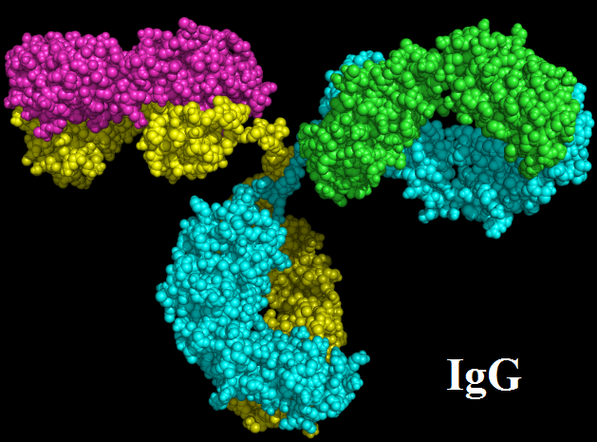
Blood Bank Testing – VAMC WRJ WAIHA - DHMC Testing
DHMC will perform the necessary testing to rule out underlying alloantibodies.
Elution
Auto-Adsorption
Using the patients own cells
Differential Adsorption
Using donor cells
Antibody Panels

Slide 34
Blood Bank Testing – VAMC WRJ WAIHA - Crossmatch
Testing at DHMC | Tubes returned from DHMC | Testing to be completed at VAMC
Eluate Only (Negative Eluate, no adsorption needed) | No Adsorbed Plasma | Perform a 60 minute saline crossmatch on the patient plasma from the original specimen.
Auto-adsorption | One tube of Adsorbed Plasma | Perform a 60 minute crossmatch using the adsorbed plasma.
Differential adsorption | Three tubes of Adsorbed Plasma Labeled “R1R1”, “R2R2”, and “rr” | Perform a 60 minute crossmatch using each of the adsorbed plasmas per donor unit to be crossmatched. *All 3 tubes must be negative for the xm to be compatible.

Slide 35
Blood Bank Testing – VAMC WRJ WAIHA - Crossmatch Results
Positive reactions with any of the patient’s plasma is considered incompatible.
Additional testing may be required.
Additional units shall be tested until compatible units are found.
If there are no compatible units available, consult with the Clinical Pathologist.
If the least incompatible units are to be given, approval must be given by the Clinical Pathologist.
A deviation report must be filled out and signed by the CP. Only the pathologists may approve the release of least incompatible units.

Slide 36
Blood Bank Testing – VAMC WRJ Information to discuss with Pathology
Whenever there is a question about what to do next, the clinical pathologist should be consulted.
Information to have in hand when contacting the CP
ABO/Rh Type
History of positive ABS, and any antibodies previously identified
Results of any testing done in house
Patient Symptoms * The CP should check the patients chart in CPRS
Transfusion History * History at WRJ and history using remote data. The pathologist should consult with the patients licensed provider to ensure there has been no transfusion outside of the VA system.
The DHMC report *If calling pathologist read entire report Results of all testing should be communicated: Plasma testing, Eluate, DAT, and results of adsorption (either auto or differential)
Which SOP you have followed to come to these results

Slide 37
Case Study
50-year-old female patient with SLE is admitted to the hospital with evidence of hemolysis
decreased hemoglobin and hematocrit
increased reticulocyte count and bilirubin.
The patient has no recent history of transfusion.
An antibody screen is ordered and 3+ agglutination is observed at the AHG phase for all cells.
An autocontrol is also tested and 3+ agglutination is observed at the AHG phase in this test as well

Slide 38
Case Study Continued
Given the results of the antibody screen and other laboratory test results and the patient's medical and transfusion history, which of the following is the MOST likely cause of the positive screen results?
Cold Autoantibodies
Warm Autoantibodies
Alloantibodies

Slide 39
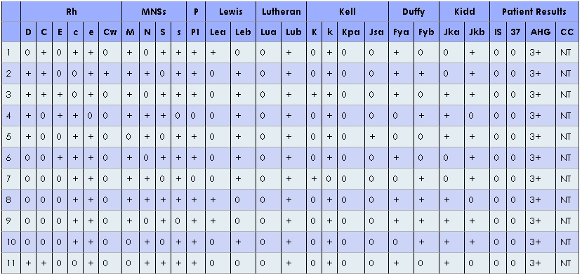
Case Study Continued
A (DAT) is performed using polyspecific antihuman globulin (AHG) and anti-IgG. Positive results are obtained with both reagents.
With a Positive DAT (with IgG specificity) and reactive screen cells and autocontrol, the presence of a warm autoantibody becomes more apparent.

Slide 40
Case Study Continued
What procedure should be performed at this point to determine if this is autoantibody, alloantibody, or a combination of auto- and alloantibodies?
An adsorption technique should be employed to remove the autoantibody and determine if there is any underlying alloantibody.

Slide 41
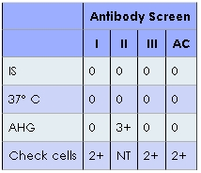
Case Study Continued
The results of the autoadsorbed serum tested with a set of antibody screen cells are shown. What does the pattern of reactivity indicate?
The autoantibody has only been partially adsorbed out
There is any underlying alloantibody
The test results are invalid

Slide 42
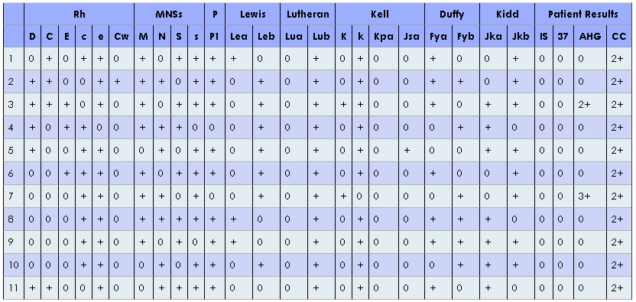
Case Study Conclusion
An antibody identification is performed using the adsorbed serum.
We see that there is a specificity of anti-K in the autoadsorbed serum.
This is a case of a warm autoantibody with an underlying alloantibody (anti-K).

Slide 43
Case Study Two
62 yr old male with history of SLE (diagnosed ~25 yrs ago, and controlled with azathioprine)
Presented for Bone Marrow biopsy
Physician noted patient complained of dizziness, and shortness of breath when standing up. Also, decreased appetite
Labs reveled Increased WBC, Increased Plt count, Decreased Hgb and Increased Bili
Physician presumes hemolytic anemia due to rapid drop in Hgb 8.9 to 7.6 in 2 days

Slide 44
Case Study Two Continued
Blood Bank Testing at WRJ
Provue
ABO/Rh typed with no issue – O positive
ABS had 2+ positive reactions in all 3 wells
Tube ABS
Not performed
60 Minute Saline ABS
Positive results in all 3 tubes
DAT
Poly +
IgG +
Complement +

Slide 45
Case Study Two Continued
What do we do next?
Because patient is suspected to have hemolytic anemia and has no history of a positive antibody it is ok to crossmatch units until a compatible unit is found
Patient samples should be sent to DHMC for additional workup
The results are wrong. Rerun the antibody screen and DAT

Slide 46
Case Study Two Continued
Report Received from DHMC
Testing Results:
ABO/Rh: O Positive
DAT - Poly: Positive, IgG: Positive, C3: Positive
Elution: Panagglutinin
Serum Antibody Identification: Auto Panagglutinin identified in plasma and eluate. Antibody screens on plasma adsorbed x3 with selected donor cells treated with Papain were negative. No underlying allo antibodies.
Three tubes of the patients plasma were sent back from DHMC. Labeled R₁R₁ , R₂R₂, and rr.

Slide 47
Case Study Two Continued
Now what do we do?
Electronically Crossmatch units
Crossmatch Units on the Provue with one of the returned plasmas
Crossmatch Units on the Provue with each of the returned plasmas
Crossmatch Units on the Bench with each of the returned plasmas
Crossmatch Units on the Bench with each of the returned plasmas, using the Sixty Minute Saline Procedure
Although this is what DHMC
suggests, it has NOT been approved By Dr. Ratcliffe at this time.

Slide 48
Case Study Two Continued
Donor Unit | R₁R₁ | R₂R₂ | rr
123 | Compatible | Compatible | W+ Incompatible
321 | Compatible | Compatible | Compatible
987 | Compatible | Compatible | Compatible
789 | Compatible | Compatible | Compatible
Which Units may be given to the patient?
123 321 987 789
If the patient needs additional units, what units do we give next?
123 None of these
Additional units should be tested and only units that are compatible with ALL 3 returned
tubes of plasma may be given. If no compatible units are available, the Clinical Pathologist
may approve the units that are the LEAST incompatible

Slide 49
Case Study Two - Conclusion
The patient was admitted into the hospital on two separate occasions over the course of 7 days. After receiving units the patients Hgb increased, but not to the extent is should have. After being discharged for 2 days the patient returned and the Hgb had dropped below where it was on the first admission, and continued to decrease.
 | Day 1 | Day 2 | Day 3 | Day 6 | Day 7
 | Patient Pre-op Testing | Patient Admitted |  | Patient Admitted
Pre Transfusion Hgb | 8.1 | 7.6 | Not tested | 6.6 | 5.9
Units given | None | None | 2 Units | None | 1 Unit
Post Transfusion Hgb |  |  | 8.1 |  | 6.9
 |  |  | Patient Discharged |  | Patient Discharged

Slide 50
Conclusion
As stated in earlier slides, the question of transfusing patients with Immune Hemolytic Anemia is highly debatable.
The fate of the transfused red blood cells may be the same as the patient's own cells. And it is a clinical decision that balances the risks and clinical needs.
Blood should never be withheld from a patient in a life-threatening event because of incompatibility from autoantibodies.
The volume of transfusion should be the least amount to maintain adequate oxygen transportation and relieve the symptoms of anemia.
When request are received for blood products for these patients, it is always best to consult with the clinical pathologist!

Slide 51
References
“Immune Hemolytic Anemias”- Author: Erin Tretter, MBA, MT(ASCP) Reviewer: Christine Christopher, MT(ASCP)SBB
AABB Technical Manual

