Slide 1
SKIN KOH
Dermatology

Slide 2
SKIN KOH

Slide 3
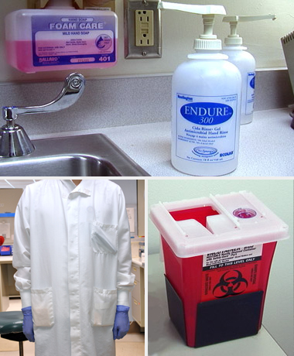
Safety
Follow facility protocols for personal protective equipment, hand hygiene, workspace disinfection, medical waste, and chemical safety guidelines. Special safety precautions are required for handling KOH because it is caustic and has a potential for injury. Instructions for the use of personal protective equipment and post exposure care may be found in the Safety Data Sheet (SDS).

Slide 4
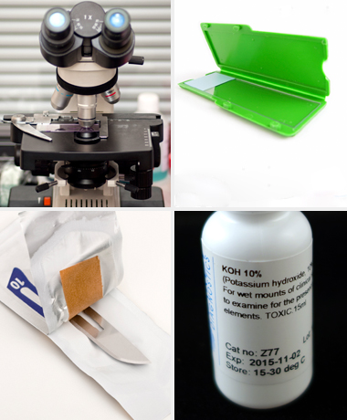
Set up
After donning a lab coat, perform hand hygiene and put on lab gloves.
Prepare the work area with all equipment and supplies needed to process and examine the specimen.
Perform microscope maintenance/CLEANING AFTER EACH USE.

Slide 5
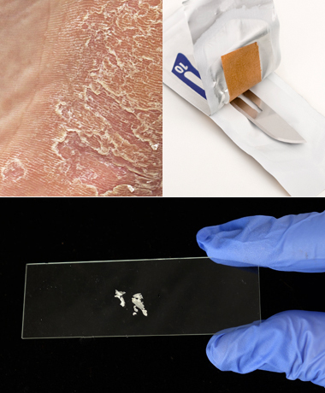
Procedure
Procedural steps for the skin lesion KOH exam may vary from facility to facility. The following is a general example of a skin lesion KOH exam: Label a microscope slide with patient identification, according to facility protocol. Cleanse sample area with rubbing alcohol to remove contaminants. Collect the sample from the infected area. Using a No. 10 or 15 scalpel blade (handheld, without a handle), forcefully scrape the scales from the active margin of the lesion, so that the scales land directly onto the microscope slide held just underneath. Scrape in a perpendicular direction to the skin surface. Do not scrape hard enough to draw blood.

Slide 6
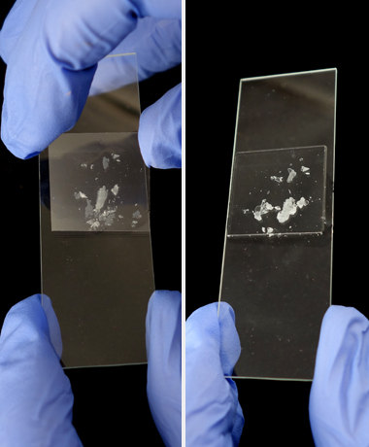
Processing
The KOH solution can be applied to the sample in two different manners, depending on facility protocol: If a coverslip was placed over the scales immediately after collection, KOH can be added to the slide without removing the coverslip. Apply drops of 10% KOH solution to the slide, immediately adjacent to the edge of the coverslip. Capillary action will draw the solution into the space between the microscope slide and coverslip, filling the space between. Trapped bubbles under the coverslip may obscure the field of view. To loosen or remove tiny bubbles, tilt the microscope slide about 10 degrees and gently tap the end of the slide with your fingernail. If a coverslip was not placed over the slide immediately after collection, add one or two drops of 10% KOH solution to the sample, and then carefully place the coverslip over the sample. Remove trapped bubbles as directed in the previous paragraph.

Slide 7
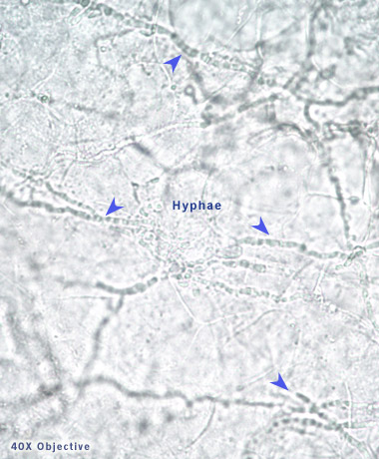
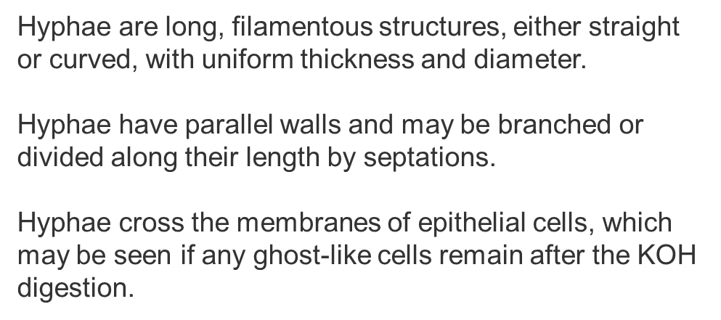
Clinical findings

Slide 8
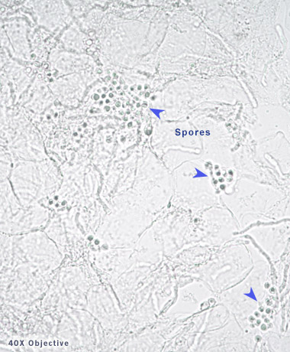
spores
Spores are uniform in size, usually round, rectangular, or oval. The spores may appear singly or in clusters or chains.

Slide 9
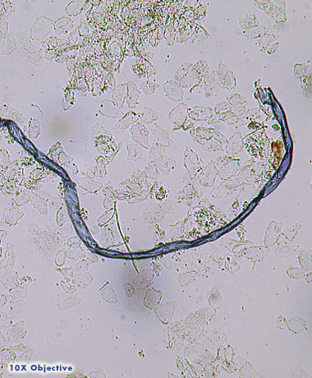
Artifacts
Common artifacts include lint or cloth fibers and lipid cells in the stratum corneum. Lint/cloth fibers must be distinguished from fungal hyphae. Distinguishing characteristics of these fibers include: non-uniform diameter
non-parallel walls
lack of septae
do not cross cell membranes
Lipid contents between stratum corneum cells have a non-uniform mosaic pattern and do not cross cell membranes. Lipid contents must be distinguished from yeast and spores.

Slide 10
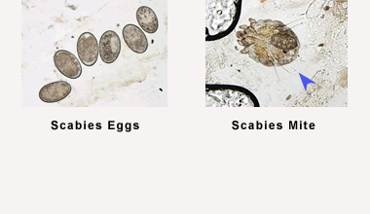
SCabies
Scabies is an itchy, contagious skin infection caused by a tiny, burrowing mite Sarcoptes scabiei. Scabies has a characteristic morphology. For scabies identification, mineral oil in place of KOH may be used, since KOH dissolves scabietic elements within an hour or two of application. Scabies confirmation can include several findings: whole adult mites; severed parts of adult mites or juvenile mites; partial or whole eggs; or, scybala (hardened masses of feces).
.

Slide 11
limitations
The skin lesion KOH test has the following limitations:
Fibers from cloth or tissue may resemble hyphae.
Lipid found in the stratum corneum (outer layer of skin) may resemble spores.
Microscope lighting is critical for the KOH prep examination. Too much light can wash out fungi, resulting in false negatives.
Examine the entire cover slip area. A random examination of the cover slipped area may result in false negatives.
Consult facility protocol for Quality Control monitoring for the skin lesion KOH test.
.

Slide 12
Competency requirements
PPMP is classified as Moderate Complex testing.
Each provider will be set up with an MTS account for training purposes. This training consists of a microscopic and KOH overview complete with quiz. The checklist will be completed with the Point of Care Coordinator.
Residents will be required to review the power point presentation, complete a quiz and checklist with the POC staff. No resident will be able to perform testing without the guidance of an attending physician and the PPMP check-off by POC!!

Slide 13
Competency continued
For new staff( new to 1 year in department): competency and training will be completed initially, between 6-7 months then at 12 months/1 year.
For experienced staff(over 1 year in department): competency/training will be completed annually through MTS and a checklist completed with the POC staff in April.

Slide 14
THANK YOU
For questions, please email our group at: Vhacinplmpoc@va.gov

Slide 15
PPM Procedure
Please review the following procuedure.
Procedures\POC.Procedure.10 PPM KOH and Scabies Exam.pdf

