Slide 1

Accu-Chek Inform II
Annual Competency Training
Erie VA Medical Center
Pathology and Laboratory

Slide 2
Outline
Policies
Procedure, equipment and supplies
Quality Control
Patient testing
Maintenance and Troubleshooting
Competency Requirements

Slide 3
Policies – When to test
Upon physician’s order
Use of this meter is for PATIENTS ONLY. Self-testing or testing of visitors, friends, relatives, or fellow employees is not permitted. (A medical emergency or code meets the criterion of “patient”).

Slide 4
Policy
Only hospital meters (Accu-Chek Inform II) validated by the Clinical Laboratory may be used for patient care, clinical decision-making, or treatment.
Only one brand of meter will be utilized for in-house testing.

Slide 5
Policy
The provider should verify the patent’s hematocrit to assure glucose test results are accurate. When the patient(s) clinically are having loss of blood or a condition that elevates hematocrit, the provider should be aware of the hematocrit levels when interpreting glucometer test results.
Note: Inform II glucometers give accurate glucose results when a patient’s hematocrit is between 10-65%.
Lipemic samples (triglycerides) more than 1800 mg/dl may produce elevated results.
The system should NOT be used to monitor patients who are receiving intensive medical intervention.
If the clinical picture is inconsistent with the fingerstick glucometer value, testing should be confirmed by a venous blood draw (glucose level) by the laboratory.

Slide 6
Procedures
All glucometer standard operating procedures (SOP) reside in the Ancillary Testing SOP binder located near the docking station (base).
MCP 113-02 “Ancillary (Waived) Testing” is found in binder near docking station and on the Erie SharePoint site.

Slide 7
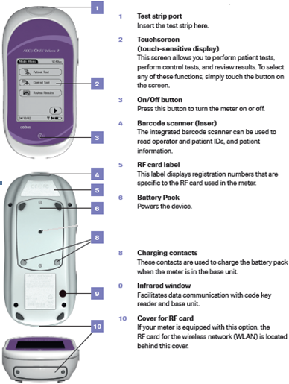
Equipment - Meter

Slide 8
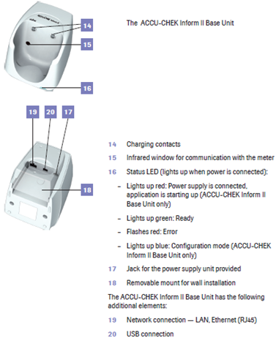
Equipment - Base

Slide 9
Supplies
Accu-Chek Inform II Strips:
Supplied by Logistics.
Store in original capped container at room temperature; no change in expiration date.
Never leave the cap off vial of strips for more than 3 minutes. Never add strips from an almost empty vial to a new vial.
If strips are opened in shipment, DO NOT USE and send back to the Ancillary Testing Coordinator in lab.

Slide 10
Supplies
Accu-Chek Inform II Controls
Supplied by the Lab and kept at room temperature.
Expire 90 days after opening or manufacture’s date, whichever comes first. Open date and expiration date should be recorded on vials.

Slide 11
Additional Supplies
Alcohol swab
Lancet – 3 varying gauges, supplies by Logistics
Gauze
Gloves

Slide 12
Quality Control
Two levels are analyzed once per 24 hours. Lockout time: 3 am
Prior to analysis, invert gently and avoid dried debris on the tip.
Control results are PASS or FAIL. Failed results must be repeated. For continued failures, start with new strip vial.
Patient testing is not permitted unless quality control is acceptable.
After testing is completed, COMMENTS ARE MANDATORY to communicate interpretation of results or actions taken.

Slide 13
Other Times to Run Quality Control
When patient glucose values are in question.
When a new vial of test strips is opened.
To check performance of meter if it is dropped or damaged.
If cap is left off the test strips.

Slide 14
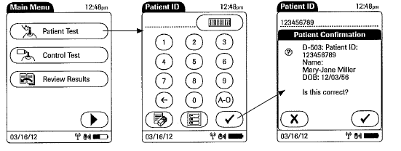
Patient Testing
Identify the patient
Confirm patient identification using two hospital approved identifiers (full name, full social security number or date of birth).
Scan the patient wristband. Try to avoid manually entering patient’s ID. Verify patient information on confirmation screen.

Slide 15
Patient Testing
Fingerstick: Select a finger for puncture. Avoid cold, cyanotic, bruised, cut or swollen fingers. The middle or ring finger is preferred. Each test should be performed from a new skin puncture..
Blood flow may be increased by warming the site for 3 – 5 minutes by using a warm washcloth or appropriate warming device. Next, gently massage the finger five or six times from the palm to the base of the finger and up to the tip of the finger.
Cleanse the finger with an alcohol swab.
The skin and your gloves must be completely dry before proceeding. Alcohol is an interference

Slide 16

Patient Testing
Hold the finger firmly with one hand and place the disposable lancet device against the finger, selecting either side of the fleshy pad.
Trigger the lancet device. Wipe away the first drop of blood. Hold the puncture site downward and gently apply intermittent pressure to the surrounding tissue. Do not apply strong repetitive pressure (“milking”).

Slide 17
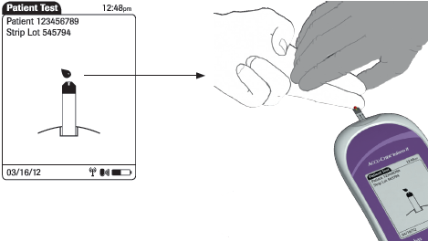
Patient Testing
Apply the drop of blood to the front edge (yellow dosing area) of the test strip. Blood will be pulled into the test strip. The meter beeps and measurement begins.

Slide 18
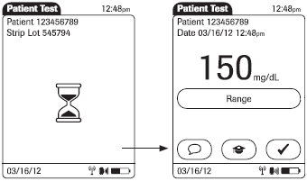
Patient Testing
The hourglass icon indicates the test is running. Once the test is completed, the result displays.
After obtaining patient result, a pre-programmed comment must be entered to communicate interpretation of result or action taken.
Press to enter a comment. Press √ to return to the results screen, and press √ again to return to
the Main Menu.

Slide 19
Patient Testing
Normal fasting value for non-diabetic adult: 70-100 mg/dL
Critical values: <50 & >400 mg/dL
Repeat IMMEDIATELY
For critical <50, result must match original ± 10 points; For critical >400, result must match original ± 50 points.
If the 2nd result does not match within the specified number of points, you may repeat a 3rd time.
If result is still not verified using above criteria, phone the Lab for a blood draw.
Measurement range of the meter is 10-600 mg/Dl. Values outside this range display as “LO” & “HI”. Lab must be phoned for a draw in these cases to get an actual numerical glucose value.
Ensure the critical results are given as soon as possible to the care provider who can influence care.
Provider notification of all confirmed critical (initial result is critical and repeat is also critical) should be documented on the Critical Fingerstick Notification Template in CPRS.

Slide 20
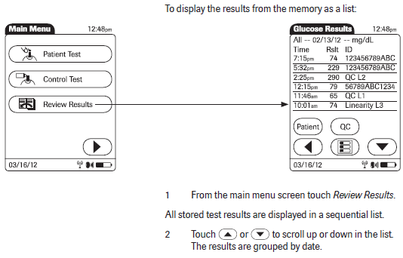
Patient Testing – Recalling Results

Slide 21
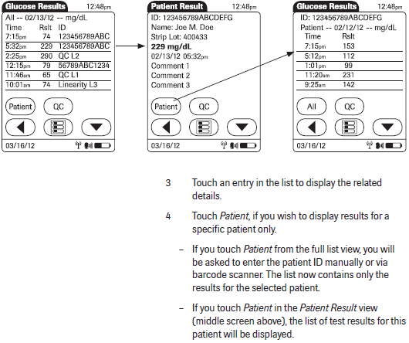
Patient Testing – Recalling Results

Slide 22
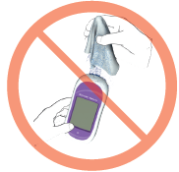
Maintenance and Troubleshooting
Glucometers are to be cleaned and disinfected after each patient use with the manufacture-approved Super Sani-Cloth disinfecting wipe.
Wear gloves
Squeeze off excess cleaning solution
Do not clean meter while strip is still in the test strip port.
Make sure no liquid gets into port

Slide 23
Cleaning Meter
Place meter on a level surface
Power off the meter
Use a Super Sani-Cloth to clean any visibly soiled surface
Dry the meter thoroughly with a dry cloth or gauze.

Slide 24
Disinfecting Meter
Use a fresh Super Sani-Cloth wipe to disinfect by gently wiping the outside of the meter 3 times horizontally and 3 times vertically.
Allow the meter to stay wet for 2 minutes with the Super Sani-Cloth. Additional wipes may be needed to ensure the meter stays wet for the full 2 minutes.
Dry the meter thoroughly with a dry cloth or gauze after the 2 minutes of contact time is finished.

Slide 25
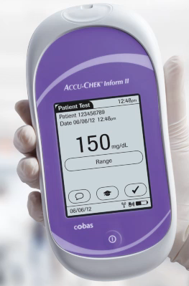
Troubleshooting
If the meter displays “Type Bad Dose”, there may be insufficient amount of blood on the test strip or the dose may have been applied before the flashing red drop appeared above the strip icon. Repeat the test using a new strip
If you have problems with your glucometer contact the Ancillary Testing Coordinator at 2187.
Meanwhile, use a different meter or borrow a spare meter from the Lab.

Slide 26
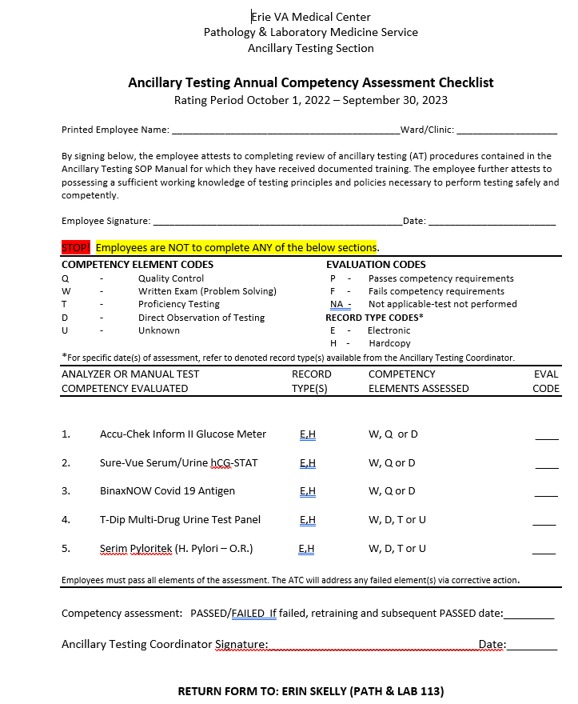
Annual Glucometer Competency Requirements
Review Accu-Chek Inform II Annual Competency power point training in MTS.
Run 2 levels on quality control on meter.
Fill out the top portion of Ancillary Testing Annual Competency Assessment Checklist and return to Ancillary Testing Coordinator before assigned due date.

