Slide 1
CAP Website Access
Attachment F
www.cap.org

Slide 2
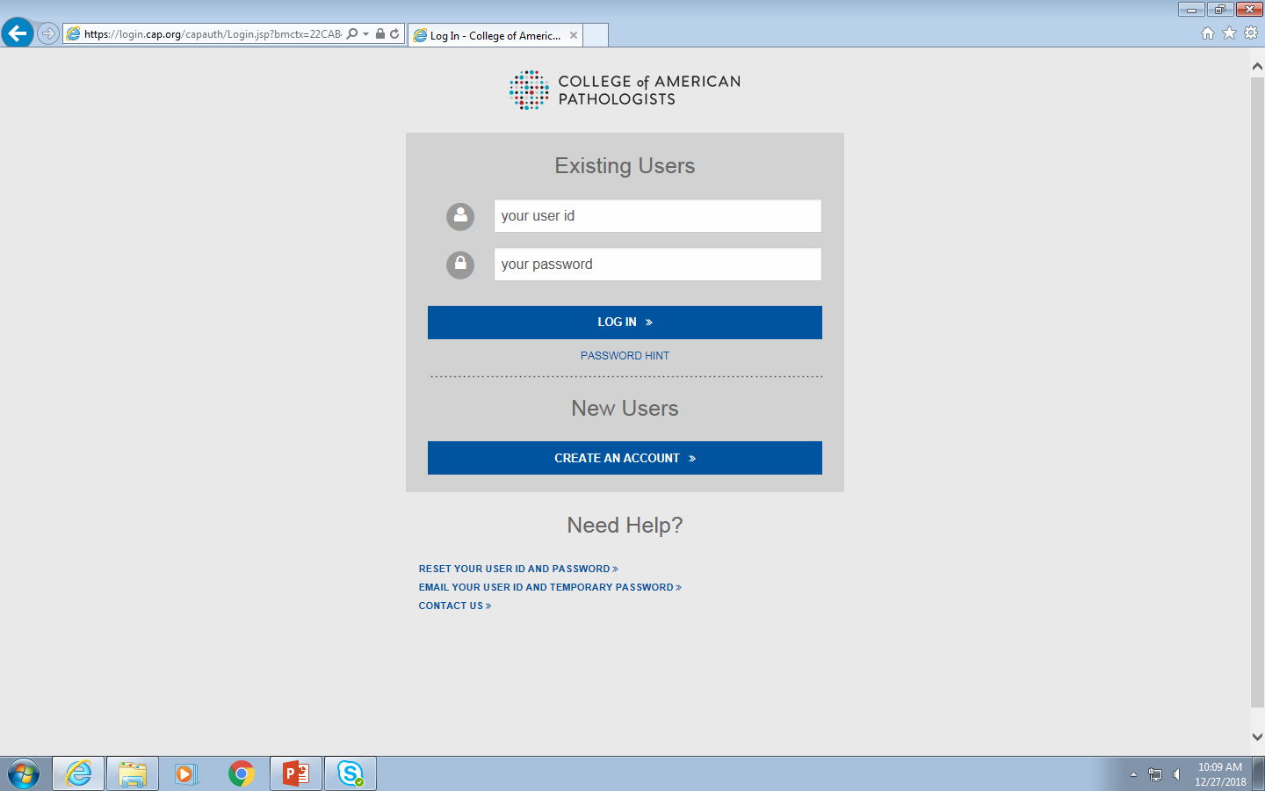
A unique account must be created for each site.

Slide 3
CAP Number for each Location
ERIE 1297601
ASHTABULA 8688500
CRAWFORD 8688525
VENANGO 8657256
WARREN 8688642
MCKEAN 8688535

Slide 4
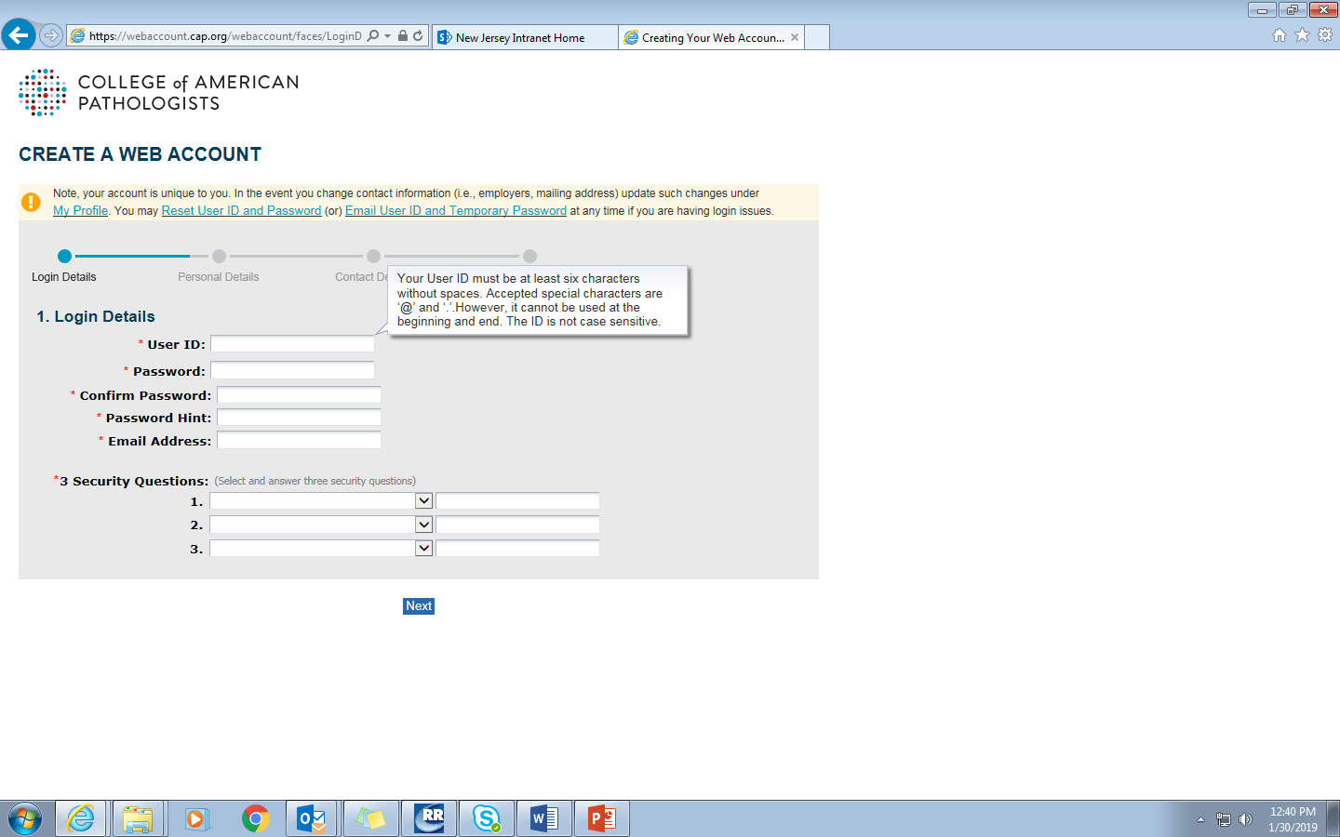
Your User ID must be at least six characters without spaces. Accepted special characters are ‘@’ and ‘.’.However, it cannot be used at the beginning and end. The ID is not case sensitive.

Slide 5
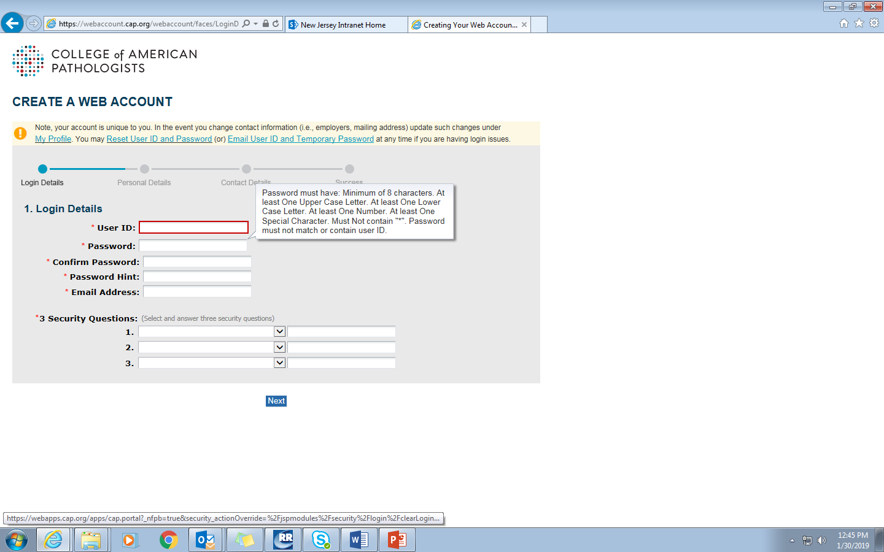
Password must have: Minimum of 8 characters. At least One Upper Case Letter. At least One Lower Case Letter. At least One Number. At least One Special Character. Must Not contain "*". Password must not match or contain user ID.

Slide 6
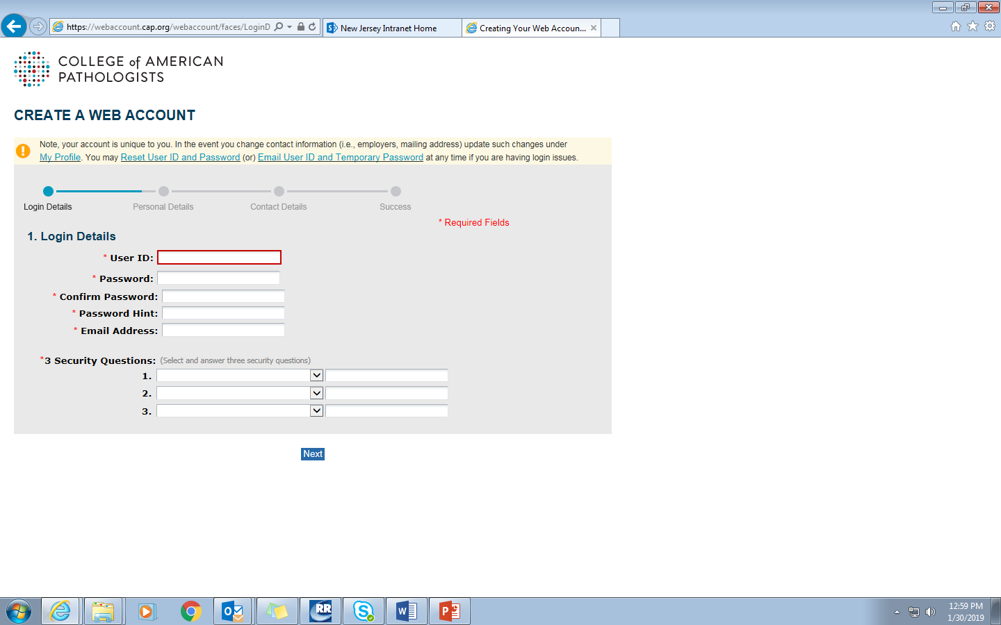
Enter a password hint, an email address, and select security questions.

Slide 7
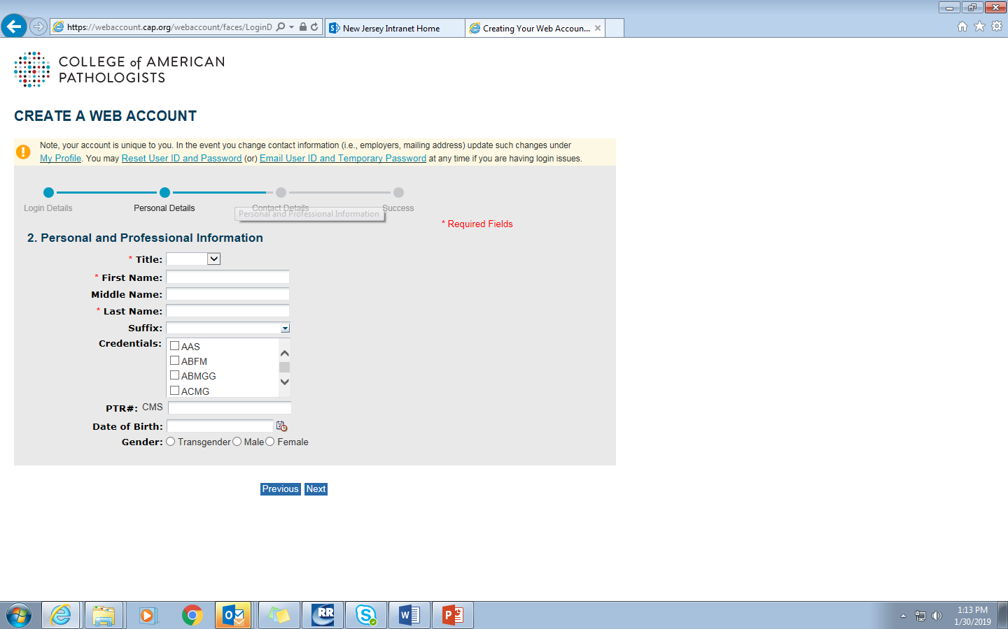
Enter personal and professional information for the account. Note that only title, first name, and last name are required.

Slide 8
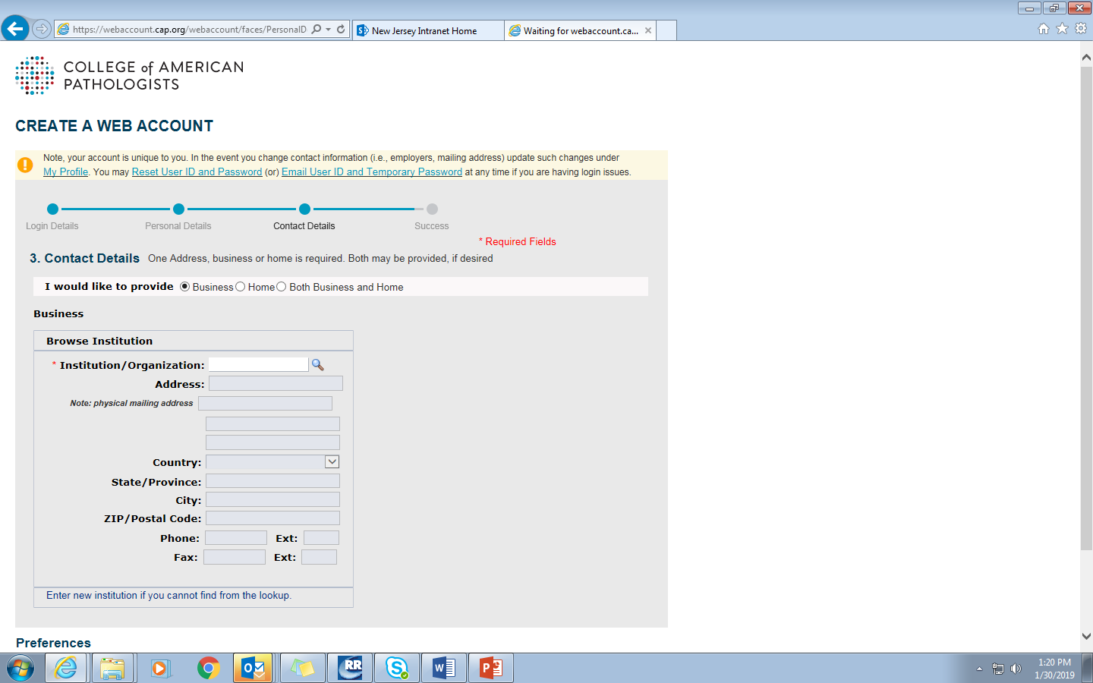
Select the Institution search icon.

Slide 9
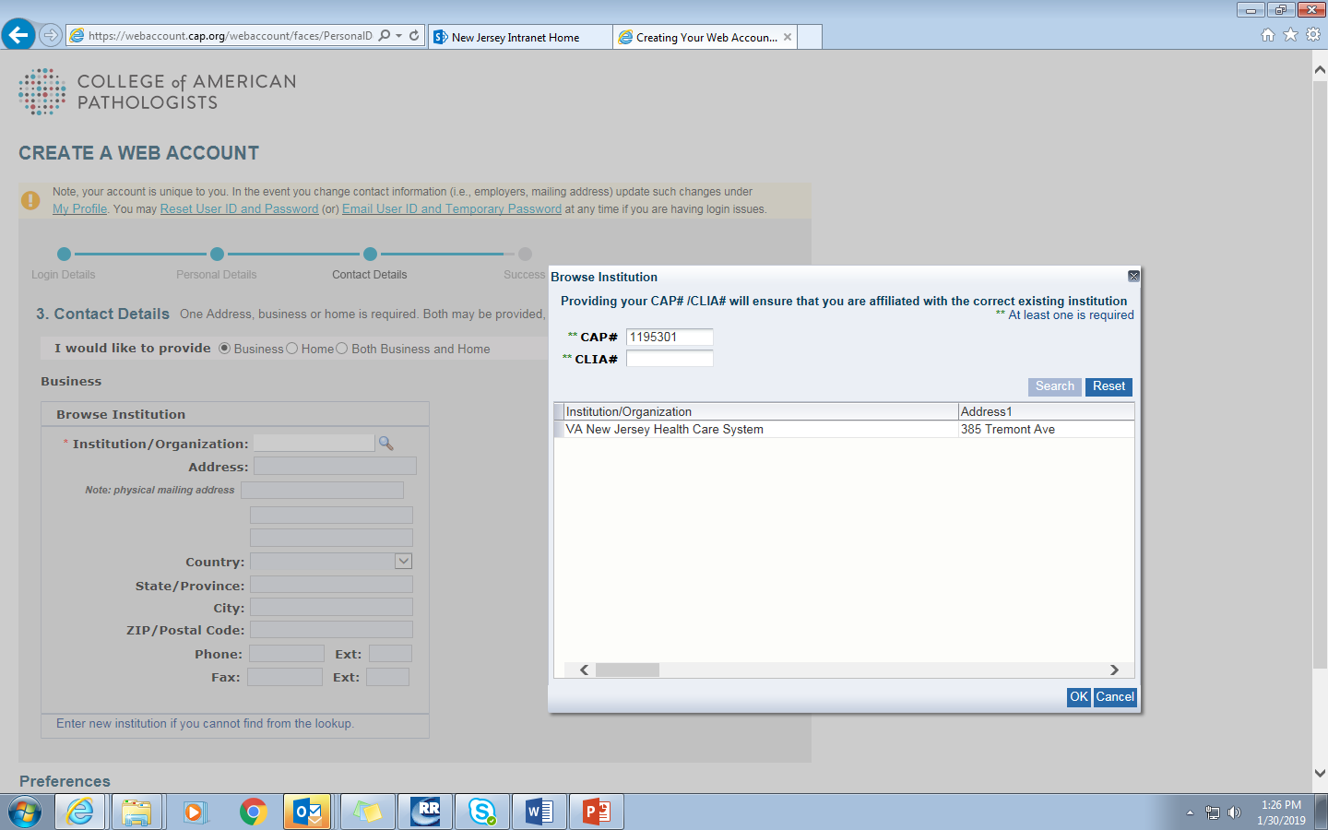
Enter the CAP number for your clinic. See slide #4 for a list of CAP numbers. Hit Search, then Select your Institution name, and hit Ok.

Slide 10
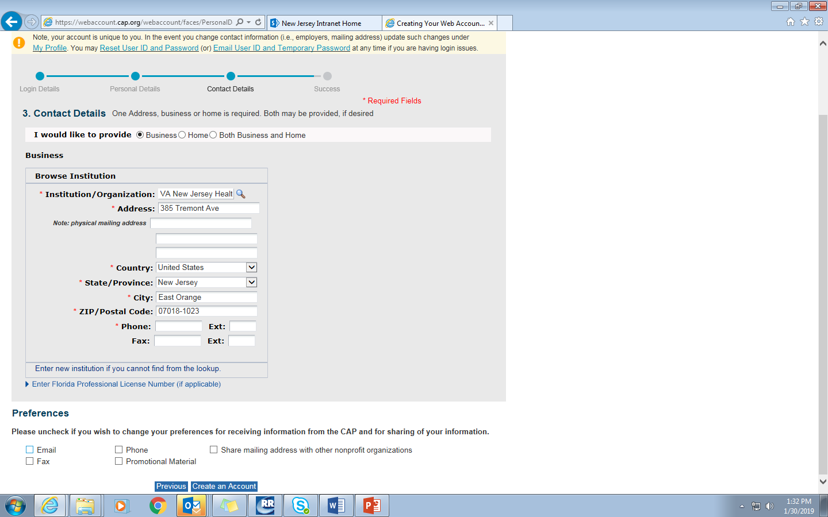
The Institution information will autofill. Click Create an Account.

Slide 11
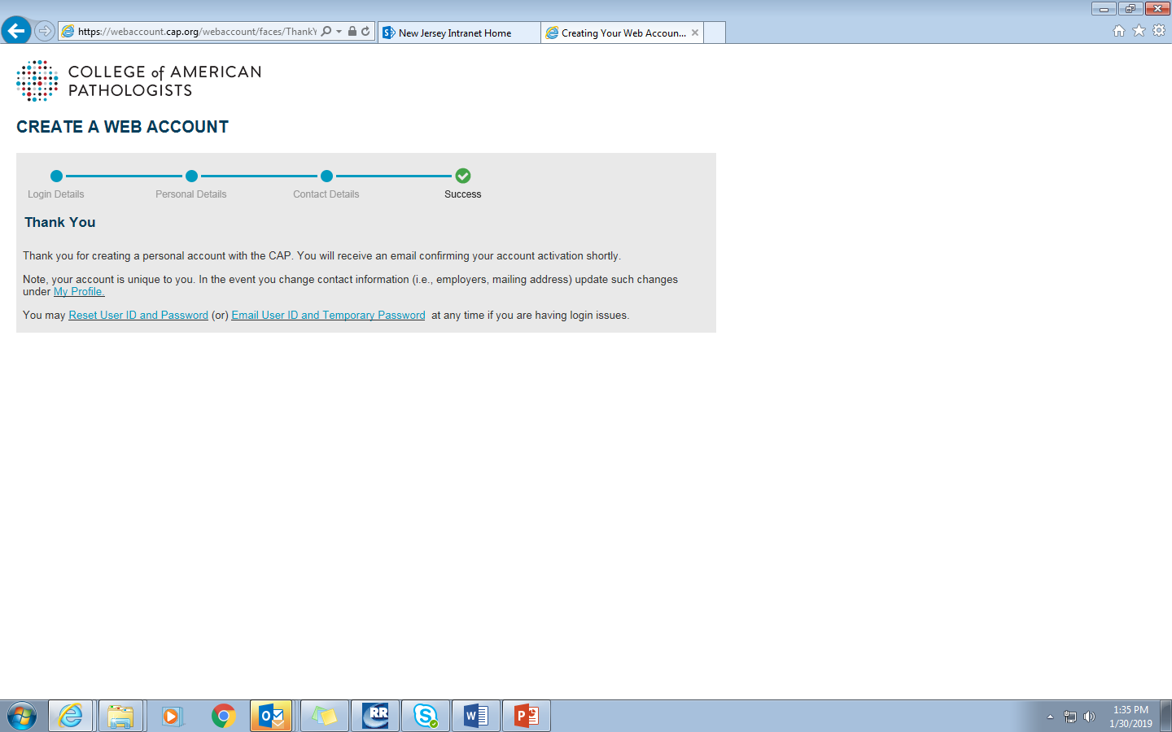
Account successfully created.

Slide 12
Once you’ve created an account, the first time you try to enter results, you will be told you do not have access permission to enter results for the account. You need to request online access from the Administrator. Once the Admin grants you access, you will be able to enter results for the account. You will get an email notifying you that you have access to the account for data entry.

Slide 13
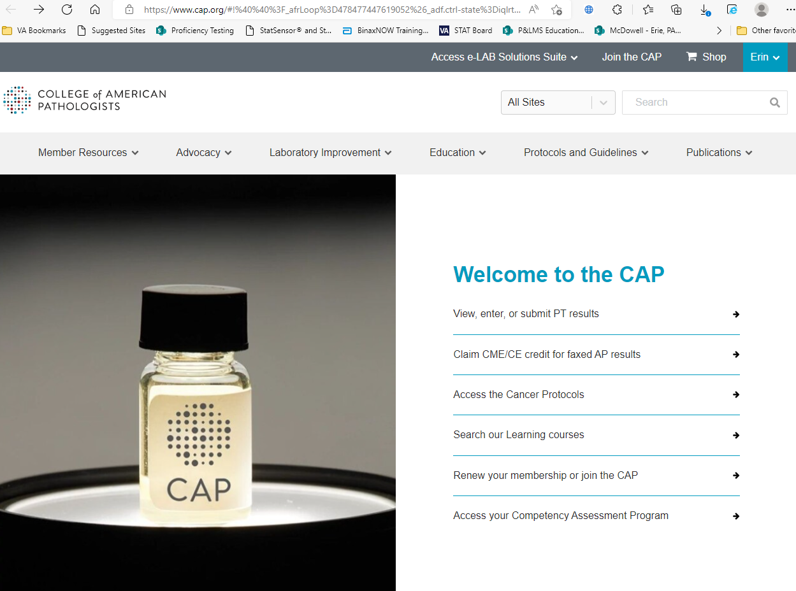
To Request Access from Administrator
Click Access eLAB Solutions Suite

Slide 14
You may send a request to your site administrator to provide you with access to the laboratory/organization, click Request Permission From Your Site Admin. Enter the required information and click Submit. Confirm that the laboratory information is correct and select the permissions that you would like to obtain. Click Submit

Slide 15
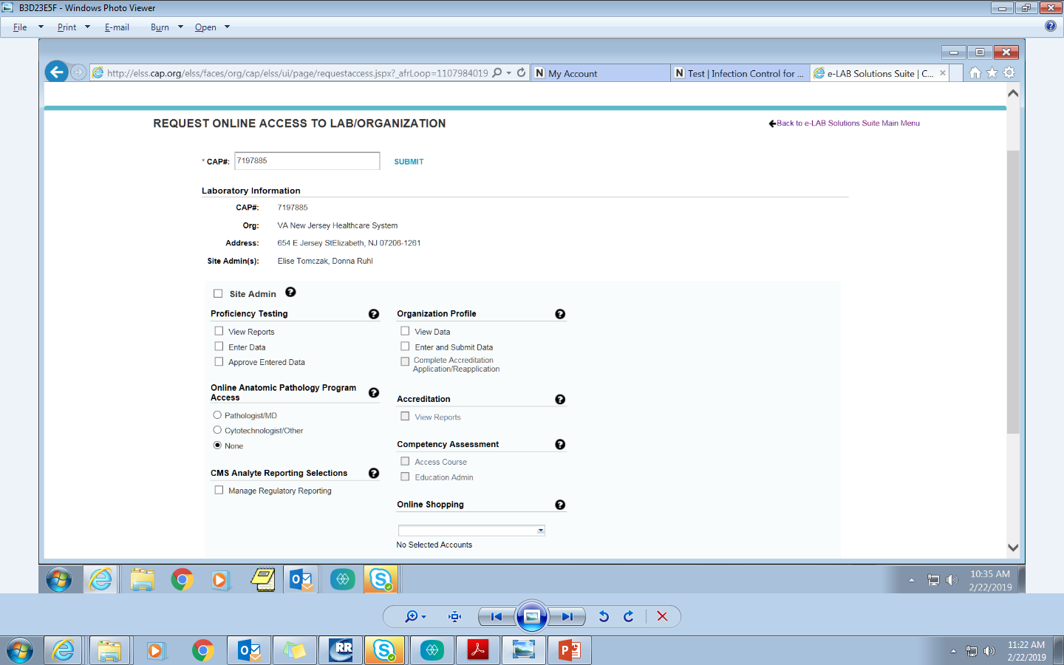
Enter CAP #, (see slide #4), then SUBMIT. Lab Info should autofill.
Under Proficiency Testing, check off View Reports, Enter Data, Approve Entered Data, then SUBMIT

