Slide 1


BinaxNOW Covid 19 Antigen Annual Competency
Erie VA Medical Center
Pathology and Laboratory

Slide 2
Outline
Policies
Supplies and Procedures
Quality Control
Patient Testing
Competency Requirements

Slide 3
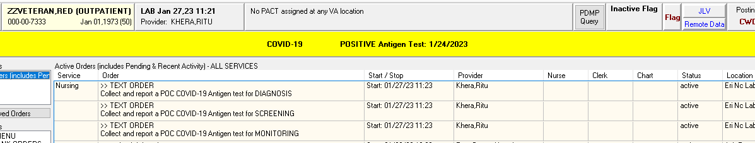
Policy
Providers should place a text order in CPRS for point of care (POC) Covid-19 antigen testing indicating if it will be used for symptomatic (diagnosis), asymptomatic (screening), or serial monitoring. No testing should occur without a doctor’s order.
All asymptomatic patients with a positive result and all symptomatic patients with a negative result should be confirmed by PCR testing.
All components of this kit should be discarded as Biohazard waste.
The presence of mupirocin may interfere with the Abbott BinaxNOW Covid-19 Antigen test and may cause false negative result. Covid-19 testing should be performed utilizing an alternate method until treatment is completed.

Slide 4
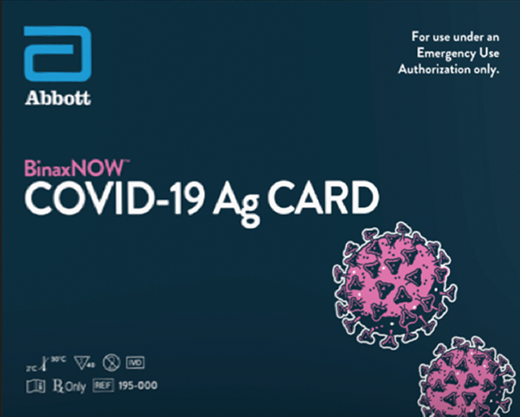
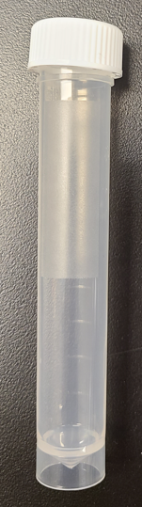
Supplies Needed
BinaxNOW Covid -19 Ag Card
Under Emergency Use Authorization (EUA) until testing is officially cleared by the FDA.
Supplied by Logistics
Contains 1 positive control swab, 40 patient swabs, extraction reagent, and 40 test card.
Timer
Thermometer
Gloves – change between handling specimens.
Transport Tube – Supplied by Logistics
Only Approved Transport Tube

Slide 5
Procedures
All Abbott BinaxNOW standard operating procedures (SOP) reside in the Ancillary Testing SOP binder located in the area where testing is occurring.
MCP 113-02 “Ancillary (Waived) Testing” is found in Ancillary testing SOP binder and on the Erie SharePoint site.

Slide 6
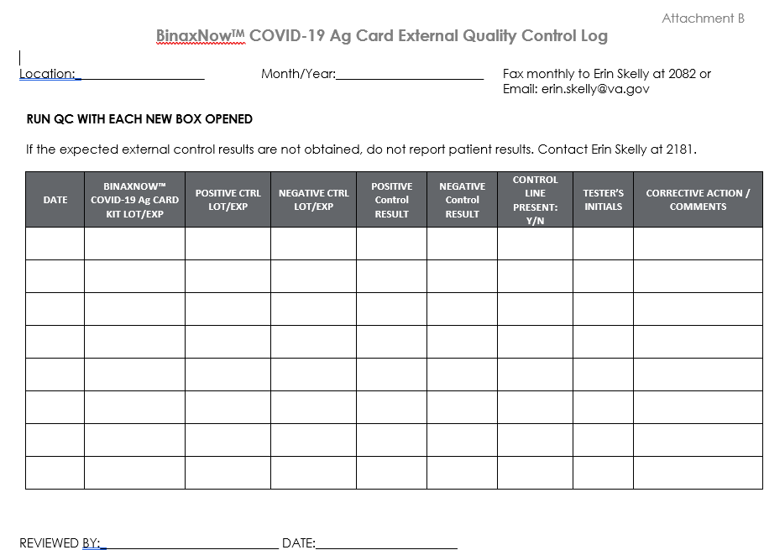
Quality control – External COntrols
External quality control – positive and negative swab should be run with each new box opened and each new operator (initial training).
Recorded on “BinaxNOW Covid-19 Ag Card External Quality Control Log”.
If control results are not acceptable, DO NOT use box for patient testing. Document on log and send box to the Ancillary Testing Coordinator in the lab.
All testing must take place at room temperature (15-30 C). Record temperatures on log each day of testing (refer to SOP AT 14 Attachement A).

Slide 7
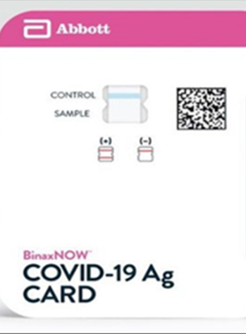
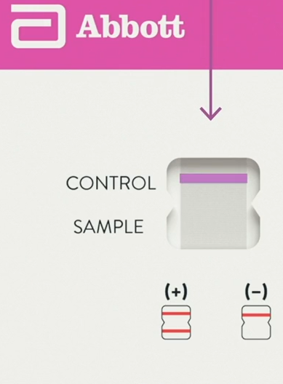
Quality Control – Internal Procedural Controls
The blue line is present and in the “control” region of card prior to testing.
Positive Internal Procedural Control: the blue line turns a pink-to-purple after 15 minutes of testing.
Negative Internal Procedural Control: the background color in the window should be light pink to white within 15 minutes of testing.
Record on “BinaxNOW Covid-19 Ag Card Result Log”.
Prior to Testing
After Testing

Slide 8
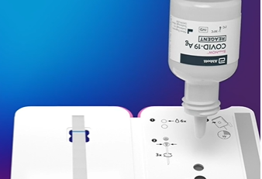
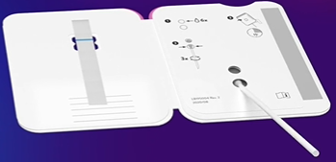
How to run External Quality control test?
Open the test card prior to use, lay it flat, and perform testing as followed.
Hold Extraction Reagent bottle vertically ½ inch above the TOP HOLE.
Slowly add 8 Drops to TOP HOLE of the swab well.
Insert either the positive control swab OR a blank negative control swab into the bottom hole.
Firmly push upwards so that the swab tip is visible in the TOP HOLE.

Slide 9
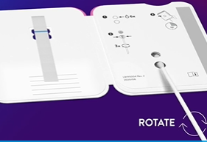
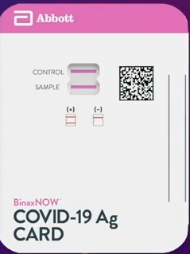
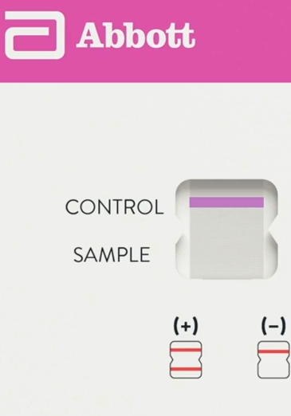
Quality Control Testing - continued
Rotate the swab shaft 3 TIMES Clockwise.
DO not remove swab.
Peel off adhesive liner from the right edge.
Close and securely seal the card.
Set timer for 15 minutes.
Read promptly at 15 minutes and not before.
Positive swab should yield a positive result and the negative swab should yield a negative result.
Positive Control Result
Negative Control Result

Slide 10
patient TEsting
Identify the patient/employee
  Confirm patient/employee identification using two full hospital approved identifiers (full name, full social security number or full date of birth) before specimen is collected.
  The two full patient identifiers must be utilized throughout the testing process (i.e. transport container, BinaxNOW card, result log, and VISTA entry).
Safety
  Wear appropriate personal protective equipment and gloves when collecting and running each test and handling patient/employee specimens. Change gloves between each specimen.
  All contents of patient testing should be disposed of in a Biohazard container.

Slide 11
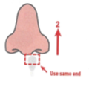


Patient testing
SAMPLE COLLECTION
Only the swab provided in the kit is to be used for nasal swab collection.
Insert one end of the swab until the tip is no longer is visible.
Rotate the swab SLOWLY in a circle around the entire inside edge of the nostril at least 3 to 5 times.
Use the same swab and repeat in the other nostril.
Patient/employees can self collect but it should be observed by a competent staff member.
A fully labeled transport tube can be utilized for transport of specimen to testing area. Do not place collected swab back into original package.
Testing must be performed within one hour of collection.

Slide 12
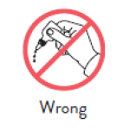
Patient testing
Hold the Extraction Reagent bottle vertically ½ inch above top hole.
Slowly add 6 DROPS to the top hole of the well.
Insert sample into the BOTTOM HOLE and firmly push upwards so the swab tip is visible in the TOP HOLE.
Rotate swab 3 times CLOCKWISE (to the right). Do not remove swab.
NOTE: False negative results can occur of the swab is not rotated prior to closing the card.
Peel off liner and seal the card.
Set timer for 15 minutes. Read promptly at 15 minutes and not before.

Slide 13
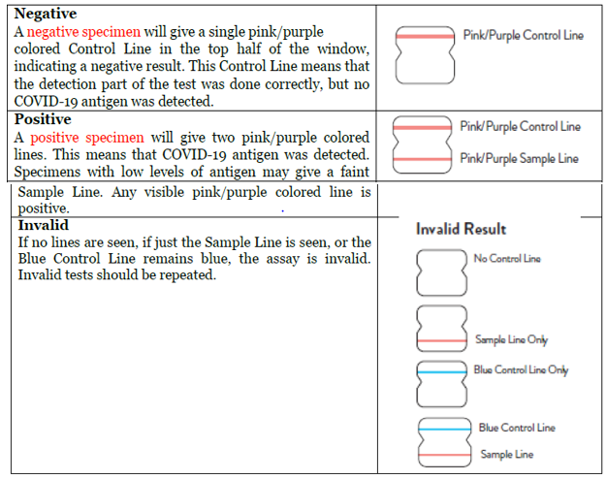
Patient testing – result interpretation

Slide 14
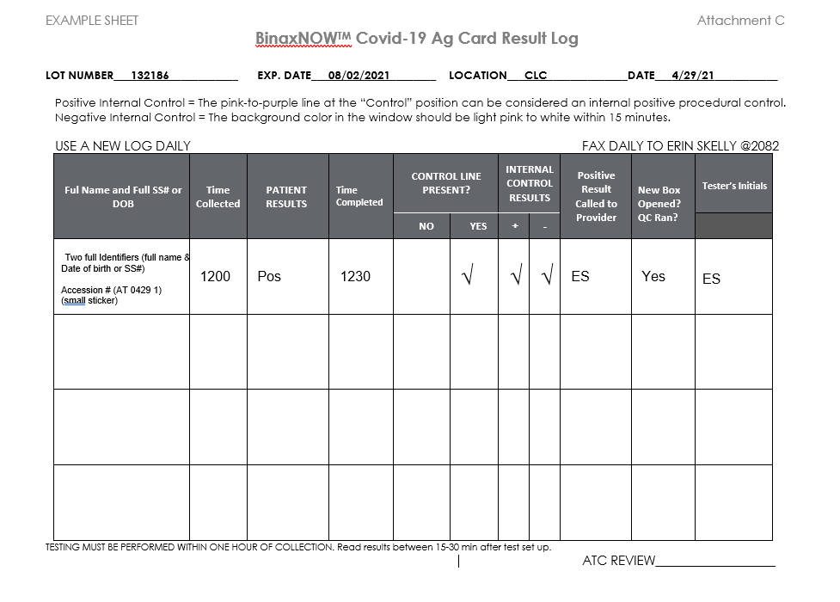
Patient testing
All patient/employee results must be recorded on the “BinaxNOW Covid-19 Ag Card Result Log”.
The log must be filled out completely with full name and full date of birth (or full Social Security number).
All patient/employee testing must be entered into the LAB package utilizing FASTBYPASS in VISTA.
Any positive result is considered a critical lab result and must be phoned to the responsible provider. This needs to be documented utilizing the “Critical POC Covid-19 Lab Value Notification” template in CPRS.

Slide 15
Competency Requirements
All operators must be authorized to perform testing. Authorization is granted at time of initial training with the Ancillary Testing Coordinator.
ONLY staff that have documented initial training with the Ancillary Testing Coordinator are deemed competent to perform any and all steps in BinaxNow testing. This includes inserting the swab into the BinaxNOW card.

Slide 16
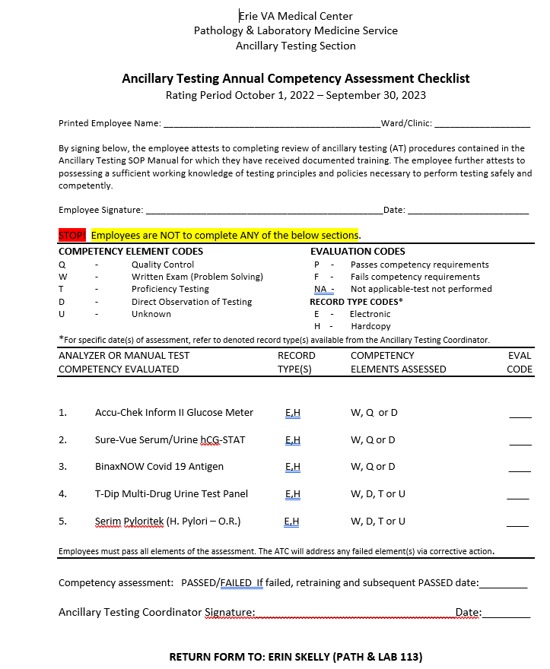
Annual BinaxNOW competency requirements
Review BinaxNOW Covid 19 Antigen Annual Competency power point training in MTS.
Complete BinaxNOW competency test in MTS (passing score >80%).
Direct observation by the Ancillary Testing Coordinator of external quality controls. Contact Erin Skelly (erin.skelly@va.gov) to schedule.
After completing the above tasks, print, fill out the top portion of the Competency Assessment (MTS), and return to Ancillary Testing Coordinator before assigned due date.
NOTE: If you are competent in multiple point of care tests, only one signed copy of Competency Assessment needs to be turned in at the completion of all point of care annual requirements.

