Slide 1
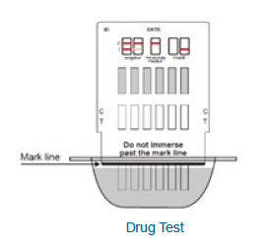
T-dip urine drug screen annual competency
Erie va medical center
Pathology and laboratory medicine

Slide 2
outline
Policies
Supplies and Procedures
Quality Control
Patient Testing
Competency Requirements

Slide 3
Policies
T-Dip UDS testing is a preliminary screening test that detects drugs of abuse at specified detection levels.
Only one brand of kits will be utilized for testing. Each testing area will have its own log that will be kept in Pathology & Laboratory Medicine.
Patient test results will be manually entered into the patient’s electronic record through VISTA.
NOTE: To confirm samples with questionable bands, or to confirm positive results, a more specific method such as Gas Chromatography/Mass Spectrometry (GCMS) should be used.

Slide 4
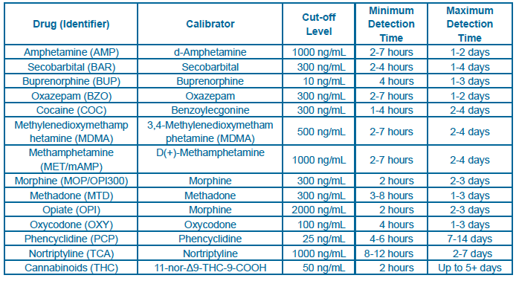
Analyte detection Limits

Slide 5


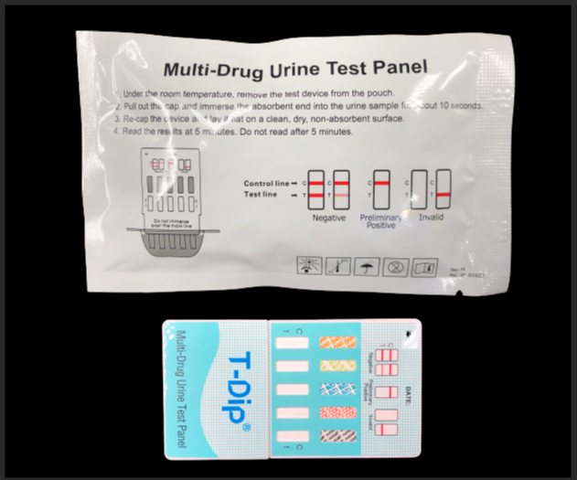
Supplies needed
Timer
Thermometer
Gloves
Abbott T-Dip Multi-Drug Test Panel – Supplied by lab and store at 4-30C
iScreen Urine Drug Control Kit – supplied and stored in lab (-20 to -10C freezer). Once opened, controls expire after 6 months.

Slide 6
Procedures
All T-Dip UDS standard operating procedures reside in Ancillary Testing SOP binders in areas where test kits are stored.
MCP 113-02 “Ancillary (Waived) Testing” is found in the Ancillary Testing SOP binder and on the Erie SharePoint Site.

Slide 7
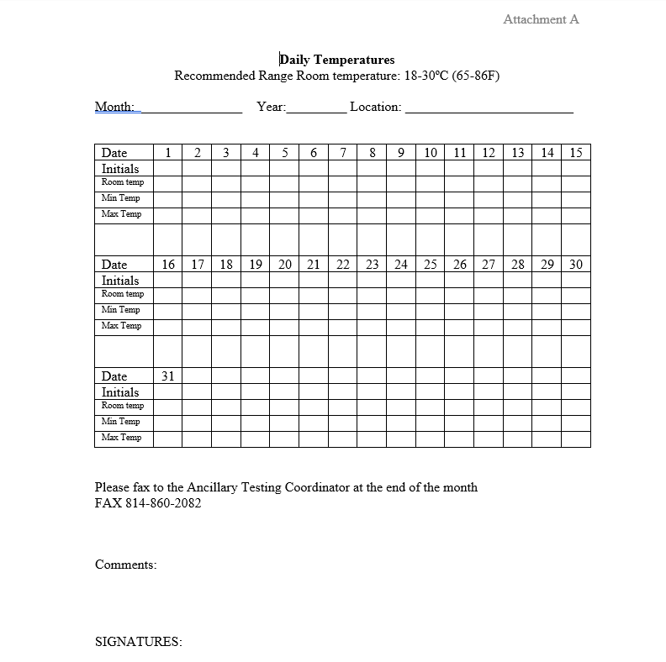
Quality control
Room temperature needs to be taken in the area where supplies are stored and testing is taking place. Record all temps on a log (see SOP AT 10 Attachment A).
A copy of temperature logs are sent monthly to the Ancillary Testing Coordinator.
Testing should be performed at room temperature (18-30 C).
Test kits and controls should not be used past expiration date printed on the packaging or open expiration date, whichever comes 1st.

Slide 8
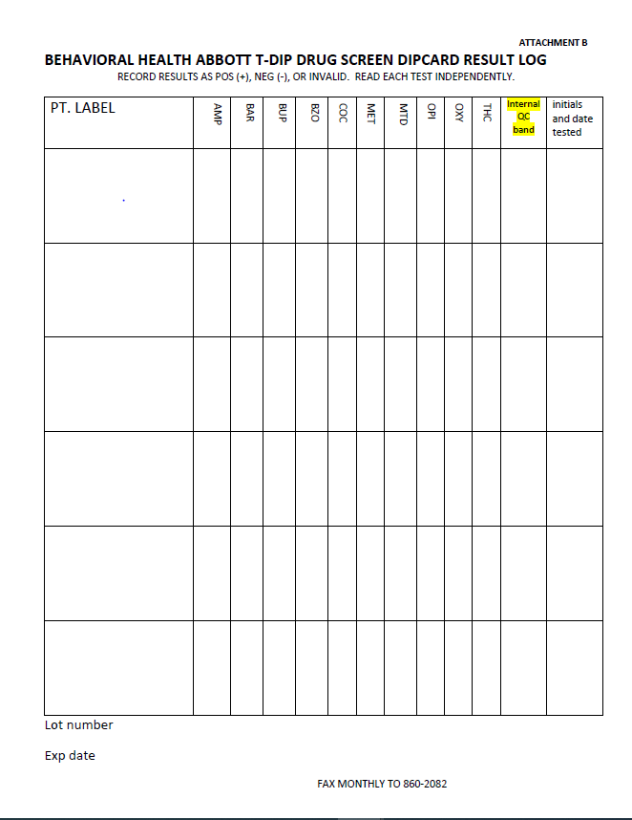
QUALITY CONTROL – INTERNAL PROCEDURAL CONTROL
Internal positive control: a red line appearing in the control region (C)
  Confirms sufficient specimen volume and correct procedural technique.
  Verifies that the reagents in the test are working properly.
The internal control result is to be recorded on the patient result log sheet (see SOP AT 10 Attachment B).
If no line appears in the control region, the test result is invalid and will need to be repeated using a new test kit.

Slide 9
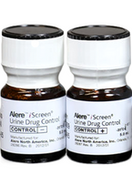
Quality control – external qc
2 levels (positive & negative) quality controls should be run:
  Monthly
  Each new lot
  Each new shipment
  Each new operator (initial training)
QC results are to be recorded on the log sheet (SOP AT 10 Attachment B)
If external quality controls do not work – patient testing should not occur on that box.

Slide 10
Patient testing
Patient Identification
Confirm patient identification using two full hospital approved identifiers (full name, full social security number or full date of birth) before specimen is collected.
The two full patient identifiers must be utilized throughout the testing process (i.e. collection of sample in cup, test kit, result log, and VISTA entry).
Safety
Wear appropriate Personal Protective Equipment (gloves) when collecting and running each test.
Specimens and controls should be considered potentially hazardous and handled as an infectious agent.
Disinfect work surface after testing.
Discard all material in proper biohazard container.

Slide 11
Patient testing
Sample Collection
Freshly voided urine specimen must be collected in a clean dry container. Recommended minimum volume is 20 mL.
Precautions should be taken to minimize the possibility of specimen adulteration.
Urine is expected to be translucent and light yellow with small number of bubbles. The presence of adulterants is suspected in specimens that are unusually bubbly, cloudy, clear, dark, or contain undissolved solids.
Temperature of the urine can be checked 30 seconds to 4 minutes after collection. Temp should fall between 90-100 F (32-37 C)

Slide 12
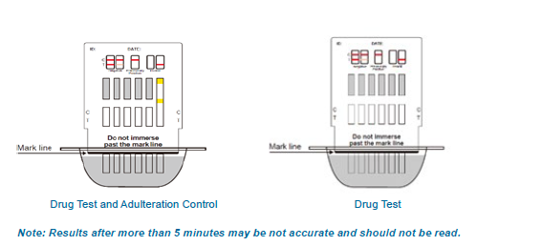
Patient testing
Remove test device from pouch and test as soon as possible.
Detach the bottom cover and dip sample pads into the urine for approximately 10 seconds.
Remove test device from sample, replace cover, and lay on a flat surface.
DO NOT dip device beyond the marked line printed on the front of device, it may cause invalid results.
Set timer for 5 minutes. Read results of test at 5 minutes. DO NOT read after 5 minutes.
Record all results on log and enter into VISTA utilizing FASTBYPASS.

Slide 13
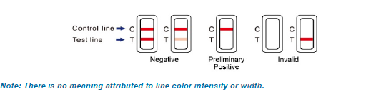
Patient testing – result interpretation
False negative and false positive results can occur with T-Dip testing.
False positives are most likely caused by cross reactants (i.e. certain foods, medicines, diet plan drugs, and nutritional supplements).
False negative can be caused by diluted specimens and adulterants
To confirm questionable results, an order should be placed for Gas Chromatography/Mass Spectrometry (GCMS) and specimen sent to the lab.

Slide 14
Competency Requirements
All operators must be authorized to perform testing. Authorization is granted at time of initial training with the Ancillary Testing Coordinator.
Only staff that have documented initial training with the Ancillary Testing Coordinator are deemed competent to perform urine drug screen testing.

Slide 15
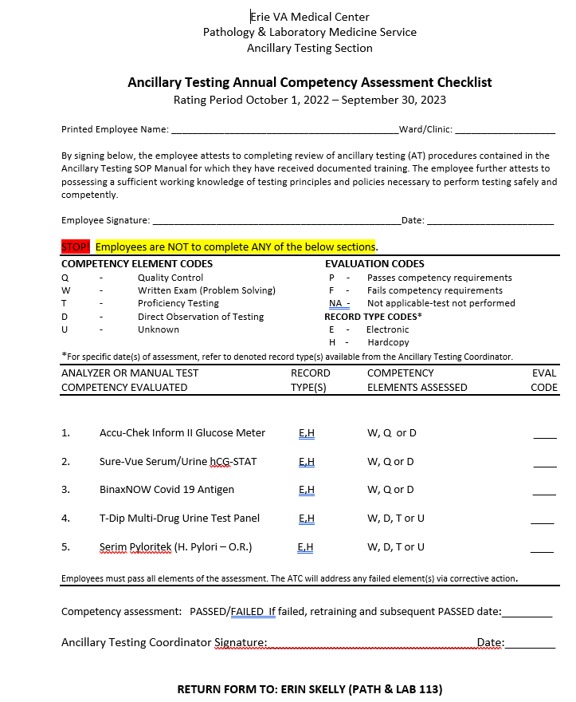
Annual uds competency requirements
Review T-Dip Urine Drug Screen Annual Competency power point in MTS.
Complete competency quiz in MTS (passing score >80%
Direct observation by Ancillary Testing Coordinator of either quality control or unknown patient samples. Contact Erin Skelly (erin.skelly@va.gov) to schedule.
After completing the above tasks; print, fill out top portion of Competency Assessment Checklist (MTS), and return to the Ancillary Testing Coordinator before assigned due date.
NOTE: If you are an operator of multiple point of care tests, only one signed copy of the Competency Assessment needs to be turned in at the completion of all point of care annual requirements.

