Slide 1

Accu-Chek Inform II
Annual Competency Training
Erie VA Medical Center
Pathology and Laboratory

Slide 2
Outline
Policies
Procedure, equipment and supplies
Quality Control
Patient testing
Maintenance and Troubleshooting
Annual Competency Requirements

Slide 3
Policies – When to test
Upon physician’s written order
Use of this meter is for PATIENT TESTING ONLY. Self-testing or testing of visitors, friends, relatives, or fellow employees (A medical emergency or code meets the criteria of “patient”) is not permitted.

Slide 4
Policy
Only hospital meters (Accu-Chek Inform II) validated by the Clinical Laboratory may be used for patient care, clinical decision-making, or treatment.
Only one brand of meter will be utilized for in-house testing.

Slide 5
Policy
The provider should verify the patent’s hematocrit to assure glucose test results are accurate. When the patient(s) clinically are having loss of blood or a condition that elevates hematocrit, the provider should be aware of the hematocrit levels when interpreting glucometer test results.
Note: Inform II glucometers give accurate glucose results when a patient’s hematocrit is between 10-65%.
Lipemic samples (triglycerides) more than 1800 mg/dL may produce elevated results.
The system should NOT be used to monitor patients who are receiving intensive medical intervention.
If the clinical picture is inconsistent with the fingerstick glucometer value, testing should be confirmed by a venous blood draw (glucose level) by the laboratory.

Slide 6
Procedures
All glucometer standard operating procedures (SOP) reside on the Pathology & Laboratory SharePoint page.
MCP 113-02 “Ancillary (Waived) Testing” is found on the Main and Pathology & Laboratory SharePoint pages.

Slide 7
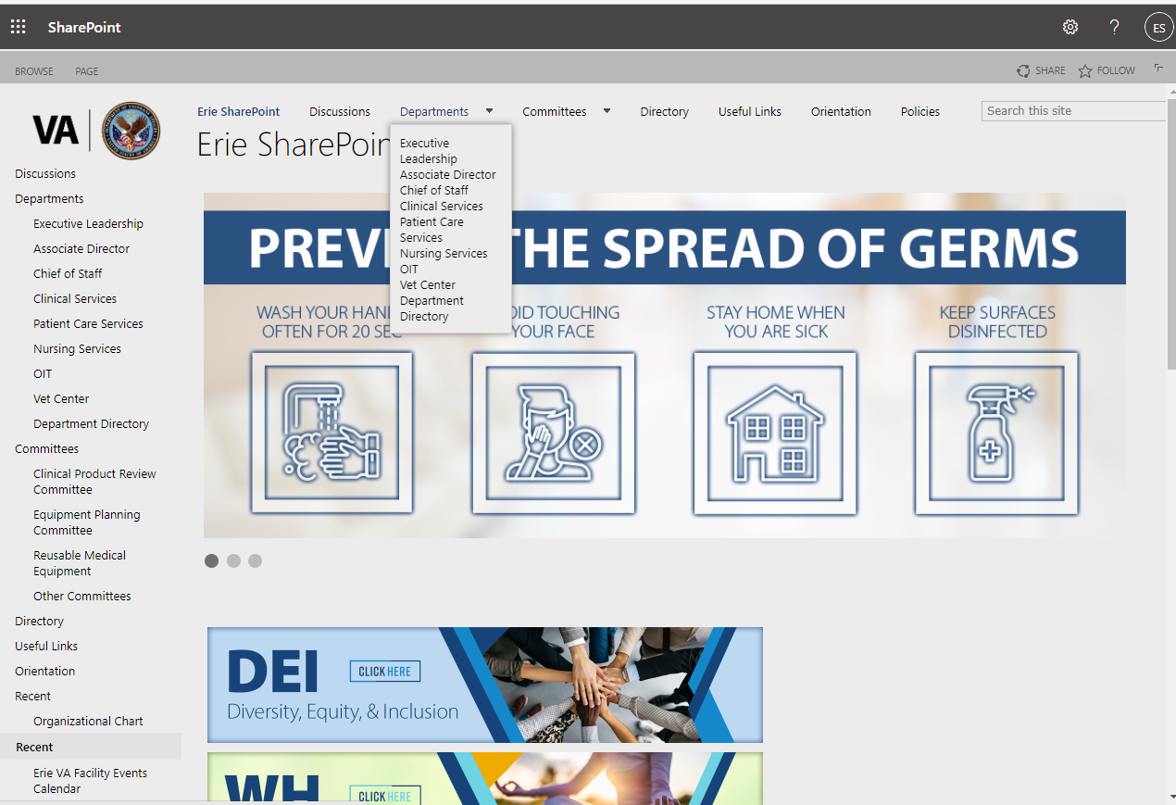
Location of Ancillary Testing SOPs
From the home page of SharePoint, click on Departments and then Clinical Services

Slide 8
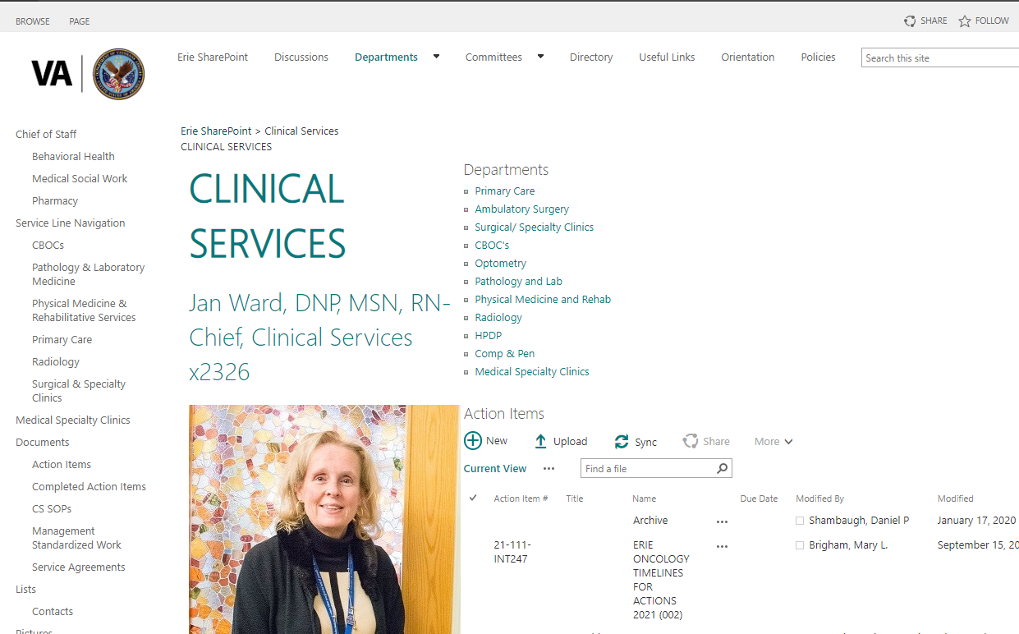
Location of Ancillary Testing SOPs
On the Clinical Services page, click on Pathology & Laboratory Medicine.

Slide 9
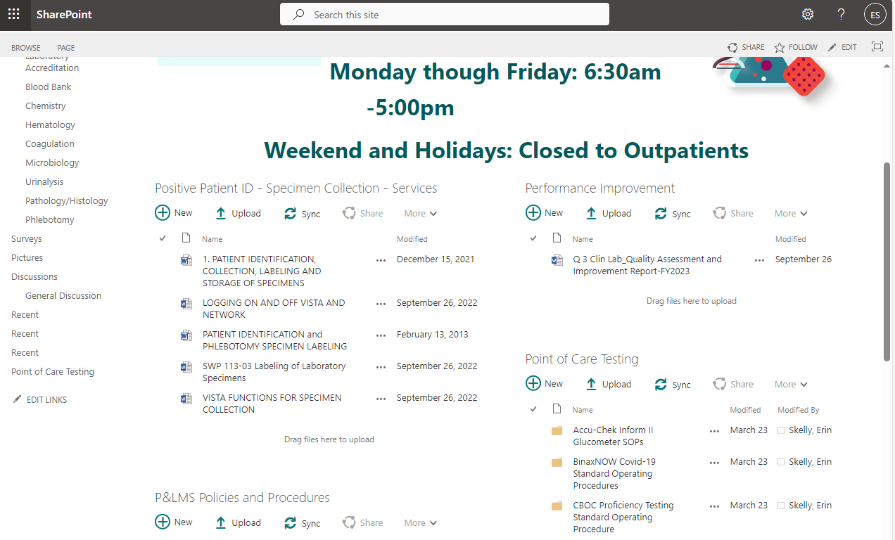
Location of Ancillary Testing SOPs
On the Pathology & Laboratory Medicine page, you can either click on Point of Care Testing on the column to the left or the body of the main page.

Slide 10
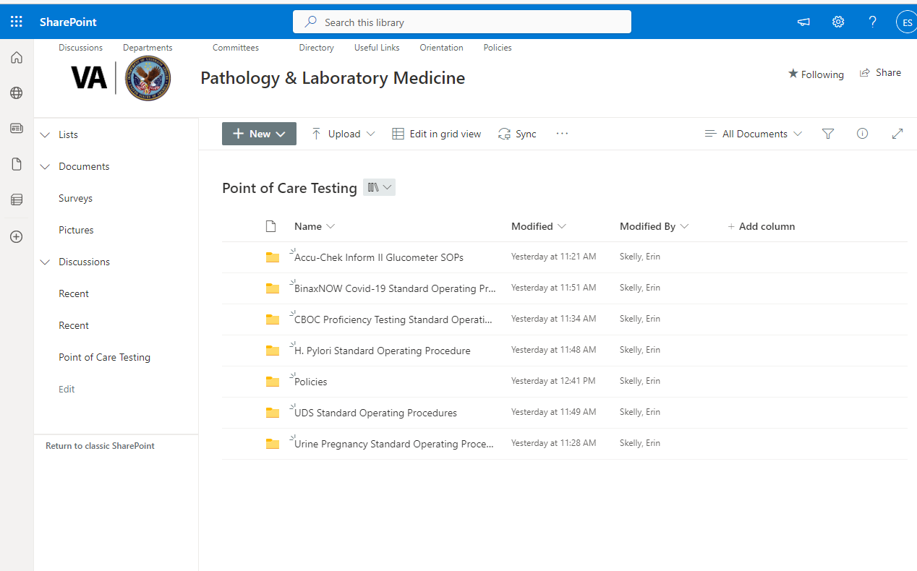
Location of Ancillary Testing SOPs
The point of care SOPs are organized in folders by test. Click on the folder for the test you are looking for.

Slide 11
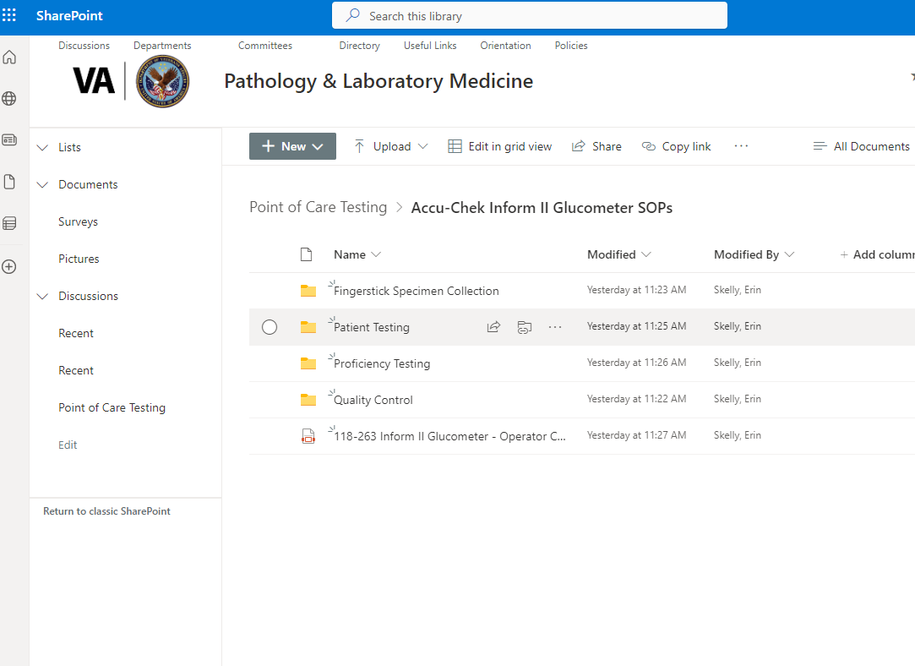
Location of Ancillary Testing SOPs
The Accu-Chek Inform II Glucometer SOP folder is divided into individual SOPs folders with attachments and forms.

Slide 12
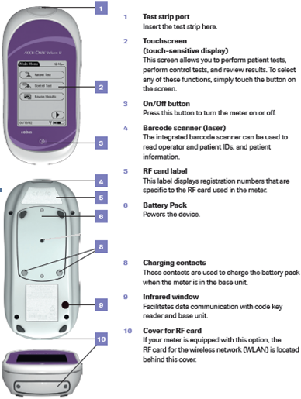
Equipment - Meter

Slide 13
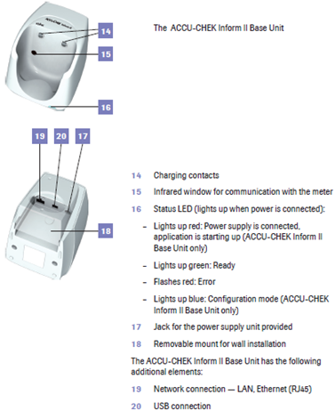
Equipment - Base

Slide 14
Supplies
Accu-Chek Inform II Strips:
Supplied by Logistics.
Store in original capped container at room temperature; no change in expiration date.
Use test strips at temperatures between 16-35 C (61-95 F) and relative humidity between 10 – 80%.
Never leave the cap off vial of strips for more than 3 minutes. Never add strips from an almost empty vial to a new vial.
If strips are opened in shipment, DO NOT USE and send back to the Ancillary Testing Coordinator in lab.

Slide 15
Supplies
Accu-Chek Inform II Controls
Supplied by the Lab and kept at room temperature.
Expire 3 months after opening or manufacture’s date, whichever comes first. Open date and expiration date should be recorded on vials.

Slide 16
Additional Supplies
Alcohol swab
Lancet (single use) – 3 varying gauges, supplies by Logistics
Gauze
Gloves

Slide 17
Quality Control
Two levels are analyzed once per 24 hours. Lockout time: 3 am
Prior to analysis, invert gently and avoid dried debris on the tip.
Control results are PASS or FAIL. Failed results must be repeated. For continued failures, start with new strip vial.
Patient testing is not permitted unless quality control is acceptable.
After testing is completed, COMMENTS ARE MANDATORY to communicate interpretation of results or actions taken.

Slide 18
Other Times to Run Quality Control
When patient glucose values are in question.
When a new vial of test strips is opened.
When the instrument readings are in question.
To check performance of meter if it is dropped or damaged.
If cap is left off the test strips.
NOTE: Each lot number of strips will need quality control run on them every day of testing. Be careful to only have one strip lot number in use at a time.

Slide 19

Accu-Chek Inform II – Login
You are given a barcode during initial glucometer training. This is a barcode ID used to identify you as the person performing the test.
The meter will scan your barcode and your name will appear on the screen.
Never borrow someone else’s ID.
If you need to replace your barcode, contact Erin Skelly in LAB (2187).
Individuals who have not been trained or whose certification has expired will be locked out of the meter.

Slide 20
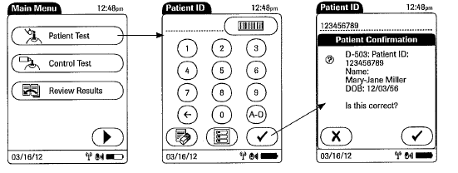
Patient Testing
Identify the patient
Confirm patient identification using two hospital approved identifiers (full name, full social security number or date of birth).
Scan the patient wristband. Try to avoid manually entering patient’s ID. Verify patient information on confirmation screen.

Slide 21
Patient Testing
Fingerstick: Select a finger for puncture. Avoid cold, cyanotic, bruised, cut or swollen fingers. The middle or ring finger is preferred. Each test should be performed from a new skin puncture.
Blood flow may be increased by warming the site for 3 – 5 minutes by using a warm washcloth or appropriate warming device. Next, gently massage the finger five or six times from the palm to the base of the finger and up to the tip of the finger.
Cleanse the finger with an alcohol swab.
The skin and your gloves must be completely dry before proceeding. Alcohol can cause an interference with glucometer results.

Slide 22

Patient Testing
Hold the finger firmly with one hand and place the disposable lancet device against the finger, selecting either side of the fleshy pad.
Trigger the lancet device. Wipe away the first drop of blood. Hold the puncture site downward and gently apply intermittent pressure to the surrounding tissue. Do not apply strong repetitive pressure (“milking”).

Slide 23
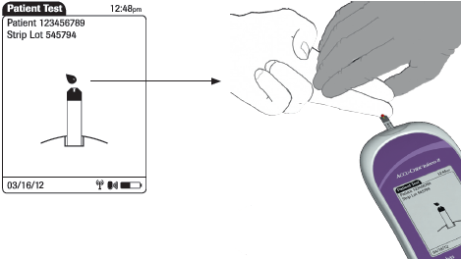
Patient Testing
Apply the drop of blood to the front edge (yellow dosing area) of the test strip. Blood will be pulled into the test strip. The meter beeps and measurement begins.
When applying the sample, the meter should be positioned so the test strip port is always higher or the same level as the blood drop. This prevents excess blood getting in the port.

Slide 24
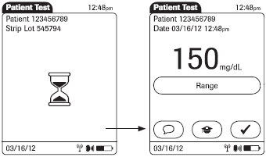
Patient Testing
The hourglass icon indicates the test is running. Once the test is completed, the result displays.
After obtaining patient result, a pre-programmed comment must be entered to communicate interpretation of result or action taken. The use of at least one comment is mandatory.
NOTE: If an error occurs in fingerstick testing, comment “Operator Error” and the result will be held and not automatically upload into the patient’s chart.

Slide 25
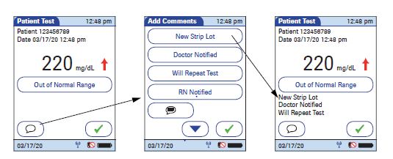
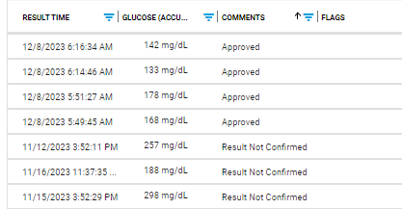
Patient Testing
Press to enter a comment. Press √ to return to the Patient Test screen, and press √ again to return to the Main Menu.
NOTE: If √ is not pressed on the Patient Test screen, the result comes through the middleware as “Result Not Confirmed”.
All glucometer results should be confirmed and have a comment entered before the meter is docked or turned off.
The green check must be pressed on the Patient Test screen before meter is docked or turned off.

Slide 26
Patient Testing
Normal fasting value for non-diabetic adult: 70-100 mg/dL
Critical values: <50 & >400 mg/dL
Repeat IMMEDIATELY
For critical <50, result must match original ± 10 points; For critical >400, result must match original ± 50 points.
If the 2nd result does not match within the specified number of points, you may repeat a 3rd time.
If result is still not verified using above criteria, phone the Lab for a blood draw.
Measurement range of the meter is 10-600 mg/dL. Values outside this range display as “LO” & “HI”. Lab must be phoned for a draw in these cases to get an actual numerical glucose value.
Ensure the critical results are given as soon as possible to the provider who can influence care.
Provider notification of all confirmed critical (initial result is critical and repeat is also critical) should be documented on the Critical Fingerstick Notification Template in CPRS.

Slide 27
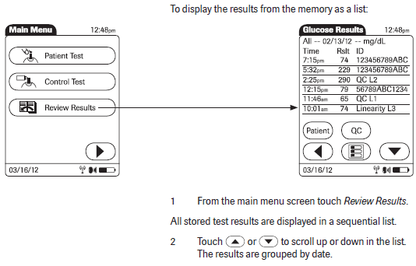
Patient Testing – Recalling Results

Slide 28
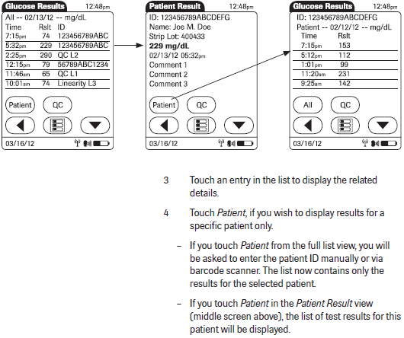
Patient Testing – Recalling Results

Slide 29
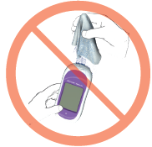
Maintenance and Troubleshooting
All exterior surfaces of the Accu-Chek Inform II meter are to be cleaned and disinfected after each patient use with the manufacture-approved Super Sani-Cloth disinfecting wipe.
Wear gloves
Squeeze off excess cleaning solution
Do not clean meter while strip is still in the test strip port.
Make sure no liquid gets into port.

Slide 30
Step 1: Cleaning the Meter
Place meter on a level surface
Power off the meter
Use a Super Sani-Cloth to clean any visibly soiled surface
Dry the meter thoroughly with a dry cloth or gauze.

Slide 31
Step 2: Disinfecting the Meter
Use a fresh Super Sani-Cloth wipe to disinfect by gently wiping the outside of the meter 3 times horizontally and 3 times vertically.
Allow the meter to stay wet for 2 minutes with the Super Sani-Cloth. Additional wipes may be needed to ensure the meter stays wet for the full 2 minutes.
After the 2 minutes of contact time is finished, dry the meter thoroughly with a dry cloth or gauze.

Slide 32
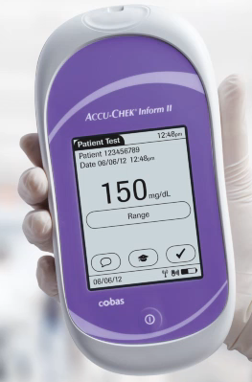
Troubleshooting
If the meter displays “Type Bad Dose”, there may be insufficient amount of blood on the test strip or the dose may have been applied before the flashing red drop appeared above the strip icon. Repeat the test using a new strip
If you have problems with a glucometer, contact Erin Skelly (Ancillary Testing Coordinator) at 2187.
Meanwhile, use a different meter or borrow a spare meter from the Lab.

Slide 33
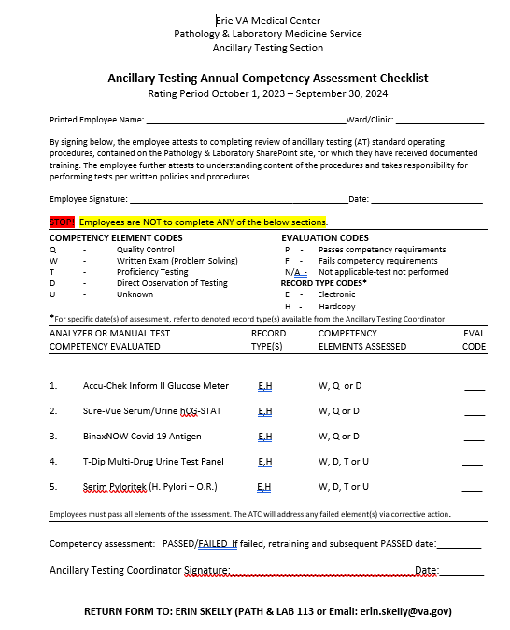
Annual Glucometer Competency Requirements
Review Accu-Chek Inform II Annual Competency power point training in MTS.
Complete glucometer competency test in MTS (passing score >80%).
Run levels 1 and 2 of quality control on meter and dock.
After completing the above tasks, print, fill out the top portion of the Ancillary Testing Annual Competency Assessment Checklist (found on MTS and attached to the annual competency notification email), and return to Ancillary Testing Coordinator before assigned due date.
NOTE: If you are competent in multiple point of care tests, only one signed copy of Competency Assessment needs to be turned in at the completion of all point of care annual requirements.

