Slide 1

SURE-VUE URINE PREGNANCY ANNUAL COMPETENCY
ERIE VA MEDICAL CENTER
PATHOLOGY AND LABORATORY

Slide 2
OUTLINE
Policies
Supplies and Procedures
Quality Control
Patient Testing
Competency Requirements

Slide 3
Policies
Providers should place a text order in CPRS for PREGNANCY TEST (URINE) (HCG BETA,QUAL); POINT OF CARE TESTING. No testing should occur without a doctor’s order.
Qualitative testing for hCG is a waived test if done on urine only. All POC pregnancy testing is to be performed on URINE ONLY.

Slide 4

Supplies Needed
Sure-Vue Serum/Urine hCG Kit – supplied by Lab
Timer
Thermometer
Gloves
External Quality Control – supplied by Lab

Slide 5
Procedures
All urine pregnancy testing standard operating procedures (SOP) reside on the Pathology & Laboratory SharePoint page.
MCP 113-02 “Ancillary (Waived) Testing” is found on the main Erie and Pathology & Laboratory SharePoint pages.

Slide 6
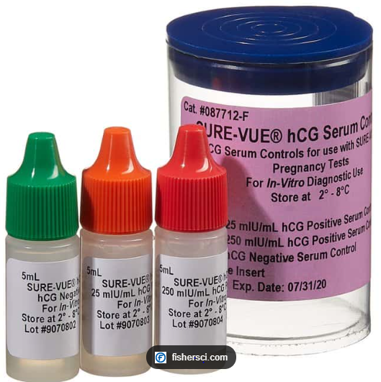
Quality control – external controls
Run at least the negative QC and one positive QC as follows:
    Each new lot/shipment of test kits
    Each day of patient or proficiency testing
    Each new operator (initial training)
    Monthly if none run for any reason stated above
NOTE: Controls contain sodium azide. Wear gloves while handling. Refer to the MSDS sheet for further instructions (SOP “Sure-Vue Urine Pregnancy Test” Attachment G).

Slide 7

Quality Controls – External Controls
Controls should be stored refrigerated (2-8 C) and brought to room temperature (15-30 C) before use.
External quality control results should be recorded on the Sure-Vue Urine HCG Test log.
If control results are not acceptable, DO NOT use the box for patient testing. Document on log and send box to the Ancillary Testing Coordinator in the lab.
All testing must take place at room temperature. Record both refrigerator (if QC stored on site) and room temp on log (Refer to SOP “Sure-Vue Urine Pregnancy Test”).

Slide 8
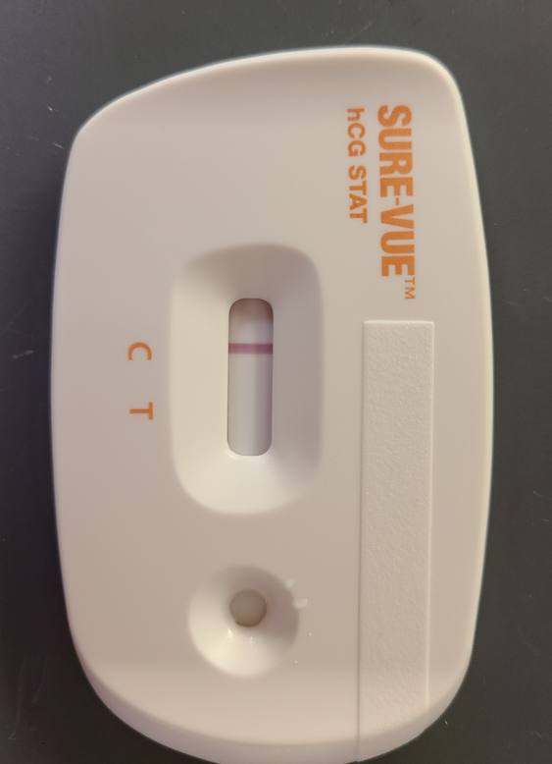
Quality control –internal procedural control
Internal positive control: a red line appearing in the control region (C).
      Confirms sufficient specimen volume and correct procedural technique
Internal negative control: a clear background after testing is complete.
      If the test is working properly, the background in the result area should be white to light pink and not interfere with the ability to read the test result.
Record the internal procedural control results (Okay) on the Sure-Vue Urine HCG Test log in the “Int. QC” column.
The control line must be present or the test in INVALID and needs to be repeated with a new test kit.

Slide 9
How to run external quality control test?
Remove external quality control from the refrigerator and allow to come to room temperature before testing.
Obtain two Sure-Vue test devices.
Open the packets and remove the test devices.
Label one device NEG Control and the other POS control.
Drop 3 drops of negative control into the device labelled NEG and 3 drops of either the LOW POS control (25 mIU/mL) or HIGH POS (250 mIU/mL) into the device labelled POS.
Set a timer for 3 minutes
Read the test promptly at 3 minutes and record results on log.

Slide 10
Patient testing
Identify Patient
Confirm patient identification using two full hospital approved identifiers (full name and full social security number or full date of birth) before specimen is collected.
The two full patient identifiers must be utilized throughout the testing process (i.e. collection of sample in cup, test kit, result log, and VISTA entry).
Safety
Wear appropriate personal protective equipment (gloves) when collecting and running each test.
Specimens and controls should be considered potentially hazardous and handled as an infectious agent.
Discard all material in proper biohazard container.
Disinfect work surfaces after testing.

Slide 11

PATIENT TESTING
SAMPLE COLLECTION
Urine specimen must be collected in a clean dry container.
First morning urine specimen is preferred since it contains the highest concentration of hCG.
Urine specimens exhibiting visible precipitates should be centrifuged, filtered, or allowed to settle to obtain a clear specimen.
Urine may be stored 2-8C for up to 48 hours prior to testing.

Slide 12
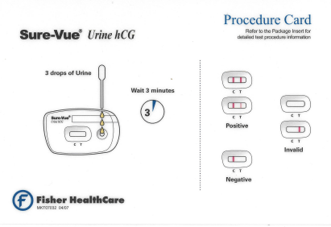
Patient testing
Remove the test device from pouch and test as soon as possible.
Set a timer for 3 minutes
Add 3 full drops to the specimen well and start timer
Read test promptly at 3 minutes and not after 4 minutes.
Record patient results along with internal procedural control results on the Sure-Vue Urine HCG Test log.
All patient testing must be entered into the LAB package utilizing FASTBYPASS in VISTA.
Fax Sure-Vue Urine HCG Test log to Ancillary Testing Coordinator after each day of patient testing.

Slide 13
Testing limitations
Very dilute urine specimens may not contain representative levels of hCG.
False negative results may occur when levels of hCG are below the sensitivity level of the test.
Conditions such as trophoblastic disease, breast cancer, and lung cancer can cause elevated hCG levels.
If urine pregnancy test result is not consistent with the clinical presentation, the provider may order a quantitative serum hCG to be sent to the Lab.

Slide 14
Competency requirements
All operators must be authorized to perform testing. Authorization is granted at time of initial training with the Ancillary Testing Coordinator.
Annual competency assessment is required after initial training.
Only staff that have documented initial training and subsequent annual competency with the Ancillary Testing Coordinator are deemed competent to perform urine pregnancy testing.

Slide 15
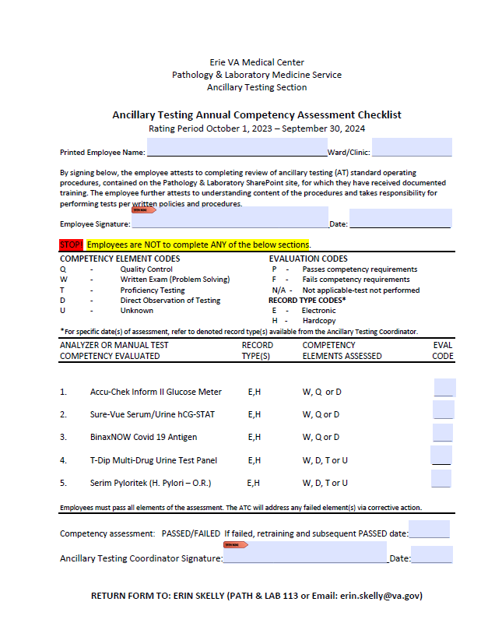
Annual urine pregnancy competency requirements
Review Sure-Vue Urine Pregnancy Annual Competency power point training in MTS.
Complete competency quiz in MTS (passing score >80%).
Direct observation by the Ancillary Testing Coordinator of external quality controls. Contact Erin Skelly (erin.skelly@va.gov) to schedule.
After completing the above tasks; print, fill out top portion of Competency Assessment (MTS), and return to the Ancillary Testing Coordinator before assigned due date.
NOTE: If you are an operator of multiple point of care tests, only one signed copy of the Competency Assessment needs to be turned in at the completion of all point of care annual requirements.

