Slide 1
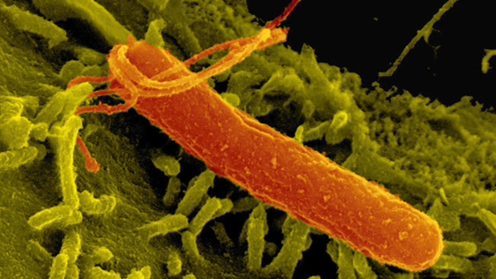
PYLORITEK H. PYLORI ANNUAL COMPETENCY
ERIE VA MEDICAL CENTER
PATHOLOGY AND LABORATORY

Slide 2
OUTLINE
Policies
Quality Control
Patient Testing
Competency Requirements
Supplies and Procedures

Slide 3
Policies
Providers should place a lab order in CPRS for HELICOBACTER PYLORI (POC) BIOPSY GASTRIC MUCOUS MEMBRANE. No testing should occur without a doctor’s order.
All patient results need to be entered into the patient’s electronic record utilizing Fast Bypass in VISTA.
Only one brand of kits will be used for testing. Pathology & Laboratory Medicine will perform initial external quality control for each lot number of reagents prior to release and maintain documentation of quality control testing.

Slide 4
Policies - Specimen
Patient Preparation:
Patient should refrain from taking antibiotics and/or bismuth for 14-28 days prior to the gastroscopy procedure.
Proton pump inhibitors should be avoided for 7-14 days prior to the procedure.
These drugs have been shown to reduce urease activity of H. pylori and to reduce the density and number of organisms, thereby increasing the chance of a false negative test result.
Type:
Gastric specimen
One biopsy is required but up to three biopsies from one patient can be placed on one Reaction Pad of one PyloriTek Reagent Strip.

Slide 5
Policies – Specimen Cont.
Handling Conditions:
Gastric biopsy must be transferred directly from the forceps to the Reaction Pad of the PyloriTek Reagent Strip in a timely manner to minimize loss of urease activity.
Do Not place biopsy on gauze or filter paper prior to testing. This can increase the chances of a false negative result.
Avoid contamination of biopsy specimens with formalin. Formalin can inhibit H. pylori urease activity and lead to false negative results.

Slide 6
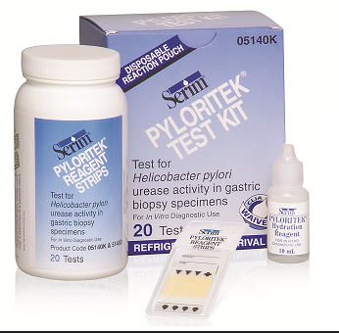
SUPPLIES NEEDED
PyloriTek Test Kit – Supplied by Lab and contains:
    Reagent Strips
    Hydration Reagent
    Disposable Reaction Pouches
Timer
Wooden applicator stick or plastic pick
Gloves
External Quality Control – Supplied and performed by Laboratory

Slide 7
SUPPLIES – Test Kit Storage Requirements
Store unopened PyloriTek Test Kit in P&LMS Microbiology refrigerator at 2-7C until kit is to be used.
Allow kit components to come to room temp 15-30C prior to opening and use.
Once opened, store kit components at room temp (15-30C) in Ambulatory Surgery.
Write opened date on bottle. PyloriTek Reagent Strips must be used within 3 months of first opening the bottle or before the kit expiration, whichever occurs first.
Do NOT store test strips near sources of heat, ammonia, or formaldehyde.

Slide 8
PROCEDURES
All PyloriTek H. pylori standard operating procedures reside on the Pathology & Laboratory SharePoint page.
MCP 113-02 “Ancillary (Waived) Testing” is found on the Main and Pathology & Laboratory SharePoint pages.

Slide 9
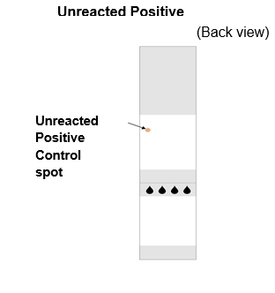
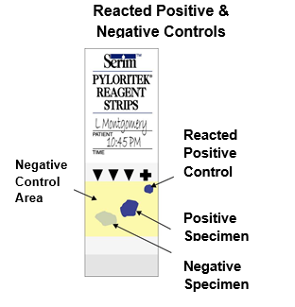
QUALITY CONTROL – Internal Controls
A positive and negative control incorporated into each PyloriTek Reagent Strips. These procedural controls verify that the Hydration Reagent was added and that the test system is working.
Internal Positive Control
Unreacted Positive Control appears as a red spot located on the Reaction Pad in the upper left-hand corner.
If the red Positive Control Spot is not visible – DO NOT use strip.
If positive Control does not develop after 60 minutes, test is invalid and should not be reported. See SOP Point-of-Care H. Pylori testing for troubleshooting steps.

Slide 10
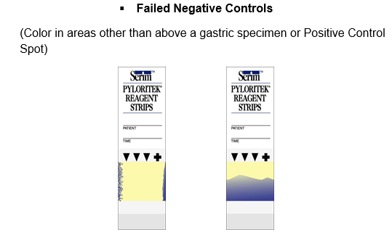
QUALITY CONTROL – Internal Controls
Internal Negative Control
Any area of yellow on the Reaction Pad other than directly above the Positive Control Spot or a gastric biopsy is part of the Negative Control area.
Should remain yellow during the entire 60 minute development time.
This indicates that the integrity of the Reagent Strip has been maintained.
If the yellow Negative Control area of the Reaction Pad displays an atypical color during the 60 minutes, the test is invalid. Refer to SOP Point-of-Care H. Pylori Testing for troubleshooting steps.

Slide 11
PATIENT TESTING – HANDLING PROCEDURES
Do not remove a PyloriTek strip from the bottle until immediately before use.
Replace the bottle cap immediately and tightly after removing a strip.
Do not return unused strips exposed to ambient conditions to the bottle.
Do not place strips back in the bottle once Hydration Reagent has been added.
Avoid touching the red control spot on the reaction pad.
Do not remove the desiccant pack.
Do not use a strip if the Reaction Pad displays atypical purple, blue or gray areas prior to use. (Some strips may have a “mottled” yellow-orange Reaction Pad, but this slight variation in color is normal and it does not affect performance of the PyloriTek Reagent Strip.)

Slide 12
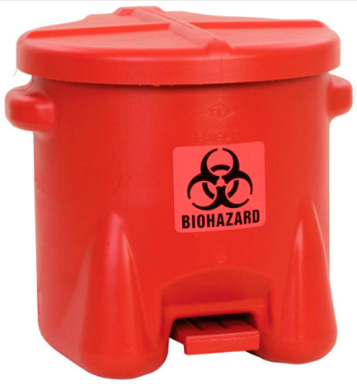
PATIENT TESTING – SAFETY PRECAUTIONS
Personal Protective Equipment (gloves) should be utilized.
Specimens and reagents should be considered potentially hazardous and handled as an infectious agent. Discard all material in the proper biohazard container.
Disinfect work surfaces after testing.
Hazardous component: Hydration reagent contains 0.1% sodium azide as a preservative. Harmful if swallowed and may be absorbed through the skin.

Slide 13
PATIENT TESTING - PROCEDURE
Make sure all components of the PyloriTek Test Kit are at room temp prior to testing.
Check expiration date of kit to make sure they have not expired.
Immediately prior to use, remove one PyloriTek Reagent Strip from the bottle and close bottle.
Check Reagent Strip to ensure a Positive Control Spot is visible in the upper left-hand corner of the Reaction Pad.
Place strip on a clean dry surface.
Once testing has begun, tests must be inserted in the disposable pouch provided in kit.
NOTE: Do not carry pouch with developing tests in pocket of clothes as biopsy tissue may contain potentially infectious organisms.

Slide 14
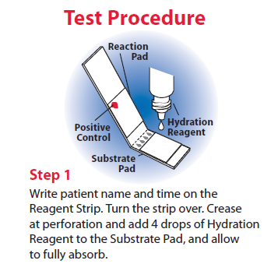
PATIENT TESTING

Slide 15
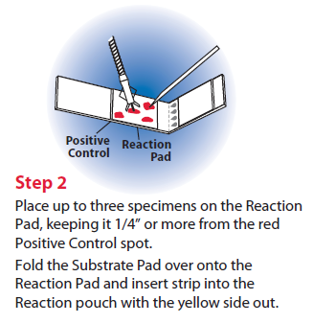
PATIENT TESTING

Slide 16
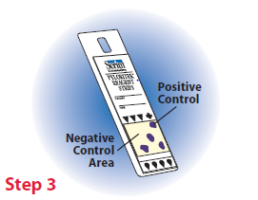
PATIENT TESTING
Within 60 minutes observe the yellow Reaction Pad for the appearance of an intense purple/blue Positive Control spot. Refer to the following slides for patient result interpretation.

Slide 17
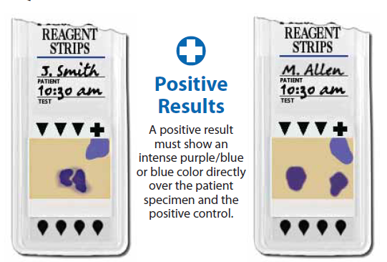
PATIENT TESTING - RESULTS

Slide 18
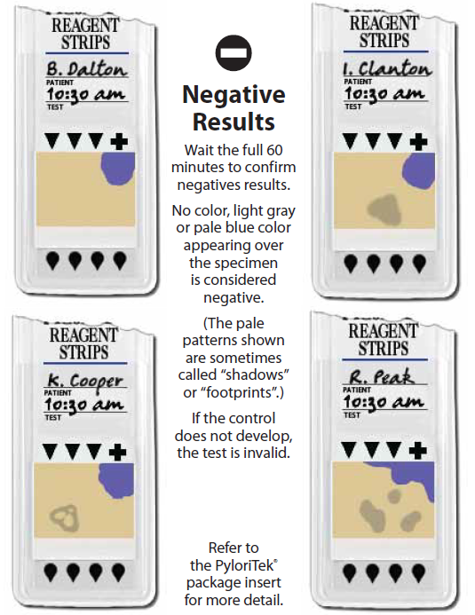
PATIENT TESTING - RESULTS

Slide 19
PATIENT TESTING – LIMITATIONS
PyloriTek Reagent Strips detect ammonia generated by H. pylori urease-catalyzed hydrolysis of urea in the Substrate Pad. Ammonia can also be produced by tissue autolysis or can be found in blood as a waste product. However, these non-specific reactions usually occur at a slower rate than can be detected visually in 60 minutes by the PyloriTek Test Kit. It is possible that abnormal increases in these reactions may give a false positive result.
False negative results may occur if the area biopsied has not been colonized by H. pylori or if the patient has been on antibiotic and/or bismuth salt therapy.
A positive test does not distinguish between asymptomatic colonization and a symptomatic infection.
The PyloriTek Test Kit is to be used as an aid in diagnosis only for those patients with clinical symptoms of H. pylori infection.

Slide 20
COMPETENCY REQUIREMENTS
All operators must be authorized to perform testing. Authorization is granted at time of initial training with the Ancillary Testing Coordinator.
Annual competency assessment is required after initial training.
ONLY staff that have documented initial training and subsequent annual competency with the Ancillary Testing Coordinator are deemed competent to perform any and all steps in PyloriTek testing.

Slide 21
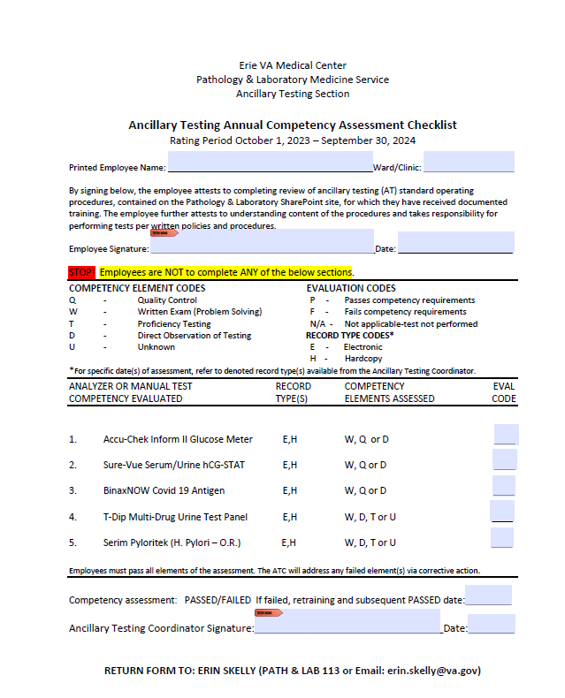
ANNUAL PYLORITEK COMPETENCY REQUIREMENTS
Review PyloriTek Annual Competency power point training in MTS.
Complete PyloriTek competency quiz in MTS (passing score >80%).
Direct observation by the Ancillary Testing Coordinator of unknown samples. A meeting will be scheduled for all operators in late April or early May.
After completing the above tasks, print, fill out the top portion of the Competency Assessment (MTS), and return to Ancillary Testing Coordinator before assigned due date.
NOTE: If you are competent in multiple point of care tests, only one signed copy of Competency Assessment needs to be turned in at the completion of all point of care annual requirements.

