Slide 1
NON-LABORATORY STAFF BLOOD CULTURE PHELBOTOMY
OSCAR G. JOHNSON
VA MEDICAL CENTER
May 2024

Slide 2
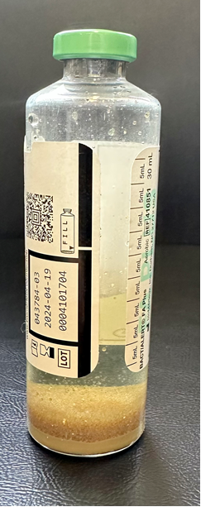
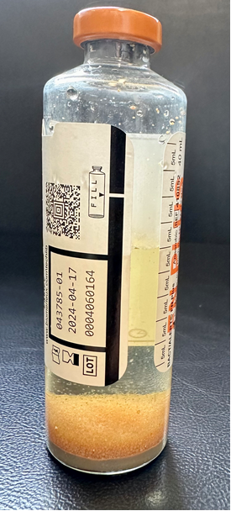
Volume of Blood Cultures
Concentration of organisms in most cases of bacteremia is low, especially if the patient is on antimicrobial therapy
One set of blood cultures is defined as one FN and one FA bottle
Draw blood into FA(aerobic)green top and FN (anaerobic) bottles
8-10 mL per tube recommended (16-20 mL/set cultures)
Creates blood-to-medium ratios of 1:5 to 1:10
Underfill consequences (<6.5 mL):
Pathogen may not be present
Overfill consequences (>10 mL):
Insufficient space for nutrients
and chemicals to support
pathogen growth
FA (aerobic)
FN (anaerobic)

Slide 3
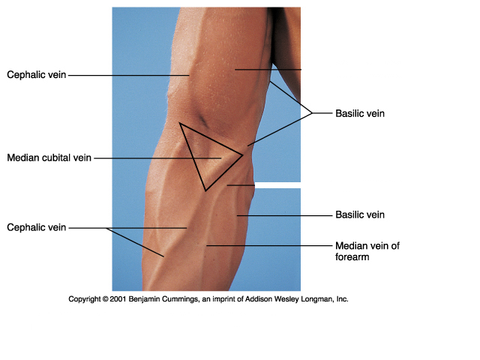
Blood Culture Phlebotomy Preparation
Cleanse hands and don appropriate PPE
2 forms of patient identification
Choose phlebotomy site(s)
Tourniquet applied to select site, released once determined
NEVER LEAVE THE TOURNIQUET ON FOR LONGER THAN 1 MINUTE
Preferred veinipuncture sites
Assemble Kurin device
Cleanse rubber
tops of FA/FN bottles
with Chloraprep One-Step
Applicator (or Iodine is
acceptable)

Slide 4
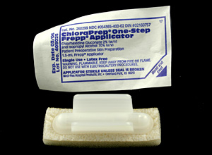
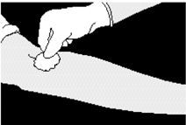
Cleansing the Site
ChloraPrep One-Step Frepp Applicator
2% chlorhexidine gluconate, 70% isopropyl alcohol
Sterilizes area up to 2.5 in. x 2.5 in.
Latex free
Discard after single use

Slide 5
Cleansing the Site (cont.)
Pinch wings to break ampule and release antiseptic
Do not touch sponge
Wet sponge by repeatedly pressing and releasing sponge against site until liquid visible on skin
Use repeated back-and-forth strokes of applicator for approx. 30 sec
Do not re-palpate site; touch above actual entry site to anchor vein
Allow site to air dry for approximately 1 min
Do not blot or wipe away
Critical! If needle enters vein before prep has dried, normal flora of skin may not have been killed, and can enter culture
Most common cause of contamination

Slide 6
Kurin Lock
Tips:
-Before performing draw, mark fill line on bottle to ensure proper fill volume
-Perform venipuncture using wings of butterfly, not needle safety mechanism, to avoid needle closing during collection
-Wait for blood to flow into channel of Kurin lock before attaching bottle

Slide 7
Direct Draws Into FA/FN Bottles
Place culture bottle into needle hub, pressing down to penetrate septa and obtain blood flow after flow has entered channel on Kurin lock device
Monitor blood flow closely to assure proper flow is obtained and to avoid backflow of bottle contents into tubing
Release tourniquet as soon as blood starts to flow
into bottle, or within 1 min

Slide 8
Blood Culture Venipuncture Overview
Choose site(s)
Assemble equipment
Sterilize tops of culture bottles and site(s)
ChloraPrep One-Step Frepp Applicator
One for bottles, one for site
Scrub site for 30 sec, allow 1 min for drying
Perform Veinipuncture
ALWAYS draw blood cultures first, following Order of Draw
Draw into FA/FN culture bottles
8-10 mL blood per bottle
Label Bottles
Gently invert tubes 5-10 times

Slide 9
Labeling Blood Cultures
Verify patient name and SSN
Initial and note date & time of draw
Indicate on each label the # of sets
Example: Culture set #1 drawn from Right Antecubital
by AB on
11/5/15
at 0800
Label should
look like:
ZZZTEST, PATIENT
AB
11/5/15
0800
#1-R.Ant
111223333
OCT 10, 1910

Slide 10
Options for Collecting Two Sets of Cultures
Option #1 – One set from each arm (no IV in place)
Option #2 – One set from arm without IV, one set
from arm with non-antibiotic IV
(Most likely scenario for UC)
Option #3 – One set from arm without IV, one set
from central or PICC line
*Taking two blood culture sets from the
SAME SITE at the SAME TIME
is not recommended*

