Slide 1
Oscar G. Johnson PLMS Laboratory
Personal Protective Equipment (PPE) & Standard Precautions Review

Slide 2
How to Protect Yourself
There are five main elements of protection against exposure to bloodborne pathogens:
1. Standard Precautions
2. Personal Protective Equipment (PPE)
3. Housekeeping
4. Engineering Controls
5. Work Practice Controls

Slide 3
Standard Precautions
Standard Precautions is an infection control process designed to reduce transmission of infectious agents between patients, hospital personnel and others. Standard precautions includes contact with blood, any body fluid, secretion/excretion, skin rash, mucous membrane, area of non-intact skin, contaminated item. The most common transmission routes that impact laboratory personnel are:
Parenteral exposures are those where blood or other infectious materials come in contact with: non-intact skin (skin with scratches, cuts, rashes, etc.); mucus membranes (such as the eyes, nose or mouth); cuts or puncture wounds (e.g. contaminated needlesticks)
Respiratory pathogens are those that can cause infection if inhaled. The risk of infection depends on the type and concentration of pathogen and on the health status of the exposed individual. Within the laboratory, aerosols are the primary hazard for respiratory transmission.
Contact transmission involves either direct or indirect contact and transfer of infectious agents. Indirect contact involves an intermediate object, such as contaminated surfaces or gloves. Proper use of gloves and keeping benchtops, instruments, computers, telephones and other surfaces clean can reduce the chance of infection due to contact transmission.

Slide 4
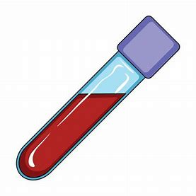
Body Fluids
Body Fluids that can cause infection:
Human Blood
Semen
Vaginal secretions
Body fluids (cerebrospinal, synovial, pleural, peritoneal, pericardial fluid)
Amniotic fluid
Unfixed tissue or organs other than intact skin from living or dead humans.
Cell or tissue cultures that contain HIV or HBV
Organ cultures, culture media, or similar solutions.

Slide 5
Ways of Exposure
Through mucous membranes, such as your eyes, nose and mouth. Often indirect transmission, such as touching a contaminated object or surface and transferring the infectious material to the mucous membranes.
Through a cut or sore on your skin.
An accidental injury by a sharp object contaminated with infectious materials. Sharps include needles, scalpels, broken glass or anything that can pierce a person’s skin.

Slide 6
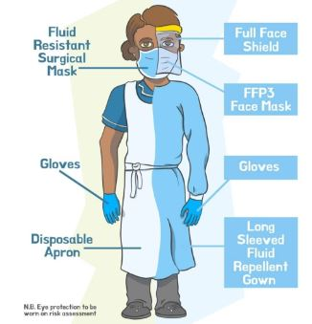
What is PPE?
PPE ( Personal Protective Equipment) –
Equipment that protects you from contact with potentially infectious materials may include gloves, masks, gowns, aprons, lab coats (i.e. blue coats specially designated to be worn as protective body clothing), face shields, goggles. Personal protective equipment must not allow potentially infectious materials to contact your street clothes, skin or mucous membranes. PPE is applied before you perform the tasks that require it, and never worn in clean areas such as hallways, elevators, lab break room or lab bathroom.
PPE must be appropriate for the task and shall be worn according to the Laboratory Task Assessment. The VISN Risk Task Assessment is a guide that outlines the PPE and Engineering Controls for various lab section areas. Laboratory Task Assessment is posted in every section of the laboratory

Slide 7
PPE - Gloves
You must wear gloves when you anticipate hand contact with blood, potentially infectious materials, mucous membranes, or non intact skin or hazardous chemicals
Mandatory when performing phlebotomy procedures.
Mandatory to change gloves in between each patient. Wash hands between each patient
Gloves must be removed outside of technical areas and before entering “clean” areas
Disposable gloves are for single use only, do not wash or disinfect gloves for reuse. Gloves shall be disposed of into regular trash unless visible contaminated with blood or other body fluids.
An induvial experiencing dermatitis problems should see the supervisor who will then be referred to the Employee Health Physician.

Slide 8
PPE- Lab Coat
Must be buttoned and worn at all times when working in a technical area
Must be fluid resistant, cover your arms and have secure cuffs
Only to be worn in the technical/analytical areas (are not to be worn outside of the lab i.e. break room, administrative offices, rest rooms.)
Blue disposable lab coats are to be changed frequently or immediately if contaminated.
Removal of Laboratory Coat for Reuse
Remove gloves first using proper removal technique as previously described.
Unbutton coat, remove and hang in appropriate area.
Removal of Laboratory Coat for Disposal
Remove gloves first using proper removal technique as previously described.
Unbutton coat and remove. Check all pockets, turn garment inside out and roll.
Place rolled coat into the regular waste disposal container.

Slide 9
PPE - Attire
Cover lower extremities (long pants, no shorts or short skirts)
Cover feet- shoes should cover the entire foot. Shoes with closed toes/back and non-slip shoes should be worn
Hair-must be secured back and off the shoulders in such a manner as to prevent it from coming into contact with contaminated materials or surfaces and moving instrumentation.

Slide 10
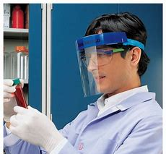
Benchtop Shields
Safety Goggles
Full Face Shields
Safety Goggles must be worn when working with chemicals
Full-face shields must be worn in addition to eye protection when conducting a procedure that may result in a violent reaction.
Benchtop shields and face shields are available if the task being performed requires them per the RTA grid.
When performing gram stains

Slide 11
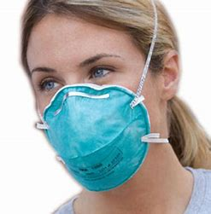
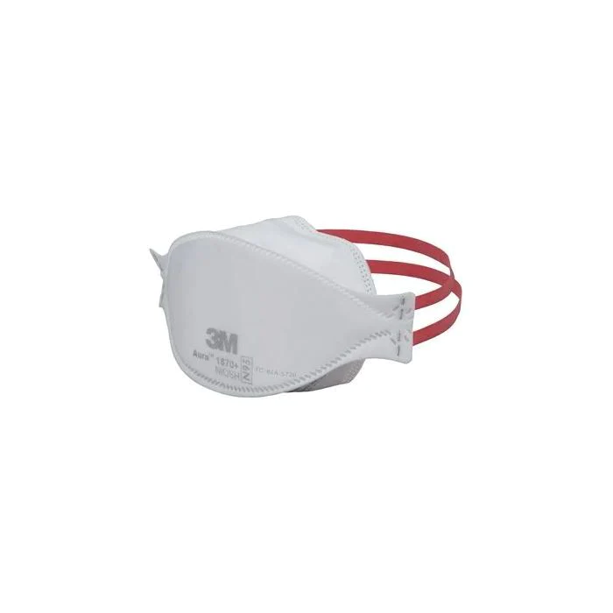
PPE – N95 Respirator
N95 Respirator used on patient floors when entering Airborne Precaution rooms. Available when the procedure requires it and is found in cabinet outside of patient room.

Slide 12
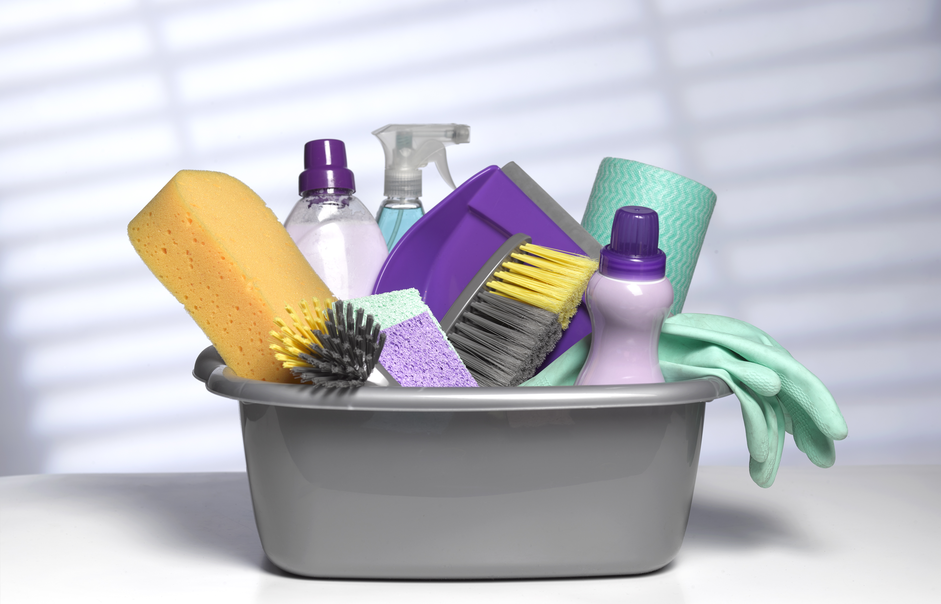
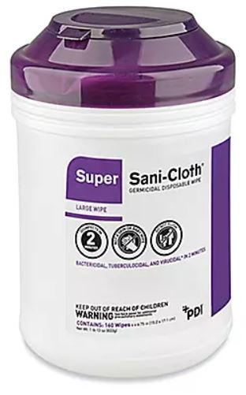
The work site shall be maintained in a clean and sanitary condition: to minimize exposure to blood and other potentially infectious material. Work surfaces shall be decontaminated at the beginning and the end of each tour of duty, or immediately, or as soon as feasible, upon visible contamination or after any spillage. Cleaning and decontaminating all infected surfaces: CaviWipes are located throughout the laboratory and should be used at the end of your tour or when needed. Disposing of Blood and body fluids properly: Regulated waste includes liquid or semiliquid blood and other potentially infectious material along with other contaminated items. Such waste is placed in biohazard or red-colored containers or plastic bags.
Housekeeping

Slide 13
Technical areas are considered “contaminated”. All surfaces may be touched with gloved hands. All telephones, internal doorknobs and handles, computer terminals and other surfaces would be considered contaminated. Persons entering these areas with ungloved hands to use telephones, computer, or other equipment would be responsible for gloving. Before leaving area, individual would be responsible for washing their hands. Contaminated phones and keyboards have the “glove’ sticker attached. NOTE: There may be a phone or keyboard viewed as “clean” in an area where specimens are not handled and will have a “no glove” label attached.
Technical Areas

Slide 14
Handwashing
Handwashing is the single most important procedure for preventing exposure to and transmission of infectious agents.
Hands should be washed frequently throughout the day:
Whenever there is visible contamination with blood or body fluids,
After completion of work,
After glove removal and between glove changes,
Before leaving the laboratory,
Before and after eating, drinking, smoking or applying cosmetics, and using the lavatory,
Before and after all other activities that entail hand contact with mucous membranes, eyes, or breaks in skin.

Slide 15
Handwashing Procedure
Soap and water technique
1. This method is always used if hands are visibly soiled
2. Wet hands wrists thoroughly under running water.
3. Apply germicidal soap and rub hands vigorously for at least 15 seconds, including between the fingers and around and over the fingernails.
4. Rinse hands thoroughly under running water in a downward flow from wrist to fingertips.
5. Dry hands with a paper towel. Use the paper towel to turn off the faucet handles.
Waterless handwashing product
1. When decontaminating hands with an alcohol based hand rub, apply product to palm of one hand and rub hands together, covering all surfaces of hands and fingers, until hands are dry. Hand sanitizers (gel, foam) are available throughout the lab (dispensers available at each phlebotomy station) .
Note: Do not use waterless handwashing procedure if exposure to Bacilllus or Clostridium is suspected or proven. The physical action of washing and rinsing hands under such circumstances is recommended because the agents in waterless handwashing products have poor activity against spores.

Slide 16
Engineering Controls
Engineering Controls - are items that reduce employee exposure either by eliminating or isolating the hazard. Examples of engineering controls include:
Hospital ventilation, air conditioning
Fume hoods, biological safety cabinets
Sharps disposal containers
Self-sheathing needles
Forceps
Hand washing facilities
Eye wash stations

Slide 17
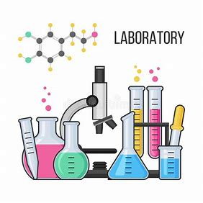
Proper handling of sharps - Manual manipulation of needles is generally prohibited - do not recap, bend, break, or remove from syringes. Needles and other sharps must be discarded immediately into approved puncture-resistant containers. It's important not to overfill sharps containers - overfilled containers lead to needlestick incidents. Containers must be closed and emptied when fill line reached. Proper handling of specimens- Use standard precautions with all specimens. Proper housekeeping - Disinfect work surfaces with a suitable disinfectant once per shift and immediately when visibly soiled. Absorbent bench covers should be changed daily or when visibly contaminated. Proper laboratory etiquette - No eating, drinking, smoking, applying cosmetics or lip balm or manipulating contact lenses. Avoid touching face (includes no pencils or pens in mouth). Restrain long hair (longer than shoulder length) and loose, flowing clothing or jewelry.
Work Practice Controls

