Slide 1
Provider performed microscopy procedure
WET MOUNT
Saline Wet Mount

Slide 2
Purpose
For direct microscopic examination of all patient material for the presence of fungal element, WBC, Clue Cells, and Trichomonas.

Slide 3
materials
Specimen Type
Saline
Glass slides
Coverslips
Gloves
Pipette
Microscope
Vaginal Discharge
Urethral Discharge
Penile Discharge
Urethral-mucosa scrapings
First voided urine
Note: Specimens should be tested immediately upon collection

Slide 4
Procedure
Place material on clean slide
Add 1 or 2 drops of saline with pipette. Mix with pipette tip and place cover slip.
Examine the specimen with low power objective (10x) and low light.
Examine the entire cover slip for motile flagellates and clue cells. Suspicious objects can be examined with the high power objective (40x).

Slide 5
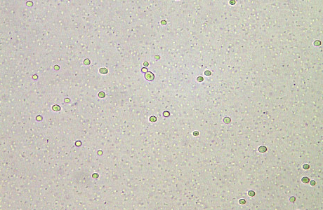
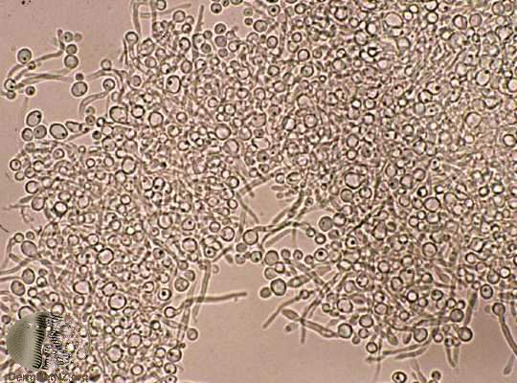
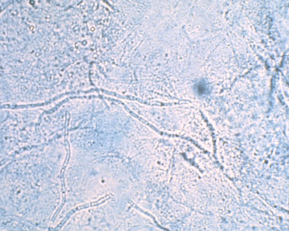
fungal elements
Budding Yeast
Hyphae
Hyphae

Slide 6
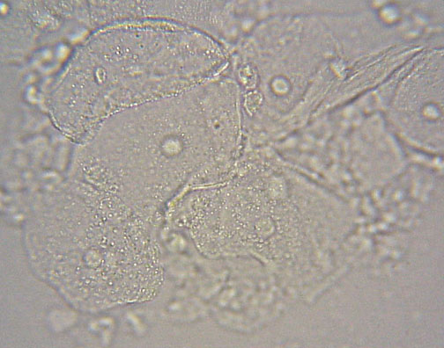
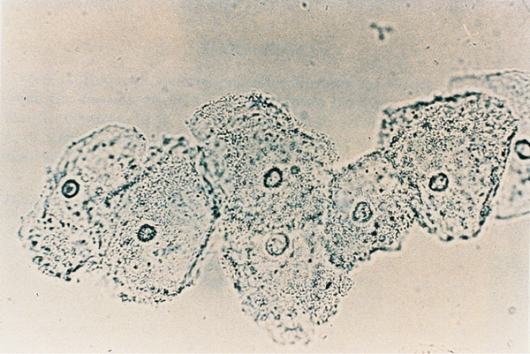
Clue Cells
Budding Yeast

Slide 7
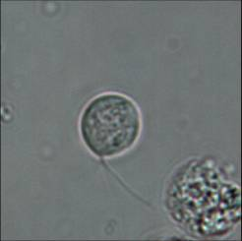
Trichomonas
Click Link: Trichomonas in Action
Budding Yeast

