Slide 1
Provider performed microscopy procedure
Semen Qualitative

Slide 2
Purpose
To evaluate semen samples for effective vasectomy or investigate infertility by the presence and/or motility of sperm in direct microscopic procedures.

Slide 3
specimen
PATIENT PREPARATION: The patient, following a 48-72 hour period of abstinence from sexual activity, collect freshly ejaculated semen.
Specimens are to be collected in clean container free of preservatives or additives
Evaluate specimen as soon as possible after ejaculation.
Store at room temperature. Specimens greater than 2 hours old should not be evaluated.
materials
Microscope with 40x objective
Sterile container
Coverslips
Sterile glass slides

Slide 4
Procedure
Samples collected outside the test site should be warmed to 37⁰C for 5-10 minutes before examination.
Using a transfer pipette, place on drop of well mixed seminal fluid on clean glass slide and cover with a cover slip.
Examine the slide immediately using the high dry 40x objective. Record the presence or absence of sperm.

Slide 5
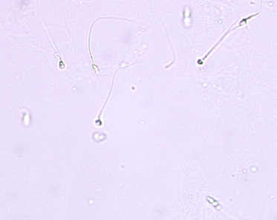
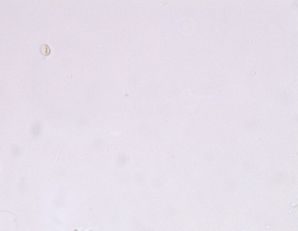
Examples of sperm-present vs. SPERM-absent
SPERM-PRESENT
SPERM-ABSENT

Slide 6
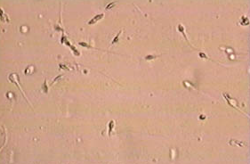
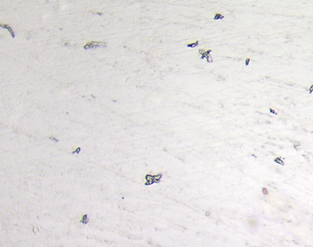
Examples of sperm-present vs. SPERM-absent
SPERM-PRESENT
SPERM-ABSENT

