Slide 1
Provider performed microscopy procedure
KOH
10% Potassium Hydroxide Preparation

Slide 2
Purpose
For direct microscopic examination of all patient material for the presence of fungal element.

Slide 3
materials
10% KOH
Non-frosted glass slides
Coverslips
Gloves
Microscope with 10x and 40x objective

Slide 4
Procedure
Place material on clean slide and add a drop of 10% KOH and cover with coverslip.
Examine slide using 10X and 40X objective.
Examine slide for presence or absence of fungal element.

Slide 5
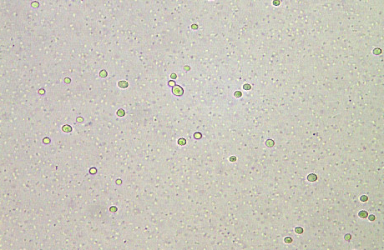
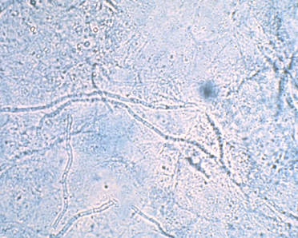
Examples of fungal element-present
Budding Yeast
FUNGAL ELEMENT-PRESENT

Slide 6
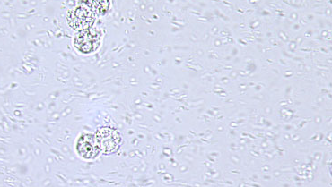
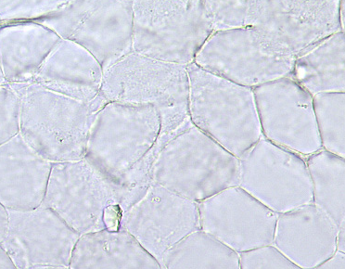
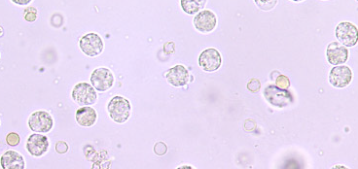
Examples of fungal element-Absent
Budding Yeast
FUNGAL ELEMENT-ABSENT

