Slide 1
Provider performed microscopy procedure
FERN TEST

Slide 2
Purpose
Detection of fern-type amniotic fluid crystallization as an aid in detection of ruptured amniotic membranes in pregnant women.
Principle
Amniotic fluid crystallizes in a fern-like pattern when left to dry on a glass slide. The typical pattern is readily observed microscopically. In contrast to cervical mucus, which also crystallizes in a fern-like pattern at times when estrogen is elevated, the “ferning” of amniotic fluid involves the entire smear, while “ferning” of cervical mucus occurs in a linear fashion.

Slide 3
specimen
Direct smear made from vaginal fluid, allow to dry for at least 10 minutes
Stability: Fresh specimen should be used
Obtain another sample if smear cannot be interpreted
Equipment
Brightfield microscope
Vaginal speculum
Sterile cotton swab
Sterile gloves
Glass slide

Slide 4
Procedure
1. Obtain sample using sterile cotton swab.
2. Roll swab on clean glass slide, creating a thin film. Set aside to air dry. (Air dry for a minimum of 10 minutes).
3. Examine air-dried smear under microscope with a coverslip using low power magnification (10x).
4. Dried amniotic fluid produces a microscopically visible crystallization in a “fern” pattern. Dried normal vaginal fluid does not produce a “fern” pattern.

Slide 5
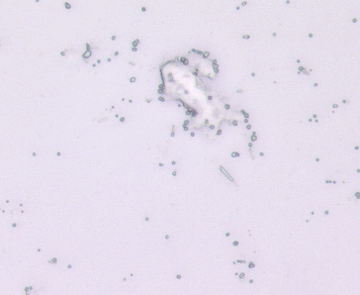
Examples of Ferning-PRESENT vs. Ferning-ABsent
FERNING-PRESENT
FERNING-ABSENT

Slide 6
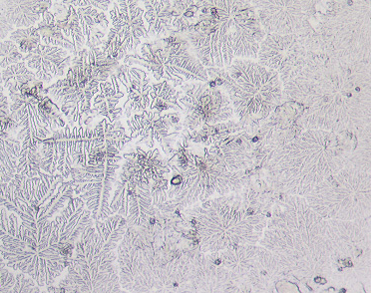
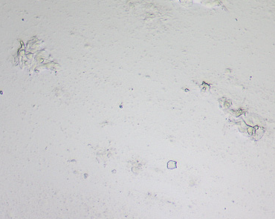
Examples of Ferning-PRESENT vs. Ferning-ABsent
FERNING-PRESENT
FERNING-ABSENT

