Slide 1
Provider performed microscopy procedure
Pinworm

Slide 2
Purpose
Enterobiasis is best diagnosed by microscopic examination of specimens taken from the perianal region to identify Enterobius Vermicularis eggs or adult female worms if present.

Slide 3
specimen
Specimens must be collected at night or first thing in the morning before a bowl movement or bath.
Female pinworms deposit eggs sporadically so specimens must be collected on at least four consecutive days to rule out false negative result.
materials
SWUBE Paddle (TM of Becton-Dickinson and Co.)
Clean sterile glass slide
Microscope with low power objective
Sterile gloves

Slide 4
Procedure
Hold paddle by the cap and remove from tube.
Press sticky surface to the right and left perianal folds.
Replace the paddle in the tube until microscopic examination.
Place the paddle on a slide.
Using the microscope, examine the entire paddle for eggs or female adults under the lower power objective.

Slide 5
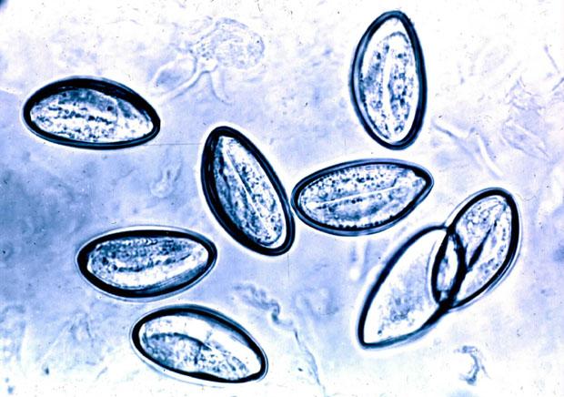
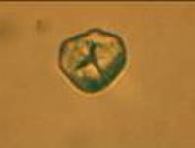
Examples of Pinworm-Positive vs. pinworm-negative
PINWORM-POSITIVE
PINWORM-NEGATIVE

Slide 6
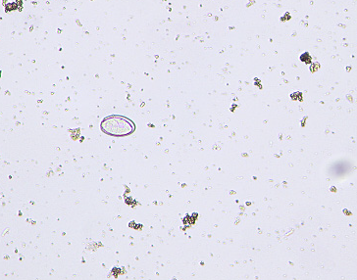
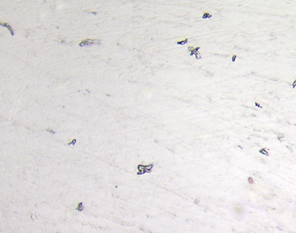
Examples of Pinworm-Positive vs. pinworm-negative
PINWORM-POSITIVE
PINWORM-NEGATIVE

