Slide 1
Provider performed microscopy procedure
Urine Sediment

Slide 2
Purpose
The urine microscopic examination is a method of identifying and quantifying cells, bacteria, and other materials in the sediment of centrifuged urine. This allows the practitioner to rule out or diagnosis urinary tract infection and aids in the diagnosis of urinary tract or renal disease.

Slide 3
materials
Clean catch urine
Sterile urine container
Centrifuge
Graduated, conical centrifuge tubes
Plastic pipettes
Microscopic slides
Cover slip
Microscope with 10x and 40x magnification

Slide 4
specimen
The urine specimen is collected by the patient using the clean catch method.
Specimen should be analyzed immediately after collection.

Slide 5
Procedure
Pour urine sample in a plastic conical tube
Place conical tube in centrifuge and place a second tube with equal amount of water directly opposite tube with urine.
Centrifuge urine specimen according to manufacture’s directions at a RCF (relative centrifugal force) of 400 x g 5-10 minutes. To calculate RPM (rotations per minute) for a specific centrifuge, use the following formula: RCF=1.18* 10⁻⁵ *r *N² r=the radius in cm (from the center of the spindle to the bottom of the tube) N=rotation per minute

Slide 6
Procedure
4. After centrifuge has stopped, remove the tube and pour off the supernatant, leaving any sediment in the bottom of the tube.
5. Using a plastic pipette, mix the remaining liquid and sediment and remove a few drops of the mixture. If there is no obvious sediment present, remove a few drops or urine from the bottom of the tube.
6. Place one drop of the sediment solution on a glass slide and cover with a cover slip.
7. Using the microscope, examine the sediment using phase contrast or bright light under low (10x) and high (40x) power, scanning several fields to obtain an average number of formed elements.

Slide 7
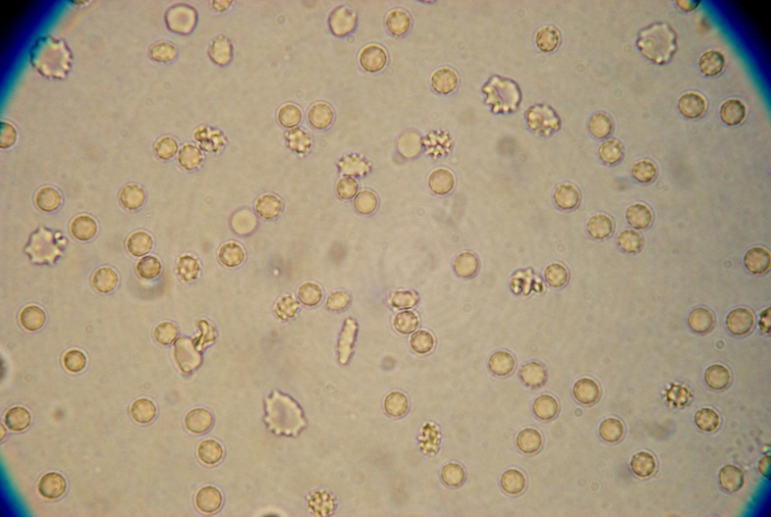
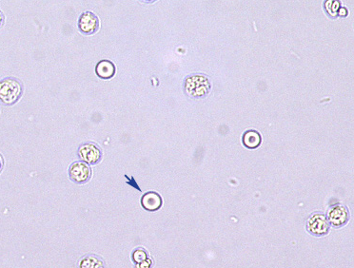
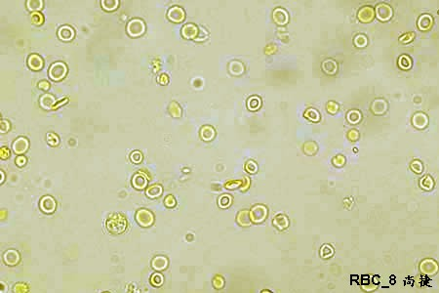
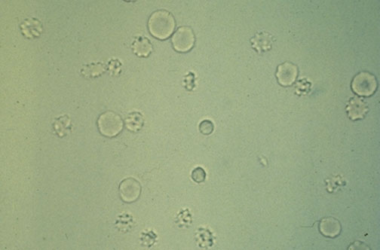
Examples of Urine Sediments- Red blood cells (RBC)
Budding Yeast

Slide 8
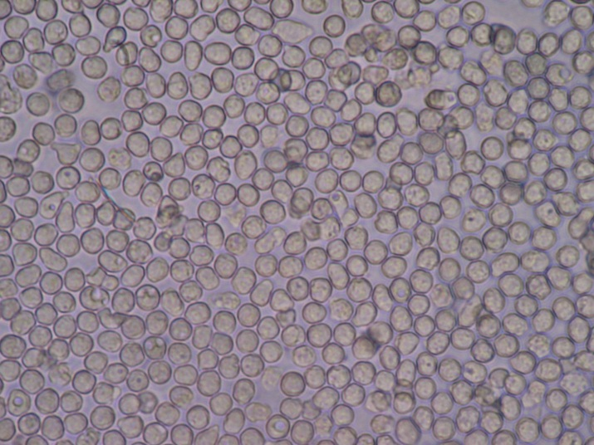
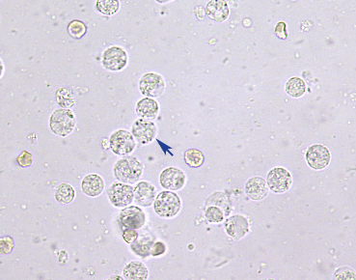
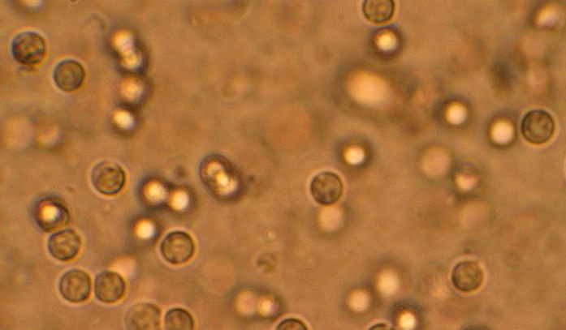
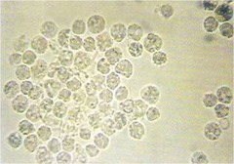
Examples of Urine Sediments- White Blood Cells-WBC
Budding Yeast

Slide 9
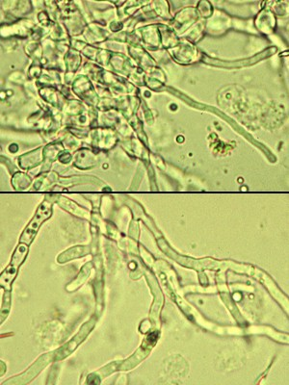
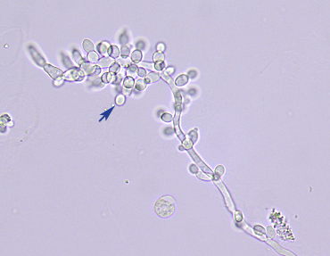
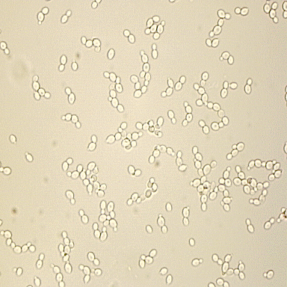
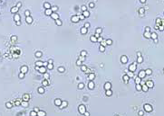
Examples of Urine Sediments- Fungal elements
Budding Yeast

Slide 10
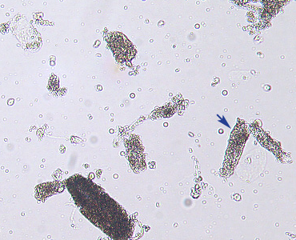
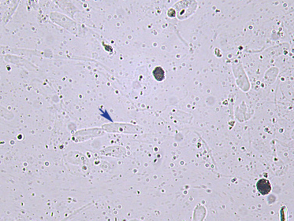
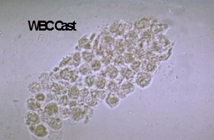
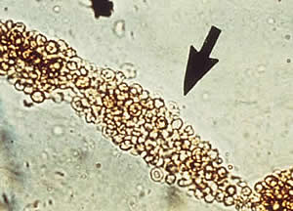
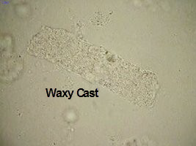
Examples of Urine Sediments- Urine CAst
Hyaline Cast
Budding Yeast
Granular Cast
RBC cast

Slide 11
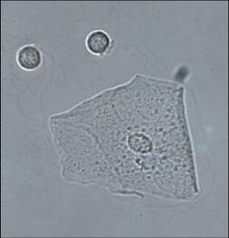
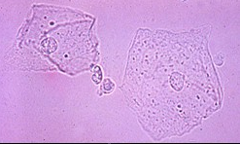
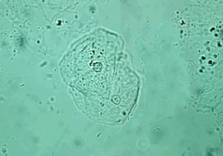
Examples of Urine Sediments- squamous epithelial cells
Hyaline Cast
Budding Yeast
Granular Cast

Slide 12
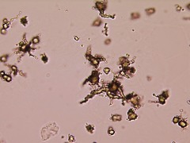
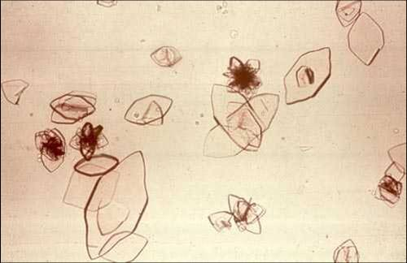
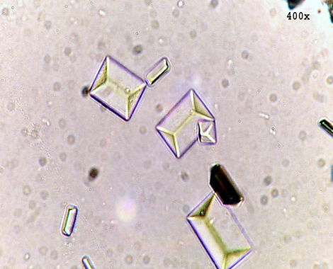
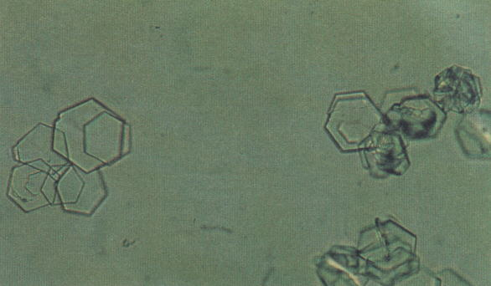
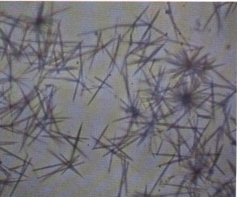
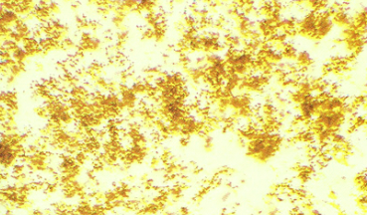
Examples of Urine Sediments- Crystals
Hyaline Cast
Budding Yeast
Ammonium Biurate
Uric Acid
Triple Phosphate
Granular Cast
Cysteine
Tyrosine
Amorphous Crystals
Other Crystals: http://uoitclinicalbiochemistry.weebly.com/urinalysis-crystals.html

Slide 13
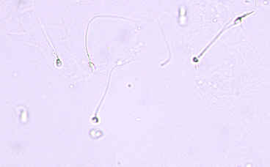
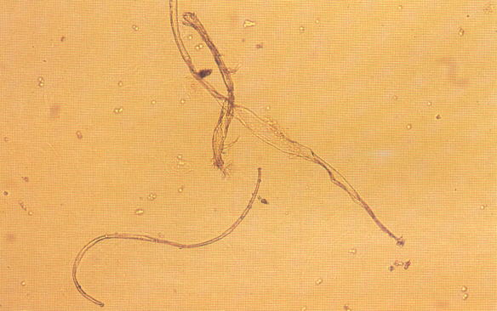
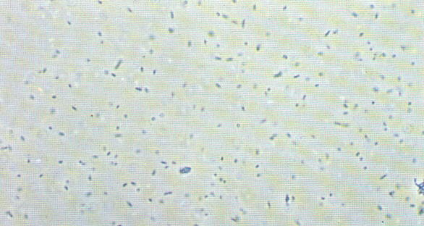
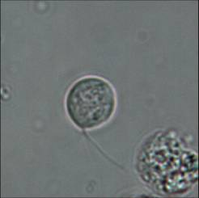
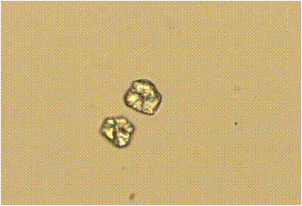
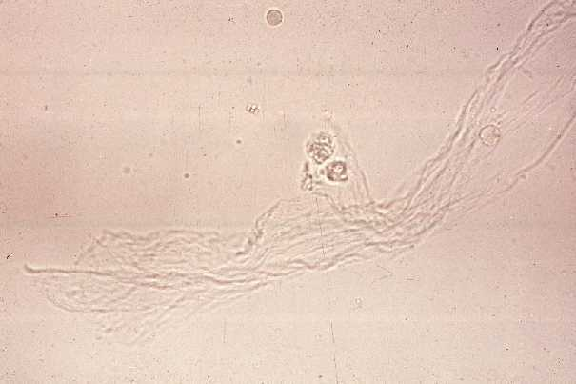
Examples of Urine Sediments- Other Urine elements
Hyaline Cast
Budding Yeast
Granular Cast
Spermatozoa
Fiber
Bacteria
Trichomonas
Starch
Mucus

