Slide 1
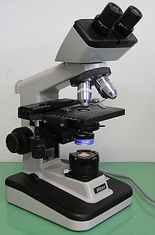
LABORATORY Performed Microscopy Elements of Wet Mounts

Slide 2
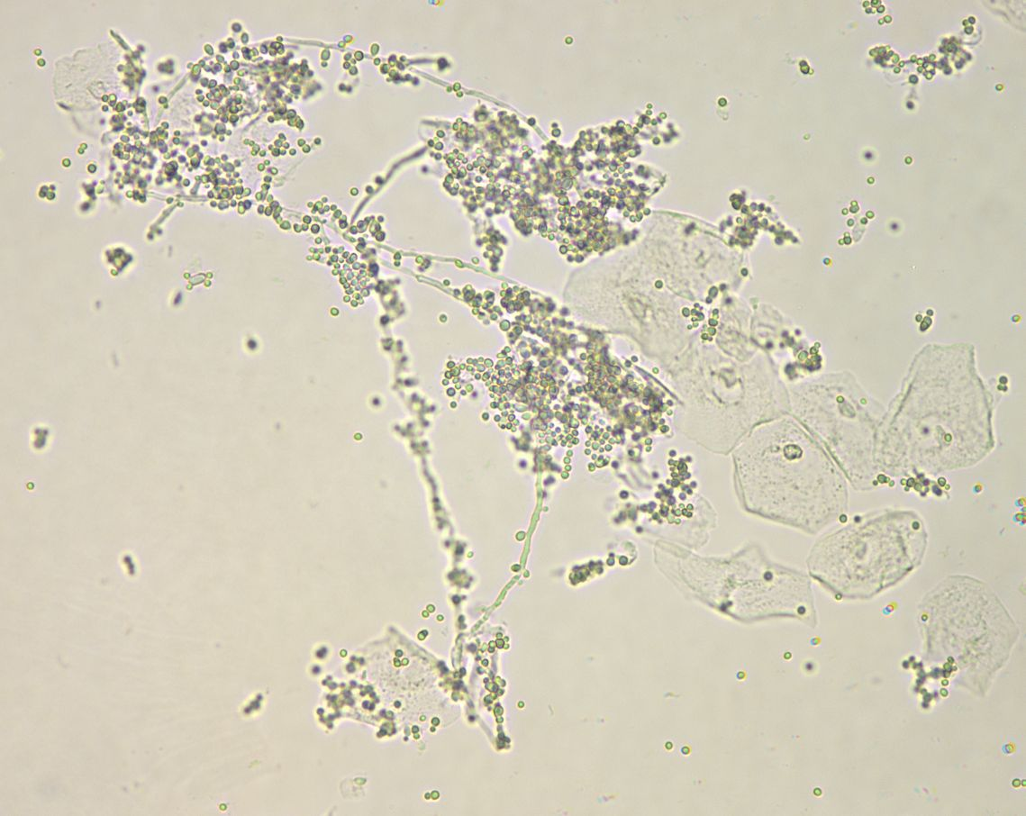
Low Power
Yeast
Notes:
Yeast-see next slide on high power.

Slide 3
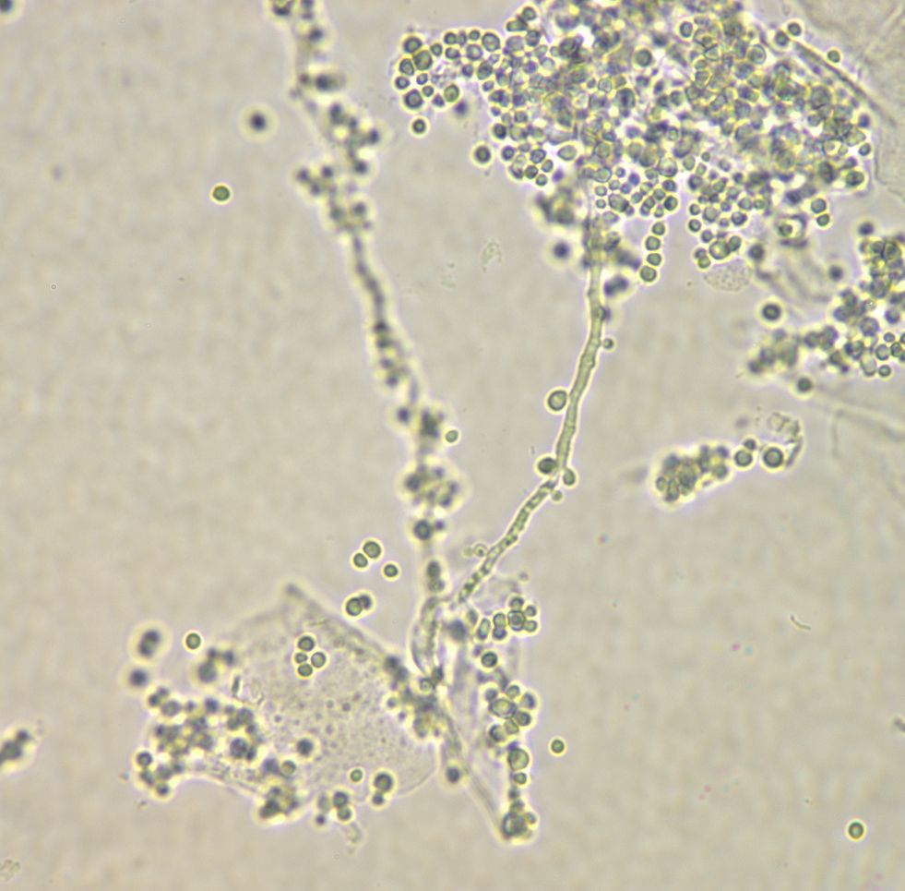
High Power
Pseudohyphae
Yeast
Yeast
Notes:
Yeast – the yeast seen here are somewhat smaller than RBC’s. Also, they do not show the birefringence of RBC’s and their shape is somewhat less uniform. To view yeast more clearly, add KOH to the wet prep slide to dissolve proteinaceous materials. This clears the “background” so that fungal elements can be more clearly seen. More discussion of pseudohyphae follows on the next slide.

Slide 4
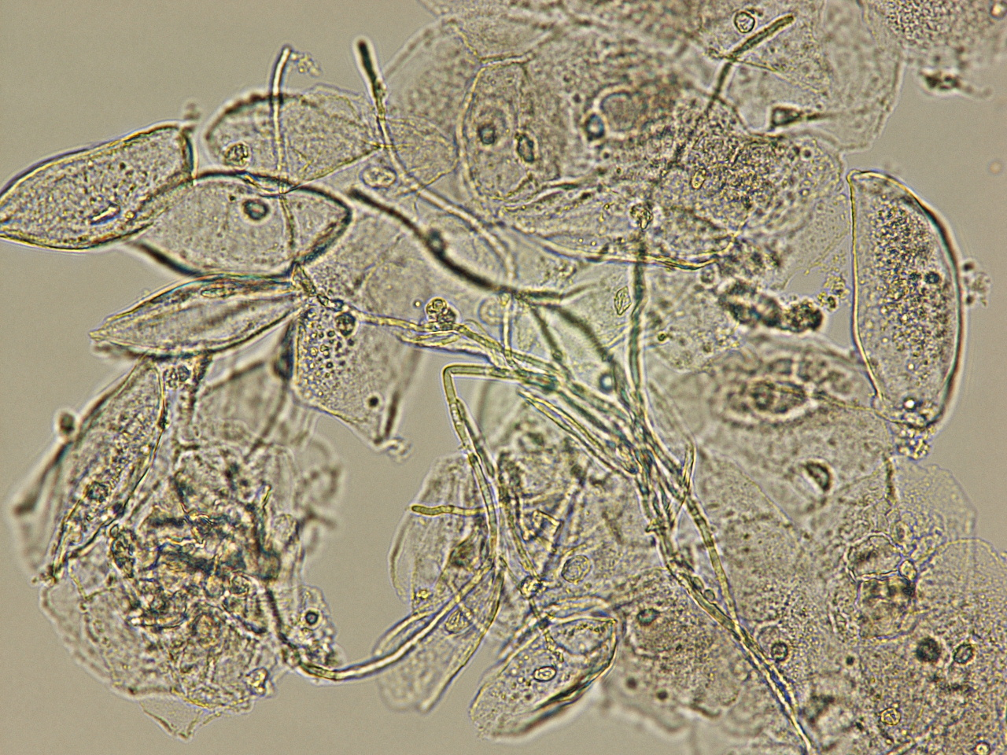
High Power
Pseudohyphae
Notes:
Pseudohyphae - They are called pseudohyphae because they lack true branching as seen with mold-like fungi. The side walls are parallel to each other which is an important characteristic that helps separate pseudohyphae from an artifact whose side walls vary in width.

Slide 5
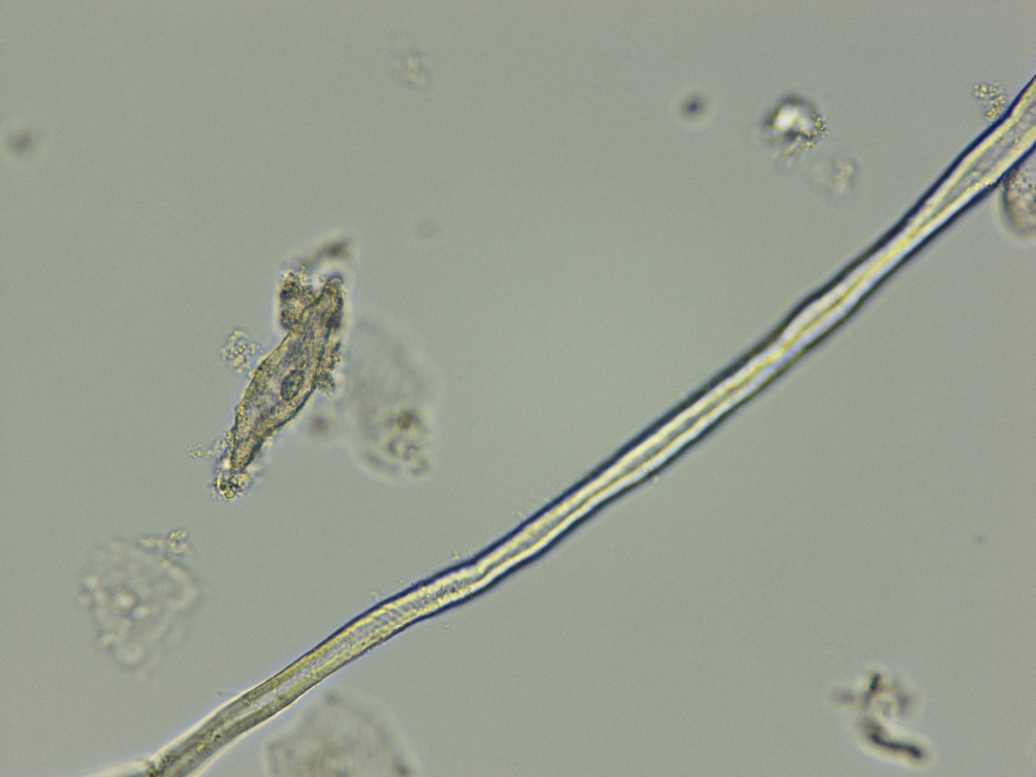
Artifact
Notes:
Artifact - This should not be confused with pseudohyphae. Fibers are generally larger in size than pseudohyphae and fibers show variable widths along the fiber. They also tend to be birefringent, i.e. they change color when focusing up and down on the object. Colors are often gold or blue and result from the microscope light being refracted by the fiber.

Slide 6
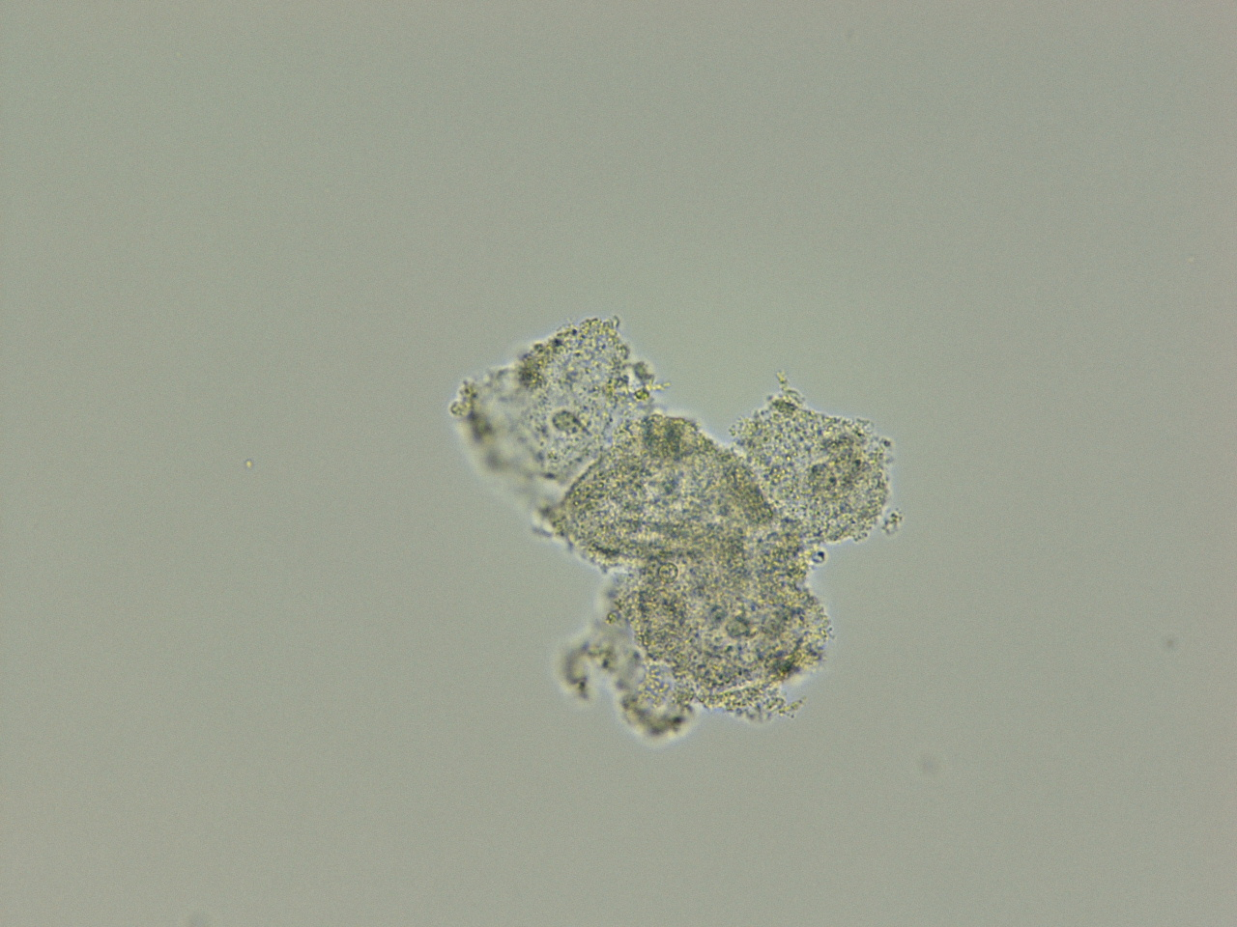
High Power
Clue Cell
Notes:
Clue Cell - Notice that the cell borders are “fuzzy”. (The cells are occluded with bacteria.) The traditional definition of a clue cell is that the bacterial overgrowth is so thick that all cell detail (such as the cell nucleus and the cellular edge) is totally obscured. However, it is sometimes possible to detect the nucleus in a clue cell by using the fine focus knob to focus throughout the cell. But the cell borders should always be completely obscured.

Slide 7
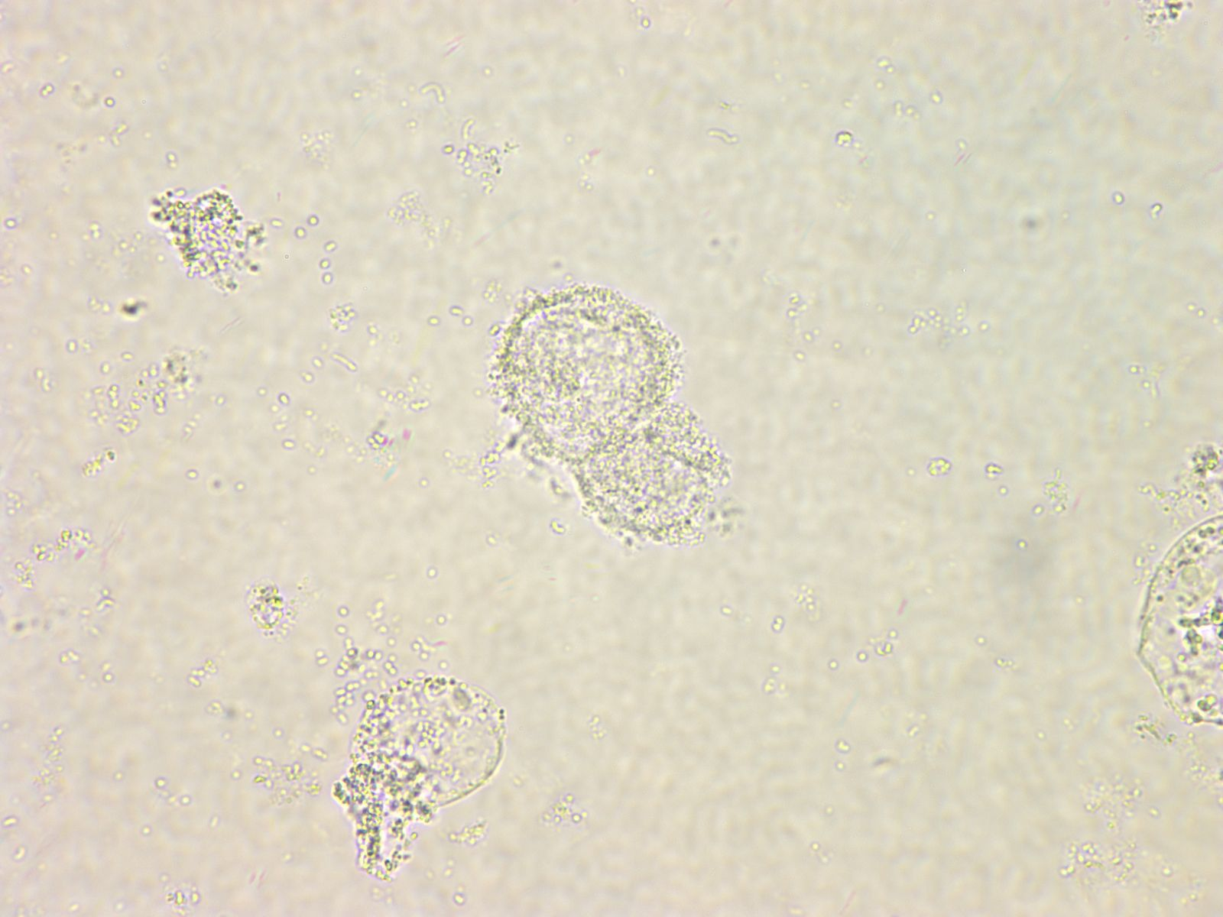
Low Power
Clue Cell
Not a Clue Cell
Notes:
Clue Cell - note the cell is completely occluded with bacteria, not even the nucleus can be seen. And all cell borders are “fuzzy”. Note the cell beneath could not be considered a clue cell since the right side of the cell border can be clearly seen.

Slide 8
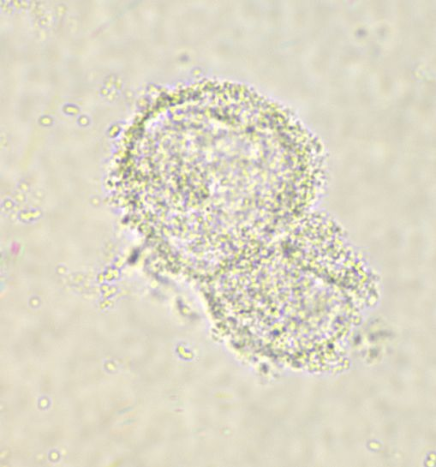
High Power
Clue Cell
Notes:
Clue Cell - the Clue Cell from the previous slide on high power magnification. Not even the nucleus can be seen.

Slide 9
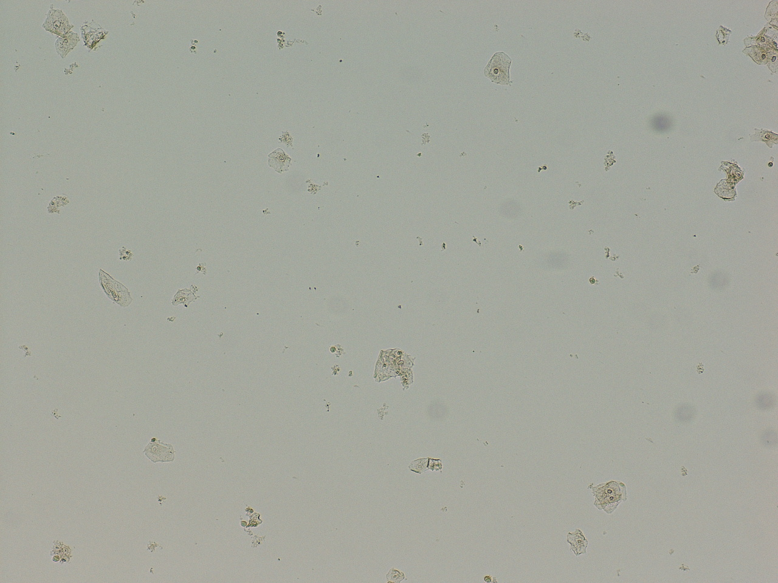
Low Power
Squamous epithelial cells
Notes:
Squamous Epithelial Cells – squamous epithelial cells measure 25-75 microns and demonstrate a polygonal “flagstone” appearance. They are almost always present in vaginal fluid.

Slide 10
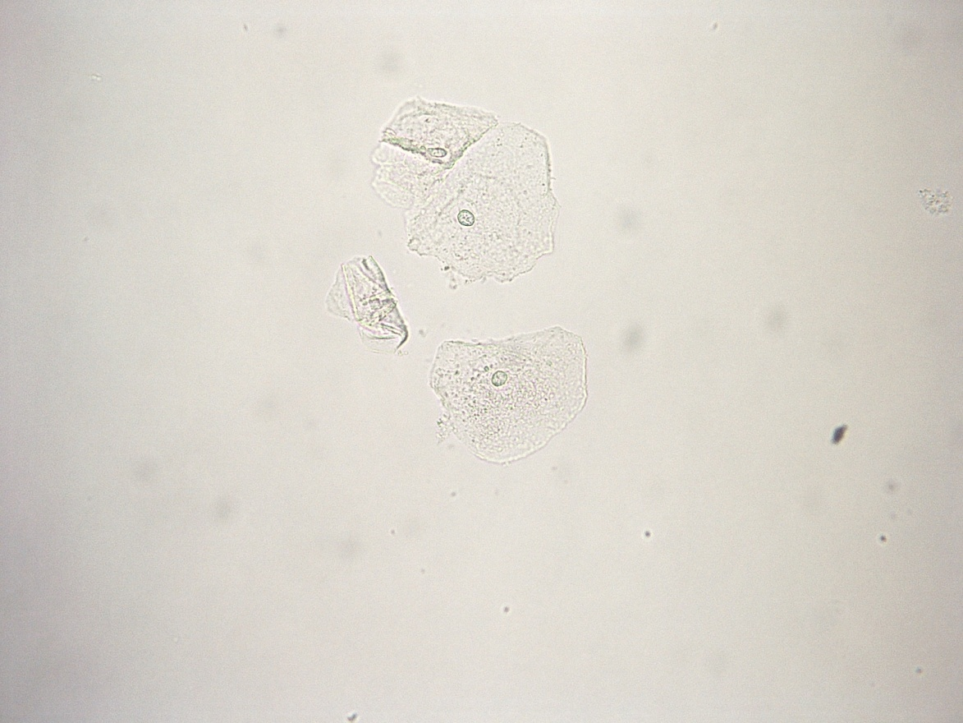
High Power
Squamous Epithelial Cells
Notes:
The squamous epithelial cells seen on the previous slide, magnified at high power. Squamous epithelial cells are large (30 to 50 μm) flat nucleated cells derived from the lining of the female urethra, external skin or vaginal mucosa. In wet preparations, squamous epithelial cells are about five to seven times larger than a red blood cell and are larger than most transitional epithelial cells. The cytoplasm is abundant and agranular and there is a single small, condensed, round, polygonal or oval central nucleus about the size of a small lymphocyte.

Slide 11
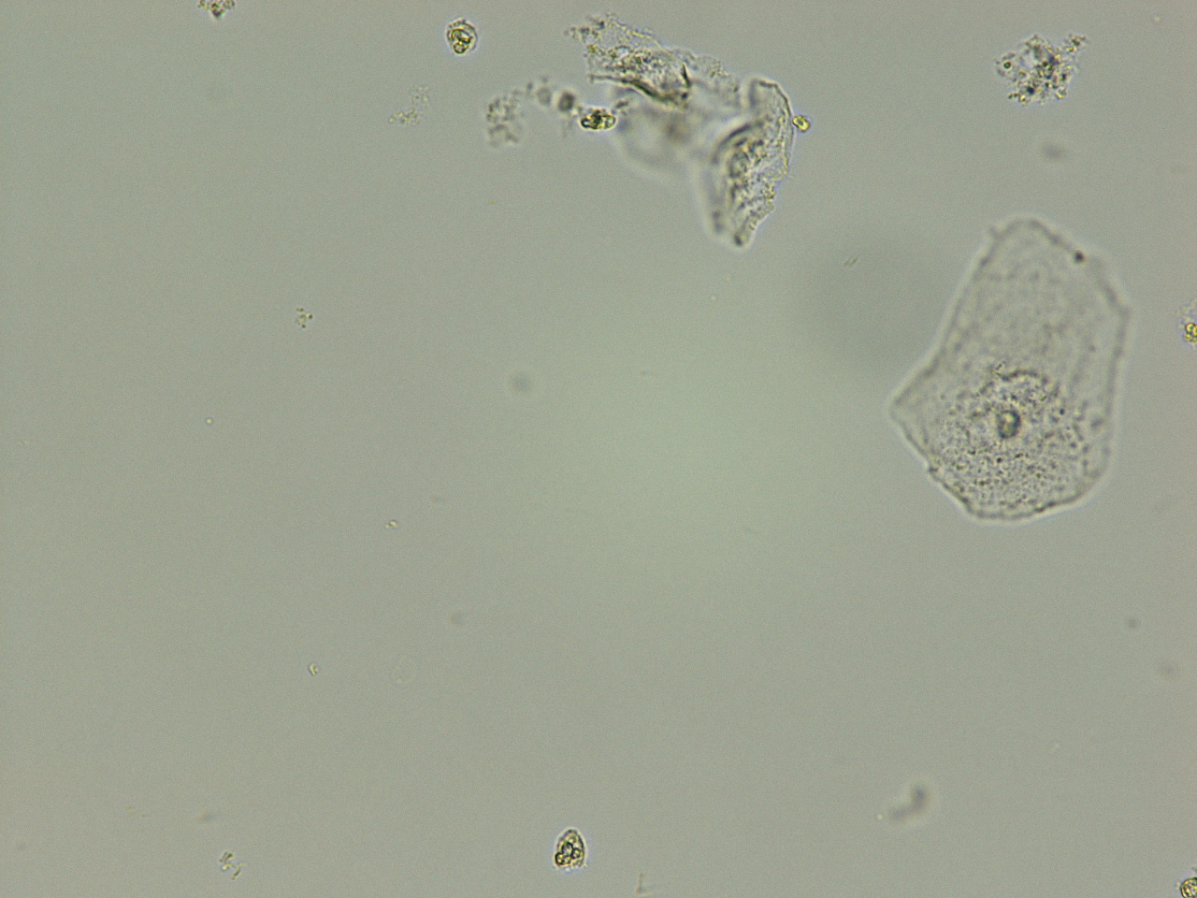
High Power
White Blood Cells
Notes:
White Blood Cells - cells are larger than Red Blood Cells and are approximately the same size as the nucleus of a
squamous epithelial cell. You can easily compare the relative size of the white blood cell with the size of the squamous epithelial cell nucleus by screening on low power. Under high power, the nuclear detail of the WBC becomes apparent. The WBC is characterized by a multilobed nucleus. The three lobes may not always be present (at least in the same focal field), but you should be able to see them by using the fine focus to focus up and down.

Slide 12
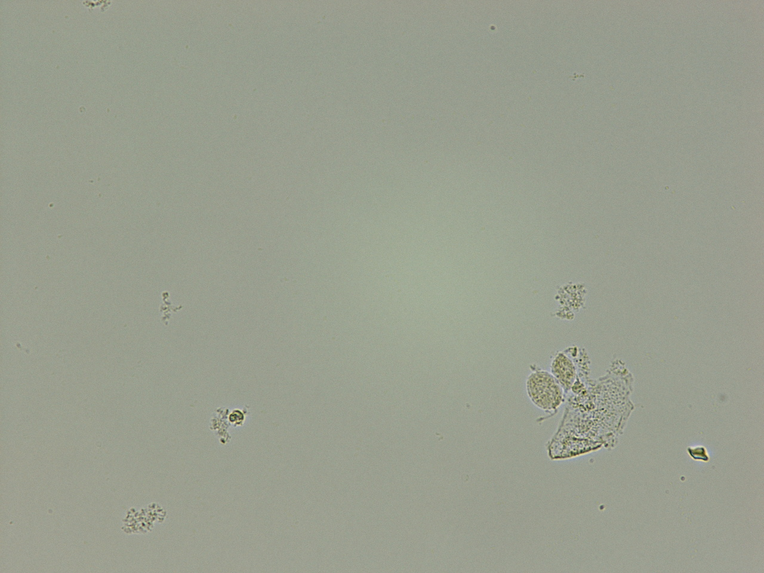
High Power
Trichomonas
Notes:
Trichomonas – Note the oval shape and clearly visible flagella anterior flagella. When viewing patient slides, always look for “jerky” motility as well. When compared to sperm, trichomonas has a much larger head and will have an axostyle protruding from the posterior end in addition to the anterior flagella (which are much shorter than the single tail of a sperm).

Slide 13
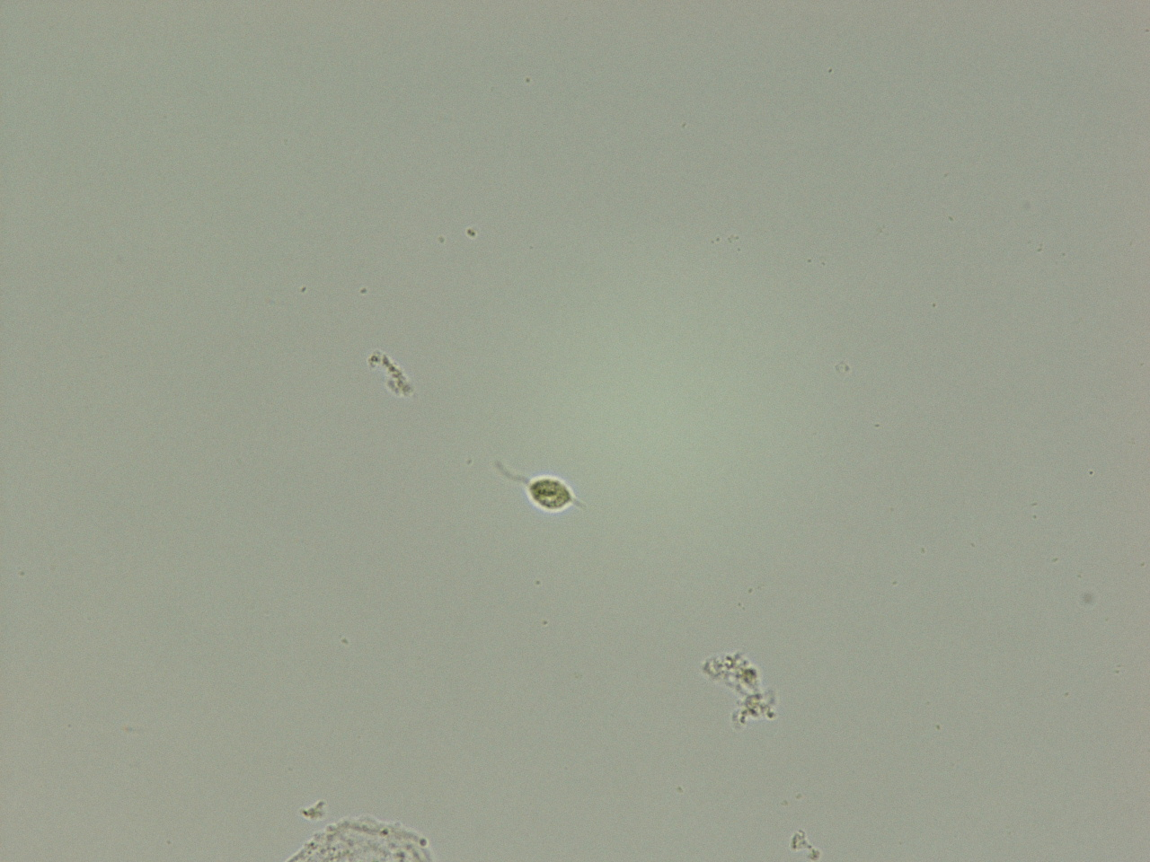
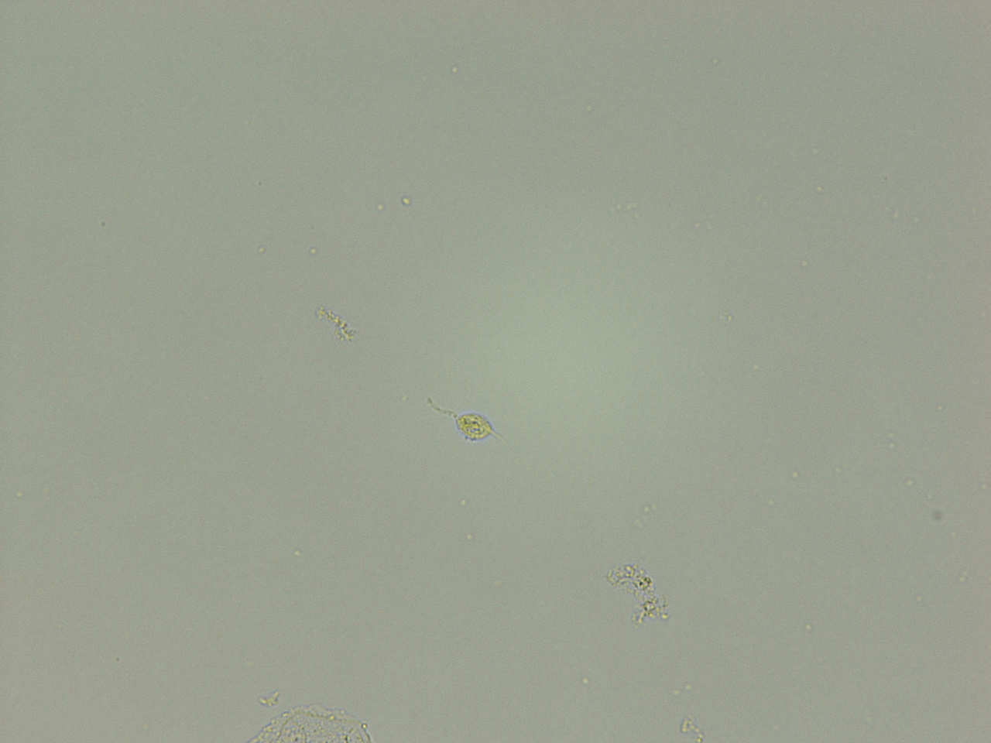
High Power
Trichomonas
Notes:
Trichomonas – Again, note the oval shape and clearly visible flagella and axostyle.

Slide 14
High Power
Bacteria
Notes:
Bacteria - Note the small size, significantly smaller than RBC’s. Also, cocci appear to be in short chains giving further clue that the objects are bacteria and not debris.

Slide 15
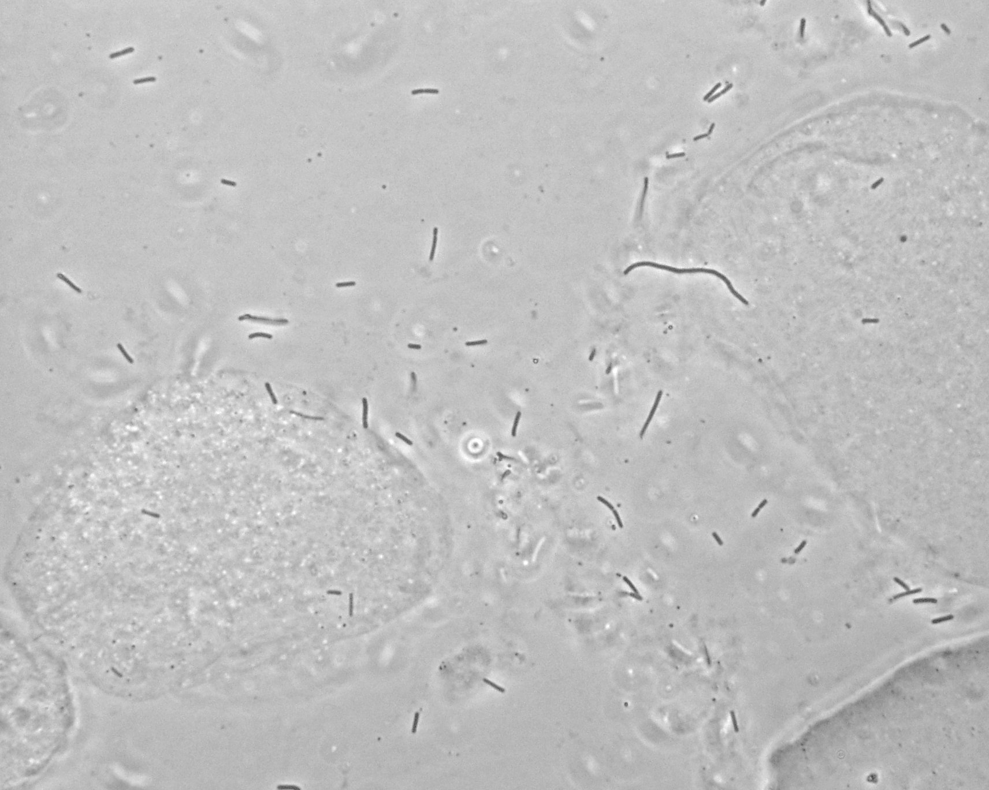
High Power
Bacteria
Notes:
Bacteria – rod shaped bacteria are seen throughout the slide.

Slide 16
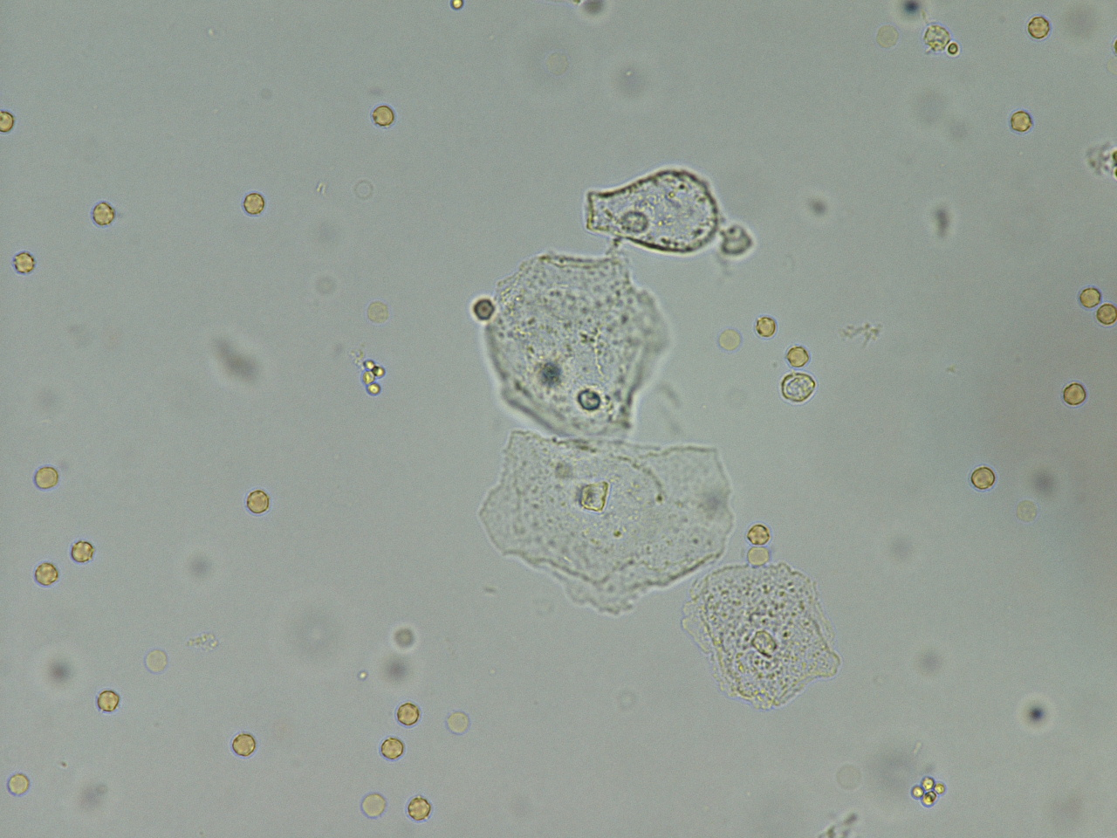
Low Power
Red Blood Cells
Notes:
Red Blood Cells - note the amber color and the size. RBC’s are roughly the size of the nucleus of the epithelial cells seen. They are somewhat smaller than WBC’s (and no nucleus!) and significantly larger than bacteria or yeast.

Slide 17
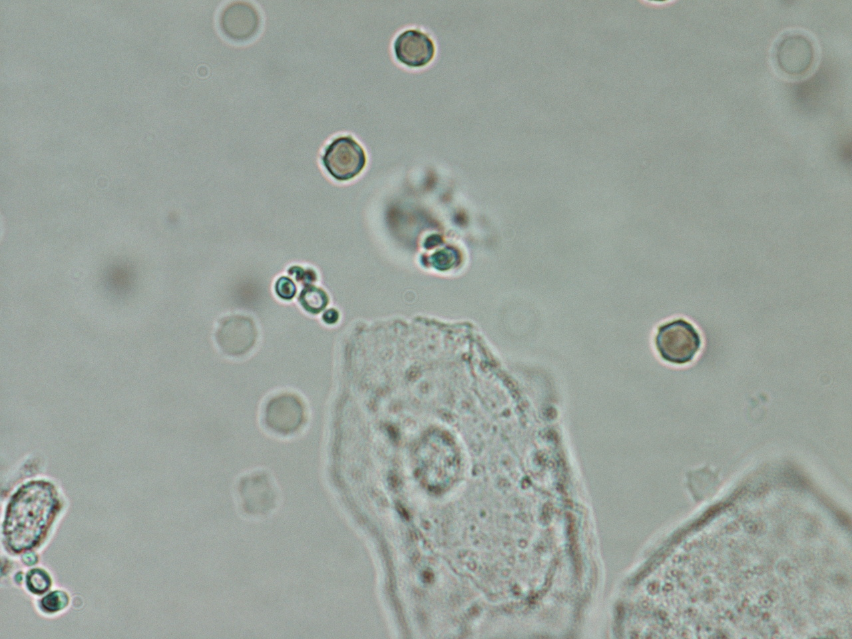
High Power
Red Blood Cells
Notes:
Red Blood Cells- cells from the previous slide at high power magnification. Note the refractory nature. Although not shown here, after 5-10 minutes, the RBC’s will crenate and get a jagged appearance.

Slide 18
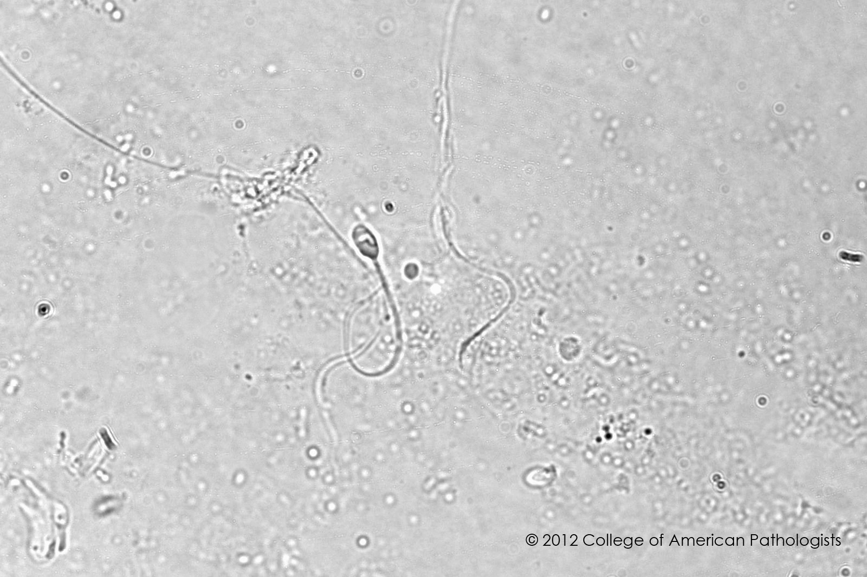
Spermatazoa
Notes:
Spermatazoa - a spermatozoa is identified in this photo. The sperm head is 4-6 μm long, while the slender tail is
approximately 40-60 μm long.

Slide 19
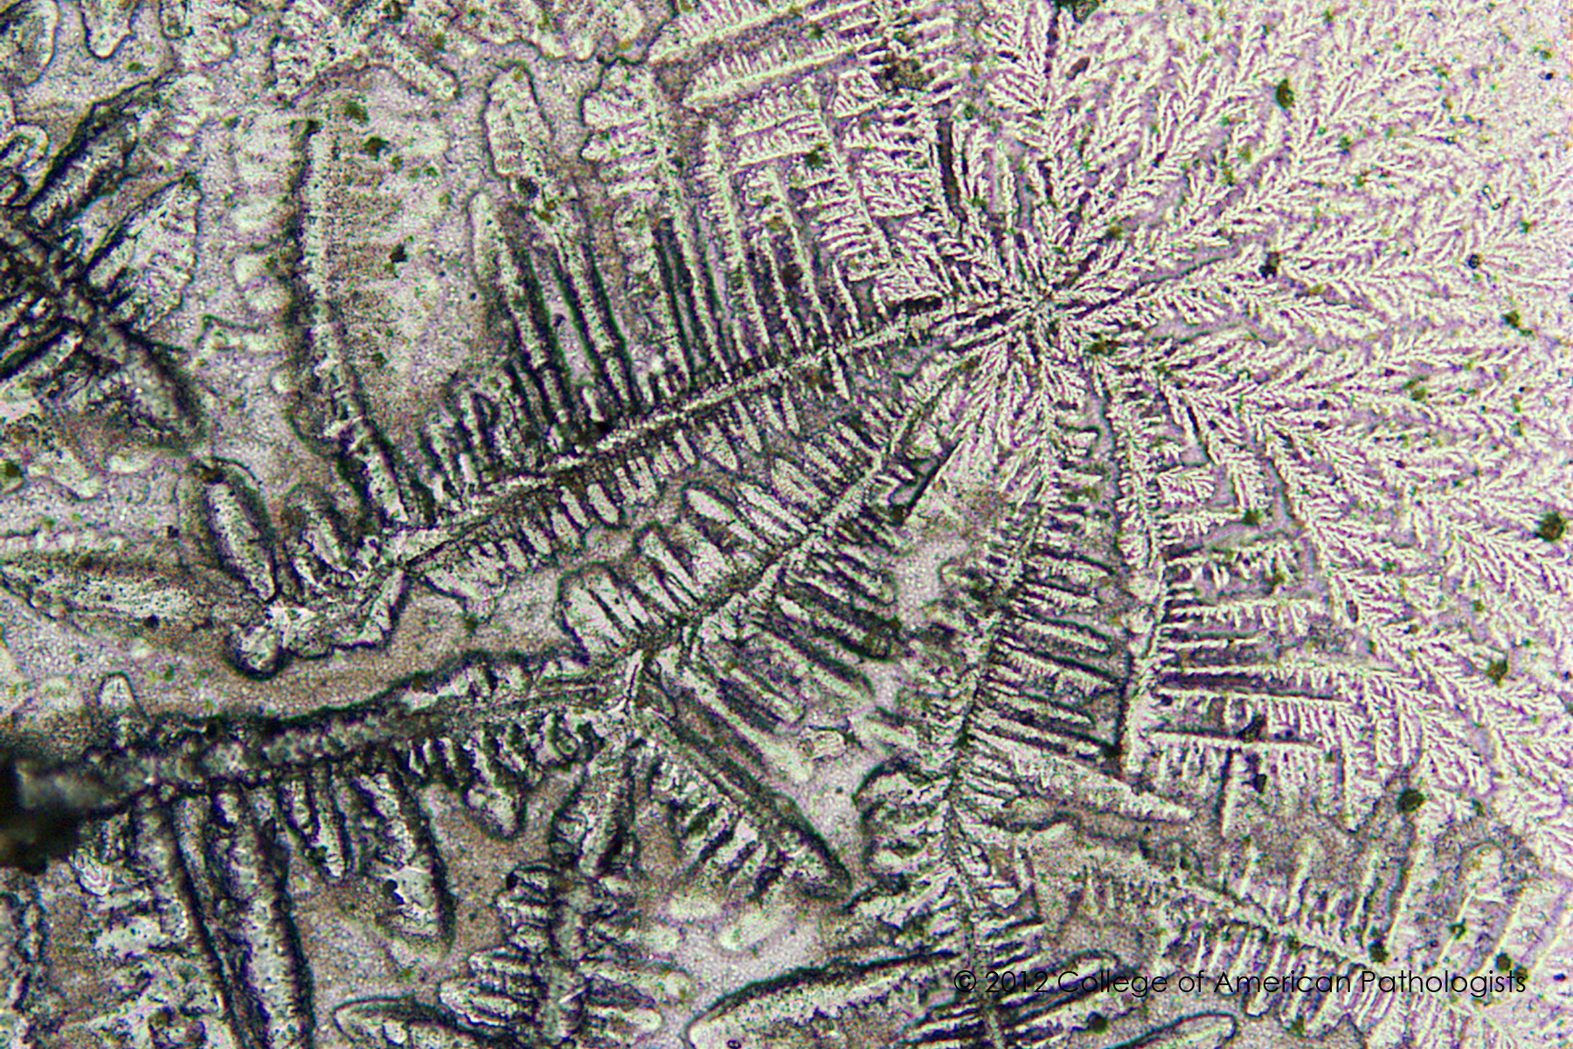
Notes:
Ferning - This vaginal wet preparation exhibits ferning. The fern test is used to detect ruptured amniotic
membranes in early onset of labor. A vaginal pool sample is collected and the fluid is allowed to air dry on
a glass slide. The slide is examined and the microscope used to detect ferning and elaborate arborized
crystallization pattern.

Slide 20
For More Information:
Highlight the link with your mouse, right click, and choose “open hyperlink” to access the CLIS Guide for Physician Performed Microscopy \\Tvhviruser\tvhpublic\Ancillary Testing\Training\CLSI Guide to Provider Performed Microscopy.pdf
Highlight the link with your mouse, right click, and choose “open hyperlink” to access the TVHS Technical Procedure for Vaginal Wet Prep/KOH \\Tvhviruser\tvhpublic\Ancillary Testing\Ancillary Testing Procedures\Vaginal Wet Mount (Privileged Providers Only).docx
Contact TVHS Ancillary Testing Coordinator Faith Hayes at Melanie.Hayes@va.gov, Nashville phone 615-873-8209 or York phone 615-225-4688
Notes:
Note that although multiple types of microscopy testing are listed and discussed in the CLIS Guide, only KOH/Wet Prep testing is performed at TVHS.

