Slide 1
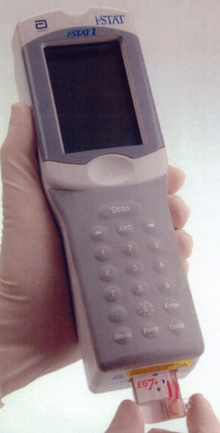
PT/INR Testing on the i-STAT System
New User Training

Slide 2
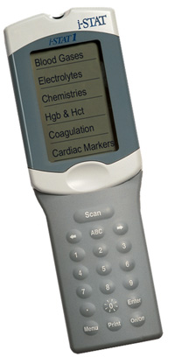
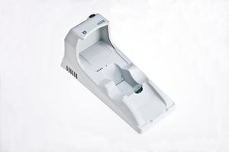
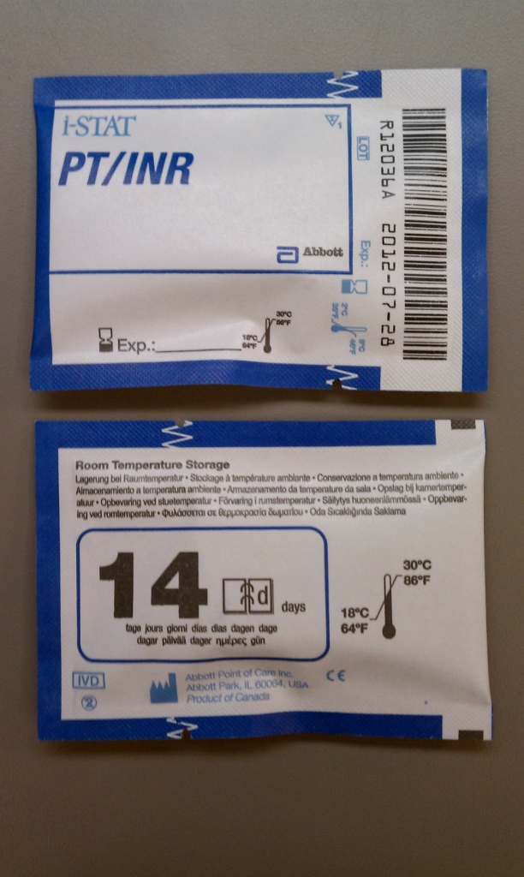
Components of the i-STAT 1 System
i-STAT 1 Analyzer
i-STAT 1 Rechargeable Network Downloader
i-STAT 1 Cartridges
And not to forget, the Operator!

Slide 3
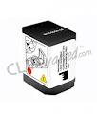
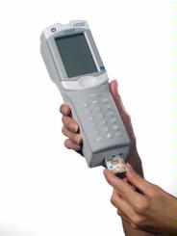
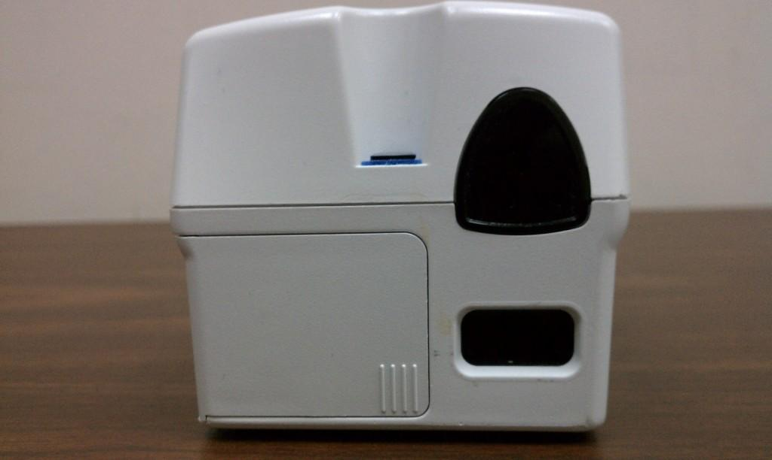
i-STAT 1 Analyzer
Rechargeable Battery
Infrared Window and Scanner
Display Screen
Key Pad
Cartridge Port
Battery Compartment

Slide 4
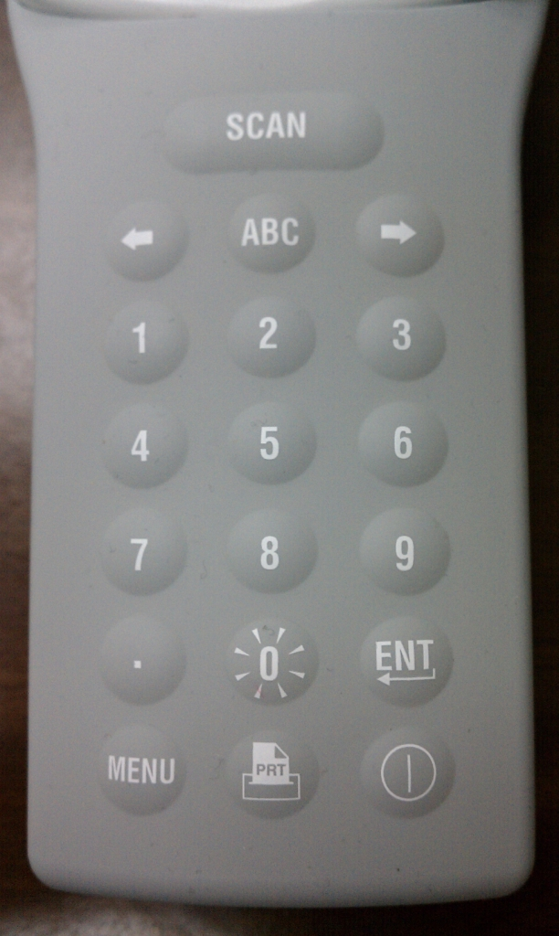
Keypad Functions
Press and hold to scan
Press to see the 2nd page of results
Acts like a back-space button to go to a previous screen or erase and incorrect entry
The 1 and 2 keys scroll through results
Backlight key
Press to get to Administrative Menus
Power Button
To print using martel printer

Slide 5
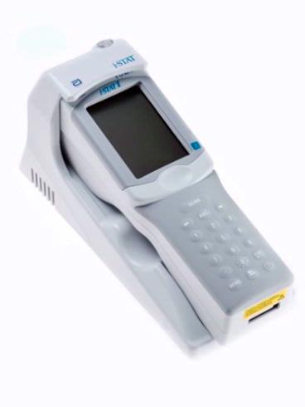
i-STAT 1 Rechargeable Downloader
Proximity Light & Charging Light
Gold Charging Contact Pins
Battery Charging Compartment
Downloaders Plug into Network Ports and chart i-STAT results to CPRS via our RALS Plus System
When working properly, you should see “Communication in Progress” on the display screen
When a scheduled transmission of results is due, a message that says “Upload required” and “press 1-to continue” appears on the screen

Slide 6
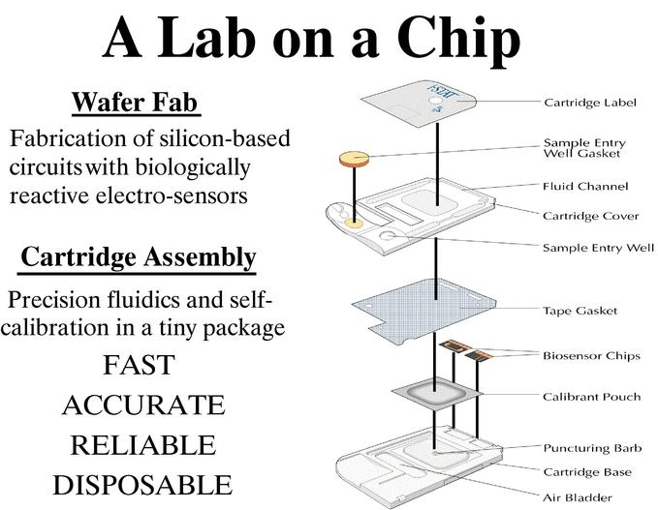
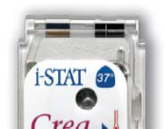
i-STAT Cartridges
What’s in a cartridge?

Slide 7
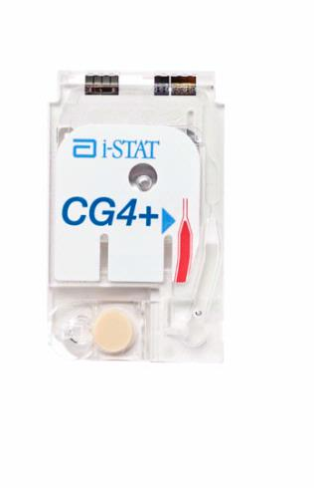
i-STAT Cartridges
Don’t handle
Sensors & Contact Pads
Don’t press
Slow and Steady!
Air Bladder
Fill Line
Sample Well
Easy to the Click!
Snap Closure

Slide 8
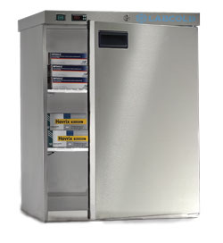
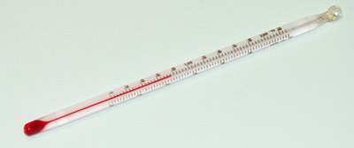
How are cartridges stored?
Main stock is kept refrigerated at 2-8°C
Monitor temps at least daily unless continuously monitored by Engineering. The supervisor other personnel should review temperature charts monthly.
Blood Gas cartridges (anything with a pH!) can be kept at room temp for up to 2 months
Always date the box or individual cartridge with the new expiration date
The room temp storage range is printed on the back of the cartridge pouch and on the box lid if you forget
All other cartridges can be kept at room temp for up to 2 weeks
Remember that if the manufacturer’s date is earlier than the room temp exp date, use it
Allow a box of cartridges to warm to room temp for 1 hour, individual cartridges for 5 minutes
No going back to fridge after warming, so don’t take out too many

Slide 9
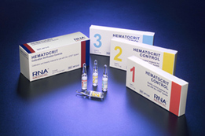
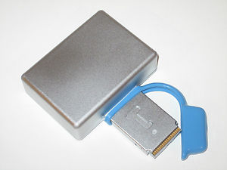
What about QC?
2 levels of appropriate liquid QC material must be tested in duplicate to verify shipments of cartridges before patient use and every 31 days or less thereafter
Most areas have a couple people trained for this
Internal Electronic QC runs every 8 hours of use automatically to verify the meter
No operator intervention required
If EQC fails, the meter will lock out patient testing
Cartridges have calibrant solutions built into each cartridge
This means that with quality samples, you’ll get quality results

Slide 10
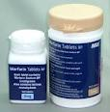
Is the patient a good candidate for i-STAT INR testing?
Is the patient on warfarin?
I-stat INR testing is only approved for monitoring patients on warfarin therapy. It is not suitable for screening for factor deficiencies or other conditions.
Does the patient have good peripheral blood flow?
If not, capillary testing is not appropriate.
Does the patient have visible edema?
If so, capillary testing is not appropriate.
Does the patient have any known or suspected lupus anticoagulant antibodies?
It is not known if lupus anticoagulant antibodies affect the i-STAT INR method, so these patients may need their INR monitored with lab plasma PT/INR’s.

Slide 11
Testing PT/INR
No samples with anticoagulants can be used
No blue tops, blood gas syringes, etc.
Use a capillary sample from finger puncture or a venous sample in a plain plastic syringe
Samples should be tested immediately after collection
All samples will begin to clot, so test right away
Don’t move the analyzer during testing
It mixes reagents and moving may cause Quality Check Codes (error codes)
INR results above 4.0 should be sent to lab for confirmation
The laboratory method is the “gold standard” and should be used anytime i-STAT results are questionable
INR Results above 5.0 are critical values
The meter will measure INR up to 8.0
Values above this will be reported as >8.0 or No Clot Detected

Slide 12
Basic Steps of Testing Patient Samples
Verify the patient’s identity by confirming their Full Name and Full SSN.
Power on
Note: you can Press 1 to see your last result if the meter timed out before you checked your results
Press 2 to begin testing
Scan in your operator ID
Scan in the patient’s ID
Scan in the cartridge lot number
Apply sample and insert cartridge
Choose a specimen type if you use this option
Enter temp, FI02, free field info if you use this option
2 minutes (or 10 for TROP) to results
If you need to test another cartridge, chose 1 for test options and you won’t have to scan in the ID again
Download meter

Slide 13
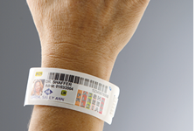
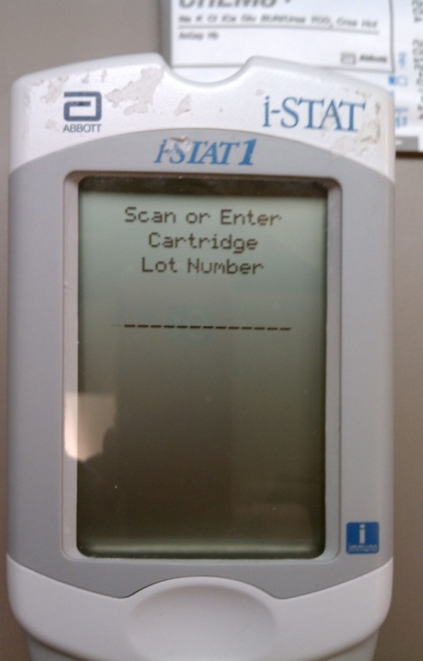
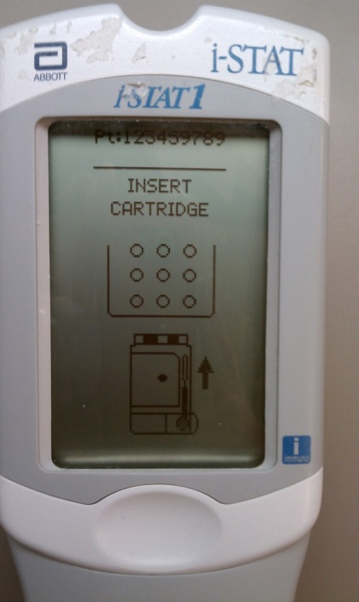
Detailed Steps for Testing Patient Samples
Power on
Press 2-i-STAT Cartridge to being testing
Press the SCAN key and scan in your Operator ID
Press the SCAN key and scan in the Patient ID (arm band, VIC Card)
Press the SCAN key and scan in the Cartridge Lot # from the cartridge pouch
Perform finger puncture, hold drop of blood over sample well and Apply Sample (see next slides) slowly and steadily to the fill line and Insert Cartridge
Step 2
Step 5
Step 6

Slide 14
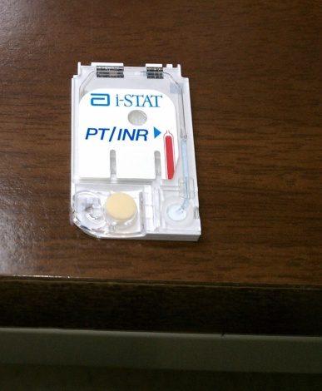
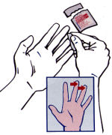
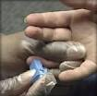
Sample Collection-Finger Puncture
Remove cartridge from foil pouch and place on a flat surface.
Prepare lancet and set aside until needed.
Clean the finger with isopropanol. Cleaning the finger with solution such as chlorhexidine will cause a false increase in INR-stick with isopropyl!
Allow the finger to dry thoroughly before sampling. Excess can be wiped away with gauze or tissue. Residual alcohol will affect results.
Prick the bottom side of the fingertip, applying gentle pressure to develop a hanging drop for testing.
Never “milk” the finger-it may hemolyze RBC’s and release excess tissue fluids affecting results
Use the first drop of blood.

Slide 15
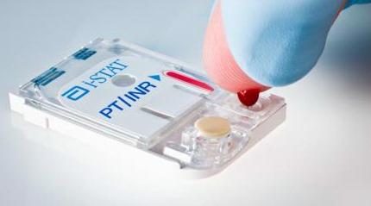
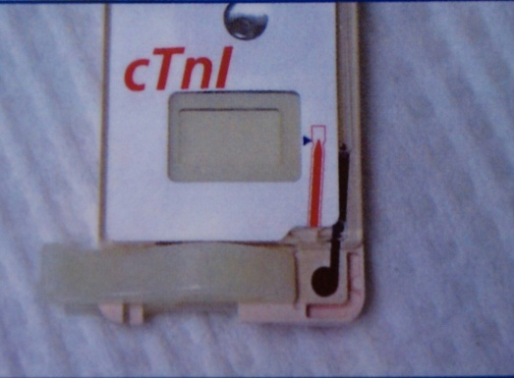
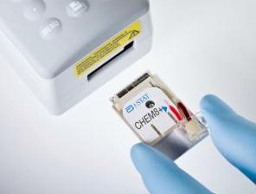
Adding Sample to the Cartridge
Touch the drop of blood against the bottom of the sample well. (It is okay to bring the cartridge to the finger for easier application if this works better for you.)
Once the drop of blood contact the sample well, the blood will be drawn into the cartridge.
Be careful to get the drop just over the well. If you touch off center, the blood may collect around the rim of well and will not be drawn into the cartridge.
Apply sample until it reaches the fill line.
Fold the sample closure over the sample well.
Press the rounded end of the closure until it snaps securely closed.
Insert cartridge.
Touch Drop to well
Filled to Blue Arrow
Insert Cartridge

Slide 16
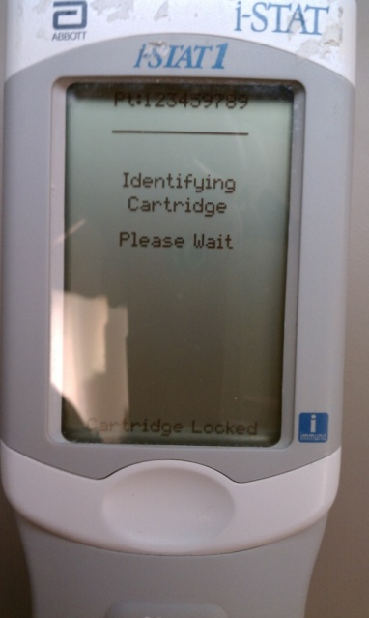
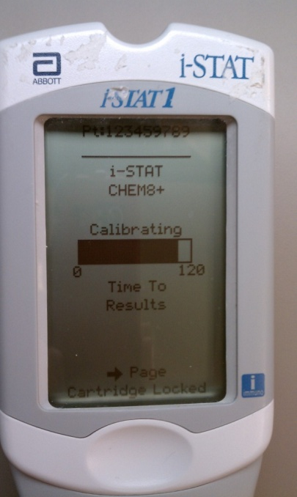
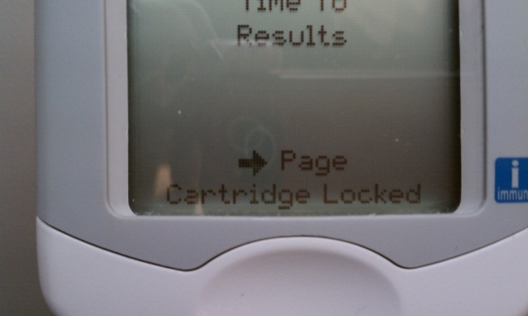
Detailed Steps for Testing Patient Samples Cont’d
Meter will identify and calibrate the Cartridge
Cartridge Locked-Don’t try to remove!

Slide 17
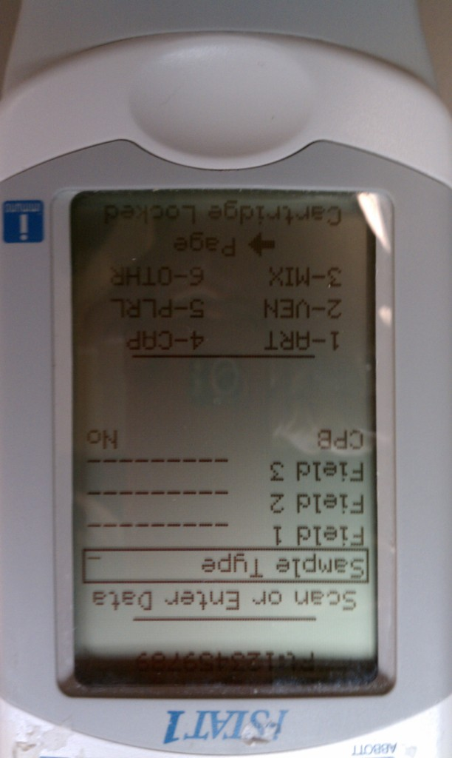
Specimen Type Option
NOTE: In some location profiles (those who are required to choose a specimen type), this “Chart Page” comes up automatically. If it doesn’t, press the right arrow to move to it.
Choose the corresponding Sample Type from numbers 1-6 displayed on the bottom of the screen and press enter. 6-Other should only be chosen to stop a test from charting.
For Anti-coagulation Clinics, capillary blood is the default specimen type. If no specimen type is chosen, the system assumes it was capillary.

Slide 18
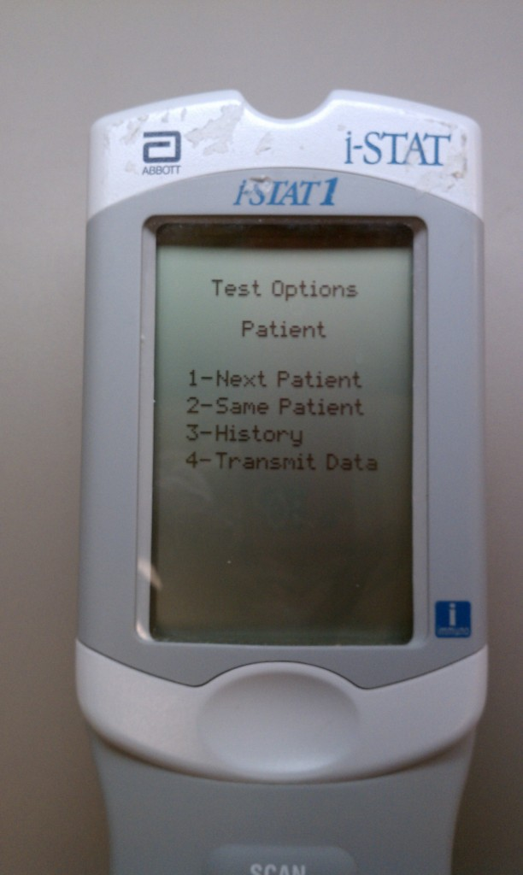
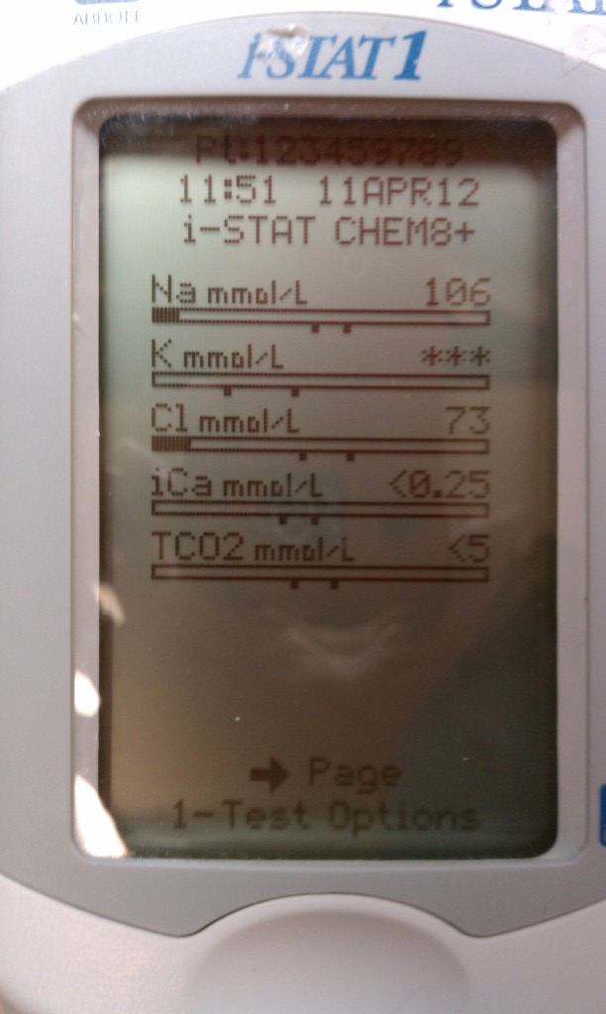
Results
Evaluate Results. Reference and critical ranges are stored in the meter.
Power off if testing is complete or Press 1-Test Options
Select 1 - Next Patient, 2 - Same Patient
Note the solid part of the bar. It tells us how close we are to the reference range, represented by the tow marks in the center of the bar.
Critical results would be flagged with a bold up or down arrow beside the value.
The reportable ranges are generally quite large, so <‘s and >’s and ***’s usually represent a sample problem or technique issue. An exception might be glucoses >700 mg/dL.

Slide 19
General Information
Quality Check Codes are error codes resulting from “bad” cartridges, sample issues, etc. Generally, collect a fresh sample and retest.
Asterisks on a result mean the sensor for the specific test was damaged.
> or < indicates the result was outside reading limits (reportable range) of the meter
INR will be reported to 6.0, values above that will display as >6.0. All values >5.0 must be confirmed with a lab draw.
Meters will hold 5000 results, so they can be reviewed in the meter when the computer system is down – no special contingency plan required
Critical Values- If you are not responsible for treating the patient and the provider is not present during testing, you should document notification to the provider in CPRS.
If the result is inconsistent with the patient’s condition, repeat with a fresh sample
All point-of-care devices, including i-STAT’s, must be cleaned and disinfected between patient uses
i-STAT’s should be disinfected using 1:10 bleach wipes for the contact time listed on the wipe container.
Avoid getting excess disinfectant in the cartridge port.
If a film of disinfectant is left on the screen, it can be wiped away with a clean, damp tissue or alcohol prep.
A film of disinfectant on the laser aperture can cause the analyzer to scan barcodes poorly.
Always dispose of used testing supplies according to TVHS infection control guidelines.
Ancillary Testing policies, procedures, and manufacturer’s manuals may be found in the Ancillary Testing folder on the TVHS Public Drive.

Slide 20
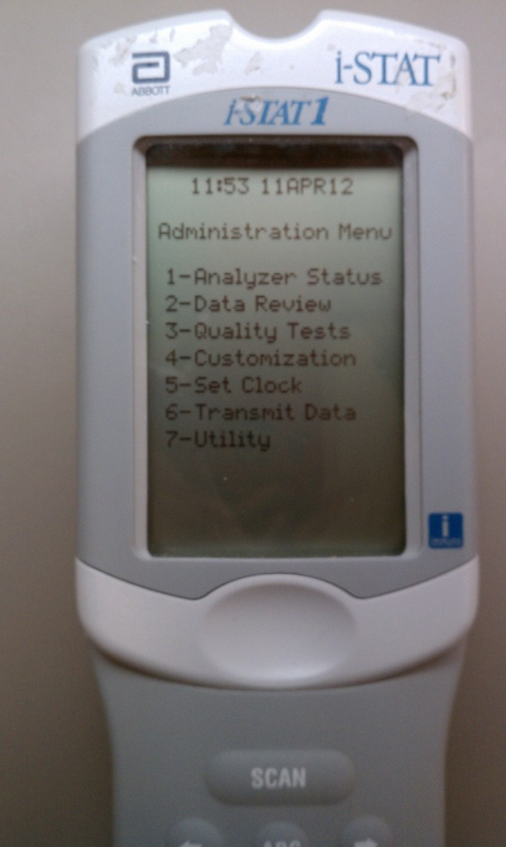
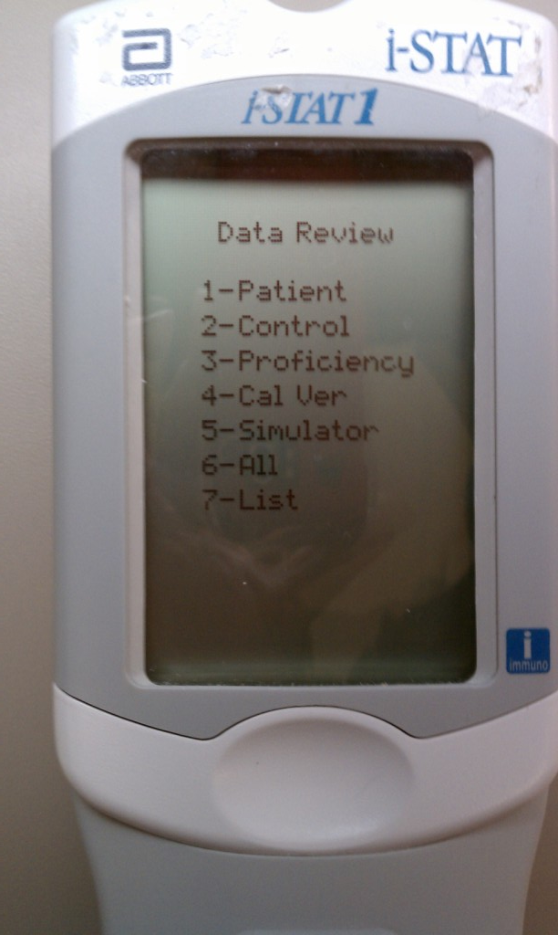
Reviewing Results in the Meter
Power on.
To see just the last result tested, press 1-Last Result.
To see more results, press the MENU button to get to the Administration Menu
Press 2 - Data Review
Choose one of the Data Review options and scroll through results to find the patient you’re looking for. Note, the instrument holds 5000 results and deletes on a “First In, First Out” basis. So you always have at least the last 5000 results to view!

Slide 21
Common Problems
Add sample promptly.
Delays may allow the sample to begin clotting, resulting in Quality Check Codes
Add sample steadily.
It doesn’t take much, and adding more after taking the finger away may introduce bubbles resulting in a Quality Check Code
“Milking” the finger or using capillary samples on patients who aren’t good candidates for capillary testing
Overfilling or underfilling the cartridge may result in Quality Check Codes.
Inserting the cartridge before adding sample or not closing the cartridge completely will result in Quality Check Codes

Slide 22
THE END!
Presented to you by Ancillary Testing
Lisa Doxey or Sandra Honett
TVHS Ancillary Testing Coordinators
Phone: York (615) 225-4688; Nash (615) 873-8209
Lisa.doxey@va.gov or Sandra.Honett@va.gov
Angus

