Slide 1
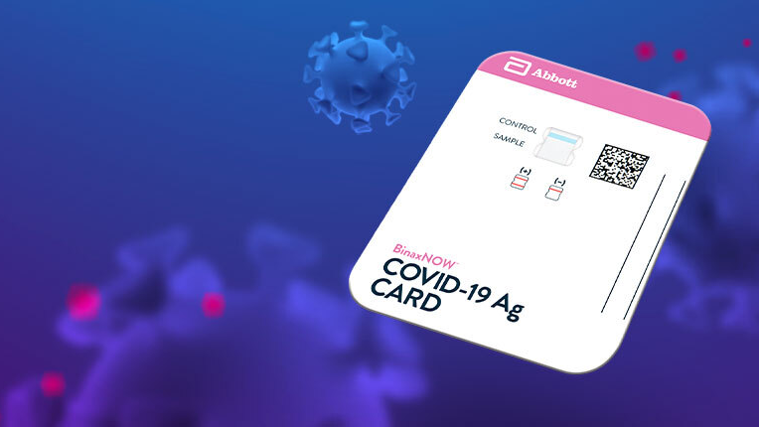
BinaxNOW COVID-19 Ag Card

Slide 2
Objectives
Demonstrate knowledge and proper use of the BinaxNOW COVID-19 Ag Card.
•Performing Quality Control and Patient Testing
•Evaluating and Manually Entering Results

Slide 3
What is the BinaxNOW COVID-19 Ag Card?
Coronaviruses are a large family of viruses which may cause illness in animals or humans. SARS-CoV-2 is an enveloped, single-stranded RNA virus of the β genus. The virus can cause mild to severe respiratory illness and has spread globally, including the United States.
BinaxNOW™ COVID-19 Ag Card is a rapid lateral flow immunoassay for the qualitative detection and diagnosis of SARS-CoV-2 directly from nasal swabs, without viral transport media.
The BinaxNOW™ COVID-19 Ag Card kit contains all components required to carry out an assay for SARS-CoV-2.

Slide 4
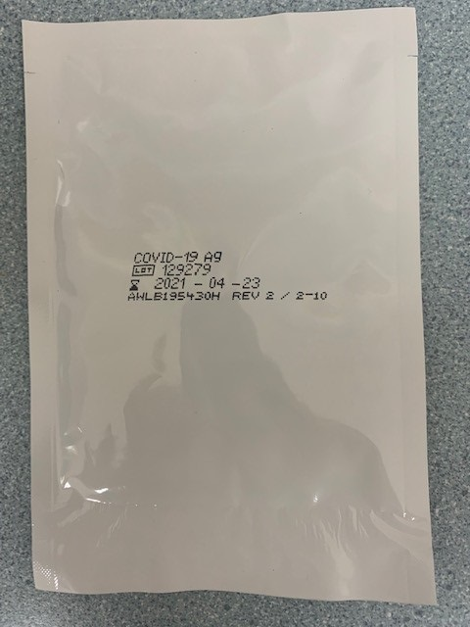
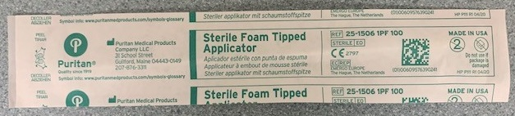
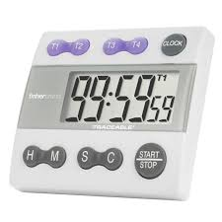
Supplies needed for testing:
BinaxNOW card
Sterile Swab
Timer

Slide 5

Storage of BinaxNOW COVID-19 Ag Cards
Tests should be stored in their sealed pouch at room temperature not to exceed 30⁰C (86⁰F) until the manufacturer’s expiration date.
Never use any supplies, including test kits, beyond their expiration date.

Slide 6
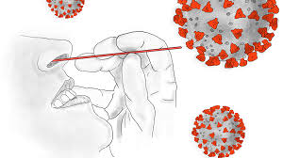
Specimen Collection and Handling for Collector
Nasal Swab
To collect a nasal swab sample, carefully insert the swab into the nostril exhibiting the most visible drainage, or the nostril that is most congested if drainage is not visible. Using gentle rotation, push the swab until resistance is met at the level of the turbinates (less than 3/4 inch into the nostril). Rotate the swab 4 times or more against the nasal wall for at least 15 seconds then slowly remove from the nostril. Using the same swab, repeat sample collection in the other nostril.

Slide 7
Specimen Collection for Patient self-collection
Remove the swab from the package. Do not touch soft end with your hands or anything else.
Insert the soft end of the swab into the nostril no more than ¾ of an inch into the nose.
Slowly rotate the swab, gently pressing against the inside of the nostril at least 4 times for a total of 15 seconds. Get as much nostril discharge as possible.
Gently remove Swab.
Using the same swab repeat steps 1-4 in your other nostril with the same swab.

Slide 8
Specimen Transport
For best performance, direct nasal swabs should be tested IMMEDIATELY after collection.
Do not return the nasal swab to the original paper packaging.

Slide 9
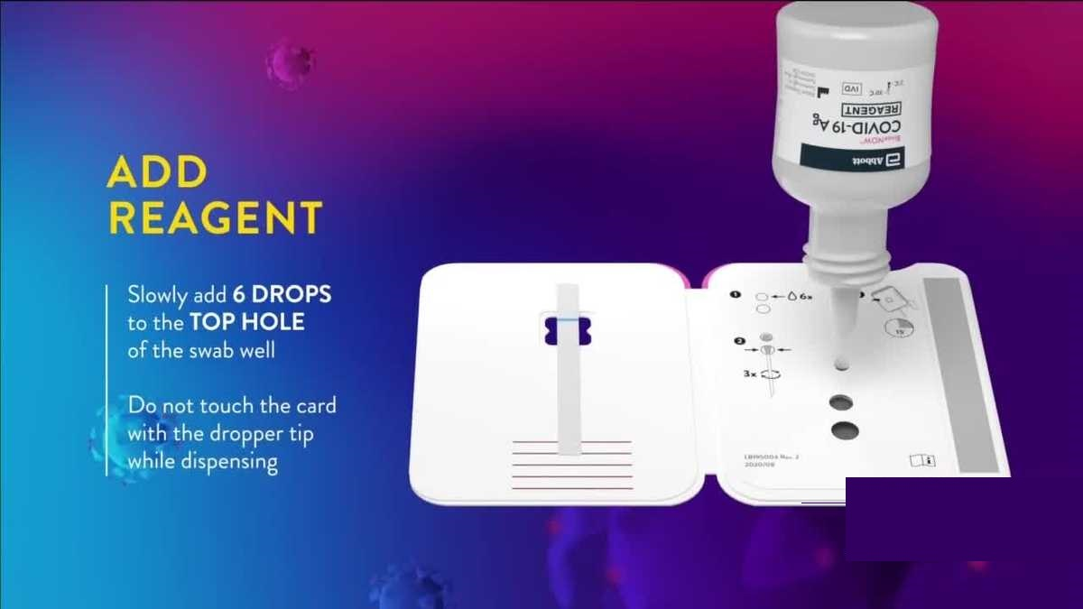
Testing Procedure
Label the test card with patient’s name and last four of the social security number.
Open the test card just prior to use, lay it flat, and perform assay as follows. The test card must be flat when performing testing, do not perform testing with the test card in any other position.
Hold Extraction Reagent bottle vertically. Hovering 1/2 inch above the TOP HOLE, slowly add 6 DROPS to the TOP HOLE of the swab well. DO NOT touch the card with the dropper tip while dispensing.

Slide 10
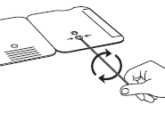
Testing Procedure Cont.
Insert sample into BOTTOM HOLE and firmly push upwards so that the swab tip is visible in the TOP HOLE.
Rotate (twirl) swab shaft 3 times CLOCKWISE (to the right). Do not remove swab.
Note: False negative results can occur if the sample swab is not rotated (twirled) prior to closing the card.

Slide 11
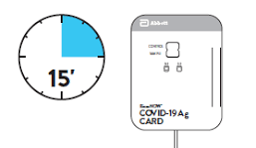
Testing Procedure Cont.
Peel off adhesive liner from the right edge of the test card. Close and securely seal the card. Read result in the window 15 minutes after closing the card. In order to ensure proper test performance, it is important to read the result promptly at 15 minutes, and not before. Results should not be read after 30 minutes.

Slide 12



Result Interpretation
Negative - A negative specimen will give a single pink/purple colored Control Line in the top half of the window, indicating a negative result. This Control Line means that the detection part of the test was done correctly, but no COVID-19 antigen was detected.
Positive - A positive specimen will give two pink/ purple colored lines. This means that COVID-19 antigen was detected. Specimens with low levels of antigen may give a faint Sample Line. Any visible pink/ purple colored line is positive.
Invalid - If no lines are seen, if just the Sample Line is seen, or the Blue Control Line remains blue, the assay is invalid. Invalid tests should be repeated.

Slide 13
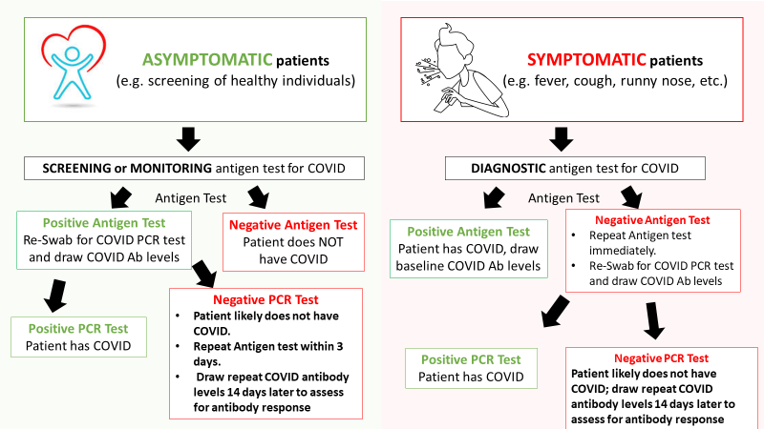

Slide 14
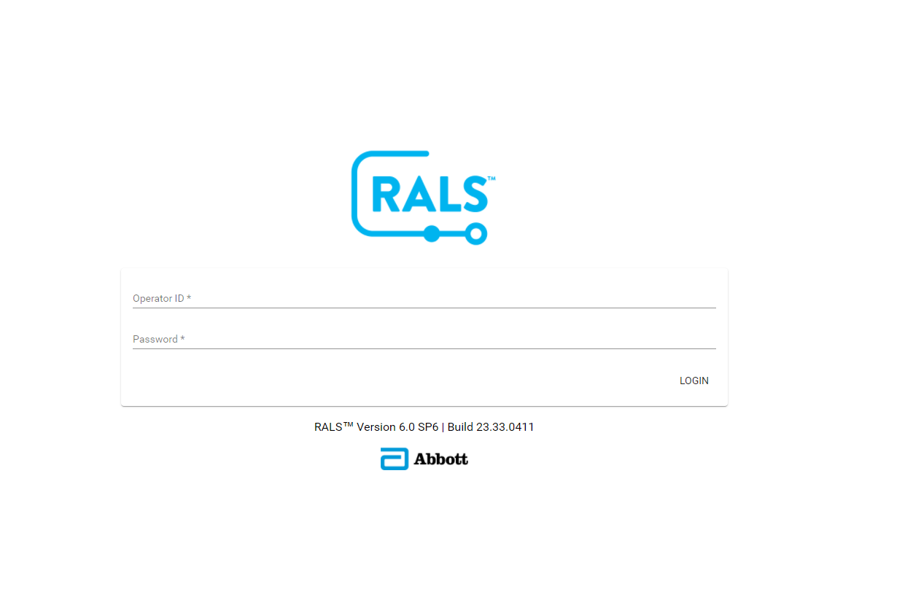

Result Entry
10.78.14.27/rals/#/login

Slide 15
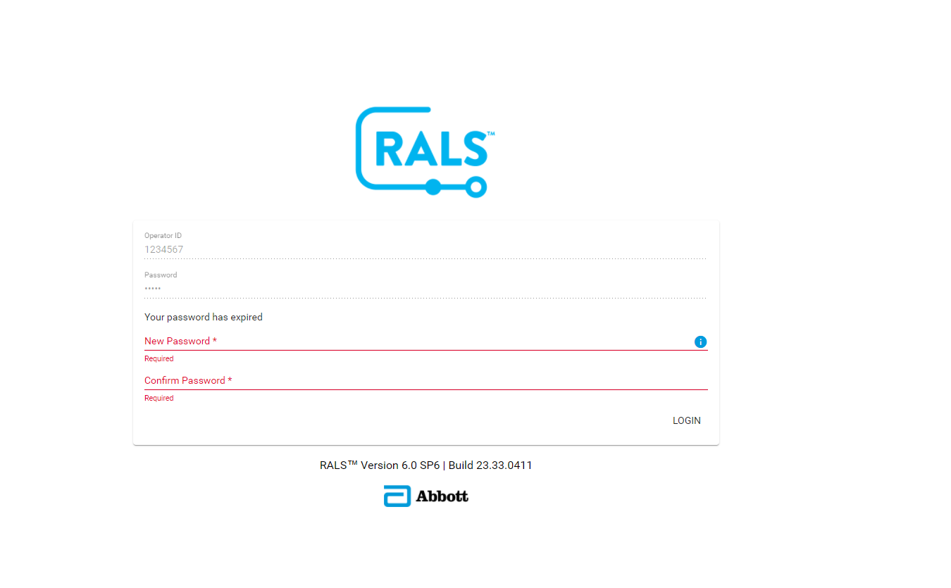
Logging into RALS
Your login is your operator ID on your badge.
Initial Password will be 11111
You will be required to change your password after the initial login.

Slide 16
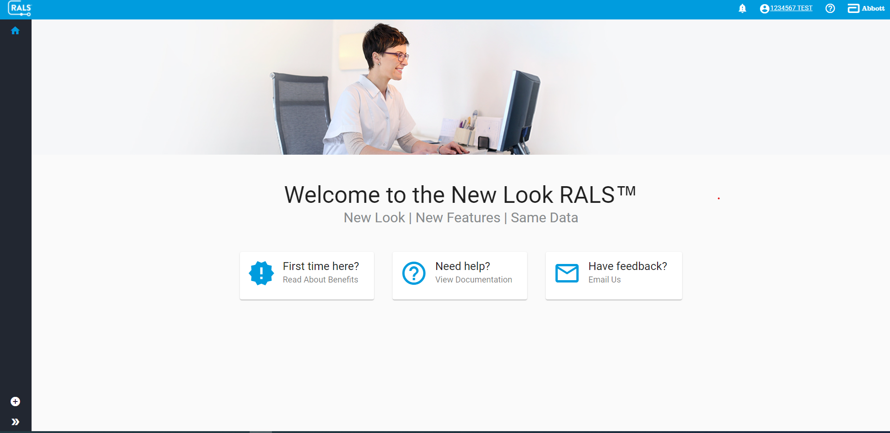



Click the plus sign to start to insert your result.

Slide 17
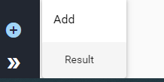
Click the arrow
Then result

Slide 18
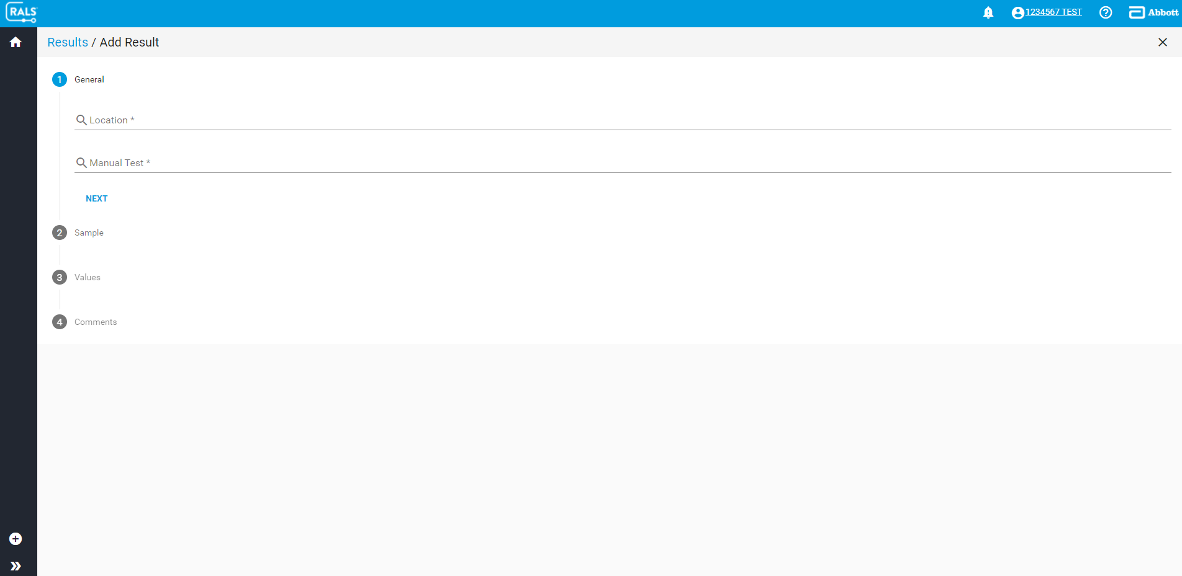
Result screen

Slide 19

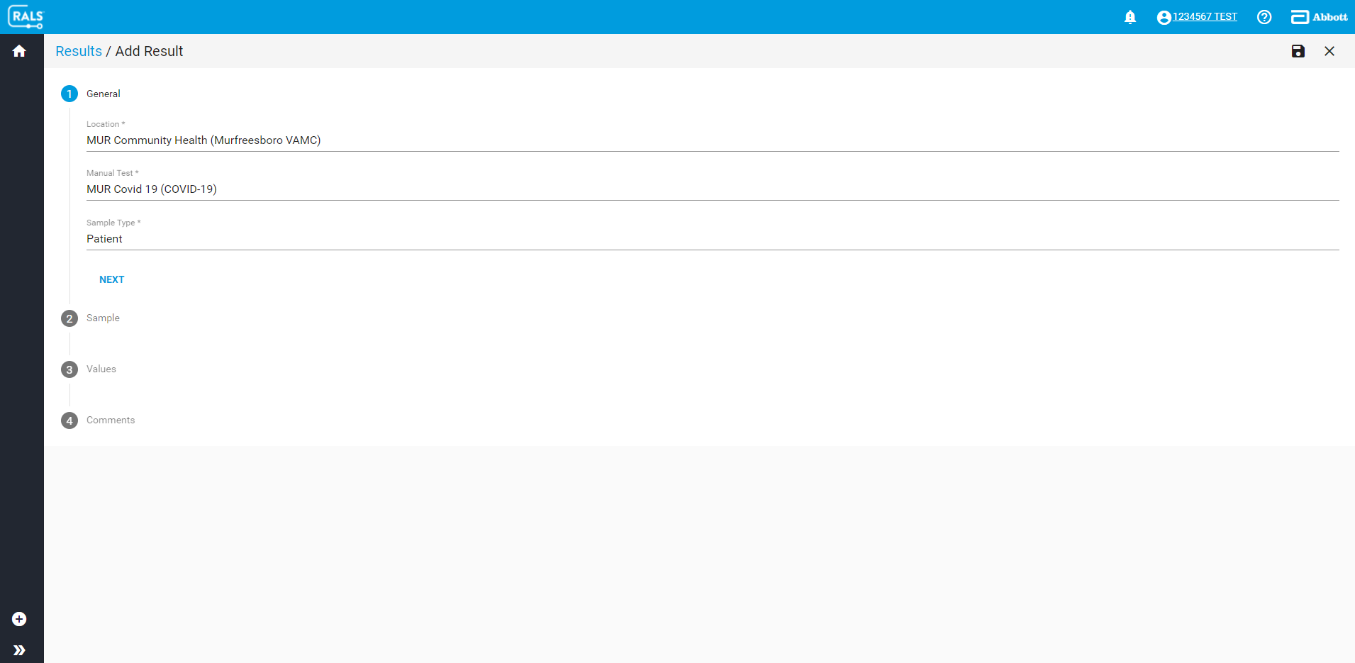
Select Location as MUR Community Health
Select MUR COVID 19
Patient (sample type)

Slide 20
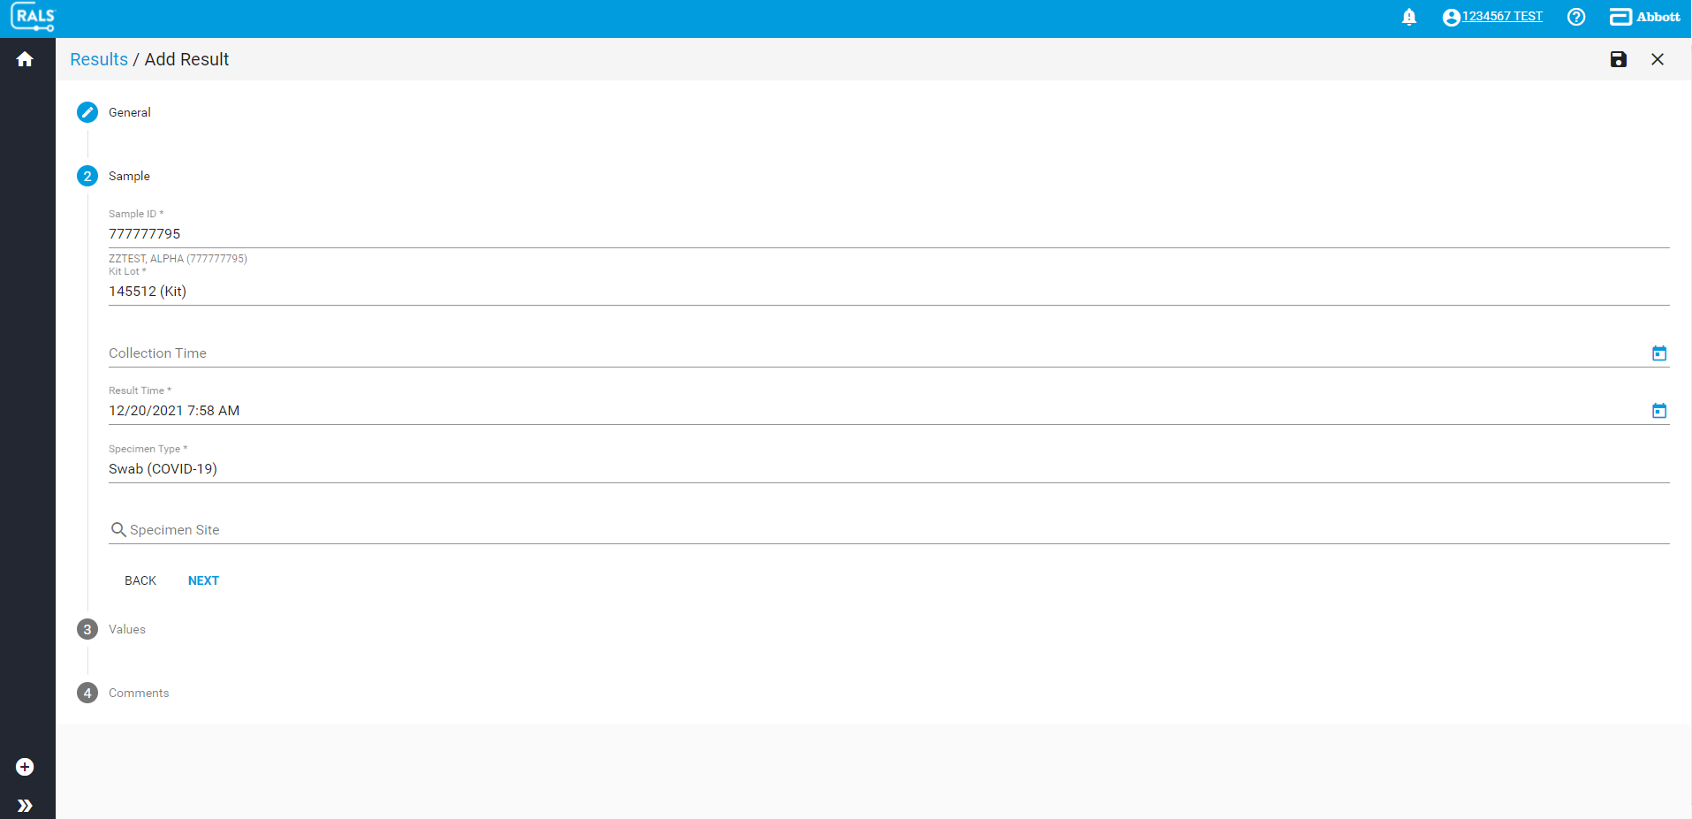
Sample ID – Enter patient SSN
Enter Kit Lot Number
Result Time should auto populate
4. Specimen type: Swab (Covid-19)

Slide 21
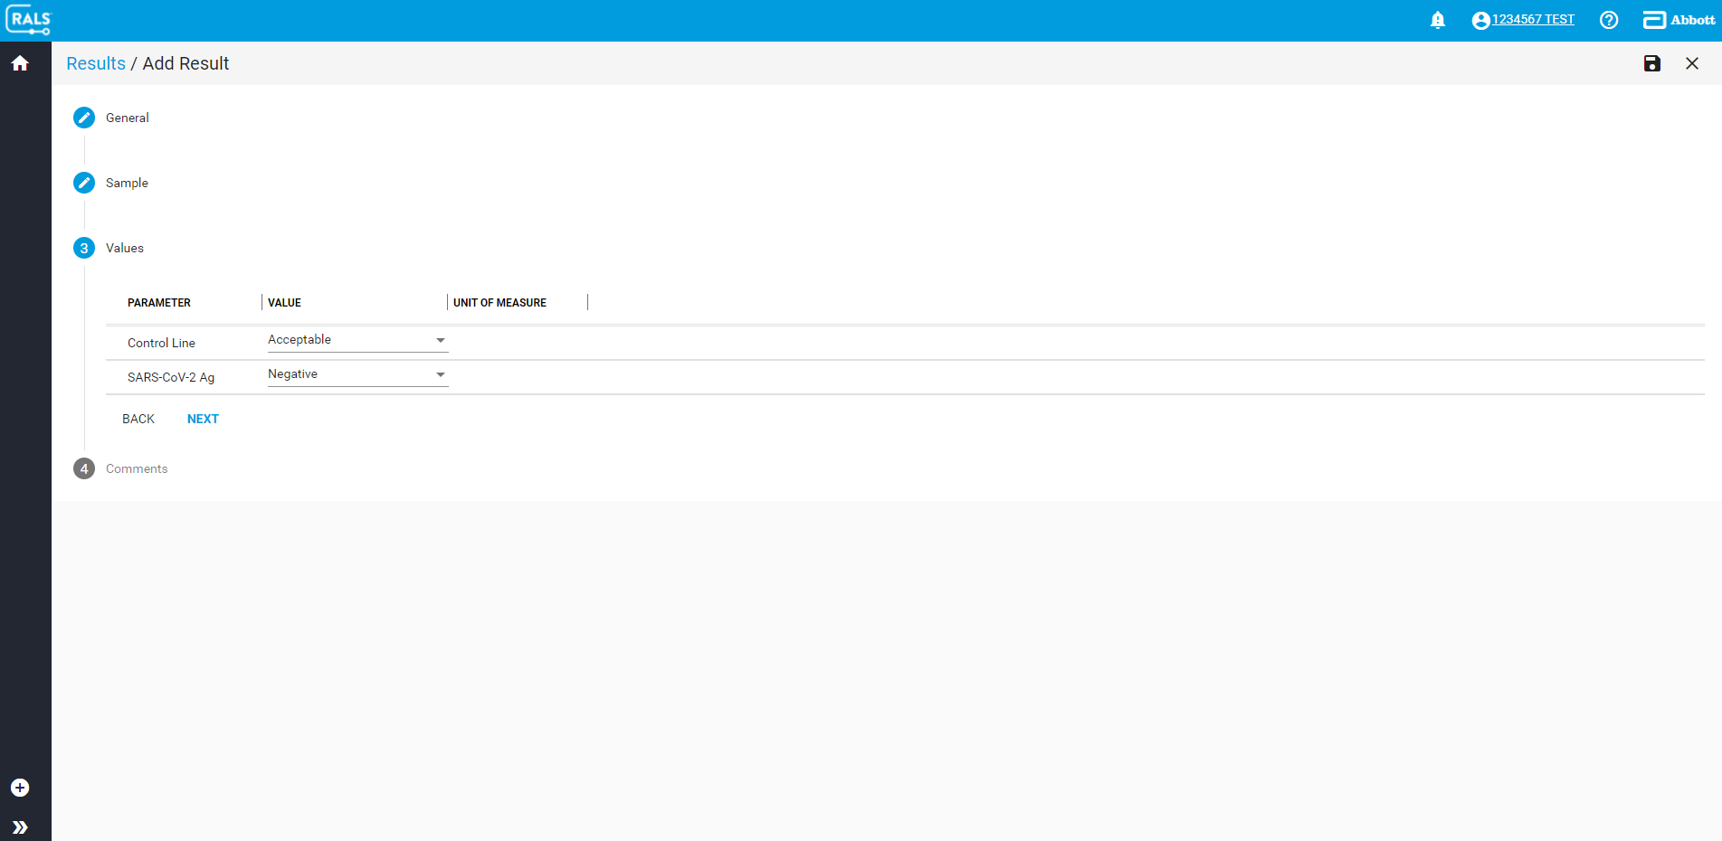
Control Line – Acceptable/Not Acceptable
SARS-CoV-2 Ag – Negative/ Positive

Slide 22
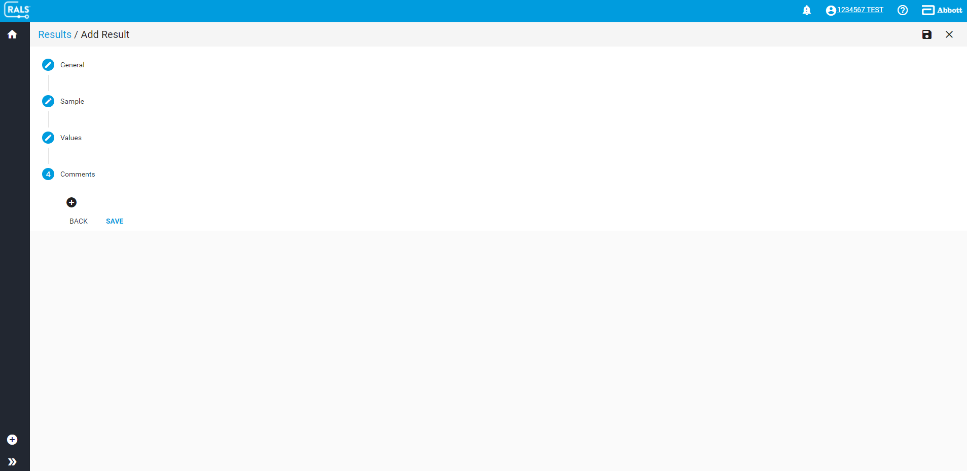
Add comments if necessary
Save – will add results to patient chart.

Slide 23

Limitations of Testing
• This test detects both viable (live) and non-viable, SARS-CoV and SARS- CoV-2. Test performance depends on the amount of virus (antigen) in the sample and may or
may not correlate with viral culture results performed on the same sample.
• A negative test result may occur if the level of antigen in a sample is below the detection limit of the test.
• The performance of the BinaxNOW™ COVID-19 Ag Card was evaluated using the procedures provided in this product insert only. Modifications to these procedures
may alter the performance of the test.
• False negative results may occur if a specimen is improperly collected, transported, or handled.
• False results may occur if specimens are tested past 1 hour of collection. Specimens should be tested as quickly as possible after specimen collection.
• False negative results may occur if inadequate extraction buffer is used (e.g.,<6 drops).
• False negative results may occur if specimen swabs are not twirled within the test card.
• False negative results may occur if swabs are stored in their paper sheath after specimen collection.
• Positive test results do not rule out co-infections with other pathogens.
• Positive test results do not differentiate between SARS-CoV and SARS- CoV-2.
• Negative test results are not intended to rule in other non-SARS viral or bacterial infections.
• The presence of mupirocin may interfere with the BinaxNOW™ COVID-19 Ag test and may cause false negative results.
• Negative results, from patients with symptom onset beyond seven days, should be treated as presumptive and confirmation with a molecular assay, if necessary, for
patient management, may be performed.
• If the differentiation of specific SARS viruses and strains is needed, additional testing, in consultation with state or local public health departments, is required.

