Slide 1
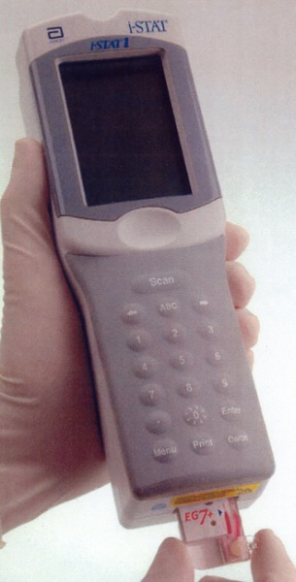
Testing on the i-STAT System
New User Training

Slide 2
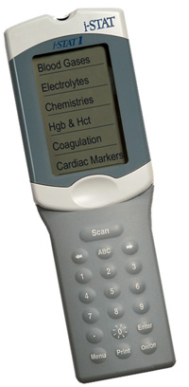
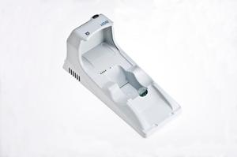
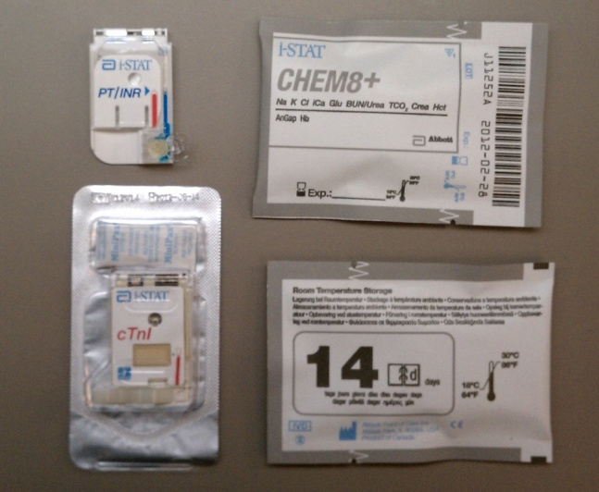


Components of the i-STAT 1 System
i-STAT 1 Analyzer
i-STAT 1 Rechargeable Network Downloader
i-STAT 1 Cartridges
And not to forget, the Operator!

Slide 3
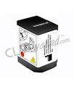
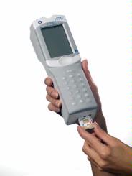
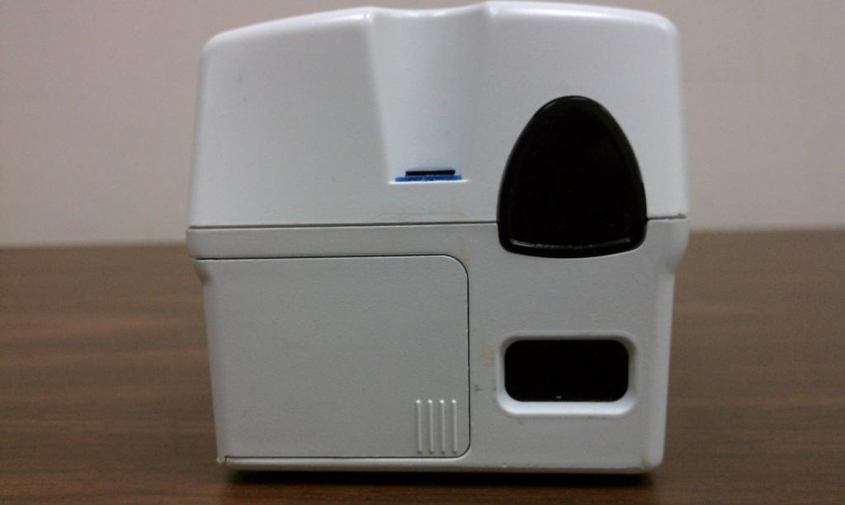
i-STAT 1 Analyzer
Rechargeable Battery
Infrared Window and Scanner
Display Screen
Key Pad
Cartridge Port
Battery Compartment

Slide 4
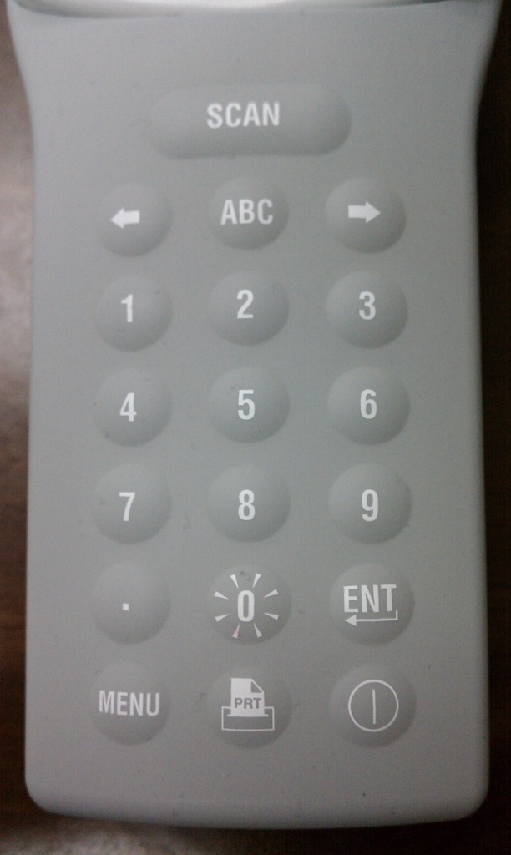
Keypad Functions
Press and hold to scan
Press to see the 2nd page of results and the free field pages
Acts like a back-space button to go to a previous screen or erase and incorrect entry
The 1 and 2 keys scroll through results
Backlight key
Press to get to Administrative Menus
Power Button
To print using martel printer

Slide 5
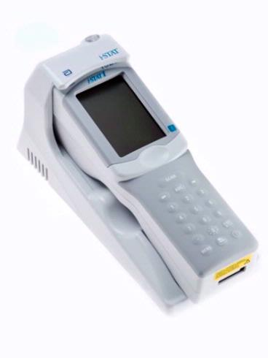
i-STAT 1 Rechargeable Downloader
Proximity Light & Charging Light
Gold Charging Contact Pins
Battery Charging Compartment
Downloaders Plug into Network Ports and chart i-STAT results to CPRS via our RALS Plus System
When working properly, you should see “Communication in Progress” on the display screen
When a scheduled transmission of results is due, a message that says “Upload required” and “press 1-to continue” appears on the screen

Slide 6
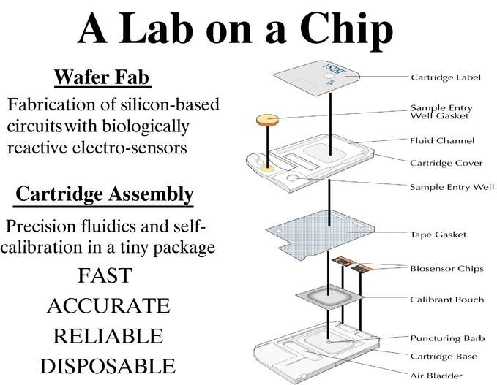

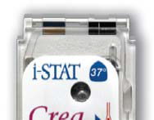
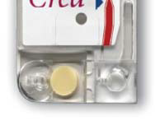

i-STAT Cartridges
What’s in a cartridge?

Slide 7
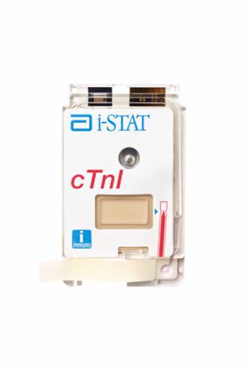
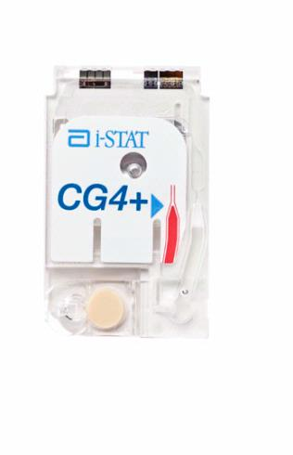
i-STAT Cartridges
Don’t handle
Sensors & Contact Pads
Don’t press
Slow and Steady!
Air Bladder
Fill Line
Sample Well
Sample Well
Easy to the Click!
Slide Closure
Snap Closure

Slide 8
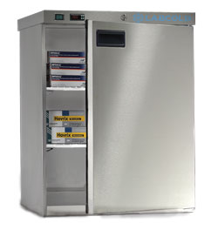
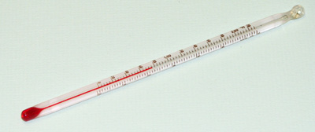
How are cartridges stored?
Main stock is kept refrigerated at 2-8°C
  Monitor temps at least daily unless continuously monitored by Engineering. The supervisor other personnel should review temperature charts monthly.
Blood Gas cartridges (anything with a pH!) can be kept at room temp for up to 2 months
  Always date the box or individual cartridge with the new expiration date
  The room temp storage range is printed on the back of the cartridge pouch and on the box lid if you forget
All other cartridges can be kept at room temp for up to 2 weeks
  Remember that if the manufacturer’s date is earlier than the room temp exp date, use it
Allow a box of cartridges to warm to room temp for 1 hour, individual cartridges for 5 minutes
  No going back to fridge after warming, so don’t take out too many

Slide 9
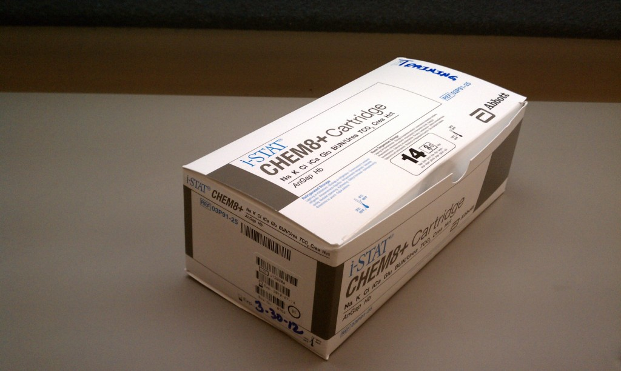
What cartridges do we use at TVHS?
PT/INR for monitoring warfarin therapy patients ONLY!!
  Not for any type of screening use, i.e. stroke, pre-op, etc.
ACT’s for OR and Cath Lab procedures, and sometimes for follow up on these patients in the MICU and SICU
Blood Gases and Chemistries throughout the facility
  G3’s, CG4’s, CG8’s, E3+’s, EG6’s, CHEM 8+’s, CREA’s
Troponin-I in the ER and occasionally in the MICU

Slide 10
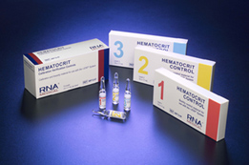
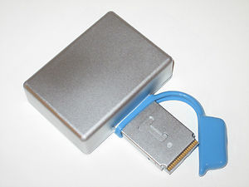
What about QC?
2 levels of appropriate liquid QC material must be tested in duplicate to verify shipments of cartridges before patient use and every 30 days thereafter
  Most areas have a couple people trained for this
Internal Electronic QC runs every 8 hours of use automatically to verify the meter
  No operator intervention required
  If EQC fails, the meter will lock out patient testing
Cartridges have calibrant solutions built into each cartridge
All this means that with quality samples, you’ll get quality results

Slide 11
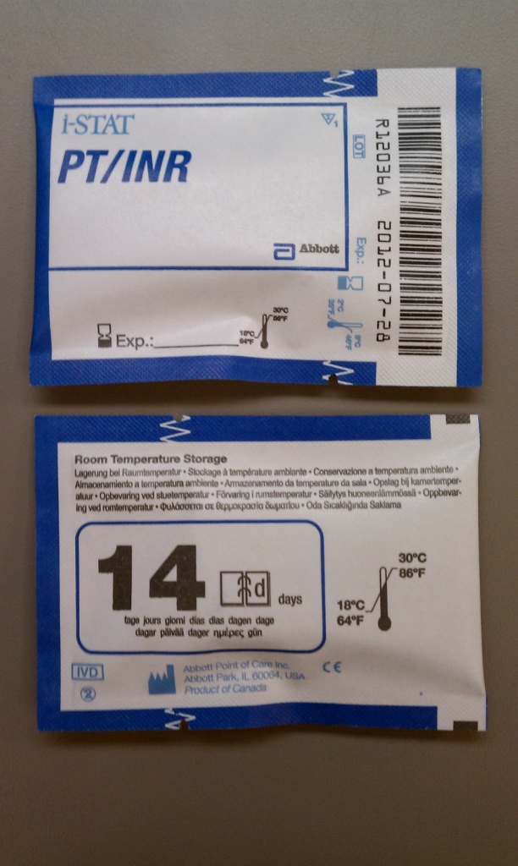
Testing ACT and PT/INR
With these i-STAT tests, no samples with anticoagulants can be used
  No blue tops, blood gas syringes, etc.
  ACT = plain syringes with venous or arterial blood only
  PT/INR = plain syringes or finger puncture (if your area has dispenser caps for blood tubes , you may use plain red tops in place of the plain syringe)
Samples should be tested immediately after collection
  All samples will begin to clot, so test right away
Don’t move the analyzer during testing
  It mixes reagents and moving may cause Quality Check Codes (error codes)
INR results above 5.0 must be sent to lab for confirmation
ACT results will read up to 1000 seconds

Slide 12
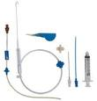
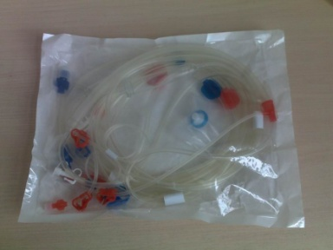
ACT –Some Notes
We only use ACT-Kaolin cartridges. There is an ACT-Celite cartridge but we don’t use it. If you see any of these, they were ordered in error, don’t use them!
We use a “prewarmed” mode. This just means that results are calibrated to match Hemochron Analyzers using prewarmed reagent tubes. I-stat cartridges don’t have to be warmed in any way.
Hemodilution and platelet dysfunction may affect results
Remember, no anti-coagulated samples. Plain syringes only and test immediately!
Drawing from an Indwelling Line
  Heparin contamination and specimen dilution must be considered. If you must use, flush the line with 5 mL of saline. The first 5 mL of blood or six dead space volumes should be discarded.
Drawing from an Extracorporeal Line
  Flush the extracorporeal blood access line by withdrawing 5 mL of blood into a syringe and discard the syringe.

Slide 13
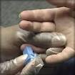
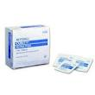
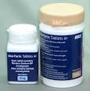
PT/INR-Notes about Collection
Never “milk” the finger-it may hemolyze RBC’s and release excess tissue fluids
Always wipe away excess alcohol thoroughly-residual alcohol may affect results
Cleaning the finger with solution such as chlorhexidine will cause a false increase in INR-stick with isopropyl!
It is not know if the presense of lupus anticoagulant antibodies will affect results, so use a lab method for patients with know or suspected lupus Ab’s

Slide 14
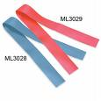

Testing Blood Gas Cartridges
Venous, arterial, or mixed samples are acceptable, but reference ranges and critical values are for arterial ONLY.
Lactate rises 70% in 30 minutes, so test samples for lactate IMMEDIATELY and collect them without a tourniquet.
Samples in heparinzed blood gas syringes are preferable and should be completely full
  Under-filling dilutes the sample, over-filling decreases ionized Ca
  Test within 10 minutes
Samples in plain syringes must be handled with great care to minimize any exposure to oxygen
  Introducing air will increase pO2 significantly.
Free Fields are used to document settings such as flow rate.
  More information will be given in the area if these are used.
Patient temperature may be entered.
  The i-stat will temperature-correct blood gas values. Only the corrected values will chart to CPRS.

Slide 15
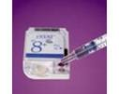
Testing Chemistry Cartridges
“chemistry” cartridges are those with electrolytes, etc and no pH. If there is a pH, blood gas requirements apply
Venous or arterial samples from plain syringes, blood gas syringes (balanced heparin), or green top (lithium heparin) tubes
Samples from plain syringes should be tested within 3 minutes
It is really important to mix all samples well immediately prior to testing or you may get inaccurate HCT results

Slide 16
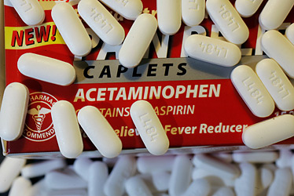

Chemistry Cartridges-Some Specifics!
When hemodiluting patients by more than 20% during CPB, don’t use solutions such as normal saline or Ringer’s lactate-they may cause significant errors on Na, Cl, iCa
Hydroxyurea may cause a falsely increased CREA and GLU
Toxic levels of acetaminophen may interfere with several i-stat chemistry tests. Use another method if acetaminophen overdose is known or suspected.
HCT results may be affected by grossly elevated WBC count, contamination of flush fluids, or settling of RBC’s (remix if testing delayed more than 1 minute after collection)
iCA results are ↑ by prolonged tourniquet use, ↓ when sample is exposed to air, ↓ with toxic levels of salicylate
Whole blood and plasma K values will be slightly lower than serum values because 0.1-0.7 mmol/L will be released during clotting

Slide 17
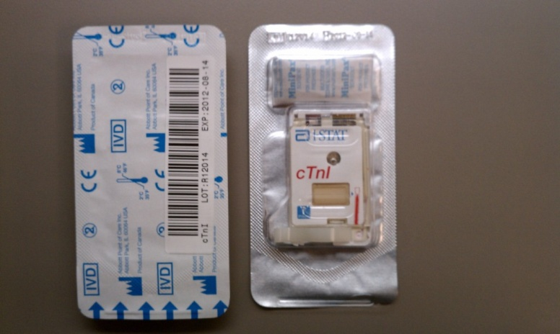
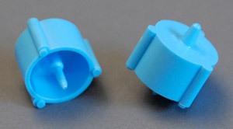
Testing Troponin-I Cartridges
Venous or arterial samples from plain syringes, blood gas syringes (balanced heparin), or green top (lithium heparin) tubes
  Green tops are the preferred sample and must be AT LEAST HALF FULL
  Other anticoagulants may cause falsely decreased readings
  Gross hemolysis can cause ↓ TnI detection. This is hard to know since you are testing whole blood, so proper collection techniques is essential!
Interpretive ranges are NOT the same as a lab troponin-I
  <0.1 = NEG, 0.1-0.39 = Nondiagnostic with possible ACS; >0.39 = POS for MI
  Use caution when interpreting values at the cut-offs because all methods have some variability
Samples from plain syringes should be tested within 1 minute
Microclots will cause falsely elevated readings
  always mix green tops well after collection (at least 8 inversions)
  As noted above, don’t delay in testing any plain syringes-they clot quickly!
The meter should not be moved during testing
This cartridge takes longer than all others, 10 minutes
Results will read to 50 ng/mL, but results above 35 will display as >35 in CPRS
Note the cartridge closure
  It slides closed rather than snaps

Slide 18
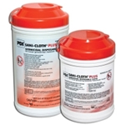

General Information
Quality Check Codes are error codes resulting from “bad” cartridges, sample issues, etc. Generally, collect a fresh sample and retest
Asterisks on a result mean the sensor for that specific test was damaged
> or < indicates the result was outside reading limits (reportable range) of the meter
Meters will hold 5000 results, so they can be reviewed in the meter when the computer system is down – no special contingency plan required, just follow the plan in your unit
Critical Values- If you are not responsible for treating the patient, you should document notification to the provider in CPRS
  If the result is inconsistent with the patient’s condition, repeat with a fresh sample
Best practice is to clean and disinfect between uses
  Clean surfaces with alcohol or germicidal wipes
  Disinfect using germicidal wipes for the contact time on the wipe container

Slide 19
Basic Steps of Testing Patient Samples
Power on
  Note: you can Press 1 to see your last result if the meter timed out before you checked your results
Press 2 to begin testing
Scan in your operator ID
Scan in the patient’s ID
Scan in the cartridge lot number
Apply sample and insert cartridge
Choose a specimen type if you use this option
Enter temp, FI02, free field info if you use this option
2 minutes (or 10 for TROP) to results
If you need to test another cartridge, chose 1 for test options and you won’t have to scan in the ID again
Download meter

Slide 20
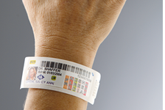
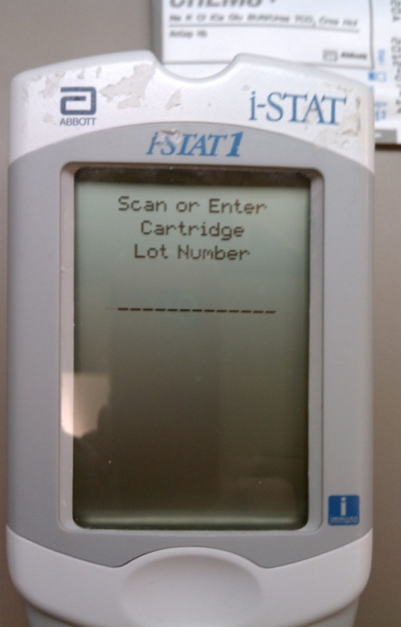
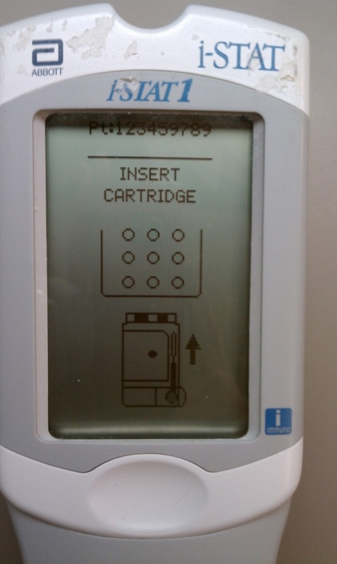
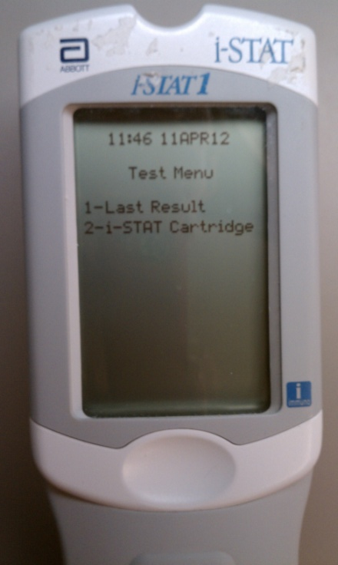
Detailed Steps for Testing Patient Samples
Power on
Press 2-i-STAT Cartridge to being testing
Press the SCAN key and scan in your Operator ID
Press the SCAN key and scan in the Patient ID (arm band, VIC Card)
Press the SCAN key and scan in the Cartridge Lot # from the cartridge pouch
Hold syringe (without needle) or tube dispenser over sample well and Apply Sample (see next slide) slowly and steadily to the fill line and Insert Cartridge
Step 2
Step 5
Step 6

Slide 21
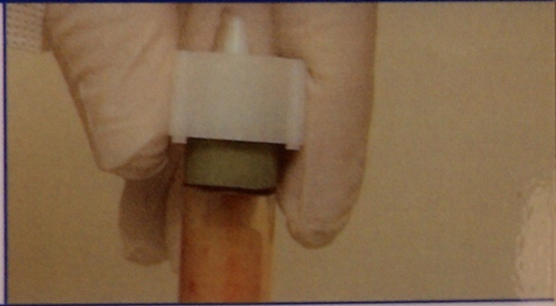
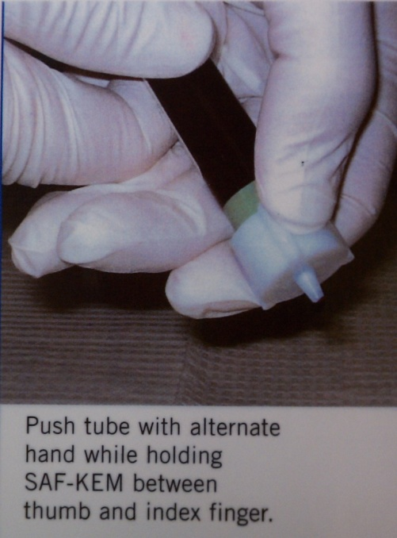
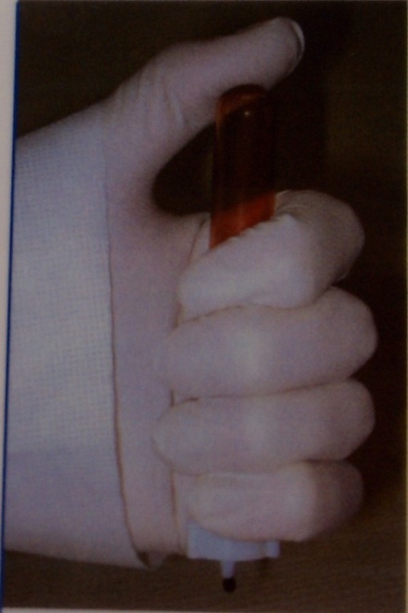
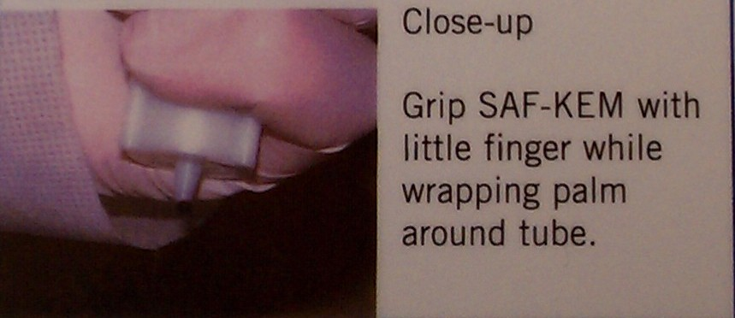
Adding Sample to the Cartridge
Using a Saf –Kem or Saf-Evac Device
Push device onto tube cap (see right). Ensure “Up-Down Play” between device and capped tube connection.
Use Position 1 or Position 2 below to dispense sample by pressing the tube further into the Saf-Kem device.
Begin with step 2 on the next slide.
Placing Device
Position 2
Position 1

Slide 22
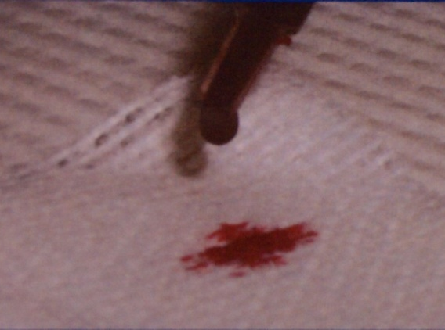
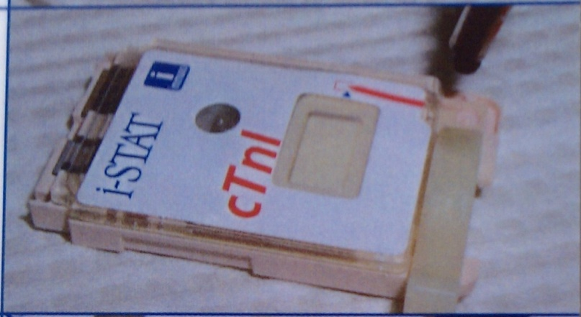
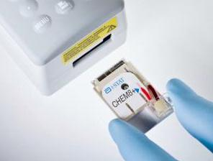
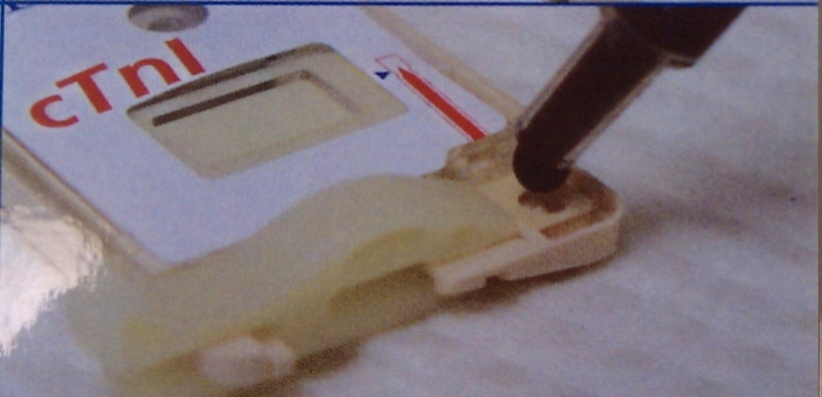
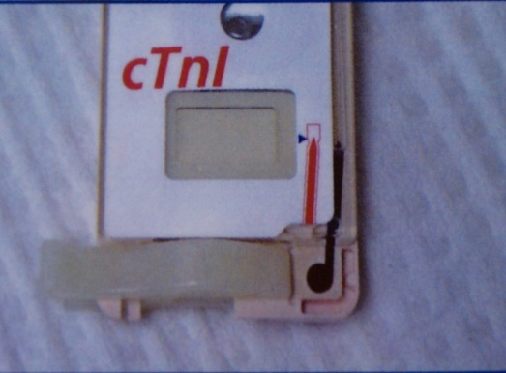
Adding Sample to the Cartridge
Remove needle, if used
Discard 1 drop (this clears unseen bubbles)
Hang a single drop slightly larger the round sample well. Don’t touch syringe tip to sample well.
Touch drop to well allowing cartridge to draw sample in. For larger volume cartridges, continue to add sample slowly and steadily until it reaches the fill line. DON’T add “dropwise”.
Close cover completely, insert cartridge.
Discard a Drop
Hanging Drop
Touch Drop to well
Filled to Blue Arrow
Insert Cartridge

Slide 23
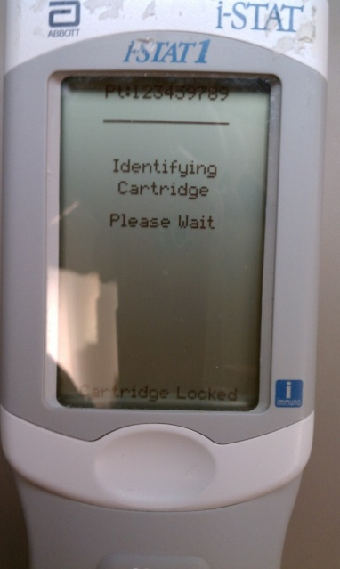
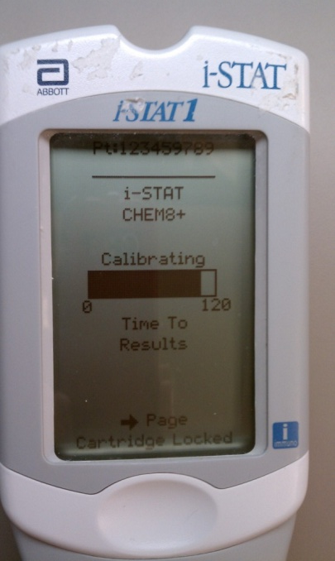
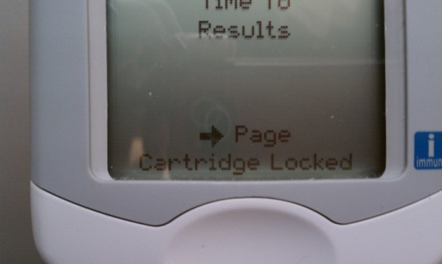
Detailed Steps for Testing Patient Samples Cont’d
Meter will identify and calibrate the Cartridge
Cartridge Locked-Don’t try to remove!

Slide 24
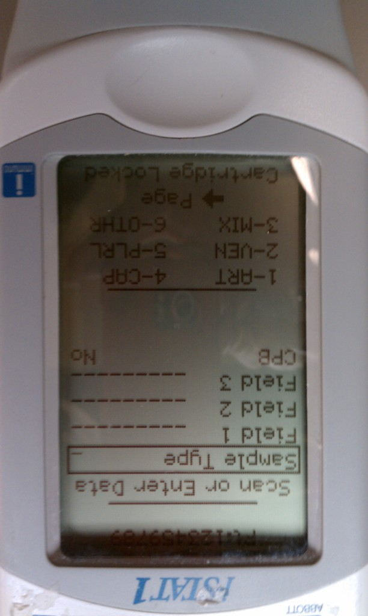
Specimen Type Option
NOTE: In some location profiles (those who are required to choose a specimen type), this “Chart Page” comes up automatically. If it doesn’t, press the right arrow to move to it.
Choose the corresponding Sample Type from numbers 1-6 displayed on the bottom of the screen and press enter. 6-Other should only be chosen to stop a test from charting.
Enter Free field information. See next slide for Free Field Chart. Enter patient temp, FIO2 and free field values. Then press the right arrow to move back to the testing screen. FIO2 will chart as a result (like pH, PO2, etc.) and information entered in the free fields will be expanded and available in the “comments” portion of the patient result in the CPRS “lab tab”.

Slide 25
FREE FIELD 1
Distal Pulse | Allen's Test | Device | Liters Per Min
1 space | 1 space | 1 space | 2 spaces
1=Yes | 1=Yes | 1=Nasal Cannula | 00-99
2=No | 2=No | 2=Trach Collar
 |  | 3=Ventilator
 |  | 4=Ambu
 |  | 5=T-Piece
 |  | 6=High Flow
 |  | 7=Ventur Mask
 |  | 8=Aerosol Mask
 |  | 9=Non Rebreather
FREE FIELD 2
Mode | Tidal Volume | Rate
1 space | 3 spaces | 2 spaces
1=Simu | 000-999 | 00-99
2=Assist Control
3=C Pap
4=Pressure Ctrl
5=Bi Pap
6=Bi-Level
FREE FIELD 3
Peep | Pressure Support |  | Pressure Control
4 spaces | 2 spaces |  | 2 spaces
00.0-99.9 | 00-99 |  | 00-99

Slide 26
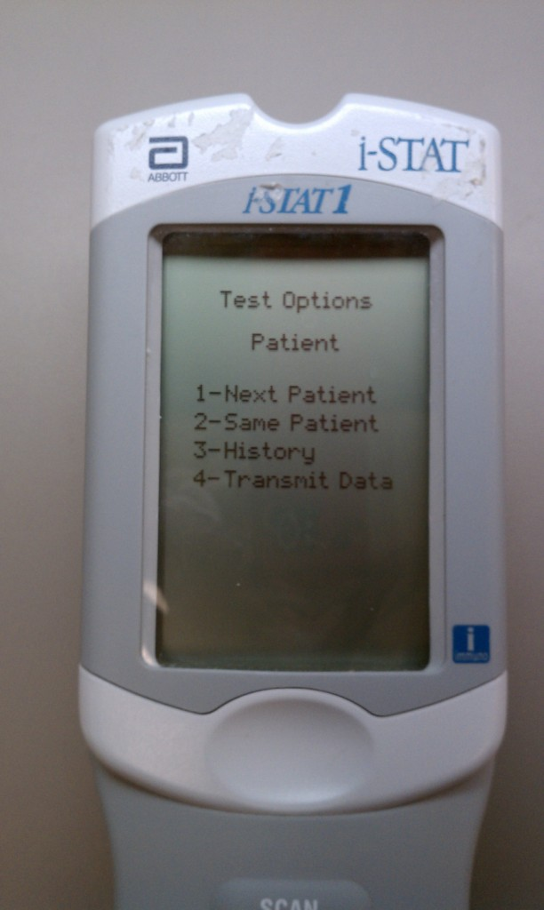
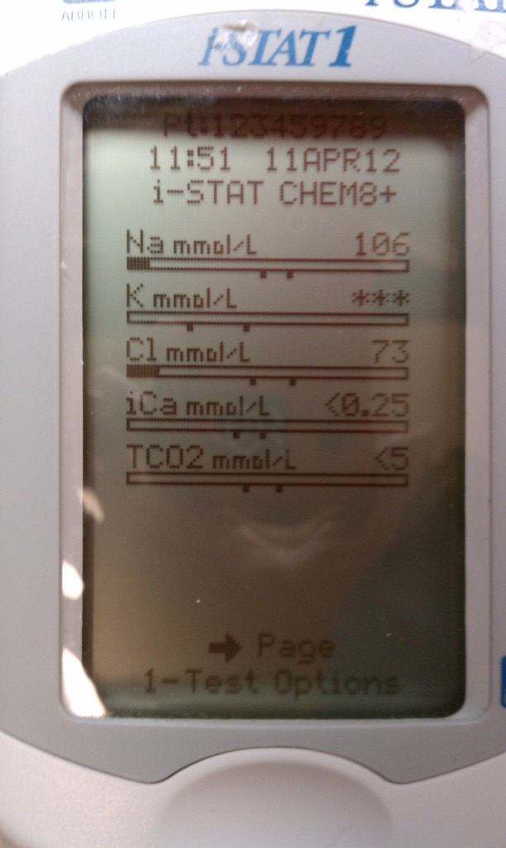
Results
Evaluate Results. Reference and critical ranges are stored in the meter.
Power off if testing is complete or Press 1-Test Options
Select 1 - Next Patient, 2 - Same Patient
Note the solid part of the bar. It tells us how close we are to the reference range, represented by the tow marks in the center of the bar.
Critical results would be flagged with a bold up or down arrow beside the value.
The reportable ranges are generally quite large, so <‘s and >’s and ***’s usually represent a sample problem or technique issue. An exception might be glucoses >700 mg/dL.

Slide 27


Reviewing Results in the Meter
Power on.
To see just the last result tested, press 1-Last Result.
To see more results, press the MENU button to get to the Administration Menu
Press 2 - Data Review
Choose one of the Data Review options and scroll through results to find the patient you’re looking for. Note, the instrument holds 5000 results and deletes on a “First In, First Out” basis. So you always have at least the last 5000 results to view!

Slide 28


THE END!
Presented to you by Ancillary Testing
M Faith Hayes, MT (ASCP)
TVHS Ancillary Testing Coordinator
Phone: York (615) 225-4688; Nash (615) 873-8209
Pager: (615) 317-3600
Melanie. Hayes@va.gov
Angus

