Slide 1
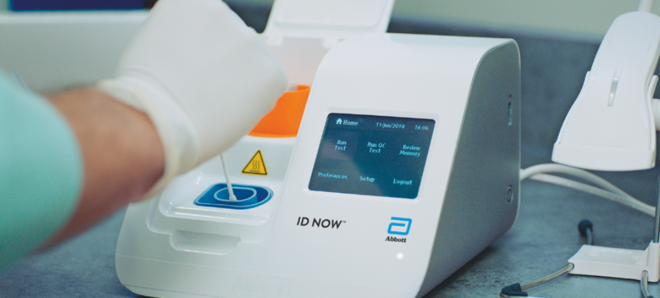
ID NOW for Covid-19 testing

Slide 2
Objectives
Demonstrate knowledge and proper use of the ID NOW COVID-19 2.0 molecular tests.
Performing Quality Control and Patient Testing.
Evaluating Results.

Slide 3
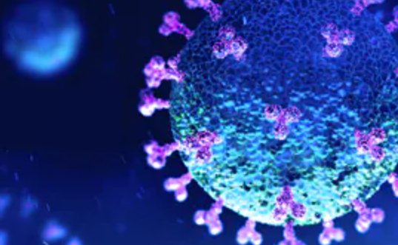
What is the id now covid-19 2.0 molecular test?
Coronaviruses are a large family of viruses which may cause illness in animals or humans. SARS-CoV-2 is an enveloped, single-stranded RNA virus of the β genus. The virus can cause mild to severe respiratory illness and has spread globally, including the United States.
ID NOW uses isothermal technology, proprietary enzymes and constant temperature control to achieve the fastest available RNA amplification. This proven molecular system greatly reduces the time for results, allowing healthcare providers to make patient care decisions sooner.

Slide 4
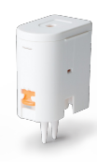
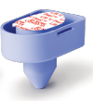
Supplies Needed for testing:
Transfer Cartridge
Analyzer
Sample Receiver
Test Base
Sterile Swab

Slide 5
Storage of supplies
Tests should be stored in their sealed pouch at room temperature not to exceed 30⁰C (86⁰F) until the manufacturer’s expiration date.
Never use any supplies, including test kits, beyond their expiration date.

Slide 6
Specimen Collection and handling
Nasal Swab
To collect a nasal swab sample, carefully insert the swab into the nostril exhibiting the most visible drainage, or the nostril that is most congested if drainage is not visible. Using gentle rotation, push the swab until resistance is met at the level of the turbinates (less than one inch into the nostril). Rotate the swab 5 times or more against the nasal wall then slowly remove from the nostril. Using the same swab, repeat sample collection in the other nostril.

Slide 8
Testing Procedure
Scan or enter user ID

Slide 9
Testing Procedure Cont.
Click Run Test

Slide 10
Testing Procedure Cont.
Click COVID-19

Slide 11
Testing Procedure Cont.
Enter or scan Patient ID

Slide 12
Testing Procedure Cont.
Open Lid and insert test base into the device.
Place sample receiver in holder.

Slide 13
Testing Procedure Cont.
Remove seal and mix swab for 10 seconds.

Slide 14
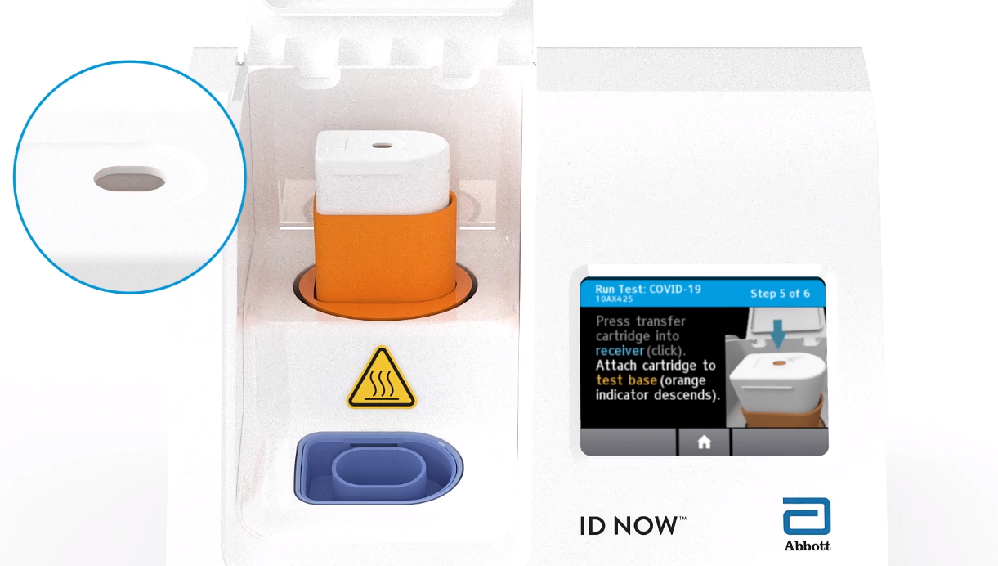
Testing Procedure Cont.
Press transfer cartridge into receiver until you hear a “click” and the orange indicator ascends to the top.
Attach cartridge to the test base and press until the orange indicator descends.

Slide 15
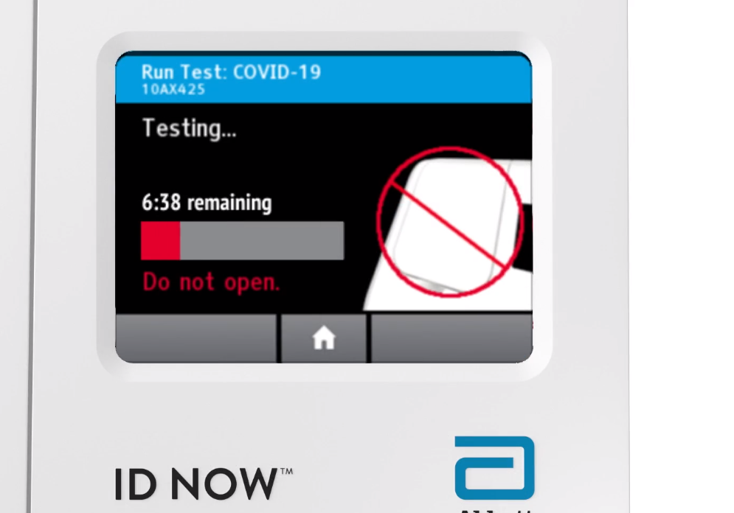
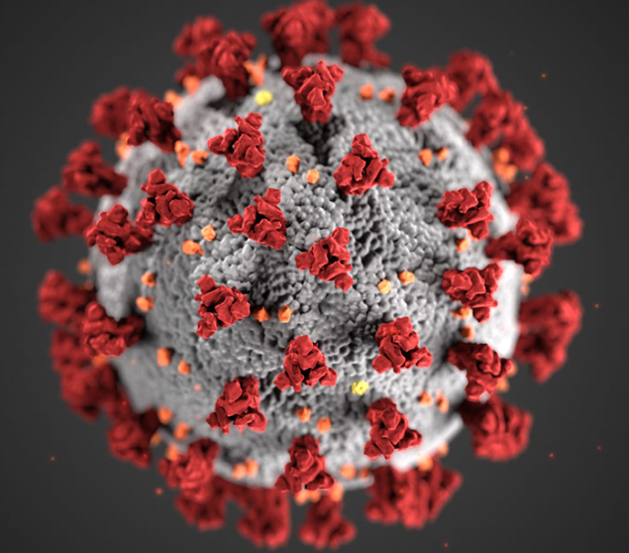
Testing Procedure Cont.
Close Lid. Wait for the timer to complete testing.

Slide 16
Testing Procedure Cont.
Result will be automatically sent to PT’s chart and be available in CPRS.
Discard all cartridges into biohazard trash.

Slide 17
Interpretation of results
Negative results should be treated as presumptive and , if consistent with clinicals signs and symptoms, should be confirmed by PCR in the lab. Positive results are presumptive positive and should be sent to the lab to be confirmed by PCR. Invalid results should be repeated.

Slide 18
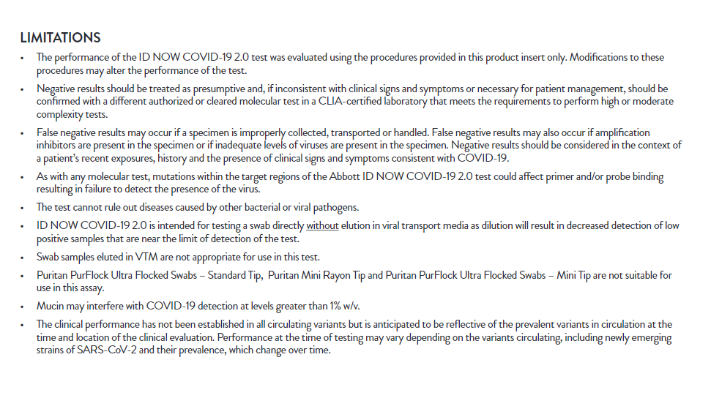
Limitations of testing

