Slide 1
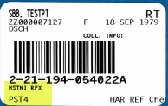
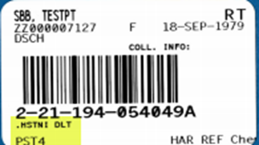
hs TnI Reflex (HSTNI RFX)
HSTNI RFX sample is drawn for the first hs Troponin.
When HSTNI RFX is resulted, a .HSTNI DLT order is automatically generated by the system, 2 hours from the time that the initial sample was drawn.

Slide 2
hs TnI Delta
dns hsTnI Rfx – This result field is automatically filled by Cerner, getting the result from the initial hs Troponin that came from the HSTNI RFX order. Do not call this result again to the provider even when you see that the value falls under the critical range. The first Troponin result has already been called and is attached to a different accession number. This result is not sent to Health Connect but is shown in Cerner and will be used in the delta calculation.
hsTnI 2nd – This is the result of the 2nd Troponin sample from the “.HSTNI DLT” order.
hsTNI Delta – This is a calculation result field performed by the system. It takes the difference of the 2nd hsTnI result and the initial hsTnI result. (Formula: hsTnI 2nd – dns hsTNI Rfx = hsTnI Delta)
**The hsTnI Delta calculation can only be performed if the 2nd hsTnI and the 1st hsTnI are draw within 6 hours of each other.**

Slide 3
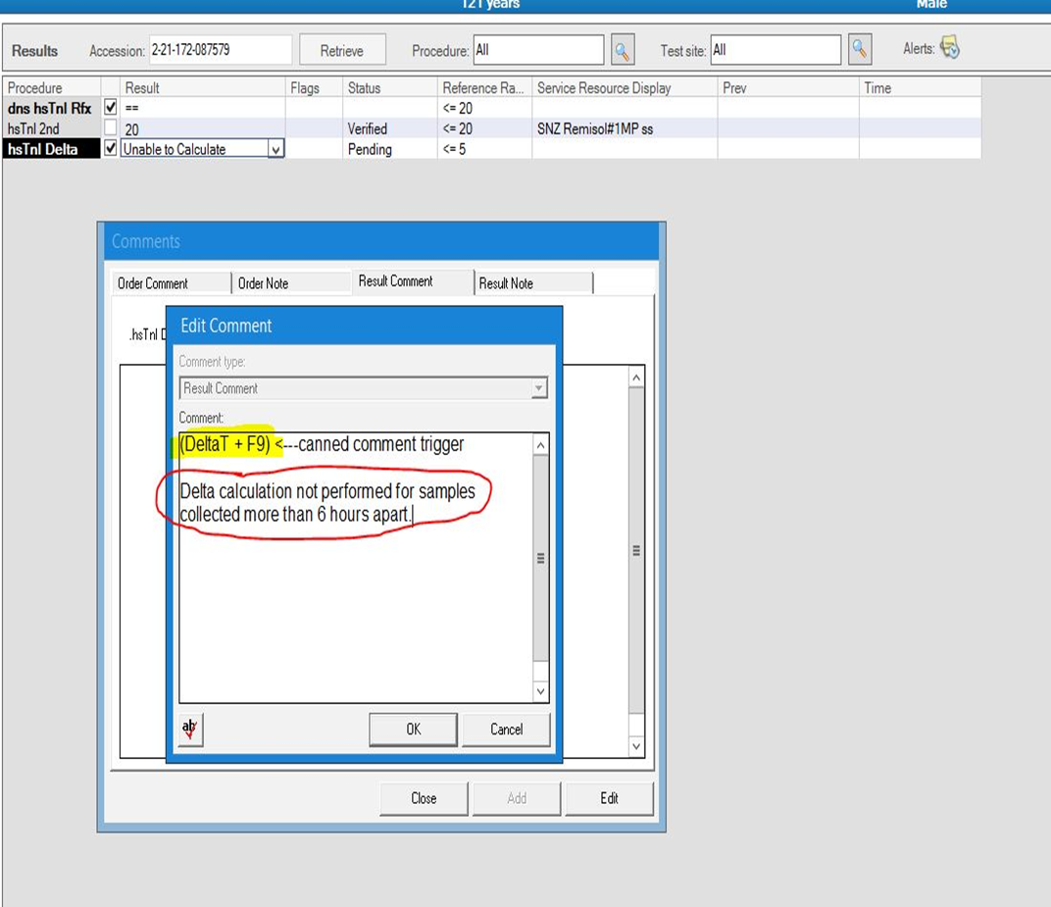
If the 2nd hsTnI is drawn later, more than 6 hours, follow these steps:
the dns hsTnI Rfx parameter is converted to Freetext and resulted with (= = )
the hsTnI Delta is converted to an Alpha response and resulted as Unable to Calculate.
A canned comment is then added using the trigger (DeltaT +F9) which will populate as “Delta calculation not performed for samples collected more than 6 hours apart.”

Slide 4
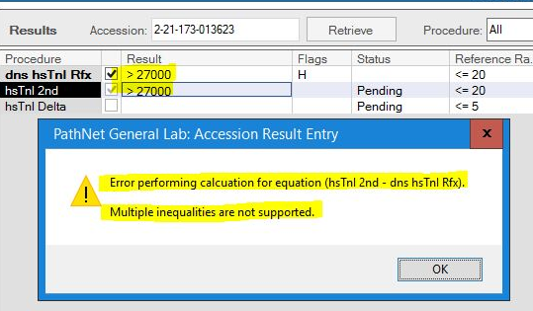
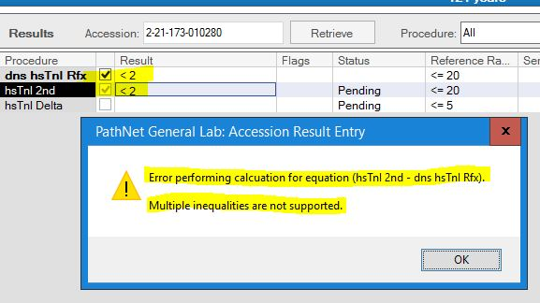
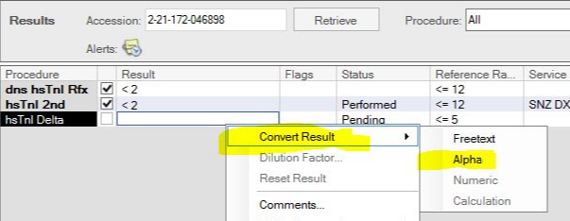
Resulting delta calculations for hsTnI results with multiple inequalities:
If both results are < 2 or with a >, Cerner will alert you of an Error in performing the calculation.
Result it as Unable to Calculate by converting it to an Alpha response.

Slide 5
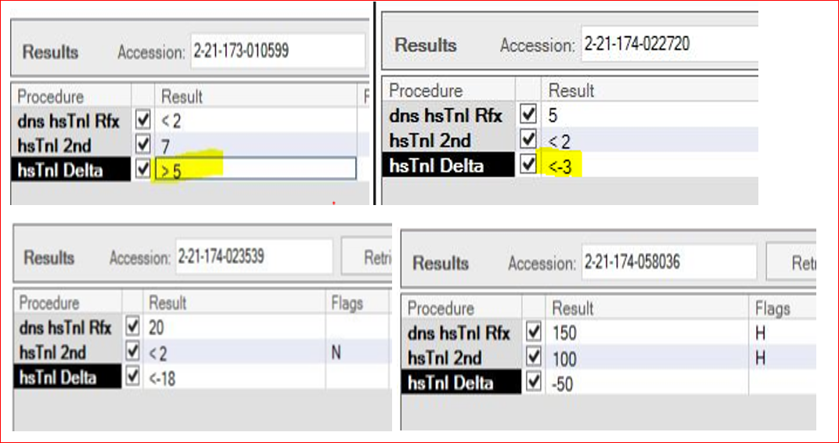
Other Scenarios of hsTnI Delta Calculations
Some delta calculations will come out with a < or > due to inequality on one of the result fields
May come out as negative when the 2nd hsTnI result is lower than the initial result.
Anytime the delta is > 11 pg/mL, it will flag as critical result and must be called to the provider.

