Slide 1

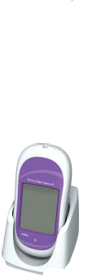
Accu-Chek Inform II
Blood Glucose Monitoring System.
Ancillary Testing Coordinator:
Michelle Roberts MT (AMT)

Slide 2
Training Objectives
By the end of this session you will be able to:
Explain why training is required.
Identify contraindications/test interferences.
State Why and When you have to quality control your meter.
Perform a Quality control and patient test as per SORCC Policy.
Identify Point of Care contact on site and where you get your meter supplies.

Slide 3
Why Training?
Because our patients deserve quality results and care.
To minimize adverse effects.
It is a CAP and JCAHO requirement.

Slide 4

Clinical Indications
Any patient requiring testing for the purpose of monitoring and managing diabetes control or glucose levels.

Slide 5
LIMITATIONS.
Hematocrit should be between 10-65%
IV administration of ascorbic acid resulting in >3 mg/dL. (May cause overestimation)
Galactose >15 mg/dL (May cause overestimation)
Lipids Triglycerides >1800 mg/dL (May increase glucose)
Dehydration
Hypotension
Shock
Peripheral Occlusive Disease
Hyperosmolar Non-Ketotic Coma
Diabetic Ketoacidosis
Unconscious Patients
Decompensated Heart Failure NYHA Class IV

Slide 6
Meter and Supplies
Barcode Scanner
Test Strip Port
Battery Compartment
Charging Contacts
Touch Screen
Infrared Window
On/Off Button

Slide 7
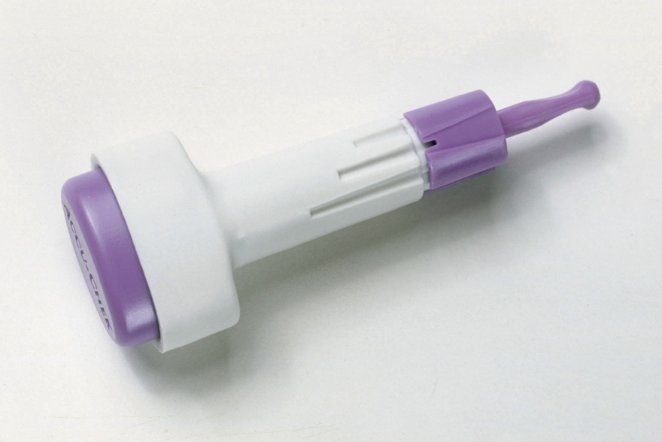
Safe T Pro Plus
Single Use Lancing Device
Depth Setting Protective Cap
Trigger Button
Notes:
Three Simple Steps:
Hold the lancet and twist off the sterility cap by twistng it in either direction. Throw the sterility cap away.
Select the depth you want by turning the depth adjuster.
Ensure the finger is clean and dry (wash with soap & water). Hold the Accu-chek Safe-T-pro plus firmly against the side of the fingertip and press the purple button on the top of the lancet. Dispose of in sharps container.

Slide 8
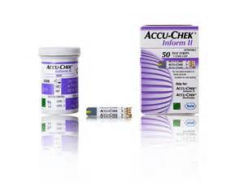
Supplies (cont.)
Control reagent and test strips are obtained from the lab.
Logistics is responsible for supplying lancets.
*Once opened, strips are good until expiration date on bottle.
*Quality Control Reagent:
Good for 90 days once opened.
You MUST put EXPIRATION date on the bottle.
Circle manufacturer’s expiration date if it is
less than 90 days after opening.

Slide 9
Accu-Check Inform II Test Strip.
Sample volume detection
Robust End Dosing Strip
Fast 5 Second Result
0.6μL sample size
Notes:
Test Strip – Is robust and can be handled as long as hands are clean, dry & free from alcohol gel. They are dosed at the tip of the strip. (End dosing strip).
You must ensure when applying blood/QC solution that the yellow test pad is completely covered for accurate results.
Storage of test strips: The lid must be kept firmly closed on the pot as exposure to heat & humidity can cause the test strips to give inaccurate results. If the lid is left off – dispose of the pot of test strips. Validation before use – On insertion of the test strip you must validate that the digit code on the pot of test strips corresponds with the code displayed on the screen of the meter before performing a test.
Check expiry date of test strips before use.
Uderdose detection (error code E4) prevents using a strip with insufficient sample.
The Performa strip also compensates for temperature, humidity & Haematocrit – gives error messages if unable to compensate.
The Performa strip also detects sample type: blood /QC

Slide 10
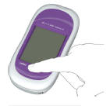
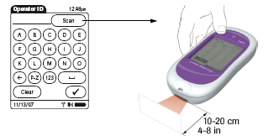
Start Up – User Identification.
1 Press and release the On/Off button . The system is now on.
2 The Power Up screen appears.
User ID is 4 digits long (last 4 of SSN)
User ID unique to user and
compulsory for all activities

Slide 11

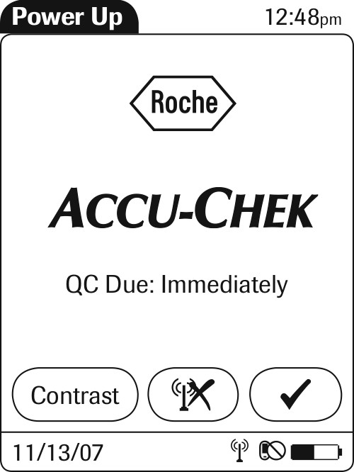
Accu-Chek Inform II
Power up screens
You will see the following screens:
There may or may not be “QC Due: Immediately”

Slide 12
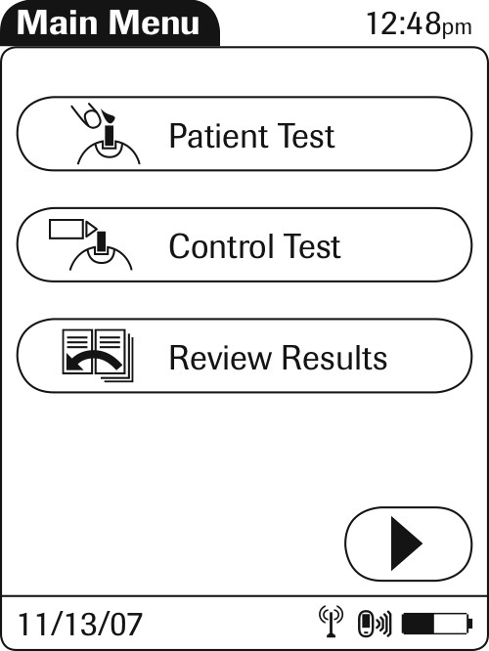
Main Menu Screen Shot.
Perform QC if prompted or action is needed
by choosing “Control Test”

Slide 13
Quality Control Testing
When to Quality Control?
Why Quality Control?
Once per 24 hours
To ensure meter and strips are operating properly.
When new lot of strips are opened.
When a new lot of reagents
are opened.
When you notice strips have
been left open.
When you suspect erroneous
results.
Anytime the meter has been dropped or mis-handled.

Slide 14
Quality Control Screens:
2.Press barcode icon
and scan control vial.
1. Press “Control Test”

Slide 15
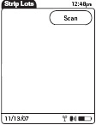
Strip Confirmation Screens
From this screen press scan
(barcode icon), then scan the
strip vial.

Slide 16
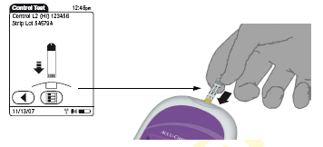
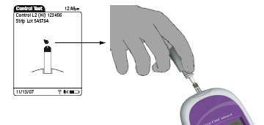
Performing a Quality Control Test.
Insert strip and wait for the screen with the droplets to appear prior to placing control drop.
*Note: Ensure you mix the QC vials prior to testing. Failure to mix is the main cause of QC errors. Also, the drop does not get placed on top of the yellow portion but rather the very end of the strip. DO NOT hold the meter in an upright position when performing QC. The QC liquid will drip in the strip port and will cause the meter to malfunction.

Slide 17
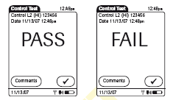
Result Screen:
Note: If using the lab meter you may see numerical values, press the “range” button to make sure QC result is within range.

Slide 18
Failed Quality Control Test
Level 1 & 2 solutions must pass QC test.
If test displays FAIL: Add Comment and repeat test.
Troubleshoot:
Ensure there are no bubbles present at tip of control vial when performing test. Mix samples adequately.
Check expiry dates, mix/change QC solutions & test strips – repeat test.
Contact ATC in the lab to report fault and obtain replacement meter.
If meter continues to fail DO NOT use it!

Slide 19
Quality Control Review:
Checks accuracy of test strips and Inform Meter.
Level 1 & 2 controls MUST be analyzed every 24 hours – otherwise the user will be locked out for testing patient samples.
The meter will “lock” when QC has expired.
Expiration date must be on control reagents. (Good for 90 days unless expiration date on bottle is earlier.)

Slide 20
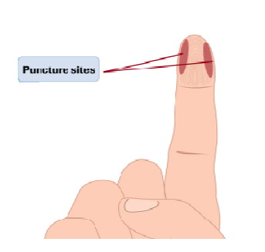
Preparing to Test
1. Operator to wash hands.
2. Identify patient.
3. Select, prepare and organize equipment.
4. Put on gloves.
5. Select site for skin puncture.
6. Clean and dry the site.
*Note: Site needs to be clean and dry otherwise it interferes with the accuracy of the result. Also to avoid contamination by food, dilution with water, alcohol and to reduce risk of infection.

Slide 21
Preparing to Test
7. Hold finger firmly.
8. Position the lancet on the site and depress the
plunger to make puncture and remove, discard
lancet in puncture resistant needle disposal unit.
9. Apply gentle pressure toward the site to create a
drop of blood at the puncture site.
10. Wipe the first drop of blood from the puncture site,
using gauze. Apply the second drop of blood to the
test strip.
11. Run test.
12. When complete remove gloves and wash hands.

Slide 22
Patient Testing.
Select patient test from menu
Scan patient badge. (If pt. does not have badge, ensure you enter correct ID number)
Meter will prompt you to confirm patient details
Scan in Test strips

Slide 23
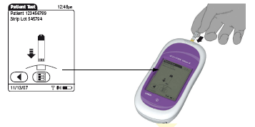
Check test strip code and insert strip.
~ Check Patients details at top of screen

Slide 24
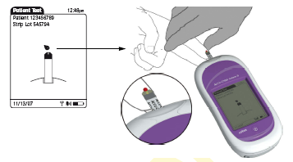
Apply patient blood when prompted.
Always perform a visual inspection of the yellow test area.

Slide 25

Results.
Normal Range = 71 – 109 mg/dL
Critical Range = <40 and >400 mg/dL
All critical results MUST be repeated by an RN immediately.
All repeated and confirmed critical results MUST have the comment “MD Notified”
Follow section protocol for critical glucose results.
If value is <30 or >545 report as such. Do not report a value <30 or >545.
If result is outside measuring range or value is not consistent with patient symptoms it should be verified with a blood draw for the lab.

Slide 26
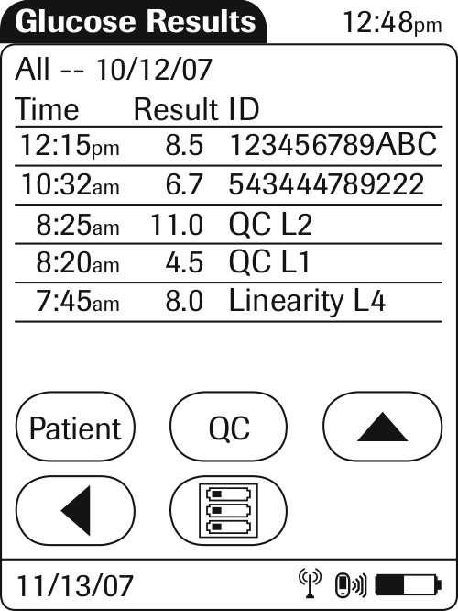
To Review Results
From main menu – select review result
All results are displayed on screen – Patient & QC
Select patient – to view patient results - scan ID
Select QC – to view QC results.

Slide 27
Cleaning the Meter.
It is a requirement that the meter be cleaned after each use.
Use the germicidal wipes approved by the facility.
Protect the strip port from moisture.

Slide 28
Meter Troubleshooting
If your meter is frozen or acting finicky you can reset it.
Resetting meter:
Remove from base. Hold power button for 20 seconds. Release power button. The meter should power on then off. Dock meter or continue with testing.
If you notice the meter is not charging or there is a buzzing sound then the charging base needs some TLC.
Ensure contacts on meter and base are clean. Sometimes the metal contacts on the base become recessed. You can take a pen tip and lightly pull the contacts out. In the event you still hear buzzing, try switching the meters on the charging stations.

Slide 29
Troubleshooting (cont.)
In the event that the meter will not cooperate, notify the ATC. If both meters are inoperable during evening, night, and weekend hours contact Roche Technical Support 1-800-440-3638.

Slide 30
CONTACTS
Michelle Roberts, Ancillary Testing Coordinator
michelle.roberts4@va.gov
541-826-2111 ext. 3227
Roche Technical Support
1-800-440-3638
Mike Gavin, Laboratory Manager
541-826-2111 ext. 3250

Slide 31
References
Roche Diagnostics. Accu-Check Inform II Operator's Manual Version 4. 02 2014.
VA SORCC Clinical Laboratory. "Accu-Check Inform II Procedure Manual." 07 2014.

