Slide 1

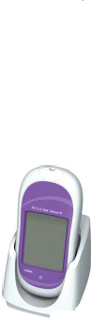
Accu-Chek Inform II
Blood Glucose Monitoring System
Ancillary Testing Coordinator:
Teresa Collins MLS (ASCP)^{cm}

Slide 2
Training Objectives
By the end of this session you will be able to:
Explain why training is required.
Identify contraindications/test interferences.
Identify components of the meter and supplies required for testing.
State Why and When you have to quality control your meter.
Perform Quality control, patient test and proficiency as per SORCC Policy.
Interpret glucose results.
Identify Point of Care contact on site.

Slide 3
Why Training?
Because our patients deserve quality results and care.
To minimize adverse effects.
To maintain competency in testing, interpreting results, and troubleshooting.
It is a CLIA, TJC, and CAP requirement.

Slide 4
SAFETY
Use proper hand hygiene (MCM IC-044)
Identify patients using two unique identifiers
Wear gloves when testing QC or patient specimens, change gloves in between patients, and wash or cleanse hands in between patients.
Use single-use Lancet and discard in approved sharps container after use.
Clean and disinfect Accu-Chek glucose meter after each patient use.

Slide 5

Clinical Indications
Any patient requiring testing for the purpose of monitoring and managing diabetes control or glucose levels.
Not to be used for critically ill patients.
Definition of critically ill patient: A patient with a mean arterial pressure of less than 60 mmHg or systolic pressure less than 90 mmHg or patient on vasopressors, patient with mottling of skin, patient with end stage congestive heart failure (CHF) (as defined by ejection fraction less than 15% mmHg), patient with hypothermia (body core temp less than 95 degrees Fahrenheit (F)), or patient with lactic acid of over 4.0 mmol/L. Note: if a patient present meeting the critically ill criteria and glucose testing is needed a lab draw for testing on lab instrumentation is required.

Slide 6
LIMITATIONS
Hematocrit should be between 10-65%
IV administration of ascorbic acid resulting in >3 mg/dL. (May cause overestimation)
Galactose >15 mg/dL (May cause overestimation)
Lipids: Triglycerides >1800 mg/dL (May increase glucose)
Dehydration
Hypotension
Shock
Peripheral Occlusive Disease
Hyperosmolar Non-Ketotic Coma
Diabetic Ketoacidosis
Unconscious Patients
Decompensated Heart Failure NYHA Class IV

Slide 7
Meter and Supplies
Barcode Scanner
Test Strip Port
Battery Compartment
Charging Contacts
Touch Screen
Infrared Window
On/Off Button

Slide 8
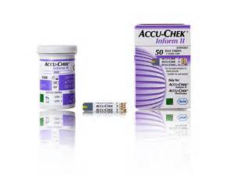
Supplies (cont.)
Control reagent and test strips are obtained from the lab.
Supply Chain Management is responsible for supplying lancets and
cleaning wipes.
*Reagent Strips:
Once opened, test strips are good until expiration date on bottle when properly closed and stored.

Slide 9
Accu-Check Inform II Test Strip:
Supplies (cont.)
Sample volume detection
Robust End Dosing Strip
Fast 5 Second Result
0.6μL sample size

Slide 10
Supplies (cont.)
*Quality Control Reagent:
Good for 90 days once opened.
*You MUST write EXPIRATION date on the bottle.
*Circle manufacturer’s expiration date if it is less than 90 days after opening.
* Meter will know when the manufacturer expiration date is but not the open expiration date.

Slide 11
Quality Control Testing
When to Quality Control?
Why Quality Control?
Once per 24 hours
To ensure meter and strips are operating properly.
When new lot of test strips are opened.
When a new lot of quality control are opened.
When you notice test strips have been left open.
When you suspect erroneous
results.
Anytime the meter has been dropped or mis-handled.

Slide 12
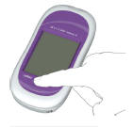
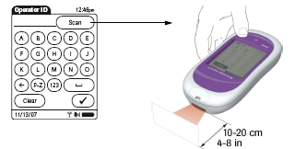
Start Up – User Identification
1 Press and release the On/Off button. The system is now on.
2 The Power Up screen appears.
Scan user ID (EHR ID)
User ID unique to user and
compulsory for all activities

Slide 13

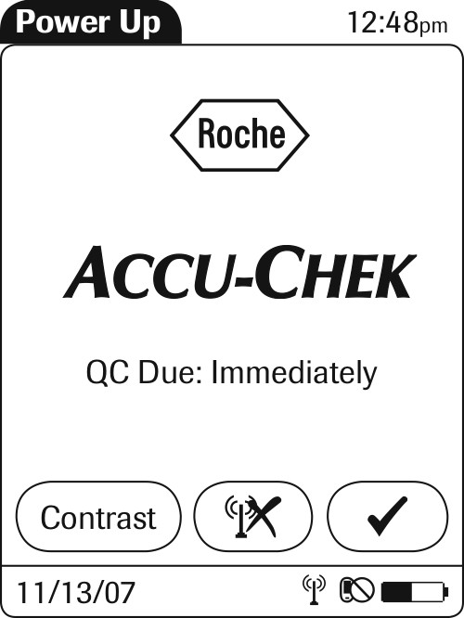
Accu-Chek Inform II
Power up screens
You will see one of the following screens:

Slide 14
Performing quality control
1. Press “Control Test”
2.Press barcode icon and scan control vial.

Slide 15
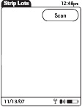
Performing quality control
3. Press “Scan” (barcode icon), then scan the test strip vial.

Slide 16
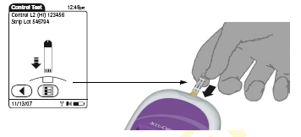
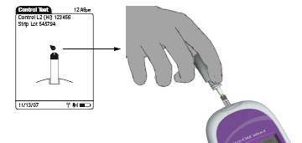
Performing quality control
5. Wait for the screen with the droplets to appear then place control drop on end.
4. Insert test strip.
Note: Ensure you mix the QC vials prior to testing. Failure to mix is the main cause of QC errors.
The drop does not get placed on top of the yellow portion but rather the very end of the strip.
DO NOT hold the meter in an upright position when performing QC. The QC liquid will drip in the strip port and will cause the meter to malfunction.

Slide 17
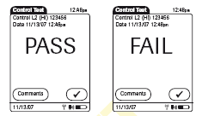
Performing quality control

Slide 18
Failed Quality Control Test
Level 1 & 2 solutions must pass QC test.
If test displays FAIL: Add Comment and repeat test.
Troubleshoot:
Ensure there are no bubbles present at tip of control vial when performing test. Mix samples adequately.
Check expiry dates, mix/change QC solutions & test strips.
Contact ATC in the lab to report fault and obtain replacement meter.
If meter continues to fail DO NOT use it!

Slide 19
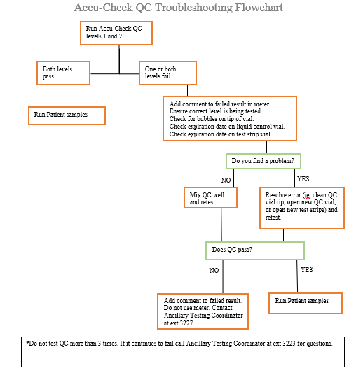
QC failure
Flowchart

Slide 20
Quality Control Review
Checks accuracy of test strips and Inform Meter.
Level 1 & 2 controls MUST be analysed every 24 hours – otherwise the user will be locked out for testing patient samples.
The meter will “lock” when QC reaches manufacturer expiration.
Expiration date must be on control reagents. (Good for 90 days unless expiration date on bottle is earlier.)

Slide 21
Patient Testing
1. Perform hand hygiene. Select, prepare and organize equipment
Log in to meter
Identify patient. Press the barcode and scan patient badge.
  a. If patient does not have badge, type the correct ID number using the keypad and press the check mark.
4. Press the check mark if the patient ID entered is correct. ALWAYS confirm patient name and date of birth prior to testing!
a. If not correct, press the “X” and re-enter.

Slide 22
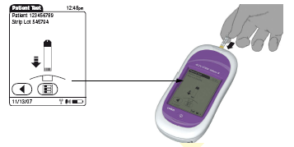
Patient Testing
5. Press the barcode and scan the test strips.
6. Review the test strip lot number and verify the patient ID at the top of the screen
7. Insert test strip.

Slide 23
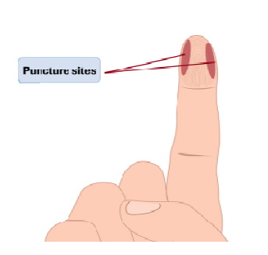
Patient testing
8. Put on gloves
9. Select site for skin puncture
10. Clean and dry the site*
11. Hold finger firmly, position the lancet on the site and depress the plunger to make puncture. Remove and discard lancet in puncture resistant needle disposal unit.
12. Apply gentle pressure toward the site to create a drop of blood at the puncture site
13. Wipe the first drop of blood from the puncture site, using gauze. Use the second drop of blood to add to the test strip.
*Note: Site needs to be clean and dry otherwise it interferes with the accuracy of the result. Avoid contamination by food, dilution with water, alcohol and to reduce risk of infection.

Slide 24
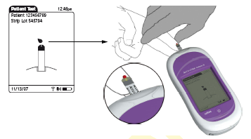
14. Apply patient blood when prompted. Always perform a visual inspection of the yellow test area, if it is discoloured use another strip.
Patient Testing

Slide 25
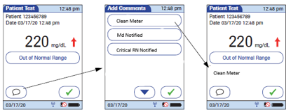
Patient Testing
15. Review results and add Clean Meter comment and critical comments if necessary
16. Click the check mark to accept the results with comment.
17. When complete, remove gloves and wash hands
18. Log out, clean and dock the meter

Slide 26

Normal Result Range
Normal Range: 71 – 109 mg/dL
If value is not consistent with patient symptoms it should be verified with a blood draw from the lab!

Slide 27

Critical Result Range
Critical Range: <50 and >400 mg/dL
All critical results MUST have the comment “Critical RN Notified” and be repeated by an RN immediately.
All repeated and confirmed critical results MUST have the comment “MD Notified”
Enter chart note for Critical Point of Care (POC) Value Notification.
If result is outside measuring range of <30 or >600, report as less than or greater than. It is recommended to verify with a blood draw from the lab.
*DO NOT report actual values <30 or >600.

Slide 28
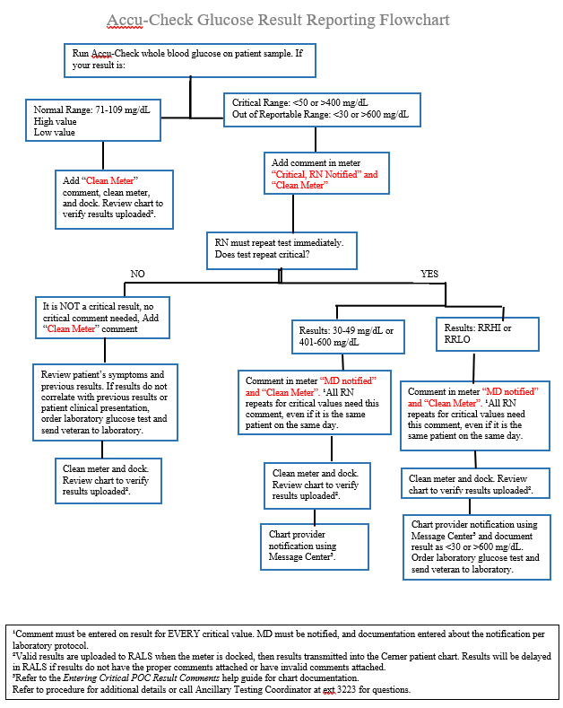
Resulting
Flowchart

Slide 29
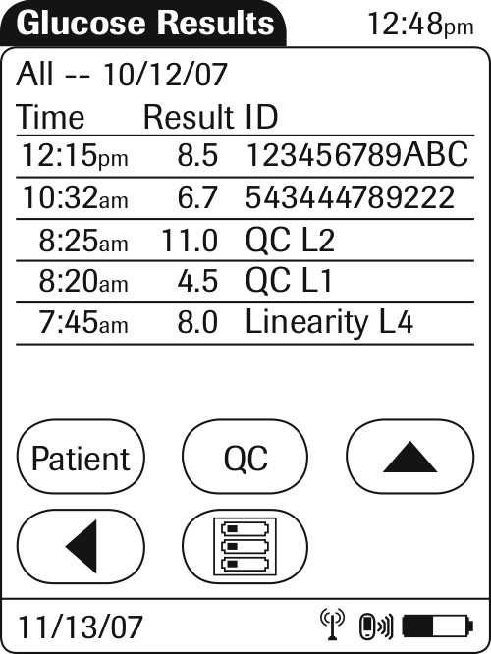
Reviewing Results
From Main Menu – select “Review Results”
All results are displayed on screen – Patient & QC
Select “Patient” – to view patient results (scan ID to search)
Select “QC” – to view QC results
Select list icon to back to the Main Menu

Slide 30
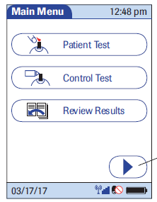
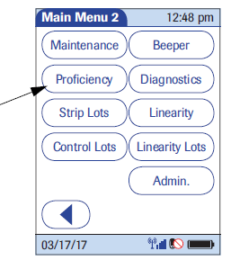
Performing proficiency testing
Press “Arrow” to access menu
2. On Main Menu 2, Press “Proficiency”

Slide 31
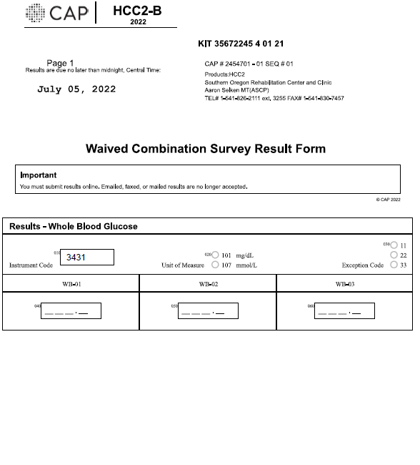
Performing proficiency testing
3. Enter name of proficiency test with keypad.
4. Press the green check
5. Scan test strips and run test
6. Record results on paperwork
7. Sign Attestation sheet if provided.

Slide 32
Cleaning the Meter
It is a requirement that the meter be cleaned and disinfected after each patient use using a 2-step process.
Use the manufacturer approved wipes.
Wring wipe out before use.
Protect the strip port from moisture.
Dry completely before docking.

Slide 33
Meter Troubleshooting
If your meter is frozen or acting finicky you can reset it.
Resetting meter:
Remove from base. Hold power button for 20 seconds. Release power button. The meter should power on then off. Dock meter and continue with testing.
If you notice the meter is not charging or there is a buzzing sound then the charging base needs some TLC.
Ensure contacts on meter and base are clean. Sometimes the metal contacts on the base become recessed. You can take a pen tip and lightly pull the contacts out. In the event you still hear buzzing, try switching the meters on the charging stations.

Slide 34
Troubleshooting (cont.)
If there is a red light on the base that doesn’t go away.
Interface issue. ITOPS may be working on it but if the light stays red then there is a problem that the ATC and ITOPS need to fix.
In the event that the meter will not cooperate, notify the ATC.
If both meters are inoperable during evening, night, and weekend hours contact Roche Technical Support 1-800-440-3638.

Slide 35
CONTACTS
Teresa Collins, Ancillary Testing Coordinator
teresa.c.collins@va.gov
541-826-2111 ext. 3223
Roche Technical Support
1-800-440-3638
Aaron Selken, Laboratory Manager
541-826-2111 ext. 3255

Slide 36
References
Roche Diagnostics. Accu-Check Inform II Operator's Manual Version 7.1 2020.
VA SORCC Clinical Laboratory. "Accu-Check Inform II CBG Procedure Manual." 2023.

