Slide 1

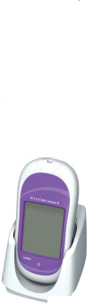
Accu-Chek Inform II
Blood Glucose Monitoring System

Slide 2
Training Objectives
By the end of this session you will be able to:
Explain why training is required.
Identify contraindications/test interferences.
Identify components of the meter and supplies required for testing.
State Why and When you have to quality control your meter.
Perform quality control, patient test and proficiency testing per SORCC Policy.
Interpret glucose results and appropriate comments.
Describe the cleaning/disinfection procesc
Identify Point of Care contact on site.

Slide 3
Why Training?
Because our patients deserve quality results and care.
To minimize adverse effects.
To maintain competency in testing, interpreting results, and troubleshooting.
It is a CLIA, TJC, and CAP requirement.

Slide 4
SAFETY
Use proper hand hygiene (INF-044)
Identify patients using two unique identifiers
Wear gloves when testing QC or patient specimens, change gloves in between patients, and wash or cleanse hands in between patients.
Use single-use Lancet and discard in approved sharps container after use.
Clean and disinfect Accu-Chek glucose meter after each patient use.

Slide 5

Clinical Indications
Any patient requiring testing for the purpose of monitoring and managing diabetes control or glucose levels.
Not to be used for critically ill patients.
Definition of critically ill patient: A patient with a mean arterial pressure of less than 60 mmHg or systolic pressure less than 90 mmHg or patient on vasopressors, patient with mottling of skin, patient with end stage congestive heart failure (CHF) (as defined by ejection fraction less than 15% mmHg), patient with hypothermia (body core temp less than 95 degrees Fahrenheit (F)), or patient with lactic acid of over 4.0 mmol/L. Note: if a patient present meeting the critically ill criteria and glucose testing is needed a lab draw for testing on lab instrumentation is required.

Slide 6
LIMITATIONS
Hematocrit should be between 10-65%
IV administration of ascorbic acid resulting in >3 mg/dL (may cause overestimation of results)
IV administration of N-acetylcysteine resulting in >5 mg/dL (may cause overestimation of results)
Galactose >15 mg/dL (may cause overestimation of results)
Triglycerides >1800 mg/dL (may produce elevated results)
Impaired peripheral circulation such as
  Severe dehydration as a result of diabetic ketoacidosis
  Hyperglycemic hyperosmolar non-ketotic syndrome
  Hypotension
  Shock
  Peripheral Occlusive Disease
  Decompensated Heart Failure NYHA Class IV

Slide 7
Meter and Supplies
Barcode Scanner
Test Strip Port
Battery Compartment
Charging Contacts
Touch Screen
Infrared Window
On/Off Button

Slide 8
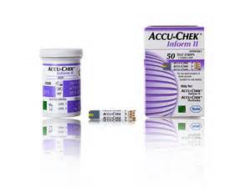
Supplies (cont.)
Control reagent and test strips are obtained from the lab.
Supply Chain Management is responsible for supplying lancets and
cleaning wipes.
Reagent Strips:
Once opened, test strips are good until expiration date on bottle when properly closed and stored.

Slide 9
Accu-Check Inform II Test Strip:
Supplies (cont.)
Sample volume detection
Robust End Dosing Strip-
insert end into meter
Fast 5 Second Result
0.6μL sample size

Slide 10
Supplies (cont.)
Quality Control Reagent:
Good for 90 days once opened.
You MUST write EXPIRATION date on the bottle.
Circle manufacturer’s expiration date if it is less than 90 days after opening.
Meter will know when the manufacturer expiration date is but not the open expiration date.

Slide 11
Quality Control Testing
Why Quality Control?
To ensure meter and strips are operating properly
When to Quality Control?
Once per 24 hours
When new box of test strips are opened
When new lot of test strips are opened
When a new lot of quality control are opened
When you notice test strip container is left open
When you suspect erroneous results
Anytime the meter has been dropped or mis-handled

Slide 12
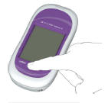
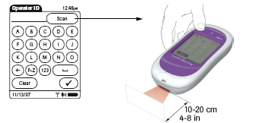
Start Up – User Identification
1 Press and release the On/Off button. The system is now on.
2 The Power Up screen appears.
Scan user ID (EHR ID)
User ID unique to user and
compulsory for all activities

Slide 13

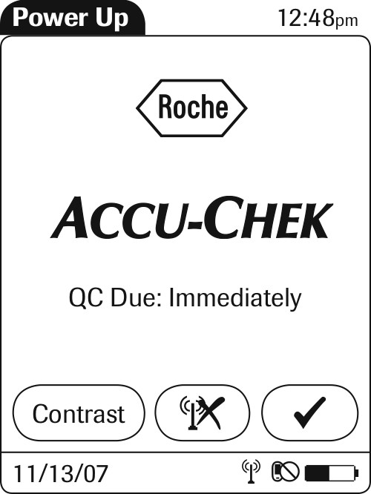
Accu-Chek Inform II
Power up screens
You will see one of the following screens:

Slide 14
Performing quality control
1. Press “Control Test”
2.Press barcode icon and scan control vial.

Slide 15
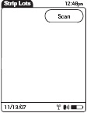
Performing quality control
3. Press “Scan” (barcode icon), then scan the test strip vial.

Slide 16
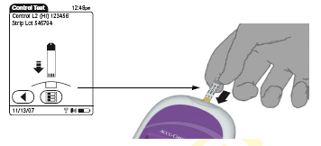
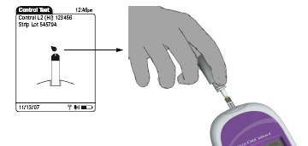
Performing quality control
5. Wait for the screen with the droplets to appear then place control drop on end.
4. Insert test strip.
Note: Ensure you mix the QC vials prior to testing. Failure to mix is the main cause of QC errors.
The drop does not get placed on top of the yellow portion but rather the very end of the strip.
DO NOT hold the meter in an upright position when performing QC. The QC liquid will drip in the strip port and will cause the meter to malfunction.

Slide 17
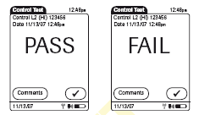
Performing quality control
Note: Enter Comments for a failed QC result

Slide 18
Failed Quality Control Test
Level 1 & 2 solutions must pass QC test.
If test displays FAIL: Add Comment and repeat test.
Troubleshoot:
Mix samples adequately.
Ensure there are no bubbles present at tip of control vial when performing test.
Check expiry dates, mix/change QC solutions or test strips.
If meter continues to fail DO NOT use it!
Contact ATC in the lab to obtain replacement meter.

Slide 19
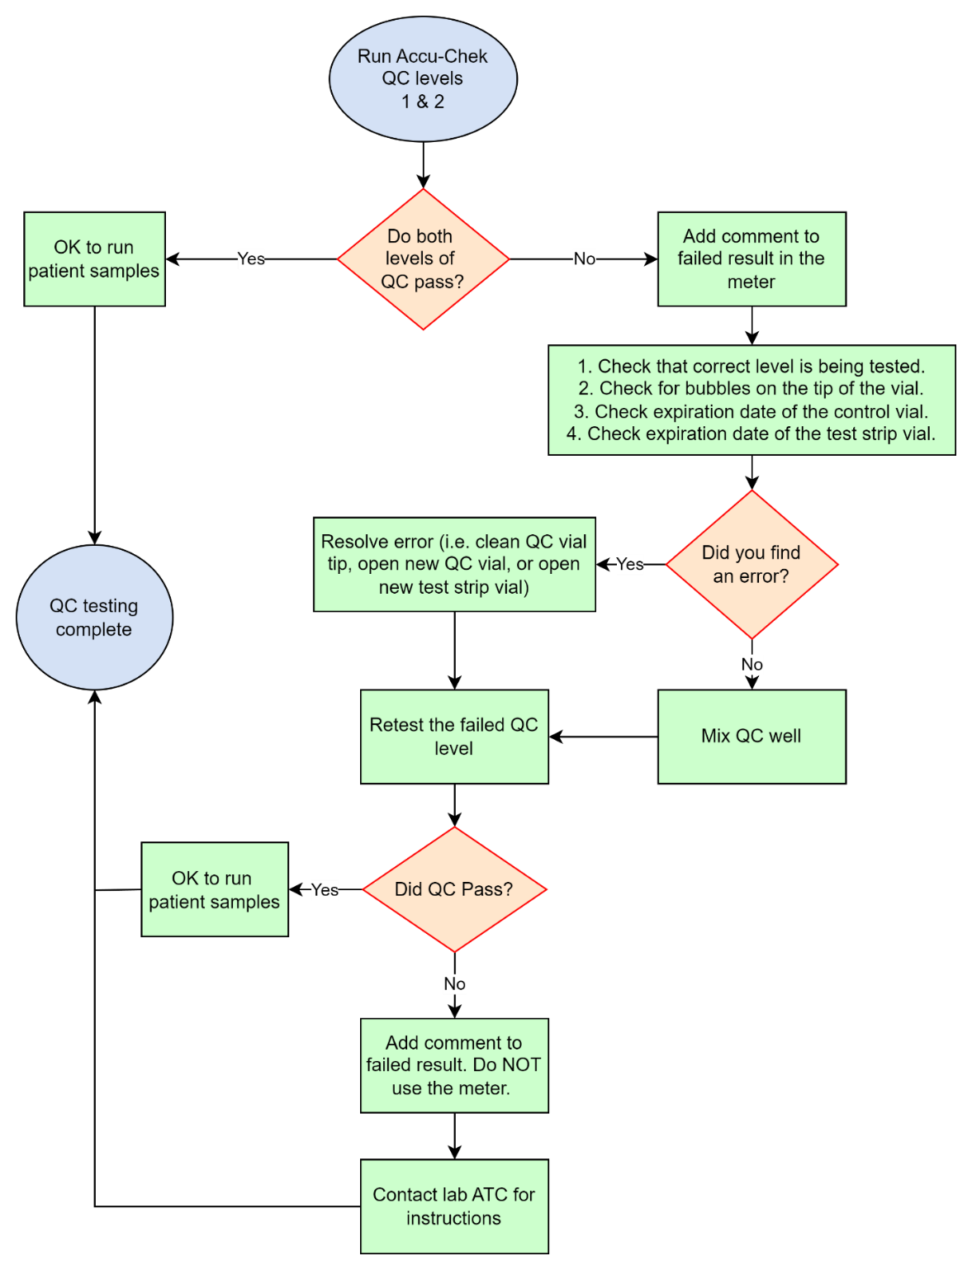
QC failure
Flowchart

Slide 20
Quality Control Review
Checks accuracy of test strips and Inform Meter.
Level 1 & 2 controls MUST be analysed every 24 hours – otherwise the user will be locked out for testing patient samples.
The meter will “lock” when QC reaches manufacturer expiration.
Expiration date must be on control reagents. (Good for 90 days unless expiration date on bottle is earlier.)

Slide 21
Patient Testing
Perform hand hygiene. Select, prepare and organize equipment
Log in to meter using operator ID
Identify patient using 2 full identifiers
  a. Scan patient ID
  b. If patient does not have barcode ID, type the correct ID number using the keypad and press the check mark.

Slide 22
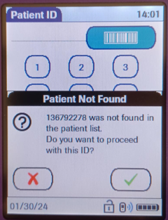
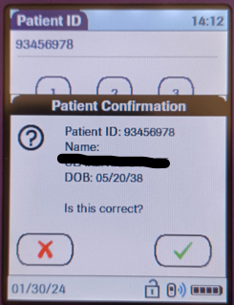
ALWAYS confirm patient name and date of birth prior to testing! Press the check mark if the patient ID entered is correct. a. If patient name and DOB are not present, press the “X” and re- enter.

Slide 23
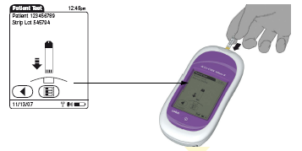
Patient Testing
Press the barcode and scan the test strips.
Review the test strip lot number and verify the patient ID at the top of the screen
Insert test strip.

Slide 24
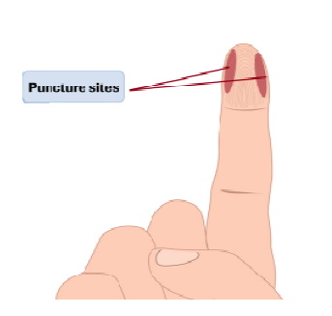
Patient testing
Put on gloves
Select site for skin puncture
Clean and dry the site
  Site needs to be clean and dry otherwise it interferes with the accuracy of the result. Avoid contamination by food, dilution with water, alcohol and to reduce risk of infection.
Hold finger firmly, position the lancet on the site and depress the plunger to make puncture. Remove and discard lancet in puncture resistant needle disposal unit.
Apply gentle pressure toward the site to create a drop of blood at the puncture site
Wipe the first drop of blood from the puncture site, using gauze. Use the second drop of blood to add to the test strip.

Slide 25
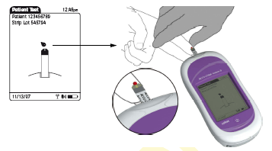
Apply patient blood when prompted.
Always perform a visual inspection of the yellow test area, if it is discolored use another strip.
Patient Testing

Slide 26
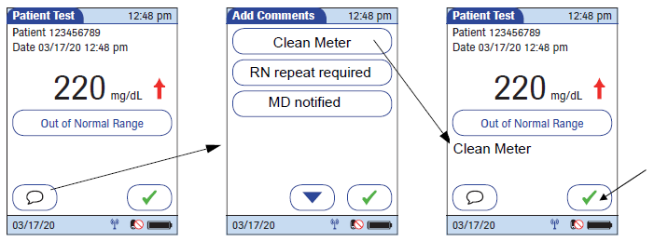
Patient Testing
Review results and add Clean Meter comment and critical comments if necessary.
  Note: You can click the comment bubble again to edit the comments.
Click the check mark to accept the results with comment.

Slide 27
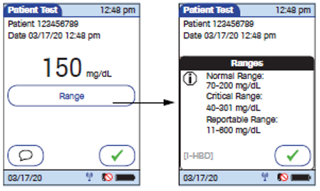
Patient Testing
Pressing the Range button will show you the reference ranges for the test.
When complete, log out, clean, disinfect, and dock the meter.
Remove gloves and perform hand hygiene.

Slide 28

Normal Result Range
Normal Range: 71 – 109 mg/dL
If value is not consistent with patient symptoms it should be verified with a blood draw from the lab!

Slide 29

Critical Result Range
Critical Range: <50 and >400 mg/dL
All critical results MUST have the comment “RN repeat required” and be repeated by an RN immediately.
All repeated and confirmed critical results MUST have the comment “MD Notified”
Enter chart note for Critical Point of Care (POC) Value Notification.
If result is outside measuring range of <30 or >600, report as less than or greater than. It is recommended to verify with a blood draw from the lab.
*DO NOT report actual values <30 or >600.

Slide 30
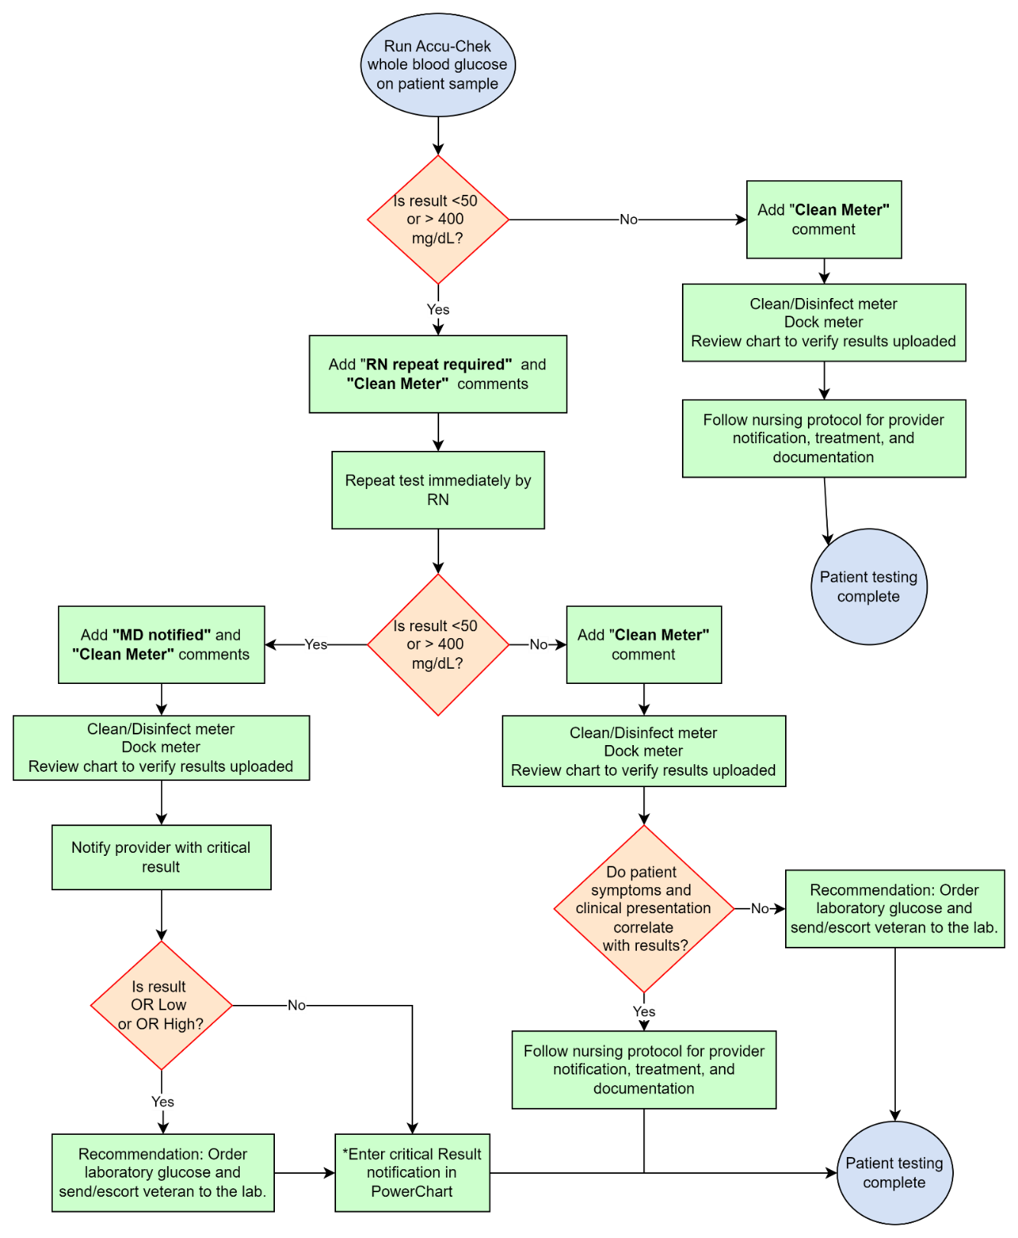
Resulting
Flowchart

Slide 31
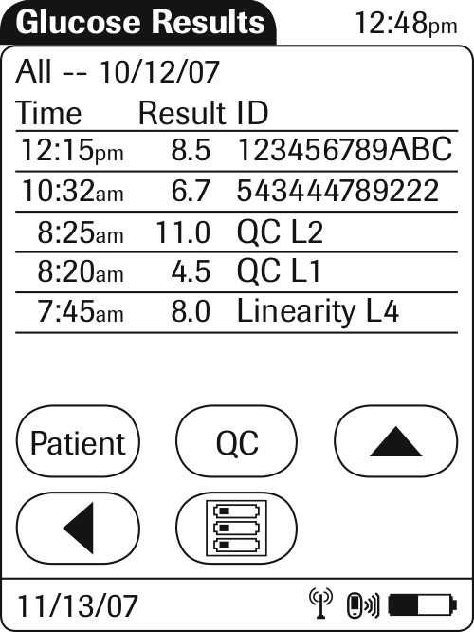
Reviewing Results
From Main Menu – select “Review Results”
All results are displayed on screen – Patient & QC
Select “Patient” – to view patient results (scan ID to search)
Select “QC” – to view QC results
Select list icon to back to the Main Menu

Slide 32
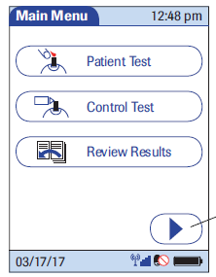
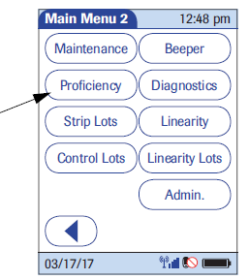
Performing proficiency testing
Press “Arrow” to access menu
2. On Main Menu 2, Press “Proficiency”

Slide 33
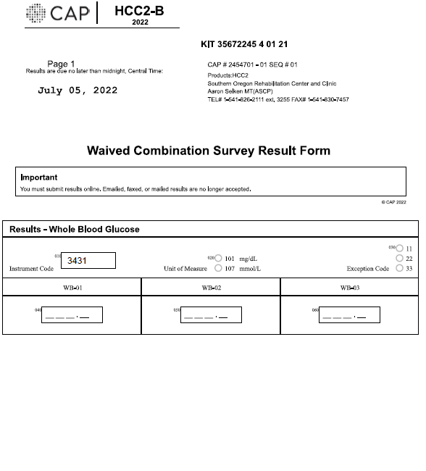
Performing proficiency testing
3. Enter name of proficiency test with keypad.
4. Press the green check
5. Scan test strips and run test
6. Record results on paperwork
7. Sign Attestation sheet if provided.

Slide 34
Cleaning the Meter
It is a requirement that the meter be cleaned and disinfected after each patient use using a 2-step process.
  Use the manufacturer approved wipes.
  Wring wipe out before use.
  Clean meter with one wipe and dry
  Disinfect meter with second wipe, allow meter to remain wet for the correct contact time
  Protect the strip port from moisture.
  Dry completely before docking.

Slide 35
Meter Troubleshooting
If your meter is frozen or acting finicky you can reset it
Resetting meter:
Remove from base. Hold power button for 20 seconds. Release power button. The meter should power on then off. Dock meter and continue with testing.
If there is a red light on the base that doesn’t go away
Interface issue. ITOPS may be working on it but if the light stays red then there is a problem that the ATC and ITOPS need to fix.

Slide 36
Troubleshooting (cont.)
If the meter is not functioning properly, notify the ATC.
If both meters are inoperable during evening, night, and weekend hours contact Roche Technical Support 1-800-440-3638.

Slide 37
CONTACTS
Teresa Collins, Ancillary Testing Coordinator
teresa.c.collins@va.gov
541-826-2111 ext. 3223
Roche Technical Support
1-800-440-3638
Aaron Selken, Laboratory Manager
541-826-2111 ext. 3255

Slide 38
References
Roche Diagnostics. Accu-Check Inform II Operator's Manual Version 7.1 8/2020.
VHA Directive 1106. 1/24/2024
The Joint Commission E-dition. Chapter: Waived Testing. 1/14/24

