Slide 1
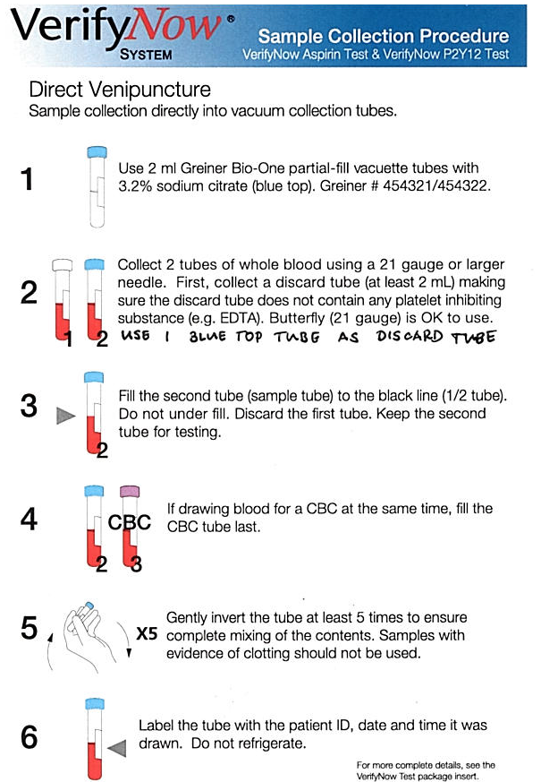
All 3 tubes ( 1 discard & 2 Greiner Tubes) to be walked to the Lab.
AL 11/2/12

