Slide 1
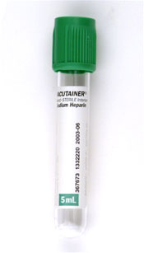
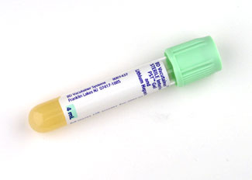
As the SCPMG Laboratory System implements its new Laboratory Computer- GenLab, a number of collection tube types have been changed. The collection labels will be changed to reflect the new collection tube types. Please refer to LabNet for further information.
Ammonia and Troponin
Current container ID GRN5
Cerner container ID PST4
Ammonia specimen still needs to be on ice.

Slide 2
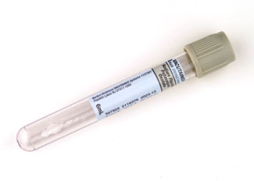
Alcohol
Current container ID GY7
Cerner container ID PST4

Slide 3
CK, CKMB, TDM’s ( Salicylate, Carbamazepine, Digoxin, Phenobarbital, Phenytoin, Theophylline, Vancomycin, Valproic, Acetaminophen, Gentamicin)
Current container ID RED7
Cerner container ID PST4

Slide 4
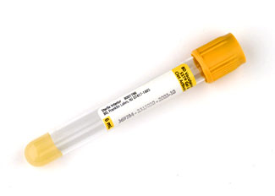
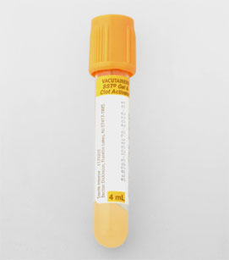
HCG and CRP
Current container ID SST7
7 ml. tube
Cerner container ID GLD6
4 ml. tube

Slide 5
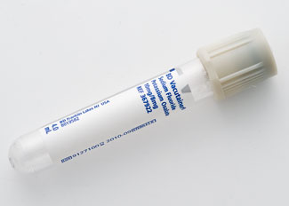
All Glucose Tolerance Tests
Current container ID PST4
Cerner container ID will still be PST4 but we will switch to Gray top tube ( 4 ml)

Slide 6
Lithium and Tobramycin
Container ID will remain RED7
We will switch to 4 ml tube

