Slide 1
How to result calculations
with inequalities
Prepared by: Lab Informatics Department Kaiser Regional Reference Lab Date: February 23, 2015

Slide 2
Calculations with Inequalities
When a test is part of a calculation and the result is less than or greater than the linear range, the calculated result is erroneous. Since Cerner is literal, it calculates only the number, and does not recognize the < or > sign.
A workflow is needed to avoid reporting the wrong calculated value.
1

Slide 3
Calculations with Inequalities
1. Click Accession Result Entry (ARE) on the AppBar.
2. Enter the Accession and click Retrieve.

Slide 4
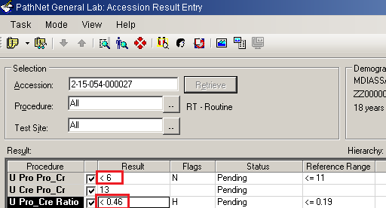
Calculations with Inequalities
3. Note that the Urine Protein Creat result is <6 and the calculated Ratio is <0.46, which is erroneous.
4. Do not Verify the result.

Slide 5
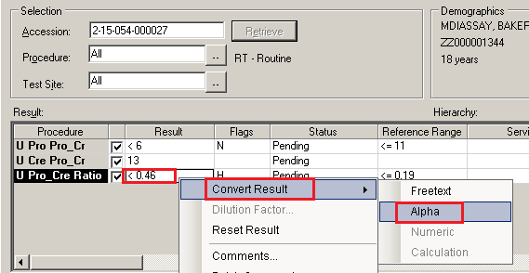
Calculations with Inequalities
5. Right click on the Ratio field, select Convert Result,
and select Alpha.

Slide 6
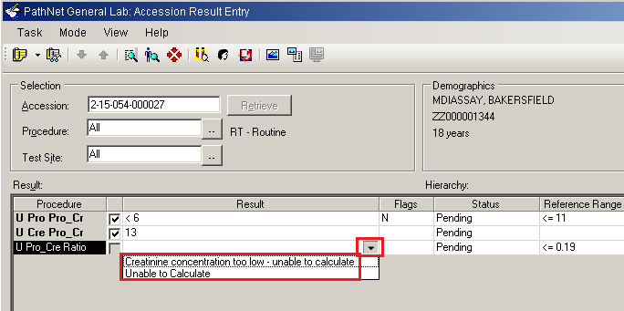
Calculations with Inequalities
6. Select the applicable text from the dropdown arrow.

Slide 7
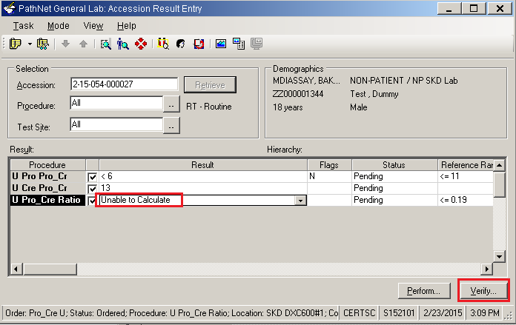
Calculations with Inequalities
7. Click Verify.

