Slide 1
LABORATORY FIRE SAFETY: Code Red Response, Fire Extinguishers, Pull Stations
4867 SUNSET BOULEVARD – MAIN LABORATORY

Slide 2
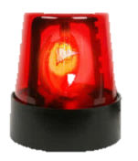
EMERGENCY RESPONSE CODE FOR A FIRE
CODE RED
3-3000

Slide 3
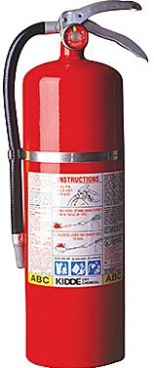
FIRE EXTINGUISHERS
P
ULL
A
IM
S
QUEEZE
S
WEEP

Slide 4
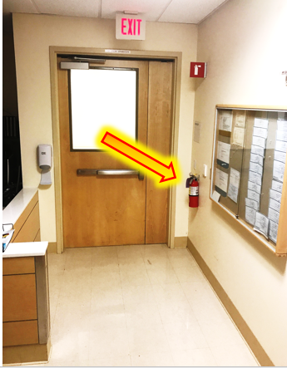
LOCATION OF FIRE EXTINGUISHERS – 4867 MEDICAL CENTER
Next to SW side door (Admin Coordinator Desk)
Outside the management entrance door to the right within the wall compartment
Behind the printer located next to Chemical Spill kit
Inside the EMPLOYEE LOUNGE
OUTSIDE MAIN ENTRANCE (Double doors leading to Flow Cytometry)
CONTROLLER AREA - Phlebotomy staging area
EMPLOYEE RESTROOM – outside of the restroom to the right

Slide 5
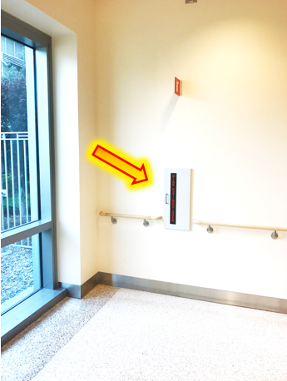
LOCATION OF FIRE EXTINGUISHERS – 4867 MEDICAL CENTER
Next to SW side door (Admin Coordinator Desk)
Outside the management entrance door to the right within the wall compartment
Behind the printer located next to Chemical Spill kit
Inside the EMPLOYEE LOUNGE
OUTSIDE MAIN ENTRANCE (Double doors leading to Flow Cytometry)
CONTROLLER AREA - Phlebotomy staging area
EMPLOYEE RESTROOM – outside of the restroom to the right

Slide 6
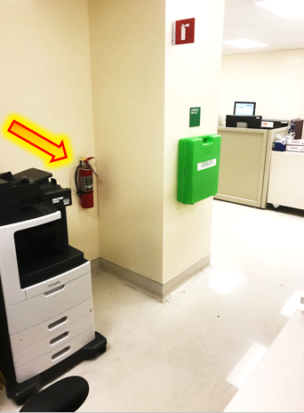
LOCATION OF FIRE EXTINGUISHERS – 4867 MEDICAL CENTER
Next to SW side door (Admin Coordinator Desk)
Outside the management entrance door to the right within the wall compartment
Behind the printer located next to Chemical Spill kit
Inside the EMPLOYEE LOUNGE
OUTSIDE MAIN ENTRANCE (Double doors leading to Flow Cytometry)
CONTROLLER AREA - Phlebotomy staging area
EMPLOYEE RESTROOM – outside of the restroom to the right

Slide 7
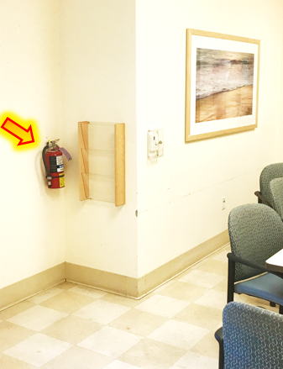
LOCATION OF FIRE EXTINGUISHERS – MAIN LAB
4867 MEDICAL CENTER
Next to SW side door (Admin Coordinator Desk)
Outside the management entrance door to the right within the wall compartment
Behind the printer located next to Chemical Spill kit
Inside the EMPLOYEE LOUNGE
OUTSIDE MAIN ENTRANCE (Double doors leading to Flow Cytometry)
CONTROLLER AREA - Phlebotomy staging area
EMPLOYEE RESTROOM – outside of the restroom to the right

Slide 8
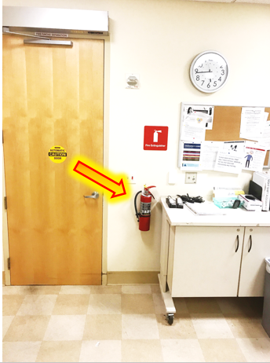
LOCATION OF FIRE EXTINGUISHERS – MAIN LAB
4867 MEDICAL CENTER
Next to SW side door (Admin Coordinator Desk)
Outside the management entrance door to the right within the wall compartment
Behind the printer located next to Chemical Spill kit
Inside the EMPLOYEE LOUNGE
OUTSIDE MAIN ENTRANCE (Double doors leading to Flow Cytometry)
CONTROLLER AREA - Phlebotomy staging area
EMPLOYEE RESTROOM – outside of the restroom to the right

Slide 9
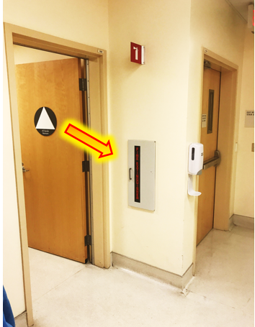
LOCATION OF FIRE EXTINGUISHERS – MAIN LAB
4867 MEDICAL CENTER
Next to SW side door (Admin Coordinator Desk)
Outside the management entrance door to the right within the wall compartment
Behind the printer located next to Chemical Spill kit
Inside the EMPLOYEE LOUNGE
OUTSIDE MAIN ENTRANCE (Double doors leading to Flow Cytometry)
CONTROLLER AREA - Phlebotomy staging area
STAFF LOCKERS / RESTROOM– outside of the restroom to the right

Slide 10
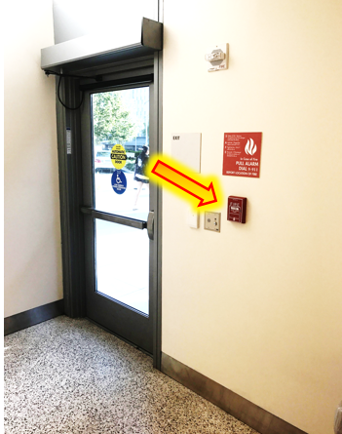
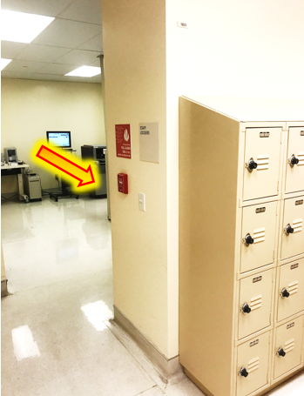
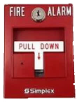
FIRE PULL STATIONS
1
2
EXIT from LAB outside “Stairwell 7”
Next to Staff Lockers outside restrooms

