Slide 1
CoPathPlus Cytology Accessioner Training
Cytology Accessioning Instructions

Slide 2
Cytology Accessioning Summary
Scan MRN barcode on Requisition form into CoPath New Accession activity.
Confirm default, or select the Order Number.
Enter the Specimen Class.
Accept the Accession Number.
Review data received from the interface.
Press Save/New Specimen.
Labels will auto-print. Properly attach them to the specimen and paperwork.
CoPath Cytology Accessioning usually takes less than a minute to complete. Error messages are uncommon, but can occur. Detailed instructions are included in this guide showing CoPath displays plus potential error messages and how to handle each situation.

Slide 3
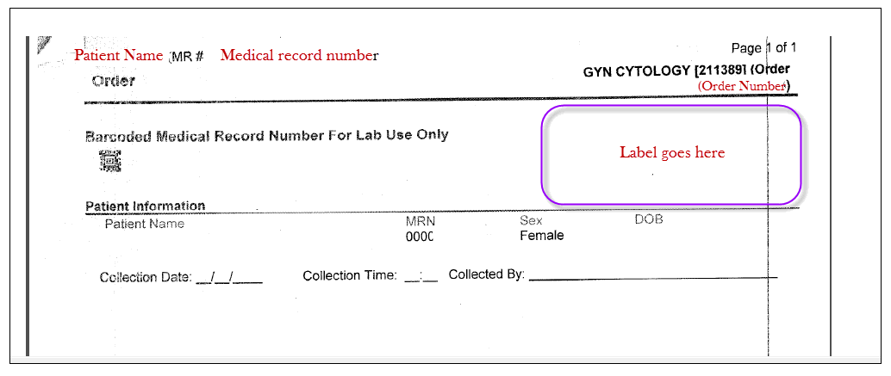
Example HC Requisition Form
The MRN Barcode is scanned into the CoPath New Accession window to identify the patient. The Order Number in the upper right can be used to select the right order when multiple orders exist. After your accession is complete, place the Requisition Label in the location indicated.

Slide 4
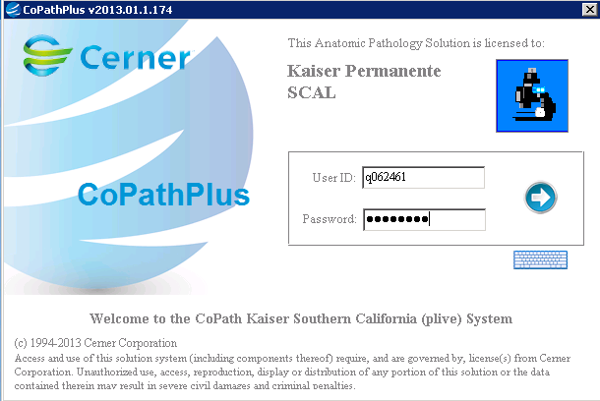
Logging in to CoPath
Double-click on the Live CoPath icon on your desktop to get to the Logon screen.
Enter your NUID as the User ID and your password into the Password field. Either hit the Enter key or click on the blue arrow icon to log on.

Slide 5
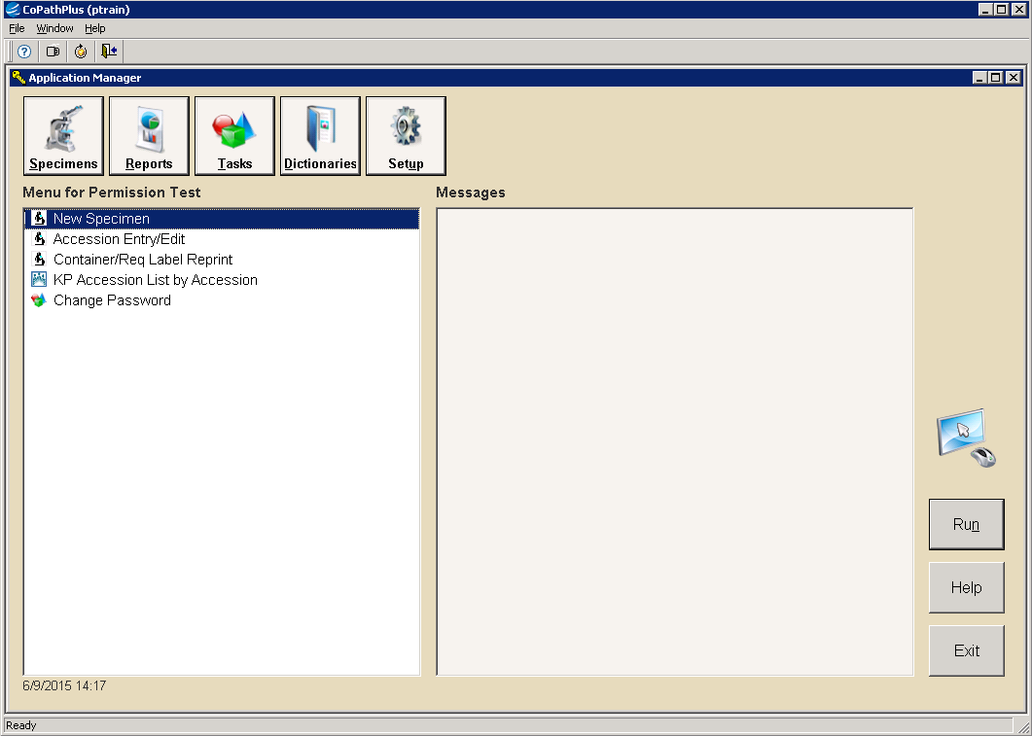
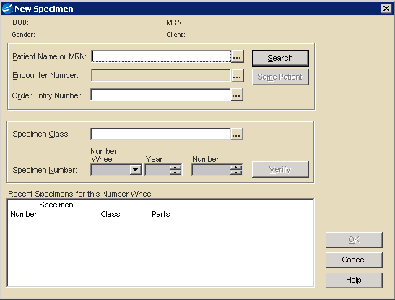
Select New Specimen
Click on New Specimen from your Personal menu to open the New Specimen window.
Scan the MRN barcode on the Requisition form into the Patient Name or MRN field.

Slide 6
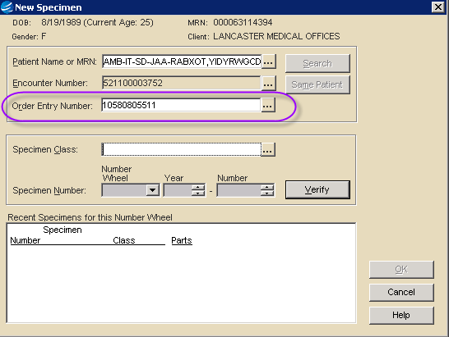
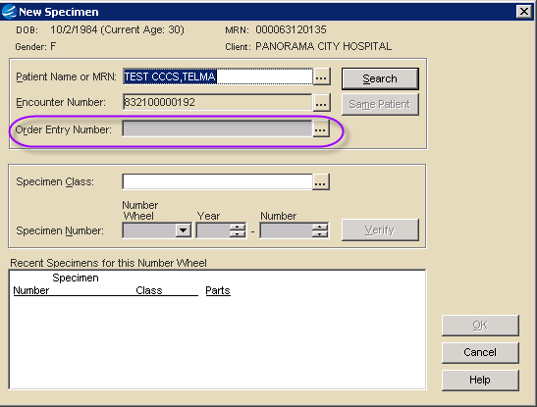
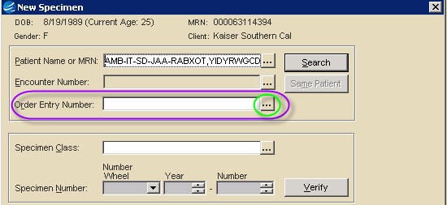
Check the Order Number Field
1
If there is just one pending order on the patient, CoPath will load it up for you.
2
With no pending orders, the Order Entry Number field is inactivated.
3
With multiple pending orders, this field is available, but empty. You MUST press the ellipsis button to select the proper order.

Slide 7
An Order Number Defaults In
1
A defaulted Order Number into your Order Entry Number field means there is just one pending order on the patient. Compare number displayed to the Order Number on the HealthConnect (HC) Requisi-tion form. If it matches, proceed with accessioning.
Note: The Order Number shown in CoPath has two leading digits that are not included on the printed Requisition Form.
Example: An Order Number of 08123456789 in CoPath matches 123456789 printed on the HealthConnect Requisition Form.
The two leading digits are:
07 = San Diego
08 = Orange County
09 = TriCentral
10 = Valley
11 = Metro LA
12 = Inland Empire

Slide 8
Inactive Order Number Field
2
An inactivated Order Entry Number field on the patient means there are no pending orders on this patient!
If you have the HC Order Requisition Form, but there are NO order messages – Call the Help Desk and report the issue. Provide the MRN and order number from your requisition form.
Someone will need to look into this issue before accessioning can occur.
Never accession the case without an order number! Doing this will cause both duplicate orders on the HealthConnect side and problems with billing.

Slide 9
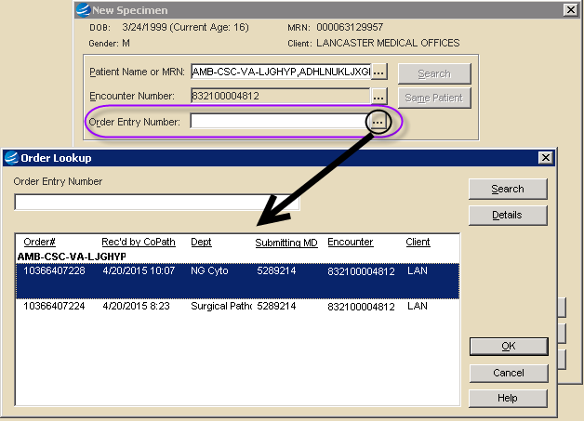
Open Order Number Field
3
An open Order Number field means multiple pending orders exist on the patient. You MUST press the Ellipsis button ( ... ) to find and select the right order number. Do NOT accession the case without selecting an Order Number!!
Use the Order# column to match on the Order Number (excluding the first two digits) from the Requisition form. You can also use the Dept column to identify the GYN Cyto and NG Cyto cases.

Slide 10
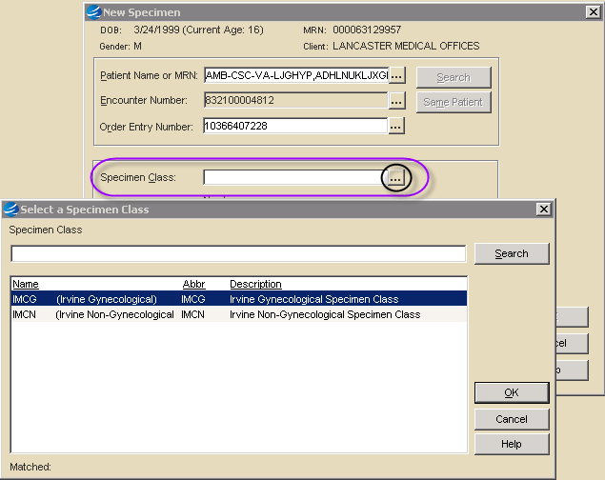
Enter the Specimen Class
Cytology Accessioners will have two available specimen classes. These classes are specific to the local medical center, and follow the format of:
xxxG for GYN
xxxN for NonGYN
Select the appropriate class for the case you are accessioning. Either use the Ellipsis to select the class or learn your two codes and just type in the appropriate code.

Slide 11
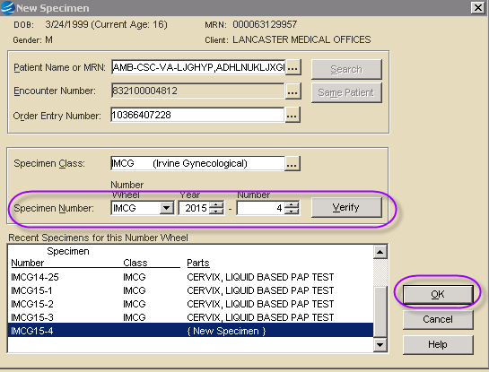
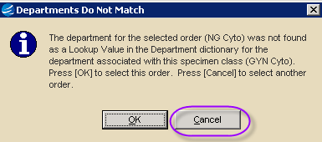
Accession Number is Assigned
CoPath auto-assigns an accession number after Specimen Class selection. Press the OK button to accept the number.
If you get the Departments do not match error you must Press Cancel!! This error means the order selected does not correlate to the specimen class selected. Check your Order Number and Specimen Class and then make the appropriate correction.
Note: If you find a surgical order in your batch of Cytology orders to be accessioned, send that order to the local pathology lab for accessioning.

Slide 12
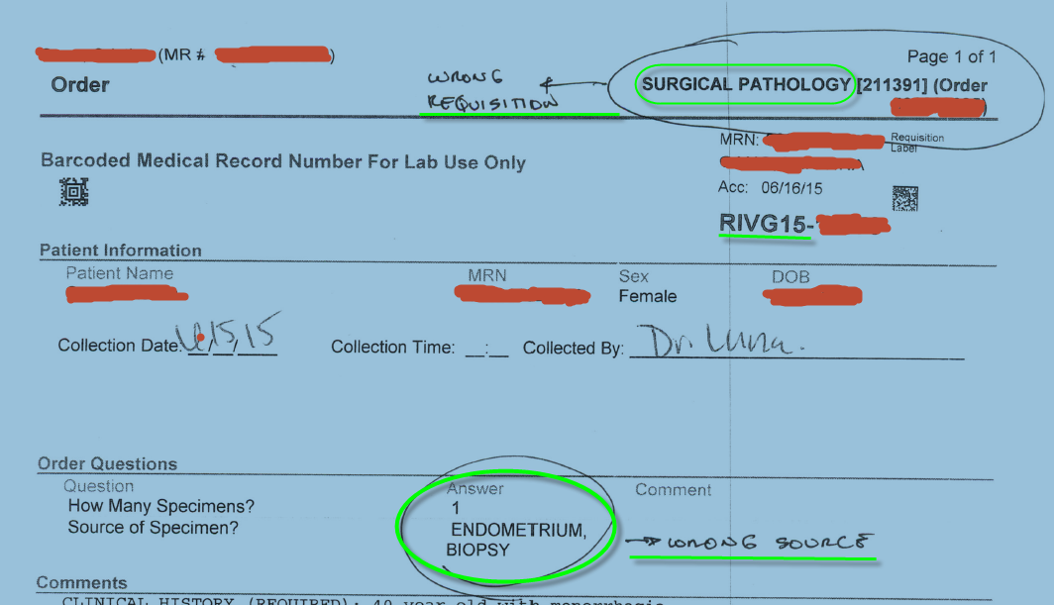
Surgical case incorrectly accessioned as a GYN Order
The requisition form also indicates department. The “Departments do Not Match” error message popped up on this case, but accession was still incorrectly saved.

Slide 13
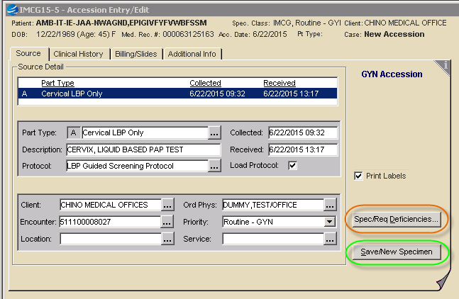
Accessioning Window Opens with Order information from Interface
HealthConnect order info will auto-populate the accession. All required fields should be filled in.
If the Part Type and Date fields are not populated, you missed selecting the Order Number on the previous screen. If so, exit and return to the previous screen to select the Order Number.
Use the Spec/Req Deficiencies Button to report minor issues.
When complete, press Save/New Specimen to save your accession.
*See next page for the only circumstance where another tab needs to be used.

Slide 14
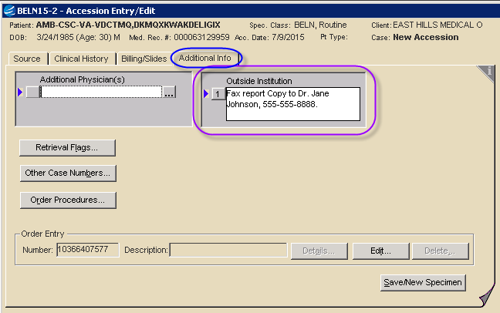
Outside Physician Copy
If the requisition order states a report copy needs to be sent outside of Kaiser, move to the Additional Info tab.
Enter report instructions into Outside Institution field.
Save the Accession.

Slide 15
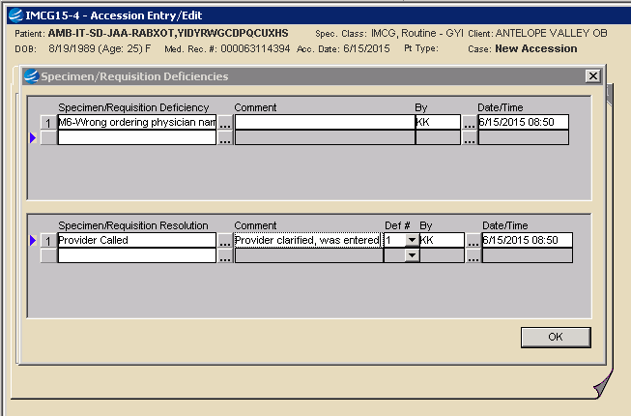
When appropriate, use Spec/Req Deficiencies to record problems
Spec/Req Deficiencies are used to record minor issues that the accessioner can take care of on their own. Use will probably be infrequent. Press the ellipsis (...) button to find the Deficiency Reason and Resolution. Comments are optional. “By” initials and Date/Time are auto-filled. Any number of deficiencies can be entered.
Reminder – Call the Help Desk when you run into a major issues such as a missing order message or other error message not described in this training.

Slide 16
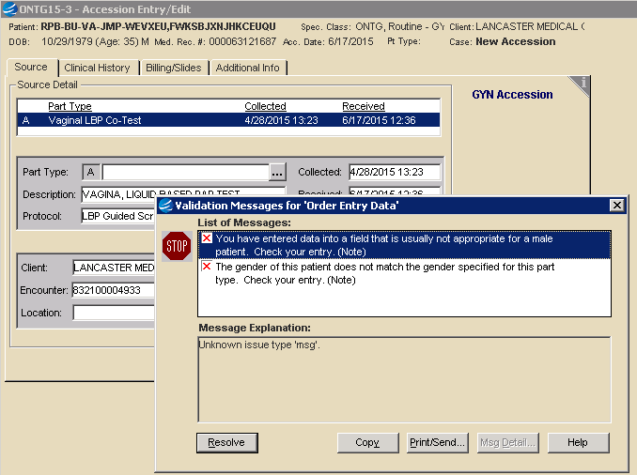
Potential Error: Wrong Gender
This error is rare.
If you receive a GYN order on a genetic male patient, the part type will be missing and you will receive these error messages. Press Resolve and then exit the case without saving it.
Do Not Accession! Send genetic male GYN cases to the Regional Cytology Lab for accessioning.

Slide 17
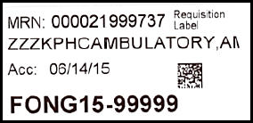
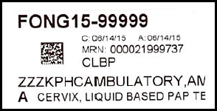
Container & Requisition Labels
Labels auto-print when accession is saved
If words or barcodes are “falling off” the side of the label, fix label stock alignment and reprint.
Place the Requisition Label in specified location.
Do NOT cover the original container label when adding CoPath labels to the container.
Requisition Label: Place on HealthConnect Requisition form.
Container Label: Put on Container without covering other label.

Slide 18
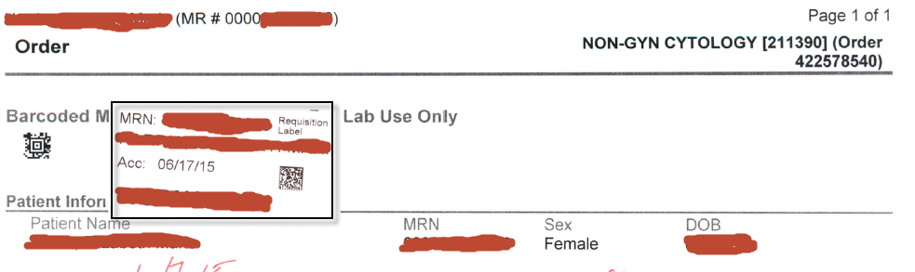
Requisition Label Placement
Correct Label Placement
Wrong Label Placement

Slide 19
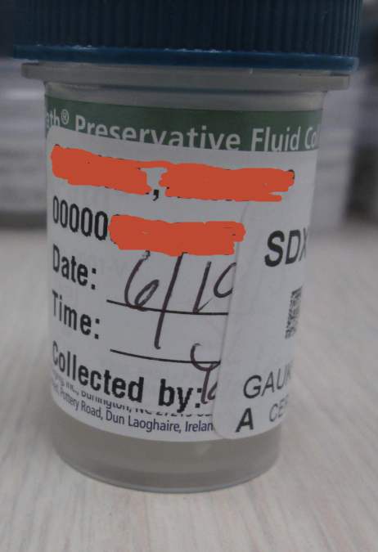
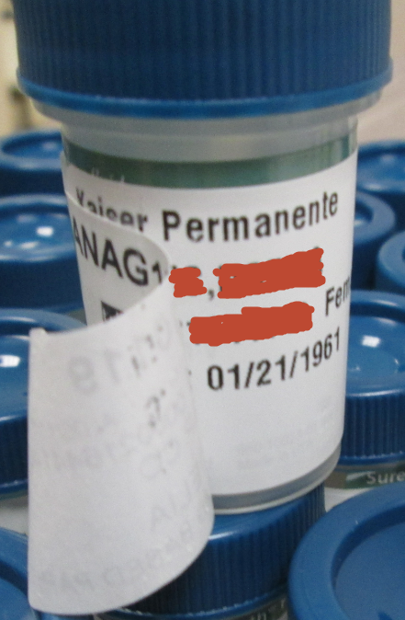
Correct Labeling
Both HC and CoPath Label are readable.
Incorrect Labeling
CoPath Label obscures HC Label.

Slide 20
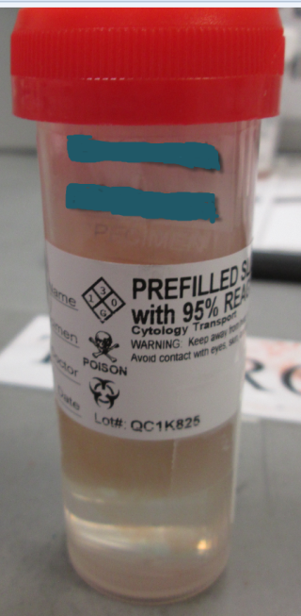
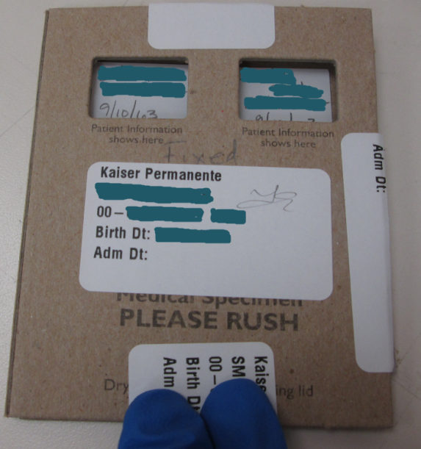
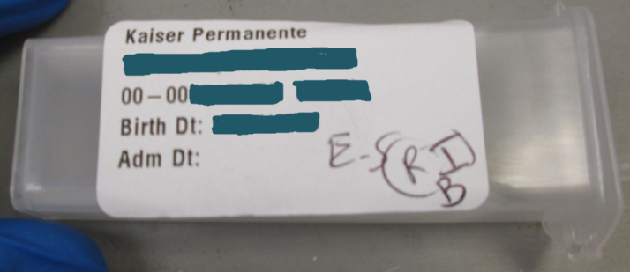
Labeling Slides
Use the Label Reprint feature to print out extra labels as needed for a Slide Container or Folder.
** Sometime you will receive pre-made slides in addition to the fluid NonGYN specimen **
If slides are received, print extra Container Labels to label the container/folder that holds the slides.
Do NOT cover the HealthConnect label.
Do NOT put labels directly onto the slides.

Slide 21
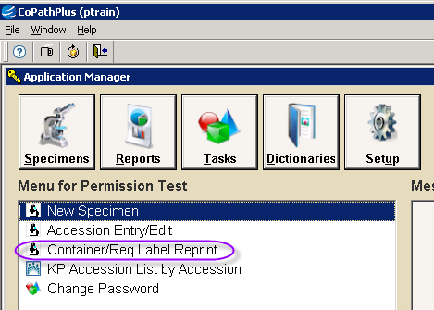
Reprinting Labels (if necessary)
Use Container/Req Label Reprint if:
Labels did not auto-print
Labels printed but the barcode or word got cut off
Select Container/Req Label Reprint from your personal menu.
If labels don’t auto-print, open a ticket with the Help Desk to get that corrected. Continue to manually print labels until label auto-print is corrected.

Slide 22
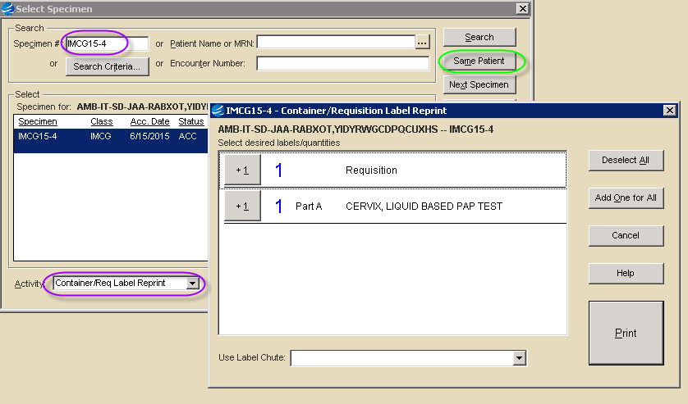
Container/Req Label Reprint
Enter Accession # or press “Same Patient” to call up the recent case.
A Label Chute (printer) defaults if one is assigned. If there is no printer displayed, use the dropdown to select a printer.

Slide 23
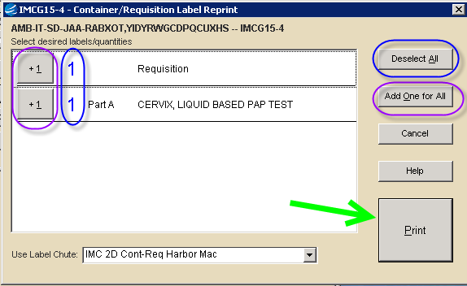
Select Labels and Print
One Req & one Container label queue to print
Press “Deselect All” or click on a blue number to deselect one or both types of labels
Press “Add One for All” or click on a +1 button to print multiple labels
If necessary, select the a printer from the dropdown list
Press the Print button

Slide 24
Generate Accession List
An Accession List should be printed and placed along with the cytology specimens in transit to Cytology.
The Accession list will include the Accession number, Date/Time the specimen was accessioned, Name of the Accessioner and the specimen type (Gyn or Non-Gyn).
- Please do not combine the Gyn and the Non-Gyn accession lists. Run them separately.

Slide 25
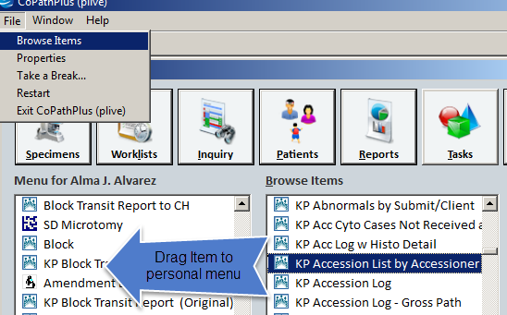
Cont…Generate Accession List
How to Generate the Accession List:
Click on File, Browse Items and type KP Accession List by Accesioner, then Drag it over to your personal menu.

Slide 26
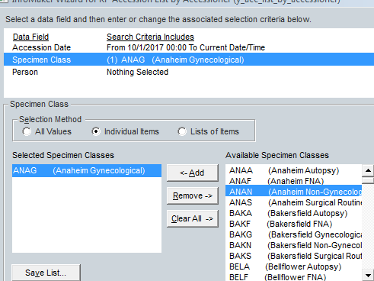
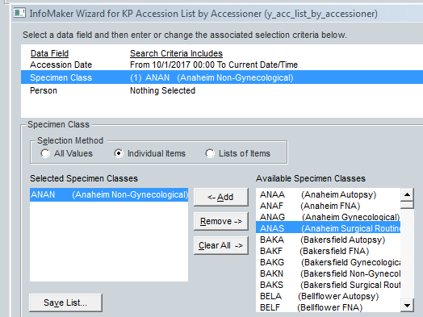
Cont…Generate Accession List
Each Medical Center will customize the report accordingly (e.g. Date, Specimen Class and list of Accessioners)

Slide 27
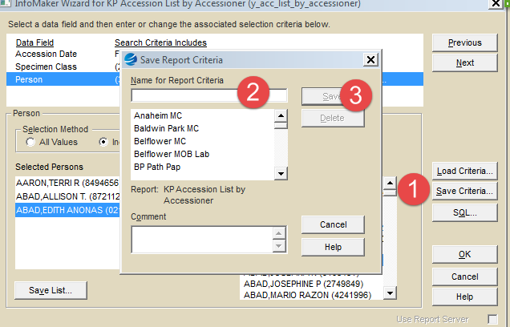
Cont..Generate Accession List
To Save the Criteria:
1. Click on Save Criteria
2. Name your Report
3. Click Ok

Slide 28
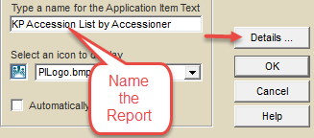
Cont… Generate Accession List
You can access the Saved Criteria from your personal Menu by Right Clicking on “KP Accession List by Accessioner” and selecting Properties.
Name the report, click details

Slide 29
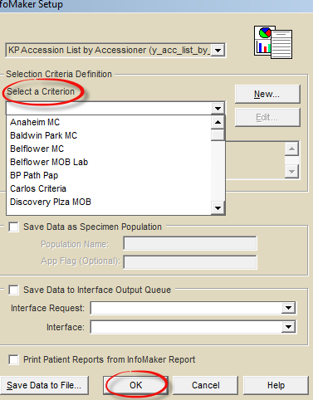
Cont… Generate Accession List
Select the Saved Criterion and Hit OK

Slide 30
General Information
Print Accession List by Accessioner report and place along with the Cytology Specimens.
Each Medical Center has their own list of which NonGYN/FNA cases are handled in the local pathology lab and which are sent to the Regional Cytology lab.
If the HealthConnect form does not include the MRN barcode, they've sent an order reprint, rather than Requisition Form that prints when the order is signed. Contact them to tell them they need to send the Requisition Form itself.

Slide 31
Summary of Problem Resolutions
The Accessioner is responsible to:
Always use the correct order number.
If “Departments do not match”, back out to fix the issue before proceeding with the accession.
Use Spec/Req Deficiencies if you corrected a minor issue
Reprint labels if barcode or words got cut off, or if labels did not auto-print.
Put labels in the proper locations.
Accession all Cyto cases other than the circumstances below.
Send case to Regional Lab to accession if:
GYN Patient is a genetic male.
ICD Code errors occur.
Open a ticket with the Help Desk if:
There is no pending order, but you have a Req form.
An error message occurs that was not covered here.
Labels do not auto-print.

Slide 32
Opening a ticket with Help Desk
Have the help desk create a low priority incident using the following items (if they ask – usually all you need to do is say it should be assigned to CoPathPlus):
Product Categorization:
Tier 1 Software
Tier 2 Application
Tier 3 Laboratory
Product name: CoPath Plus CS
Request Manager:
Support organization Application Support
Support group name AD CDA PATHOLOGY CS
Request Assignee:
Support organization Application Support
Support group name AD CDA PATHOLOGY CS
Help Desk Phone number
8-395-1143
or
888-457-4872

