Slide 1
PLACE HOLDER (DUMMY) ORDERS
Laboratory Informatics
August 26 – August 29, 2019, September 4, 2019
https://web.microsoftstream.com/video/8f084ec0-395e-48c3-8c5e-2a33121008a1

Slide 2
PLACE HOLDER (DUMMY) ORDERS
Three Non-Gyn Cytology Place Holder (Dummy) orders have been created to ensure the laboratory staff is aware of the need for the Cerebrospinal Fluid, Urine, and Sputum specimens to be accessioned in CoPath and sent to Pathology.
HOLD CSF NONGYN
HOLD URN NONGYN
HOLD SPU NONGYN
Two Flow Cytometry Place Holder (Dummy) orders have been created to ensure the laboratory staff is aware of the need to draw and send the Blood (EDTA) specimen and CSF to Pathology.
DRAW AND HOLD EDTA WHOLE BLOOD FOR FLOW CYTOMETRY
HOLD CSF FOR FLOW CYTOMETRY

Slide 3
PLACE HOLDER (DUMMY) ORDERS
Effective 9/10/2019, all place holder (dummy) orders will cross over to Cerner and KPPI like any normal lab tests.
Place holder (dummy) orders are trackable on a transfer list.
Place holder (dummy) orders can be monitored on a pending list to ensure all Non-GYN Cytology orders have been accessioned/processed.
Place holder (dummy) orders will be auto canceled once logged in as “In Lab” at the Medical Center lab location.

Slide 4
PLACE HOLDER (DUMMY) ORDERS – High Level Workflow

Slide 5
PLACE HOLDER (DUMMY) ORDERS – High Level Workflow

Slide 6
PLACE HOLDER (DUMMY) ORDERS – High Level Workflow

Slide 7
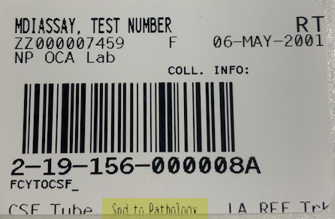
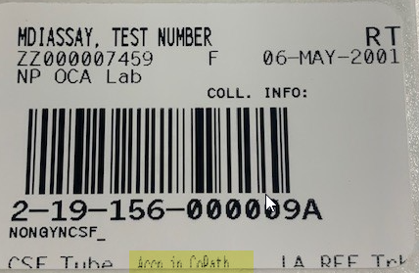
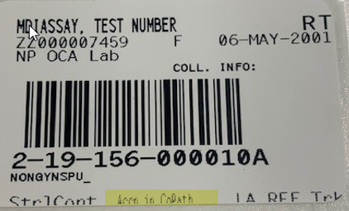
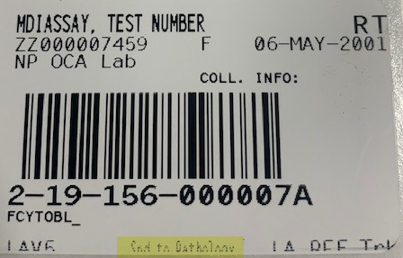
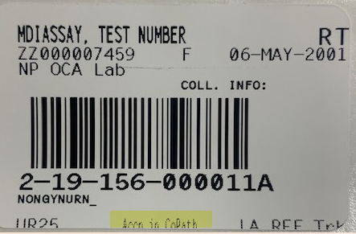
PLACE HOLDER (DUMMY) ORDERS – Specimen Labels
HOLD CSF FOR FLOW CYTOMETRY HOLD CSF NONGYN HOLD SPU NONGYN
DRAW AND HOLD EDTA WHOLE BLOOD FOR FLOW CYTOMETRY HOLD URN NONGYN

Slide 8
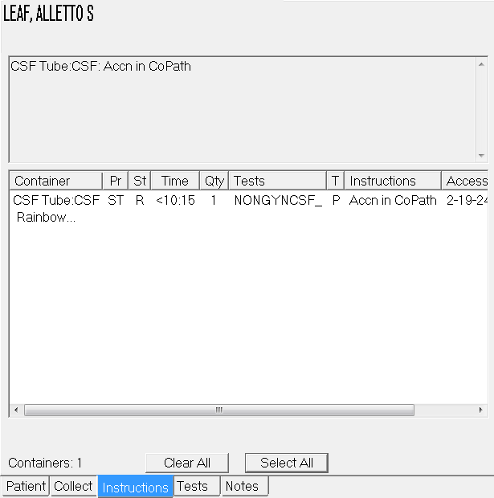
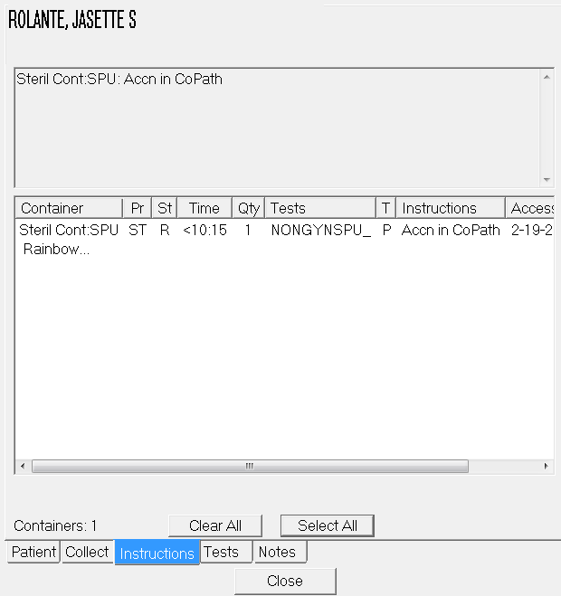
PLACE HOLDER (DUMMY) ORDERS in KPPI
HOLD CSF NONGYN HOLD SPU NONGYN

Slide 9
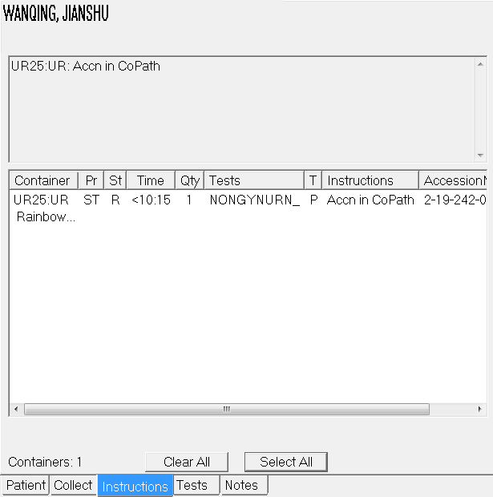
PLACE HOLDER (DUMMY) ORDERS in KPPI
HOLD URN NONGYN

Slide 10
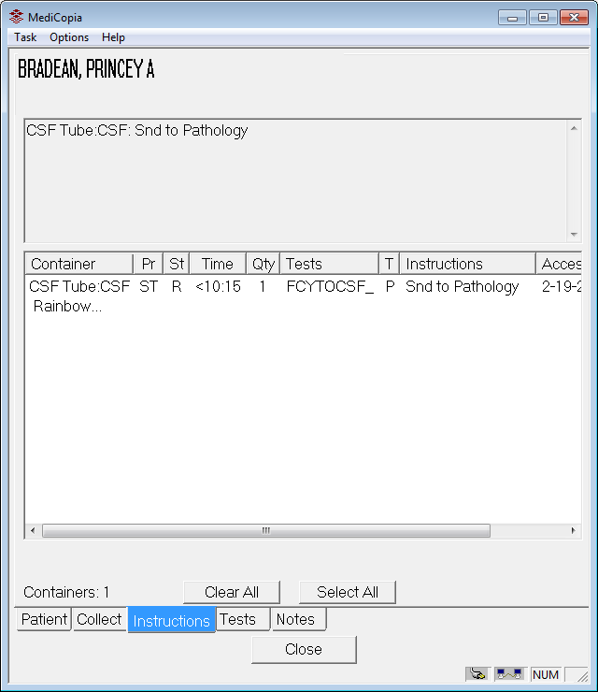
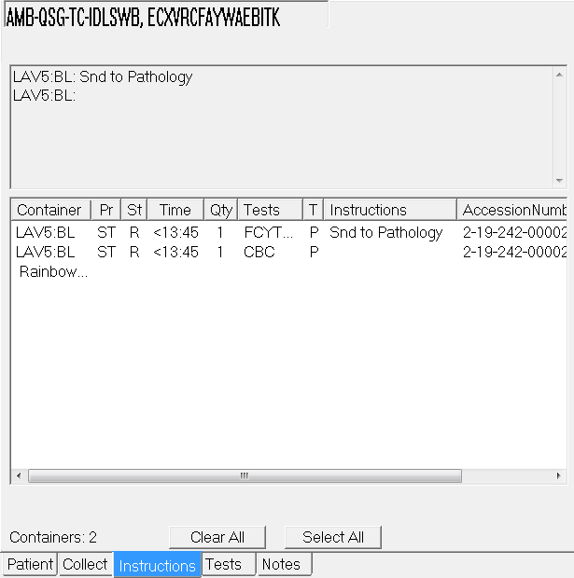
PLACE HOLDER (DUMMY) ORDERS in KPPI
HOLD CSF FOR FLOW CYTOMETRY DRAW AND HOLD EDTA WHOLE BLOOD FOR FLOW CYTOMETRY

Slide 11
Cerner Screenshots
Once order has been accessioned in RMS, it will be Dispatched in Cerner and will crosses over to KPPI if it is an inpatient order.

Slide 12
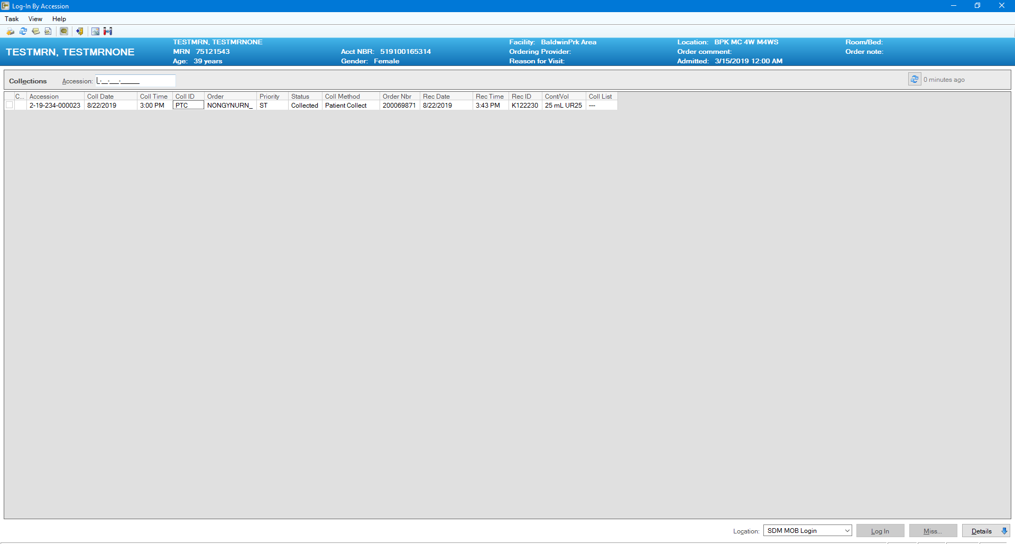
Cerner Screenshots
Log in specimen and its collection information. If collected using KPPI, collection information will be auto-populated like any GenLab tests

Slide 13
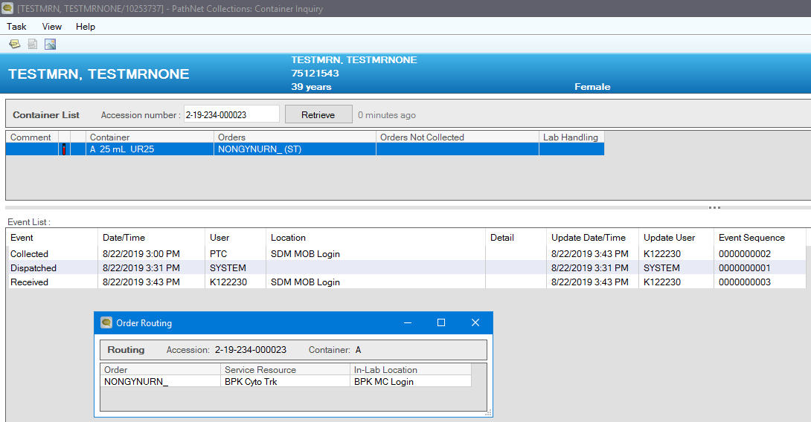
Cerner Screenshots
Create a transfer list to Medical Center Lab if necessary

Slide 14
Cerner Screenshots
Transfer to Medical Center Lab

Slide 15
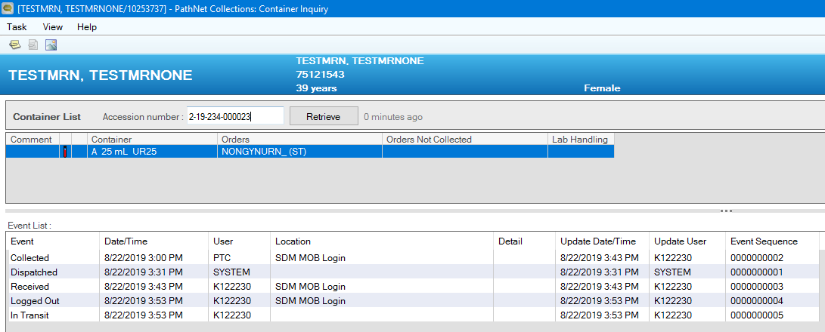
Cerner Screenshots
Transfer to Medical Center Lab

Slide 16
Cerner Screenshots
Once logged in at the In-Lab location (Medical Center Lab), Place Holder (Dummy) will autocancel with a reason of “Canceled by Lab: Place Holder Order”

Slide 17
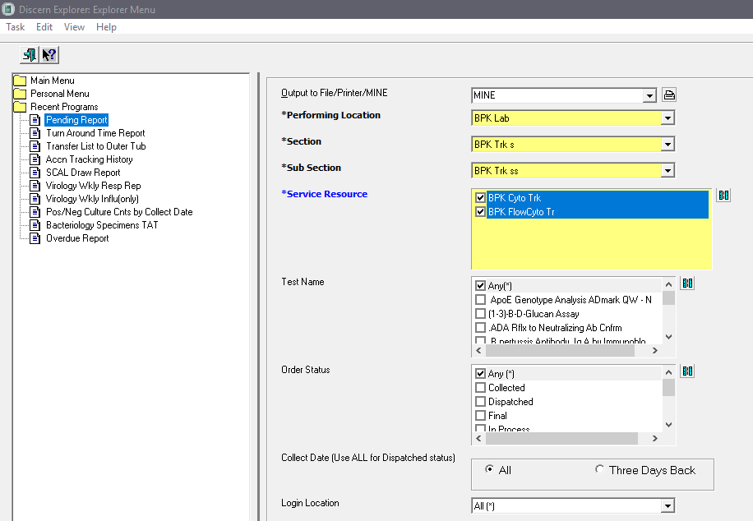
Cerner Screenshots
Pending Report can be run via Explorer Menu

Slide 18
Cerner Screenshots

