Slide 1
24-Hour Urine Prompt for Total Volume & Report Request for Cerner Chart Copy
September 19, 2019 – September 24, 2019

Slide 2
Topics Cover in this Training Session
How to document/enter total volume via prompt in Specimen Log In for Quest 24 hour urine tests.
How to identify total volume is missing on a Quest 24 hour urine test from a Pending Report via Explorer Menu and from the Packing List.
How to request Report Request (Chart Copy) in Cerner.

Slide 3
What’s New for Quest 24 Hour Urine Tests
There will NOT be a separate accession generated for Total Volume
Total Volume is entered/documented via Specimen Log In
Total volume will NOT be electronically transmitted to Quest if specimen/order has been transferred. Make sure to enter the total volume BEFORE transferring the specimen/order in Cerner
Review and verify total volume is listed on the packing list
If Quest has verified and released the results and should the total volume needs to be corrected, Kaiser must call and notify Quest of the correct total volume AND CLS must do a corrected report by entering the correct total volume via correction mode in Cerner. DO NOT correct other DTAs other than the total volume.

Slide 4
What Processes Remain Unchanged or Unaffected
Process to enter total volume for in house performed 24 hour urine tests remain the same at this time.
The scope on who can measure and enter total volume remain the same.
Track and transfer RLN Quest tests to medical center lab remain the same. Total Volume measurement and documentation can be performed at the medical center lab if MOBs do not have CLSs or MLTs onsite.

Slide 5
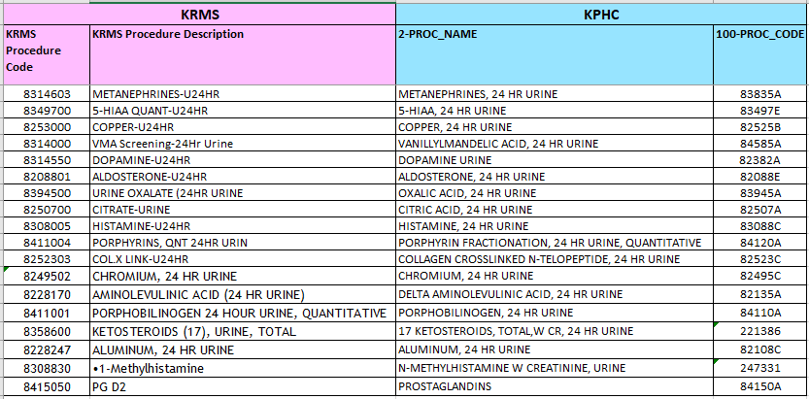
Quest 24 Hour Urine Prompt for Total Volume
Effective Thursday, September 26, 2019, the following list of 24 hour urine tests will migrate to Cerner RLN
**Note: Prostaglandins (PG D2) is a random urine test and has no prompt for TV. It is included as part of this batch of Quest RLN migration.

Slide 6
How to Enter Total Volume via Specimen Log In
During specimen log in, user will notice the prompt test icon

Slide 7
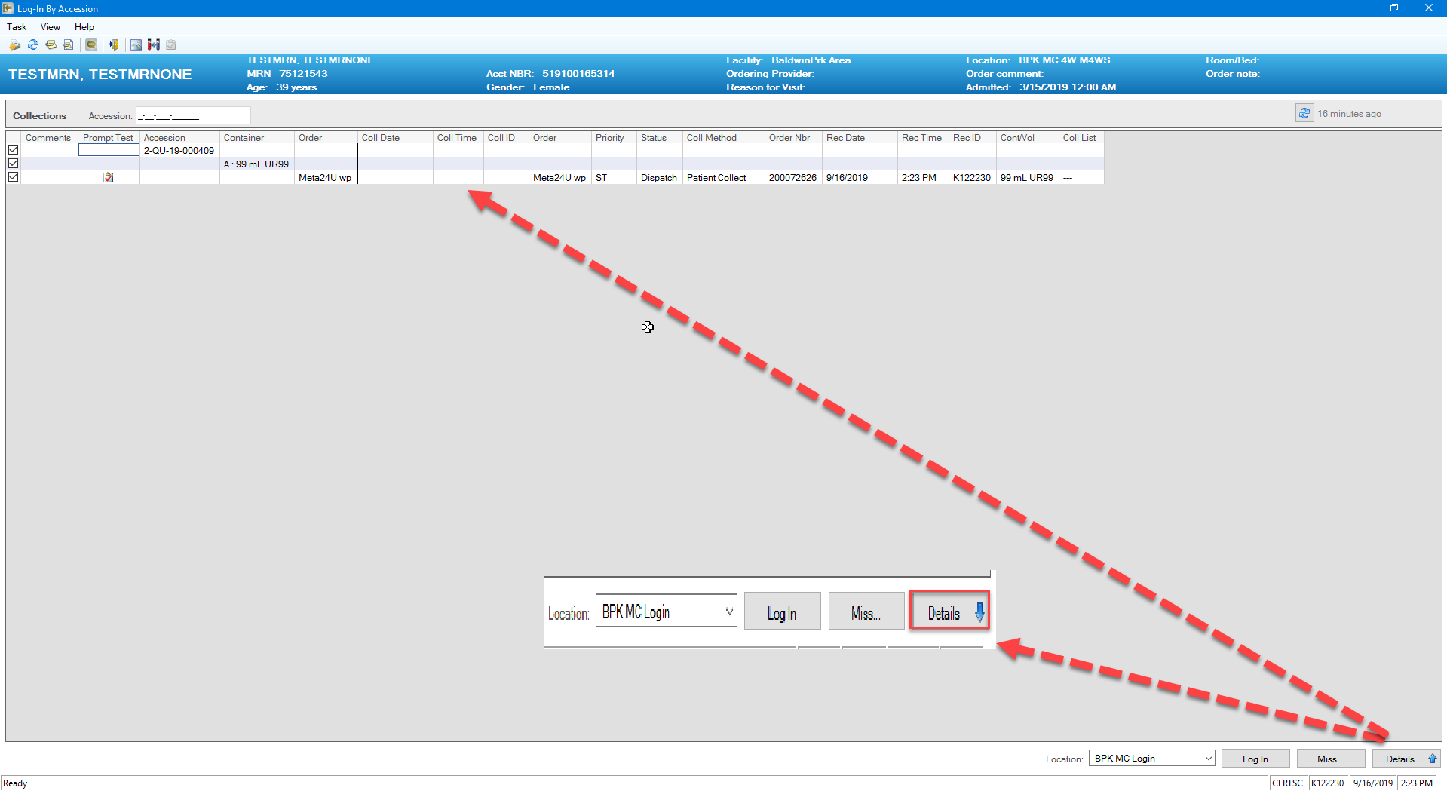
How to Enter Total Volume via Specimen Log In
To enter the total volume, click on the “Details” button at the lower righthand side of specimen log in page to expand

Slide 8
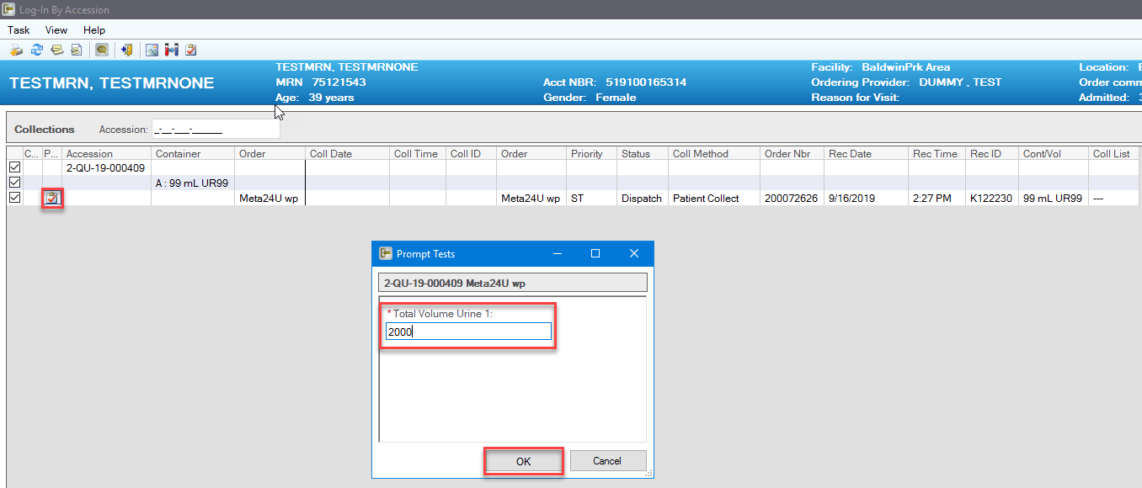
How to Enter Total Volume via Specimen Log In
Double click on the prompt test icon , then prompt tests window opens. Enter total volume and click “OK”

Slide 9
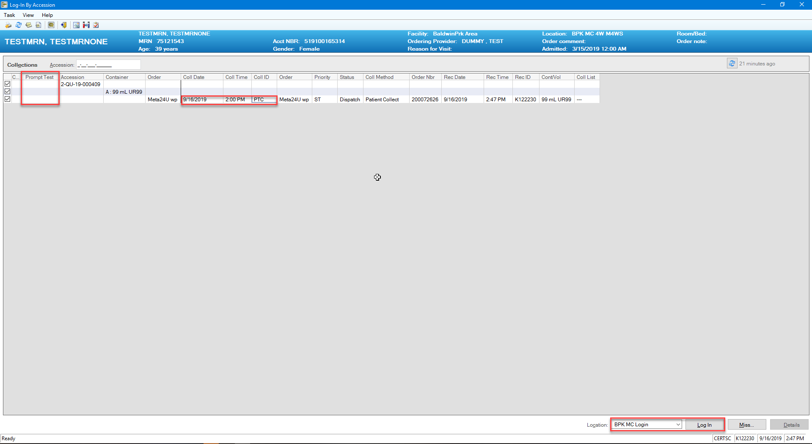
How to Enter Total Volume via Specimen Log In
Prompt test icon disappears once volume is entered. Enter collection information and log in the specimen per current established SOP.

Slide 10
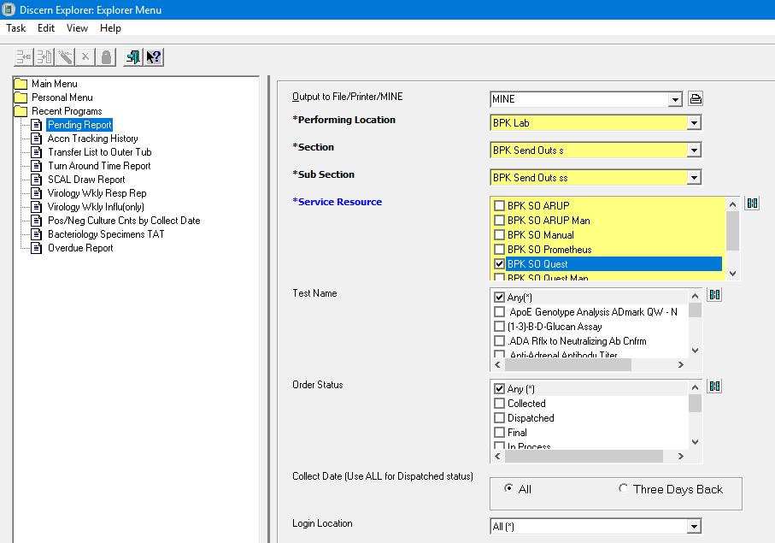
How to Double Check or Monitor Total Volume Has Been Entered
Pending Report via Explorer Menu. If Total Volume is missing, the Result Status column will be blank.

Slide 11
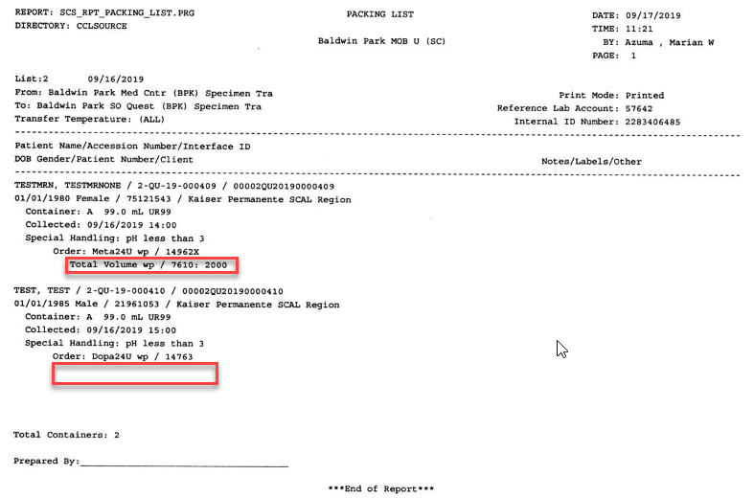
How to Double Check or Monitor Total Volume Has Been Entered
Review Packing List to ensure total volume is listed for every 24 hour urine tests. If missing, enter total volume in Cerner and MUST call and notify Quest of the total volume since the order has been electronically transferred.

Slide 12
Report Request (Chart Copy) in Cerner
Effective Tuesday, September 24, 2019, Report Request is the new Cerner App to request a Cerner chart copy report.
Before you begin to use Report Request, the following defaults need to be set:
Report Scope
Template

Slide 13
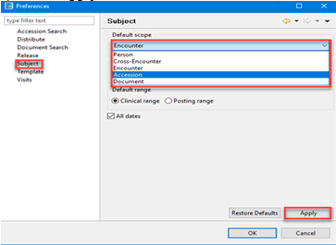
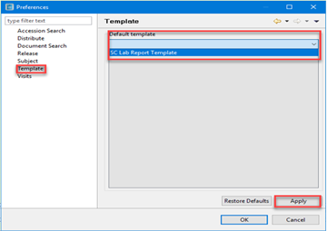
How to Set Defaults for Report Scope and Template
Click on the Report Request icon on the Cerner Appbar
At the task bar, click “View” then “Options”
If setting default for Report scope Select subject Use Default scope drop down arrow to select Accession Click Apply | If setting default for Template Select Template Use Default template drop down arrow to select SC Lab Report Template Click Apply

Slide 14
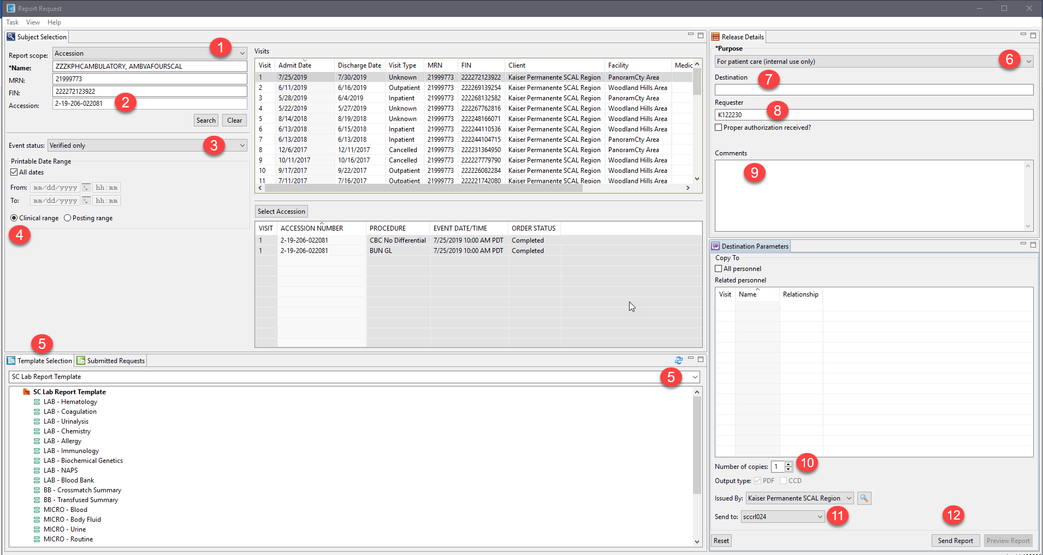
How to Request and Print Cerner Chart Copy
Click on the Report Request icon on the Cerner Appbar.
Select or verify that the Report Request screen displays the appropriate settings from the drop-down windows.
Report Scope: Accession
Enter accession number
Event status: Verified only
Clinical range is selected
Template Selection: SC Lab Report Template
Purpose: (i.e. For patient care, For patient/guardian,etc.)
Destination: Optional free text field
Requester: Optional free text field (i.e. enter name or NUID#)
Comments: Optional free text field
Number of copies: use arrow to select number of copies
Send to: Use arrow to select the printer
Click Send Report button to print

Slide 15
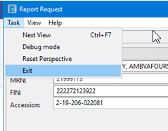
How to Request and Print Cerner Chart Copy
To exit Report Request when done, click Task and select Exit

Slide 16
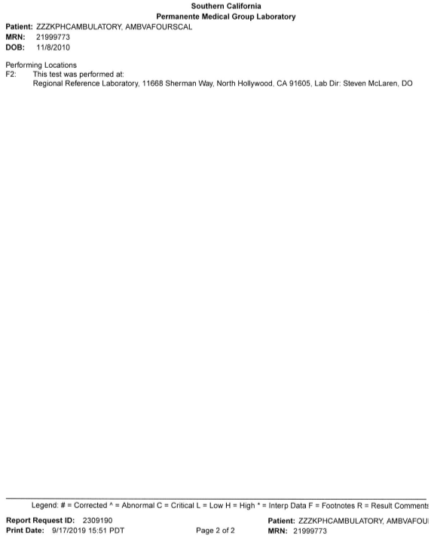
Cerner Chart Copy

