Slide 1
PRIORITY TESTING OF
COVID-19 PROCESS
Agnes Bautista
Asst. Director of Operations
Ancillary Services Department , RRL-CH

Slide 2
SITUATION
CURRENT STATE
There is confusion on how to send UTM/Eswab samples for
Priority Testing of Covid-19
to Regional Lab

Slide 3
BACKGROUND #1
Assorted colored DOTS, with different sizes, are being placed different ways, on the samples to indicate Priority Testing of Covid-19 samples
1.
DOTs placed on top of the UTM/Eswab caps
2.
DOTs placed on the side of the UTM/Eswab tube
3.
DOTs placed on the outside of the Yellow Bags

Slide 4
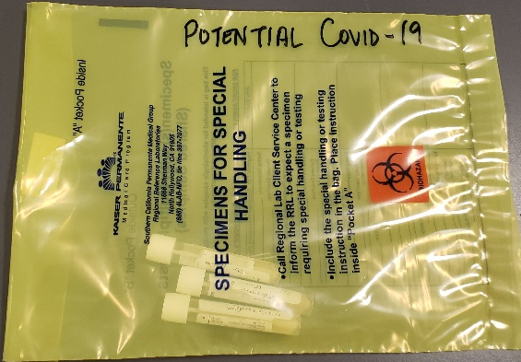
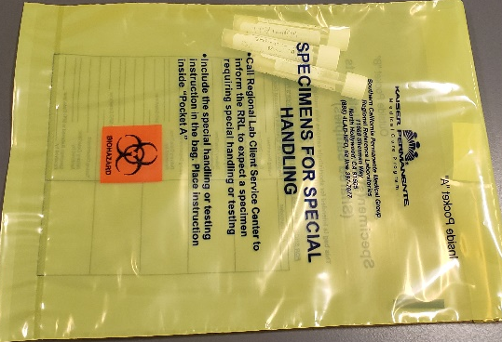
BACKGROUND #2
Covid-19 samples are sent “LOOSE” in Yellow Bags,
Yellow Bags are LABELED inconsistently, with MULTIPLE samples
“POTENTIAL
COVID-19”
“PUI”
NOT LABELED AT ALL

Slide 5
ASSESSMENT
We need to “STANDARDIZE” the following items…
DOT color & size
DOT placement on the samples
DOT order supplies
Yellow Bags consistent labeling
Yellow Bags should only have ONE sample, per bag

Slide 6
RECOMMENDATION
CURRENT STATE (Standardize Process)
DOT Color & Size
Use designated FLOURESCENT GREEN DOTS only
DOT Placement
Place DOTS on TOP of the UTM/Eswab Caps only
DOT Supplies
Order DOTs through ONELINK
YELLOW BAGS
Label Yellow Bags consistently, POTENTIAL COVID-19 or PUI
Put ONE sample per ONE Yellow Bag only
REMINDERS
Tighten the caps of the samples to prevent leakage
Inform nurses to tightly cap the samples and break the swab at the scored line to prevent leakage
ONELINK Manufacturer: Online_Labels Item: Labels hole reinforcement 0.5625 in Flourescent Green, 156 dots/sheet OneLink Number: 10802585

Slide 7
ff
PRIORITY TESTING OF COVID-19
Standardized Transport Process to Regional Lab
DOT Color, Size & Placement
Use designated FLOURESCENT GREEN DOTS only
Place DOTS on TOP of the UTM/Eswab Caps only
DOT Supplies
Order DOTs through ONELINK
Blue Racks (LBX)
Place Covid-19 samples in Blue Racks prior to transport to RRL
ADVANTAGES:
1. For Patient Safety
2. For Upright Transport of tubes to
prevent Breakage, Leakage and
Contamination
3. For Safe Transport of Glass Test Tubes
4. To Automate the process with LBX
5. To Prevent Test Cancellations
COVID SPECIMEN BAG
Place Blue Rack in a large clear plastic bag labeled …
“Covid Specimen Bag”
(AVERY 6876 Shipping Label)
Transport to RRL, as usual
ONELINK Manufacturer: Online_Labels Item: Labels hole reinforcement 0.5625 in Flourescent Green, 156 dots/sheet OneLink Number: 10802585

Slide 8
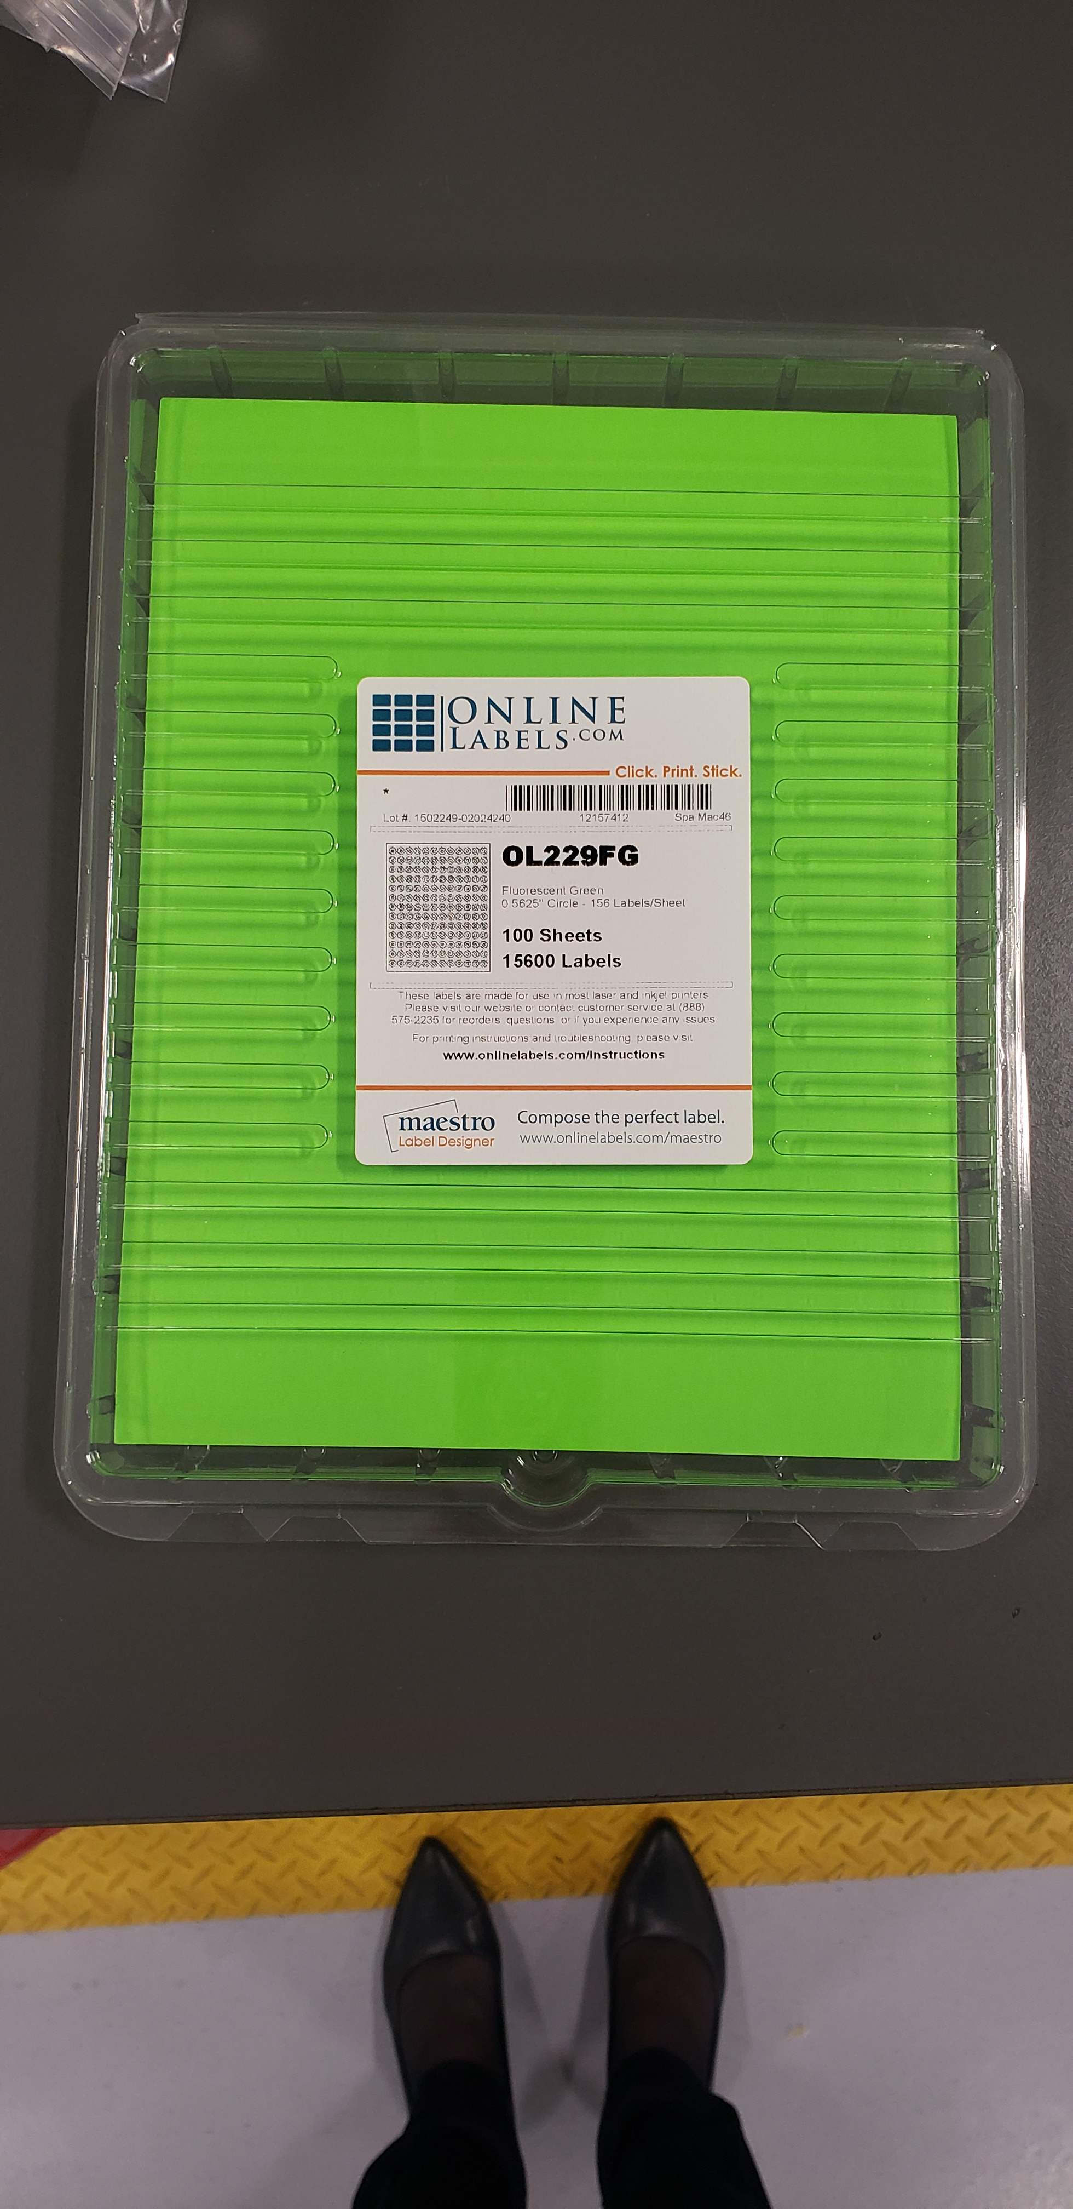
STARTER KITS
ff
FUTURE STATE
DOTS Flourescent Green
10 – Sheets
156 Dots/Sheet
Total: 1,560 Dots
Order in OneLink (OneLink# 10802585)
COVID SPECIMEN BAG
50 pre-labeled large plastic clear bags
Size: 12” x 16”
Order clear bags from RRL
SHIPPING LABEL Order Info
Avery 6876 Shipping Labels
Size: 5-1/2” x 8-1/2”
Order via Ariba, Guy Brown Catalog

Slide 9
Thank You!
Do we have your approval on the proposed
FUTURE STATE
LODS?

