Slide 1
Products of Conception
Processing Genetics Requests
Main OR

Slide 3
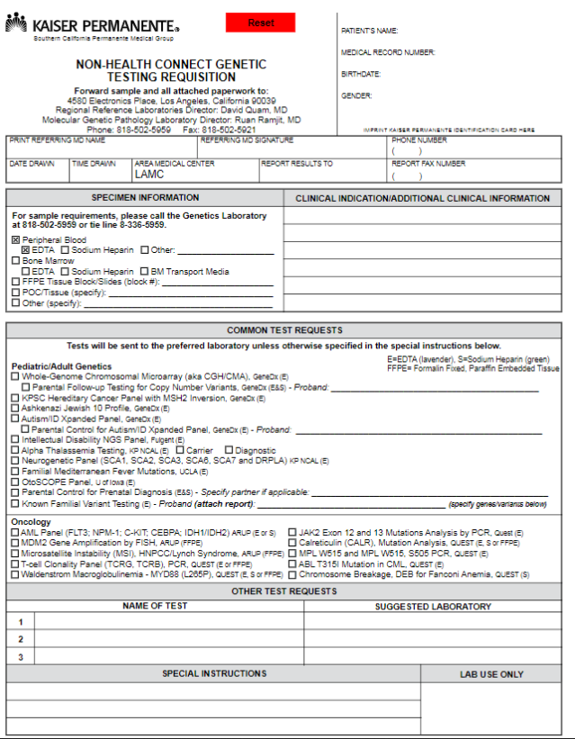
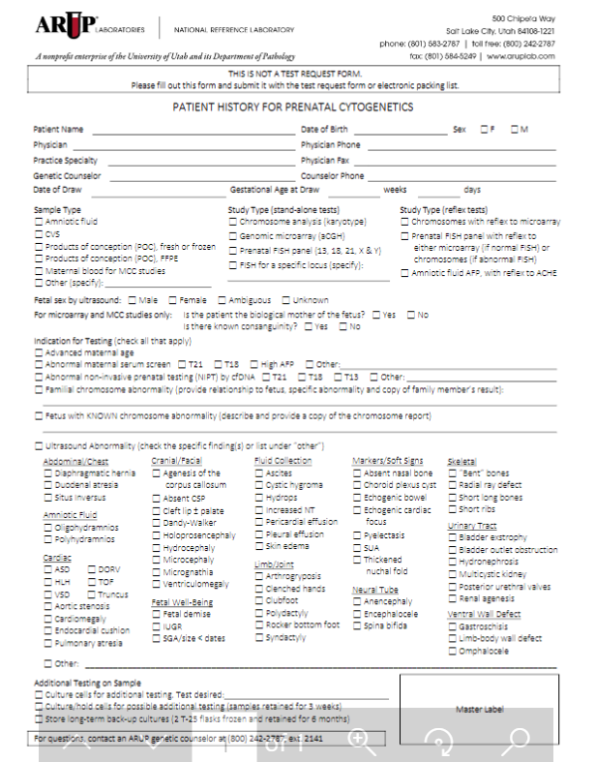
PRODUCTS OF CONCEPTION
3
Up to 3 Test Forms
2
Specimen Types
1
Location to deliver

Slide 4
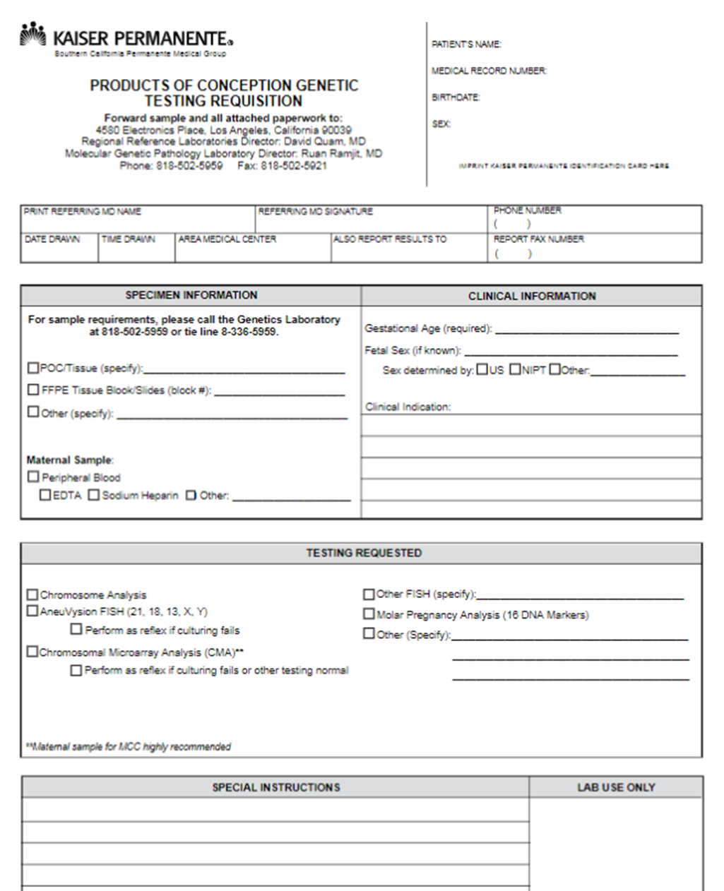
PRODUCTS OF CONCEPTION
3
Up to 3 Test Requisitions Forms
PRODUCTS OF CONCEPTION GENETIC TESTING REQUISITION
NON-HEALTH CONNECT GENETIC TESTING REQUISITION
ARUP

Slide 5
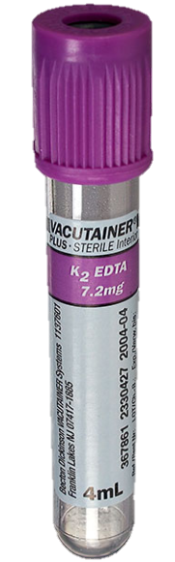
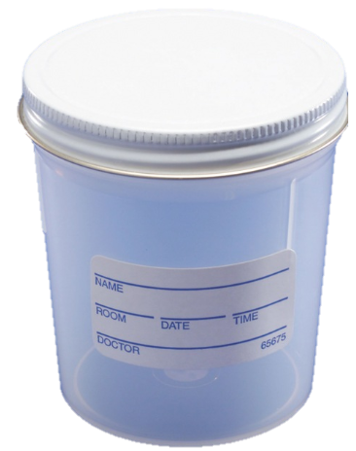

PRODUCTS OF CONCEPTION
2
Specimen Types
Maternal Sample
EDTA
POC Specimen
Sterile Saline
Various Containers

Slide 6
CURRENT
1
Delivery Location: Main Lab
NEW
START
START
POC specimen obtained
Eliminate a step
Reduce possibility of lost or delayed specimen
Ensure timely transport to Genetics lab
POC specimen obtained
4900 Laboratory
Main Laboratory
Main Laboratory
Processing
ARUP
Processing
KP REGIONAL GENETICS LAB
ARUP
KP REGIONAL GENETICS LAB

Slide 8

PROCESSING
POC Specimen
Sterile Saline
Various Containers
Maternal Sample
EDTA
GENETICS LAB
ELECTRONICS PLACE
POC Genetics Req
NonHC Genetics Req
POC Specimen
Sterile Saline
Various Containers
ARUP Laboratories
ARUP

Slide 9
THE END

