Slide 1

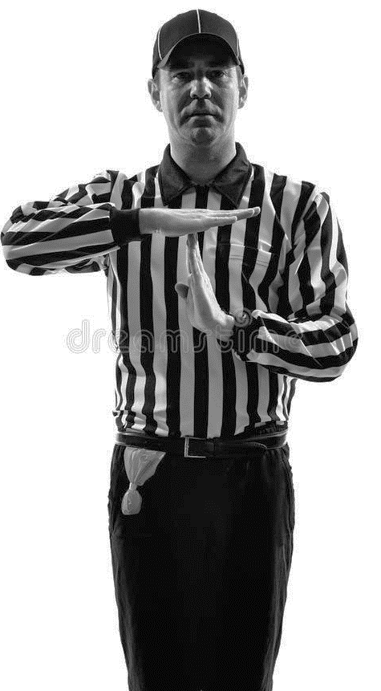

“SAFETY CHECK”

LAMC LABORATORY SPEAK UP MODULE
1

Slide 2
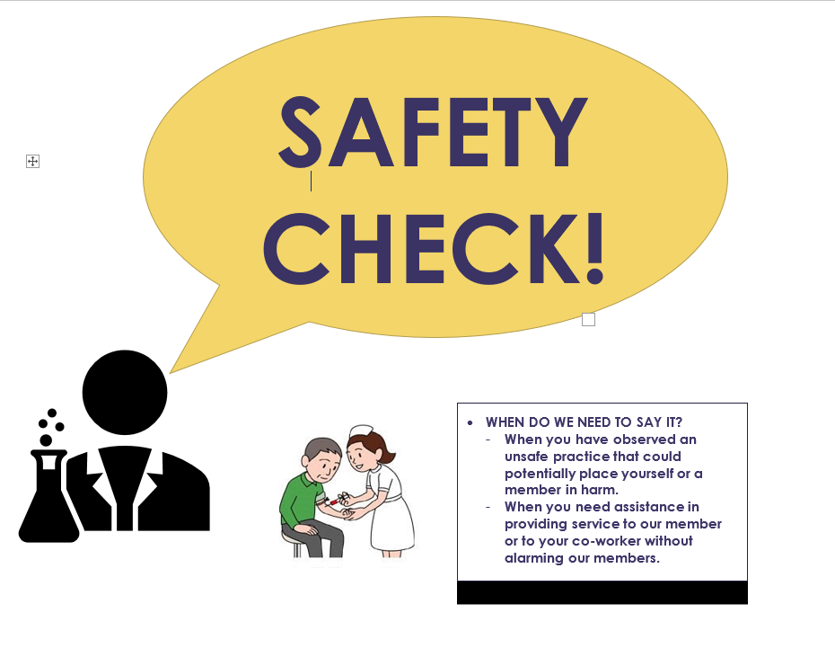
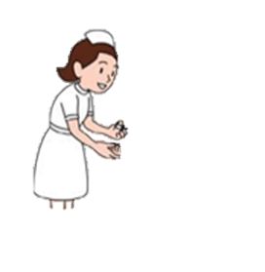
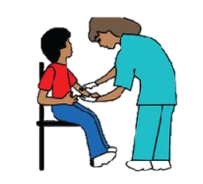
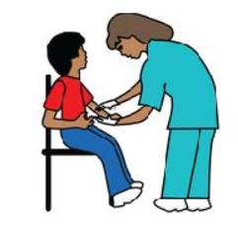
WELLNESS CHECK!
When do we need to say it?
When you need to call it for yourself in the presence of members and to inform your coworkers that you have a sudden need to pause or stop your current task. This may be from pain, discomfort or fatigue that your coworker(s) may not be aware of.

Slide 3
What is a “SAFETY CHECK”

A SAFETY CHECK is a discreet verbal signal for an immediate need to stop and take a time out, for an observed work practice or safety concern, that may be potentially cause harm with the intent not to cause panic, alarm, anxiety or draw attention to members and visitors.
If you hear a “Safety Check”, it is strongly recommended to pause what you are doing, do not proceed with the current task, wait for information from the person who announced the safety check, and proceed when cleared and safe to do so.
If the Safety Check was directed for you, have the discussion away from member facing area, listen openly to the issue or concern, make any necessary corrections, and proceed as instructed.
Safety Check should only be used in the event of an observed work practice or task may potentially cause immediate danger , harm or a negative outcome if not corrected.
This is a way to empower all staff to Speak Up with the intent for successful outcome
“Safety Check” or any other agreed upon phrase may be used that is universally understood and accepted by your team and your managers.
2

Slide 4



Scenario 1:
A member in a wheelchair comes in for a blood draw. Your coworker starts gathering supplies and walking around the draw table and begins to prep the patient standing up and bent over to start the collection. Which of the following should be done?
More than one answer may apply
A
Announce a “Safety Check” to alert all your coworkers for an immediate safety issue that was observed
Kindly direct your coworker away from the member facing area and inform them of the concern.
B
C
Consider the use of available exam room within the lab, if available, so the procedure is not done within proximity to other members
D
Adjust the table and / or chair to your specifications for better access to the patient draw site.
E
Do not inform your coworker because the laboratory is short staffed and it is getting busier.
3

Slide 5


Scenario 2:
You are assisting a collection procedure and the parent is watching and helping to hold their child. The procedure is taking longer than expected and the child is stronger than you thought. You start to feel pain on your wrists and back. What should you do?
A
Continue with the procedure until you can’t stand the pain and yell “Ouch!”
B
Inform the parent and your coworker, “I don’t mean to alarm anyone, but we have a problem!”
C
Dig deep from within yourself and find the inner strength to carry on.
D
Calmly announce “Safety Check” so that your coworker knows to pause or time out for a safety reason
E
Inform your coworker and the member that you can’t assist because the laboratory is short staff.
4

Slide 6

Scenario 3:
The lab assistant who is drawing blood next to you is collecting several tubes on a patient. There was some expired lot numbers of blood tubes that you had just discarded and you suspect that the lab assistant may have replenished their station with expired tubes and had not noticed. She is about to place the needle into the patient’s arm. What would happen if you did NOT call a “Safety Check”?
More than one answer may apply
A
The lab assistant will use the expired tube and member will not get their lab results because the test will be rejected.
B
No harm was done. This was the other lab assistant’s problem. Just as long as you draw your own patient, it shouldn’t affect you.
C
The member may have to repeat another phlebotomy procedure that could have been avoided.
D
Nobody would benefit from staying silent. The member would suffer in the end, nobody learned any lessons to improve safety practices.
E
Member dissatisfaction and loss of trust in Laboratory Services
5

