Slide 1
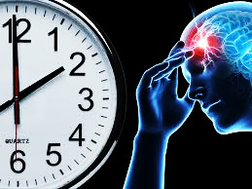
lamc laboratory PATHOLOGY, LABORATORY, TRANSFUSION SERVICE, FLOW CYTOMETRY, medical office buildings 2020 CODE STROKE inservice
CODE STROKE
ANCILLARY SERVICES: PATHOLOGY / LABORATORY / TRANSFUSION SERVICE / FLOW CYTOMETRY / LAB MOBs
B E F A S T
1

Slide 2
LOS ANGELES MEDICAL CENTER
COMPREHENSIVE STROKE CENTER
SINCE 2017
12 MONTH | 2019 YE | 2018 YE
33 | 31 | 23
71 | 89 | 70
Monitoring Performance
Data for the efficiency measure provided through the Stroke Committee
Daily department review of the Stroke Log to ensure appropriate documentation and compliance
lamc laboratory PATHOLOGY, LABORATORY, TRANSFUSION SERVICE,
FLOW CYTOMETRY, medical office buildings 2020 CODE STROKE inservice
2

Slide 3
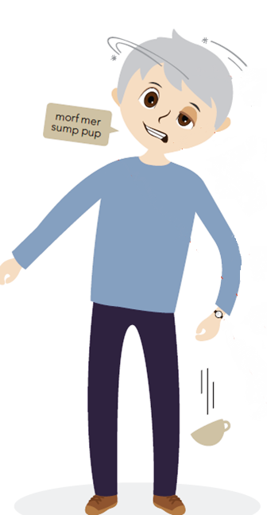
SIGNS OF STROKE: B E F A S T
BALANCE CHANGES
Sudden change in balance and coordination
B
ALANCE
VISION CHANGES
Sudden vision loss or double vision
E
YES
FACIAL DROOP
Face looks uneven
F
ACE
A
RMS
ARM WEAKNESS
Sudden arm numbness or weakness
S
PEECH
SLURRED SPEECH
Sudden difficulty speaking or can’t speak clearly
T
IME
DON’T STALL; CALL
Make note of the time the symptoms started
2020 CODE STROKE INSERVICE
LAMC – 4867 SUNSET BLVD
LABORATORY
3

Slide 4
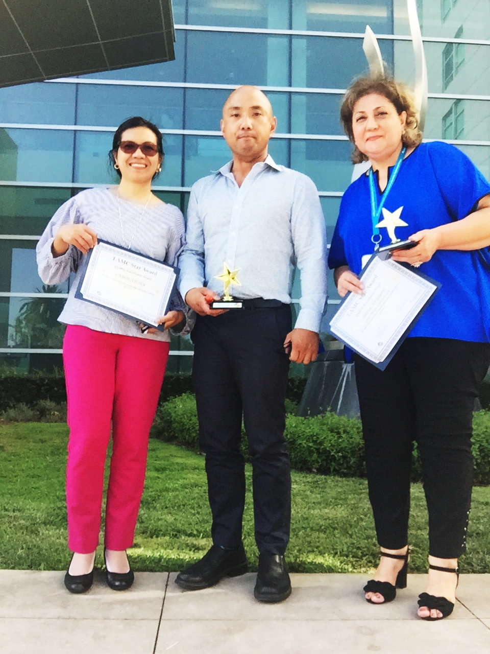
TRUE STORY
LAMC LAB EMPLOYEE RECOGNIZES
CODE STROKE IN A PATIENT …. A LIFE SAVED
2020 CODE STROKE INSERVICE
LAMC – 4867 SUNSET BLVD
LABORATORY
4

Slide 5
CODE STROKE IS AN
EMERGENCY
PAGE CODE STROKE NEUROLOGIST
Tier 1: 279-1000
HOSPITAL PATIENT
VISITOR OR EMPLOYEE
CALL x 3-3000
OUTSIDE HOSPITAL
CALL 911
lamc laboratory PATHOLOGY, LABORATORY, TRANSFUSION SERVICE,
FLOW CYTOMETRY, medical office buildings 2020 CODE STROKE inservice
6

Slide 6
Code stroke: COMMUNICATION
JOINT AND SHARED ACCOUNTABILITY
Controller:
Make communicate with STAT LAB
STAT LAB Stroke Champion:
Communicate name, document on white board. Oversee the process follow up on specimen and resulting
Phlebotomy:
Report to location of Code Stroke. Announce your presence. If you are not needed or if you are told to wait return, obtain the name of the provider for documentation.
Shift to Shift:
All process should be seamless and overseen by the Stroke Champion. Spin specimens follow up if not received
SEND KPPI TEXT MESSAGE TO ASSIGNED LAB ASST
Controller
Lab Assts
STAT Lab
DOCUMENT IN STROKE LOGBOOK
lamc laboratory PATHOLOGY, LABORATORY, TRANSFUSION SERVICE,
FLOW CYTOMETRY, medical office buildings 2020 CODE STROKE inservice
ANY ISSUES MUST BE ADDRESSED IMMEDIATELY –
INVOLVE A MANAGER. LEAD CLS, or STROKE CHAMPION
9

Slide 7
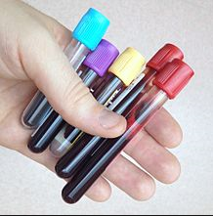
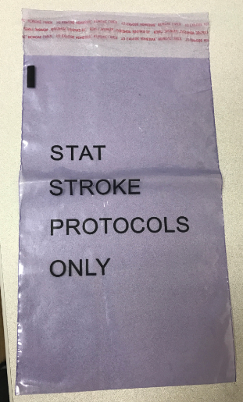
Code stroke: COMMUNICATION
“CODE STROKE”
RECD IN LAB
SPECIMENS SHOULD BE IN LAB WITHIN 10 MINUTES OF ANNOUNCEMENT
SPECIMENS SHOULD COME IN DESIGNATED PURPLE BAG
FOLLOW UP
CALL ED / RN
CALL CONTROLLER
CALL LAB ASST ASSIGNED
lamc laboratory PATHOLOGY, LABORATORY, TRANSFUSION SERVICE,
FLOW CYTOMETRY, medical office buildings 2020 CODE STROKE inservice
10

Slide 8
Code stroke: BARRIERS
ISSUES AND EXCEPTIONS:
NOTIFY IMMEDIATELY
CONTROLLER/ INPATIENT LAB ASSTS | PROCESSING – STAT LAB LAB ASSTS / REPS / CLS | STAT LAB CLS CALL RN/MD PROVIDER
LAB ASST – CHALLENGES IN OBTAINING SPECIMEN LOCATING PATIENT PATIENT ACCESS BREAK/MEAL COVERAGE CONCERNS (PATIENT CARE FIRST) | SPECIMEN LABEL ISSUES NO LABEL , MISLABELLED SPECIMEN ORDER ISSUES: WRONG ORDER OR INCORRECT ORDER | SPECIMEN HEMOLYZED UNACCEPTABLE FOR TESTING INVALID RESULTS INSTRUMENT DELAY PROCESS DELAY
CONTROLLER – NO RESPONSE FROM PHLEBOTOMIST WORKFLOW CHALLENGES TEAMWORK ISSUES | SPECIMEN ISSUES: QNS HEMOLYZED DAMAGED IN PROCESSING WRONG TUBE COLLECTED MISSING A TUBE | INVALID RESULTS – DO NOT WAIT TO REPEAT
lamc laboratory PATHOLOGY, LABORATORY, TRANSFUSION SERVICE,
FLOW CYTOMETRY, medical office buildings 2020 CODE STROKE inservice
DO NOT DELAY COMMUNICATION
12

Slide 9
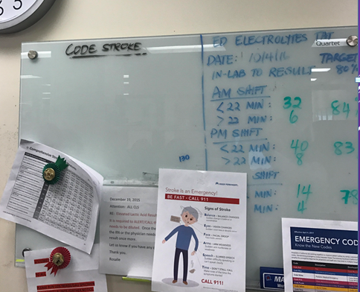
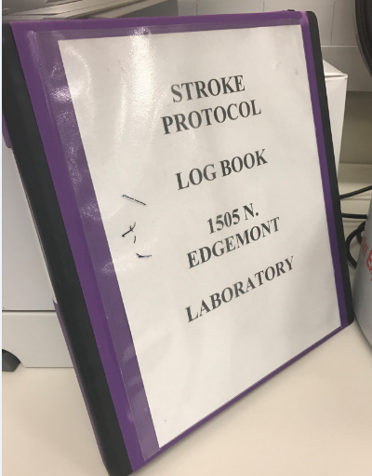
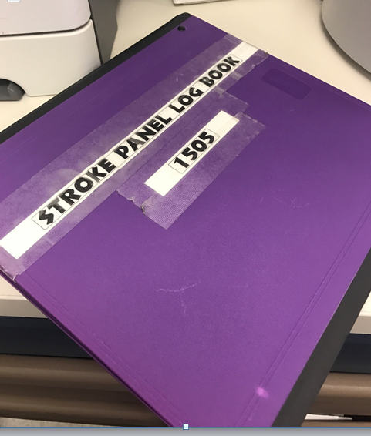
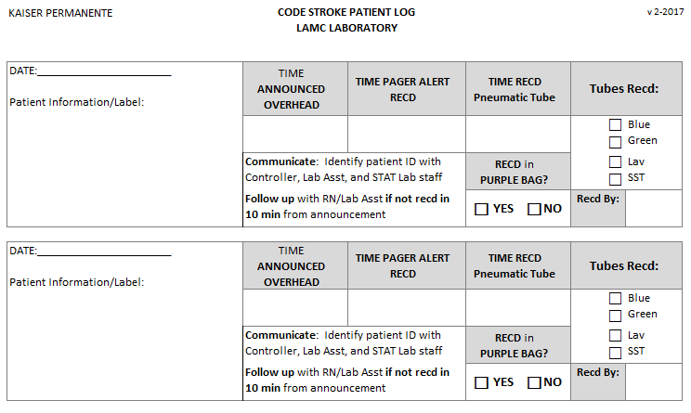
Code stroke: COMMUNICATION
DOCUMENTATION
STAT LAB – “WHITE BOARD”
CODE STROKE BINDER – STAT LAB
COMMUNICATE / DISCUSS
IDENTIFY PATIENT NAME
ARRIVAL OF SPECIMEN
HAND OFF TO CLS
EXAMPLE
lamc laboratory PATHOLOGY, LABORATORY, TRANSFUSION SERVICE,
FLOW CYTOMETRY, medical office buildings 2020 CODE STROKE inservice
11

Slide 10
LAB EFFICIENCY MEASURE:
CODE STROKE TURN AROUND TIME
45 MINUTES
10 MIN
10 MIN
25 MIN
DOOR TO ORDER
ORDER to
COLLECT
COLLECT to
RECEIVE
RECEIVE to
RESULT
SHARED TARGET REGARDLESS OF
ED vs LAB COLLECT
The sooner the specimen is collected this increases chance to meet the target and also save a life.
Documentation is imperative when there are delays i.e.
(CT Scan, RN dismissed the lab to collect – obtain the name)
17

Slide 11
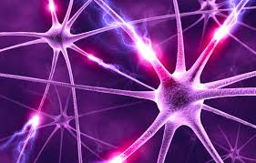
ANY QUESTIONS?
REMEMBER: TIME LOST IS BRAIN LOST
THINK ABOUT IT !!!

