Slide 1




lamc laboratory
PATHOLOGY, LABORATORY, TRANSFUSION SERVICE, FLOW CYTOMETRY, medical office buildings
2020 CODE STROKE inservice
CODE STROKE
ANCILLARY SERVICES: PATHOLOGY / LABORATORY / TRANSFUSION SERVICE / FLOW CYTOMETRY / LAB MOBs
B E F A S T
1

Slide 2

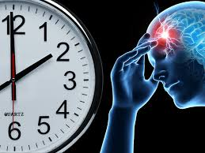


Video: time is brain
2020 CODE STROKE INSERVICE
LAMC – 4867 SUNSET BLVD
LABORATORY
2

Slide 3






LOS ANGELES MEDICAL CENTER
COMPREHENSIVE STROKE CENTER
2017
PRIMARY STROKE CENTER
Certified
Comprehensive Stroke Center
Best Practices
Monitoring Performance
Measurement of lab results changed from Order to Result
to
Door to Result
Staff education and manager review and follow up for every stroke case
Data for the efficiency measure provided through the Stroke Committee
Staff education regarding Stroke and Stroke-related workflows 1 hour / year
Daily department review of the Stroke Log to ensure appropriate documentation and compliance
Case review of outliers with Stroke Coordinator
lamc laboratory
PATHOLOGY, LABORATORY, TRANSFUSION SERVICE,
FLOW CYTOMETRY, medical office buildings
2020 CODE STROKE inservice
5

Slide 4

SIGNS OF STROKE: B E F A S T
BALANCE CHANGES
Sudden change in balance and coordination
B
ALANCE
VISION CHANGES
Sudden vision loss or double vision
E
YES
FACIAL DROOP
Face looks uneven
F
ACE
A
RMS
ARM WEAKNESS
Sudden arm numbness or weakness
S
PEECH
SLURRED SPEECH
Sudden difficulty speaking or can’t speak clearly
T
IME
DON’T STALL; CALL
Make note of the time the symptoms started
2020 CODE STROKE INSERVICE
LAMC – 4867 SUNSET BLVD
LABORATORY
4

Slide 5


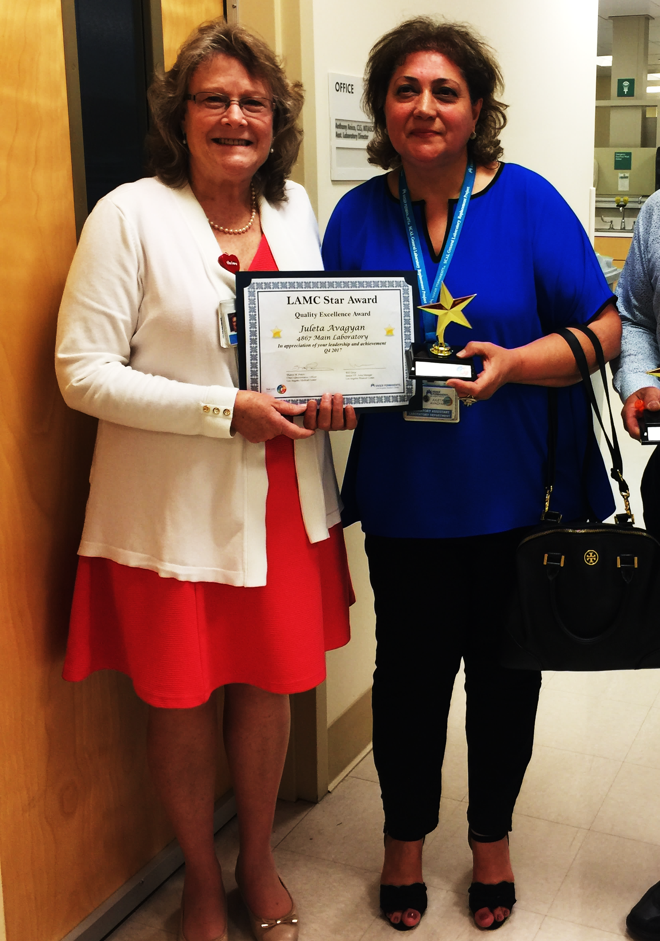
TRUE STORY
LAMC LAB EMPLOYEE RECOGNIZES
CODE STROKE IN A PATIENT …. A LIFE SAVED
2020 CODE STROKE INSERVICE
LAMC – 4867 SUNSET BLVD
LABORATORY
3

Slide 6



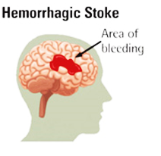
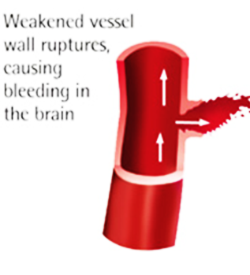
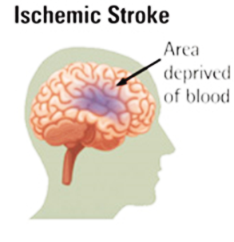
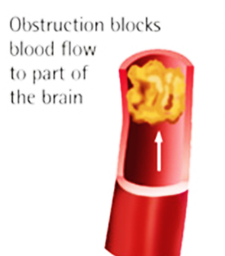
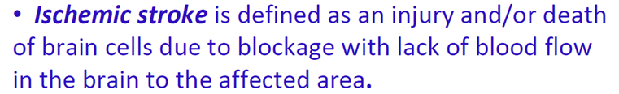
BASICS OF A STROKE
TWO
HEMORRHAGIC STROKE
ISCHEMIC STROKE
lamc laboratory
PATHOLOGY, LABORATORY, TRANSFUSION SERVICE,
FLOW CYTOMETRY, medical office buildings
2020 CODE STROKE inservice
6

Slide 7

CODE STROKE IS AN
EMERGENCY
PAGE CODE STROKE NEUROLOGIST
Tier 1: 279-1000
HOSPITAL PATIENT
VISITOR OR EMPLOYEE
CALL x 3-3000
OUTSIDE HOSPITAL
CALL 911
lamc laboratory
PATHOLOGY, LABORATORY, TRANSFUSION SERVICE,
FLOW CYTOMETRY, medical office buildings
2020 CODE STROKE inservice
7

Slide 8





Code stroke: communication
OVERHEAD ANNOUNCEMENT:
“Code Stroke” + Patient Location only
CODE STROKE PAGER
Located at the Controller Desk. If removed from this area, this must be returned for the next shift.
Both Controllers are responsible between shifts.
The hand off between controllers for each shift should account for the whereabouts of the pager, and are equally responsible if the pager is missing or there is no documentation or incorrect documention of the handoff.
The Controller or the Coverage for Controller should know the break and meal assignments of each lab assistant at any given time and is responsible for sending a lab assistant immediately.
A manager should be notified for any issues with receiving a response
Information on pager:
(Name, Medical Record #, Location, Room #)
lamc laboratory
2020 CODE STROKE inservice
8

Slide 9




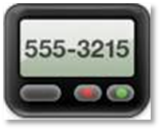




CODE STROKE vs. BRAIN ALERT
“BRAIN ALERT”:
NOTIFICATION OF POSSIBLE STROKE DOES MEET THE CRITERIA FOR HAVING A STROKE
ACTION
OVERHEAD ANNOUNCEMENT / PAGE
PHLEBOTOMY RESPONSE
PHONE CALL FOLLOW UP FOR SPECIMEN
SPECIMEN RECD IN PURPLE BAG
DOCUMENT IN STROKE LOG BOOK
CODE STROKE
BRAIN ALERT
E.D.
ALL OTHER LOCATIONS
9

Slide 10


Brain alert
“BRAIN ALERT”:
NOTIFICATION OF POSSIBLE STROKE DOES MEET THE CRITERIA FOR HAVING A STROKE
CODE STROKE
 OVERHEAD ANNOUNCEMENT / PAGE
 PHLEBOTOMY RESPONSE
 PHONE CALL FOLLOW UP FOR SPECIMEN
 SPECIMEN RECD IN PURPLE BAG
 DOCUMENT IN STROKE LOG BOOK
BRAIN ALERT
 OVERHEAD ANNOUNCEMENT / PAGE
 PHLEBOTOMY RESPONSE
 PHONE CALL FOLLOW UP FOR SPECIMEN
 SPECIMEN RECD IN PURPLE BAG ONLY NOTIFICATION
 DOCUMENT IN STROKE LOG BOOK INDICATE “BRAIN ALERT”. COMPLETE AS MORE INFORMATION IS PROVIDED.
9

Slide 11




Code stroke: COMMUNICATION
◆
JOINT AND SHARED ACCOUNTABILITY
CONTROLLER
STAT LAB
ASSIGNED LAB
ASSISTANT
SEND MESSAGE BLAST IN KPPI HANDHELD DEVICE TO LAB ASSTS
OVERHEAD
ANNOUNCEMENT
PAGER
DOCUMENT IN STROKE LOGBOOK
DOCUMENT IN STROKE LOGBOOK
lamc laboratory
PATHOLOGY, LABORATORY, TRANSFUSION SERVICE,
FLOW CYTOMETRY, medical office buildings
2020 CODE STROKE inservice
ANY ISSUES MUST BE ADDRESSED IMMEDIATELY –
INVOLVE A MANAGER OR LEAD CLS
10

Slide 12
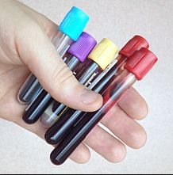


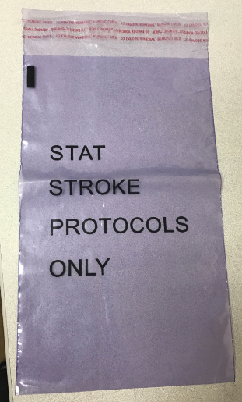
Code stroke: COMMUNICATION
“CODE STROKE”
RECD IN LAB
SPECIMENS SHOULD BE IN LAB WITHIN 10 MINUTES OF ANNOUNCEMENT
SPECIMENS SHOULD COME IN DESIGNATED PURPLE BAG
FOLLOW UP
CALL ED / RN
CALL CONTROLLER
CALL LAB ASST ASSIGNED
lamc laboratory
PATHOLOGY, LABORATORY, TRANSFUSION SERVICE,
FLOW CYTOMETRY, medical office buildings
2020 CODE STROKE inservice
11

Slide 13
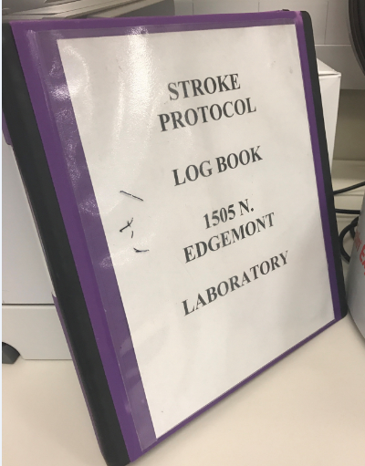
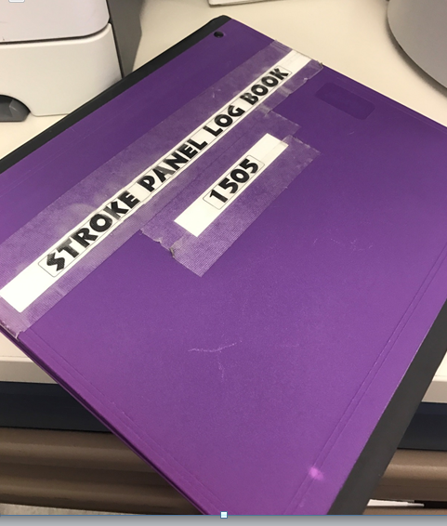
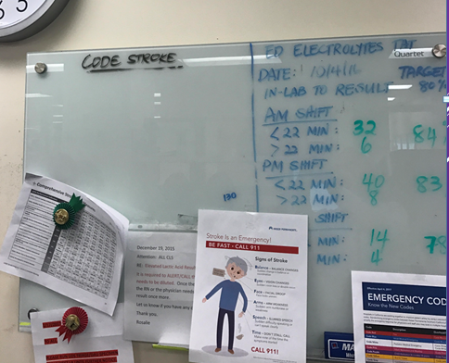

Code stroke: COMMUNICATION
DOCUMENTATION
CODE STROKE BINDER – STAT LAB
COMMUNICATE / DISCUSS
IDENTIFY PATIENT NAME
ARRIVAL OF SPECIMEN
HAND OFF TO CLS
STAT LAB – “WHITE BOARD”
lamc laboratory
PATHOLOGY, LABORATORY, TRANSFUSION SERVICE,
FLOW CYTOMETRY, medical office buildings
2020 CODE STROKE inservice
12

Slide 14
Code stroke: BARRIERS
ISSUES AND EXCEPTIONS:
NOTIFY IMMEDIATELY
CONTROLLER/ INPATIENT LAB ASSTS | PROCESSING – STAT LAB LAB ASSTS / REPS / CLS | STAT LAB CLS CALL RN/MD PROVIDER
LAB ASST – CHALLENGES IN OBTAINING SPECIMEN LOCATING PATIENT PATIENT ACCESS BREAK/MEAL COVERAGE CONCERNS (PATIENT CARE FIRST) | SPECIMEN LABEL ISSUES NO LABEL , MISLABELLED SPECIMEN ORDER ISSUES: WRONG ORDER OR INCORRECT ORDER | SPECIMEN HEMOLYZED UNACCEPTABLE FOR TESTING INVALID RESULTS INSTRUMENT DELAY PROCESS DELAY
CONTROLLER – NO RESPONSE FROM PHLEBOTOMIST WORKFLOW CHALLENGES TEAMWORK ISSUES | SPECIMEN ISSUES: QNS HEMOLYZED DAMAGED IN PROCESSING WRONG TUBE COLLECTED MISSING A TUBE | INVALID RESULTS – DO NOT WAIT TO REPEAT
lamc laboratory
PATHOLOGY, LABORATORY, TRANSFUSION SERVICE,
FLOW CYTOMETRY, medical office buildings
2020 CODE STROKE inservice
DO NOT DELAY COMMUNICATION
13

Slide 15
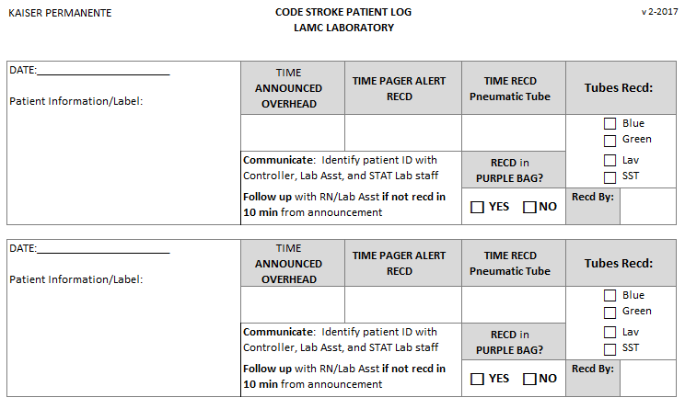
Code stroke: COMMUNICATION
DOCUMENTATION
CODE STROKE LOG
EXAMPLE
lamc laboratory
PATHOLOGY, LABORATORY, TRANSFUSION SERVICE,
FLOW CYTOMETRY, medical office buildings
2020 CODE STROKE inservice
14

Slide 16
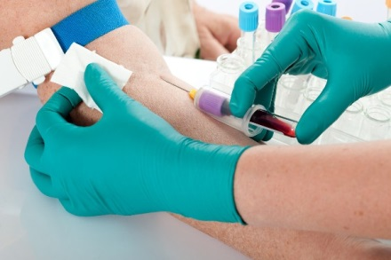
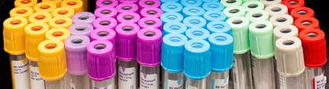
Code stroke: PHLEBOTOMY RESPONSE
JOINT AND SHARED ACCOUNTABILITY
CONTROLLER
LAB ASST assigned
ALL
LAB ASSTS
LAB RESPONSE TO CODE STROKE IS BEING TRACKED & DOCUMENTED
lamc laboratory
PATHOLOGY, LABORATORY, TRANSFUSION SERVICE,
FLOW CYTOMETRY, medical office buildings
2020 CODE STROKE inservice
15

Slide 17

Code stroke: phlebotomy response
REPORTING TO THE CODE STROKE
ANNOUNCE YOUR PRESENCE LOUD AND CLEAR –
MAKE SURE PROVIDERS KNOW THAT YOU ARE FROM THE LABORATORY
PATIENT NOT AVAILABLE? I.E. CT SCAN
FOLLOW UP WITH PROVIDER
FOLLOW THE PATIENT TO COLLECT BLOOD
LAB NOT NEEDED?
OBTAIN THE FULL NAME OF WHO INFORMED YOU
DOCUMENT THAT PROVIDER’S NAME IN KPPI
FOLLOW UP AND MAKE SURE DOCUMENTED IN MEDICOPIA
INFORM CONTROLLER, STAT LAB
STAT LAB DOCUMENTS IN CODE STROKE LOG BOOK
lamc laboratory
PATHOLOGY, LABORATORY, TRANSFUSION SERVICE,
FLOW CYTOMETRY, medical office buildings
2020 CODE STROKE inservice
16

Slide 18

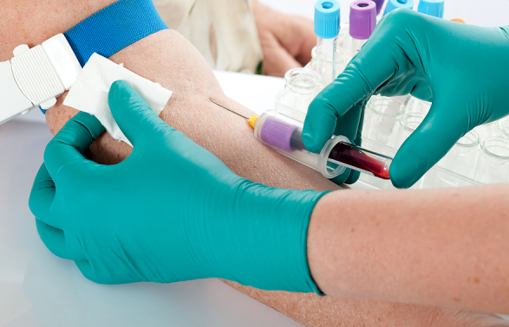



Code stroke: LAB EFFICIENCY MEASURE
DOOR TO RESULT
ORDER
COLLECT
IN-LAB
RESULTS
ORDER to COLLECT
COLLECT to IN-LAB
IN-LAB to RESULTS
17

Slide 19
Efficiency Measures - Lab
Measure: |  | Target | Jan ’18 | Feb ‘18 | Mar ‘18 | Apr ‘18 | May ‘18 | Jun ‘18 | Jul ‘18 | Aug ‘18 | Sep ‘18 | Oct ‘18 | Nov ‘18 | Dec ‘ 18 | 12-Mos. Total/Median
ED Aggregate Lab Median Times | Number of Code Strokes |  | 19 | 16 | 19 | 20 | 23 | 16 | 19 | 23 | 9 |  |  |  | 164
 | Door to Lab Ordered | ≤ 10 min | 5 | 5 | 5 | 10 | 7 | 9 | 8 | 7 | 7 |  |  |  | 7
 | Door to Lab Resulted | ≤ 45 min | 21 | 24 | 21 | 26 | 24 | 23 | 23 | 24 | 19 |  |  |  | 23
18
Notes:
ANALYSIS: The Door to order times have decreased overall. The Order to results have met target for one year. Overall Door to result time has met target.
CONCLUSION: Target met.
ACTION: The process to obtain labs in the ED has improved with the use of the Brain Alert. The Lab processes the specimens that are sent in a purple bag. Overall, metric is doing well, continue the existing protocols for ED and Lab.

Slide 20


KNOWLEDGE CHECK
LOS ANGELES MEDICAL CENTER HAS EARNED THIS DISTINCTION BY THE JOINT COMMISSION, THE FIRST AND ONLY SCAL KAISER PERMANENTE FACILITY TO ACHIEVE THIS?
A
FASTEST TURN AROUND TIME FOR RESULTS
B
RAISED ITS CERTIFICATION FROM PRIMARY STROKE CENTER TO COMPREHENSIVE STROKE CENTER
C
FORMATION OF A STROKE COMMITTEE
D
BEST STROKE EDUCATION PROGRAM

Slide 21
KNOWLEDGE CHECK
AS A REQUIREMENT FOR MAINTAINING COMPREHENSIVE CERTIFICATION, WHICH OF THE FOLLOWING IS TRUE FOR THE LABORATORY?
A
ALL EMPLOYEES SHOULD RECEIVE STROKE EDUCATION ANNUALLY
B
THE TURN AROUND TIME FOR LAB TESTS IS 45 MINUTES FROM DOOR TO RESULT.
C
THE PHLEBOTOMISTS IS REQUIRED TO RESPOND TO LOCATION WHERE THE CODE STROKE IS ANNOUNCED
D
ANY CHALLENGES IN OBTAINING SPECIMEN OR ANY REASON FOR DELAY SHOULD INVOLVE THE MANAGER.

Slide 22
KNOWLEDGE CHECK
COMPLETE THE ACRONYM: BEFAST
B
ALANCE
E
YES
F
ACE
A
RMS
S
PEECH
T
IME

Slide 23



ANY QUESTIONS?
REMEMBER: TIME LOST IS BRAIN LOST
THINK ABOUT IT !!!

