Slide 1
CYTOLOGY TRACKING
February 9, 2021

Slide 2
What is cytology tracking

Slide 3
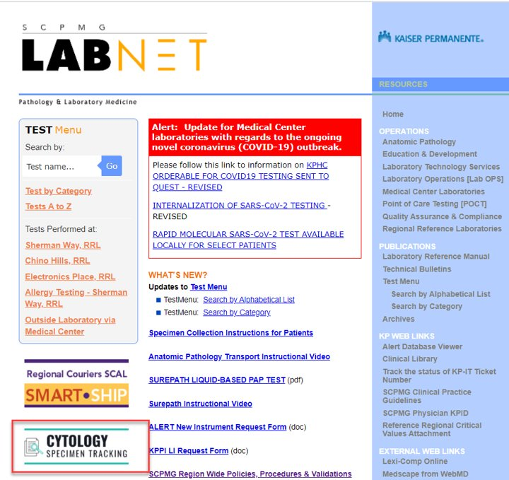
WHERE IS CYTOLOGY TRACKING

Slide 4
How to request access to cytology tracking
Click on the cytology tracking link in labnet
the following screen appears, click Request access

Slide 5
How to request access to cytology tracking
The following screen appears when access request submitted
User will receive email notification once access has been granted

Slide 7
Cytology tracking tool
Scan mob/med ctr location (sending location)
Scan KPHC barcode (MRN)
Match list of items with specimens scanned
Print tracking list
track

Slide 8
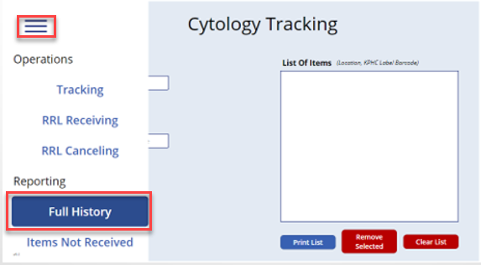
How to retrieve and reprint tracking list
Click on the menu and select full history

Slide 9
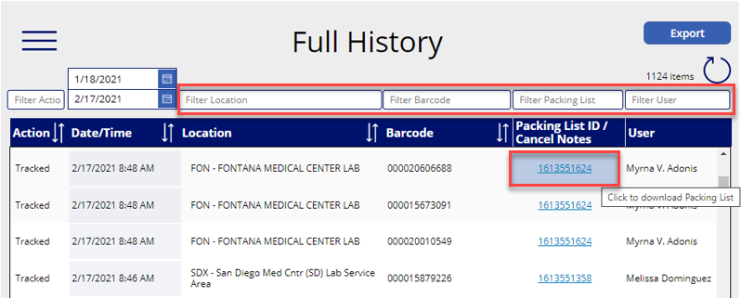
How to retrieve and reprint tracking list
User may filter the report by location, barcode, packing list, or user.
Click on the desired packing list to download and print.

Slide 10
ADDITIONAL WORKFLOW reminders:
LABELS ON SPECIMENS MUST MATCH THE KPHC REQUISITION FORM RECEIVED.
# OF SPECIMENS MUST MATCH THE CYTOLOGY TRACKING LIST
PLACE KPHC REQUISITION IN ORDER TO MATCH CYTOLOGY TRACKING LIST
PLACE SUREPATH VIALS IN YELLOW BAGS
STAPLE CYTOLOGY TRACKING LIST ON TOP KPHC REQUISITION IN YELLOw BAGS
SEAL YELLOW BAG AND ATTACH CYTOLOGY STICKER – to: Cytology Department
Place yellow bag in clear cytology bins
PRINT PAC TRACK label and tape to the outside of the clear cytology bin
SEND TO Sherman way regional labs
save a copy of the cytology tracking list and its associated pac track label if desired

Slide 11
Cytology tracking do’s and don’t
Do:
Print cytology tracking list before tracking
Do use google chrome as the web browser
Scan under cytology tracking only
Don’t:
Scan cerner barcodes
Use internet explorer or Microsoft edge as the web browser
Scan under cytology receiving or canceling – this is for RRL Cytology department use only

Slide 12
To do list before cytology tracking go live
Have users obtain access
Ensure all applicable staff are trained
Identify who will receive monitoring reports via email
Validate location barcodes are readable by scanners at your locations
Ensure all transport supplies are available (i.e. clear cytology bins, yellow bags)

