Slide 1


4867 Sunset Boulevard
Pathology, Blood Bank, Flow Cytometry, Laboratory Departments
2022 Education
Code stroke

Slide 2
CODE STROKE is an EMERGENCY
PAGE CODE STROKE
NEUROLOGIST 279-1000
HOSPITAL PATIENT
VISITOR OR EMPLOYEE
CALL CODE BLUE x 3-3000
OUTSIDE HOSPITAL
CALL 911
2022 CODE STROKE INSERVICE
LAMC
4867 LABORATORY

Slide 3
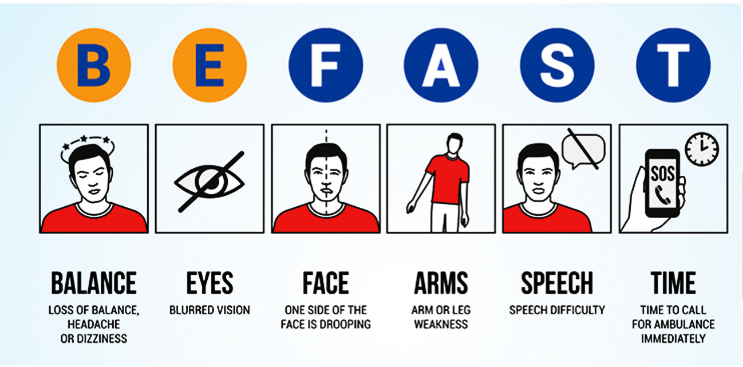
B
E
F
A
S
T

Slide 4
LABORATORY ROLE
CODE STROKE ANNOUNCED
1. RESPONSE AT THE LOCATION OF CODE STROKE
Announce your presence – Make it Loud and Clear that you are from the Lab in any circumstance.
This applies to inpatient floors and Emergency Department.
PATIENT NOT AVAILABLE / CT SCAN?
Follow up with the unit to see where patient is.
Investigate if patient still needs lab draw
REPORT TO CODE STROKE AND TURNED AWAY?
Document full name of provider that informed you
Reason lab not needed.
LABORATORY RESPONSE TO CODE STROKE IS BEING TRACKED.
CALLING TO CHECK DOES NOT COUNT AS A RESPONSE

Slide 5
LABORATORY’S ROLE
CODE STROKE ANNOUNCED
2. ACTION – JOINT RESPONSIBILITY
Controller can dispatch any Lab Asst
Lab assistant assigned, another lab assistant from another floor, or main lab processing
Patient Care Comes First!!!
Issues and Concerns during a Code Stroke can be addressed later
Breaks/Meal Coverage – Take care of the patient, inform controller and management
Document any issues and present to management or Lead CLS

Slide 6



LOS ANGELES MEDICAL CENTER
COMPREHENSIVE STROKE CENTER
2022
PRIMARY STROKE CENTER
Comprehensive Stroke Center
Best Practices
Monitoring Performance
Measurement of lab results from
Order to Result
Staff education and manager review and follow up for every stroke case
Data for the efficiency measure provided through the Stroke Committee
Staff education regarding Stroke and Stroke-related workflows 1 hour / year
Daily department review of the Stroke Log to ensure appropriate documentation and compliance
Case review of outliers with Stroke Coordinator
lamc laboratory
PATHOLOGY, LABORATORY, TRANSFUSION SERVICE,
FLOW CYTOMETRY, medical office buildings
2022 CODE STROKE inservice
6

Slide 7


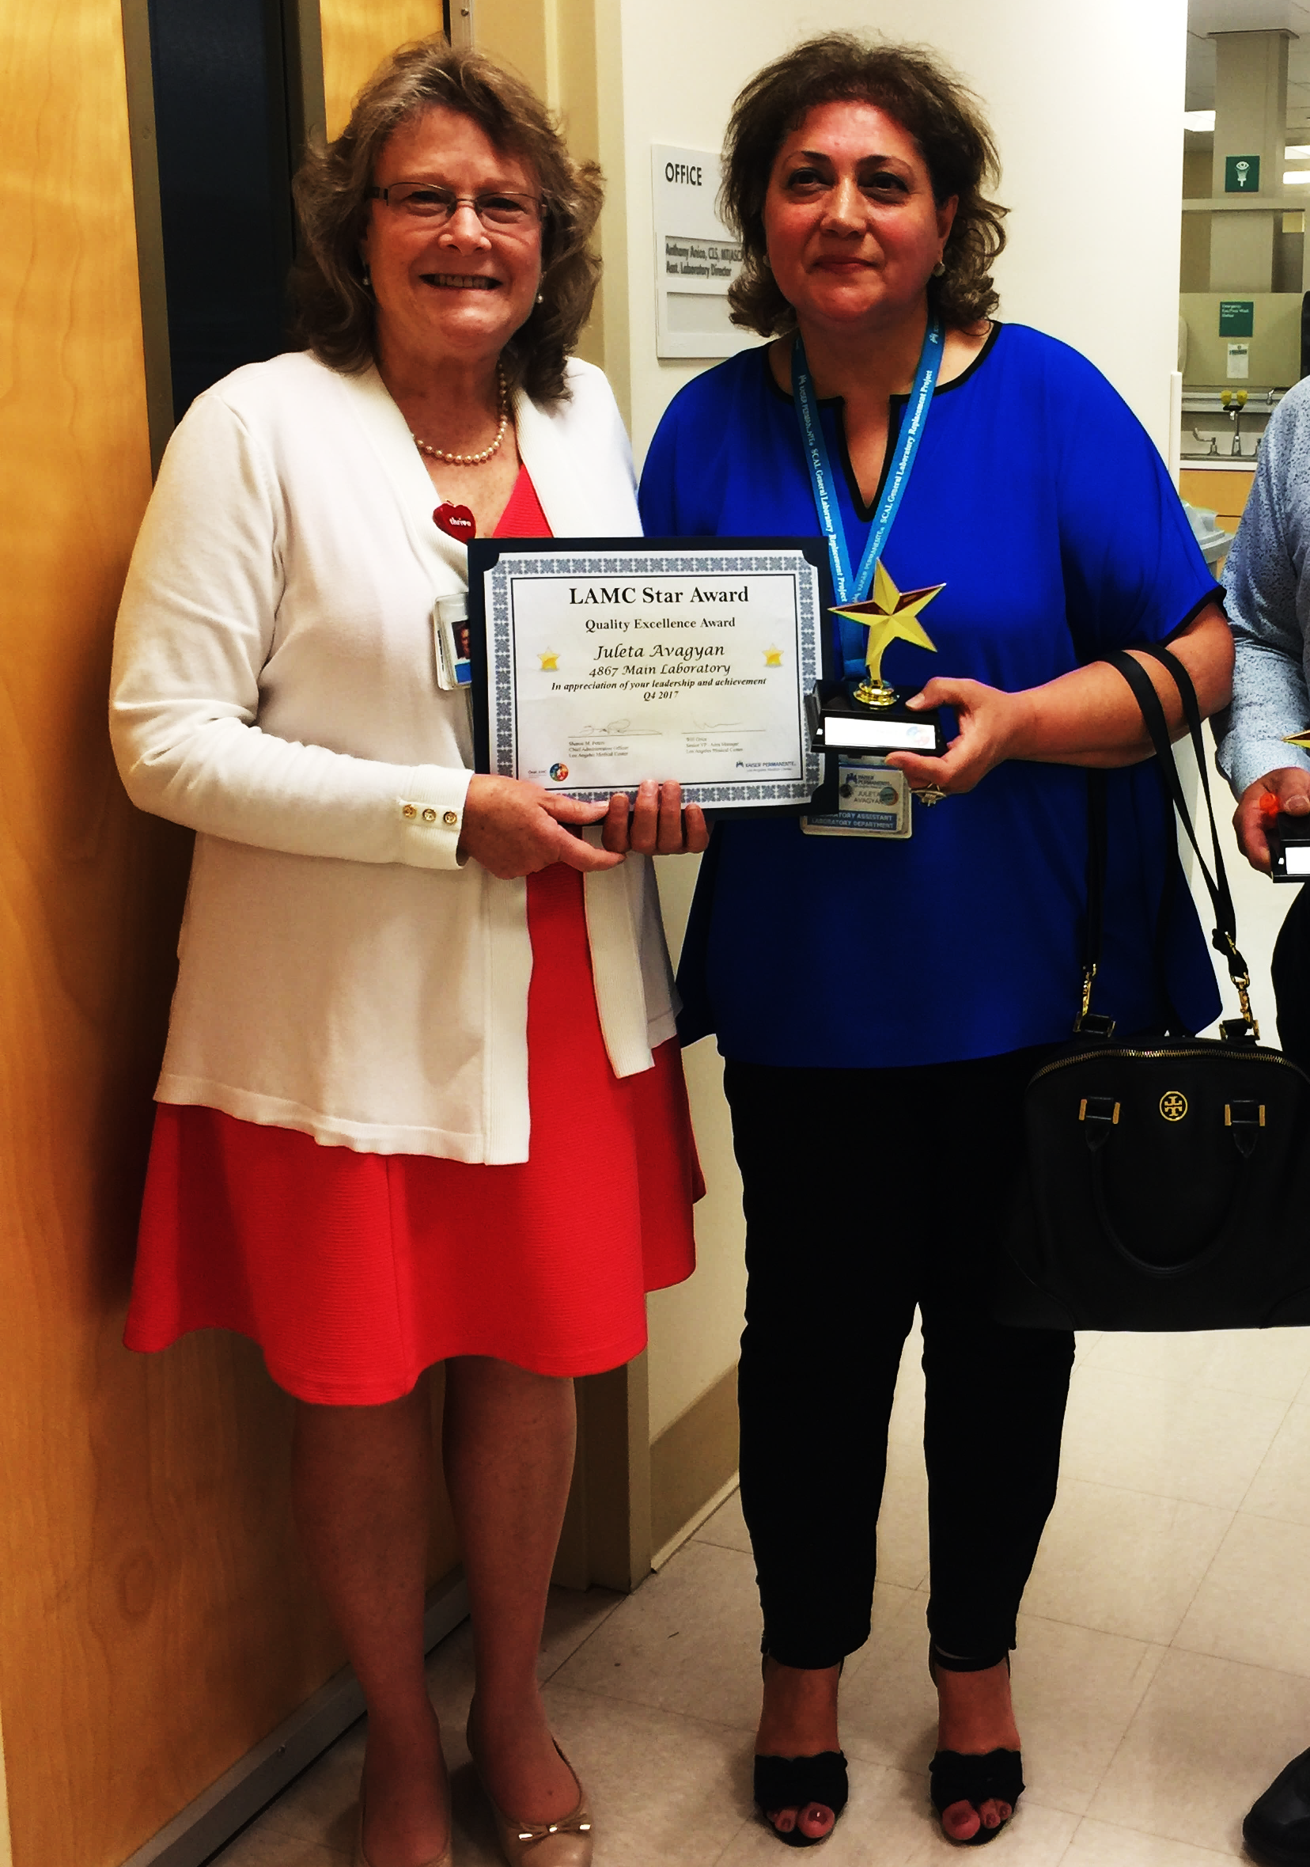
TRUE STORY
LAMC LAB EMPLOYEE RECOGNIZES
CODE STROKE IN A PATIENT …. A LIFE SAVED
2022 CODE STROKE INSERVICE
LAMC – 4867 SUNSET BLVD
LABORATORY
7

Slide 8
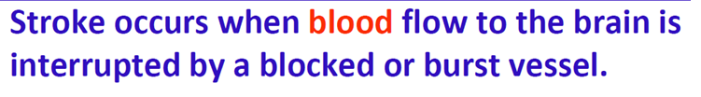

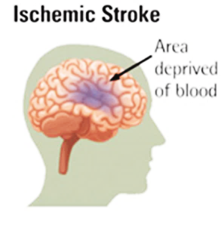
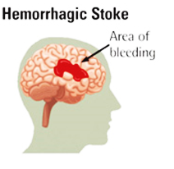
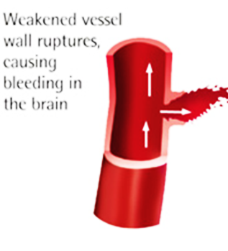
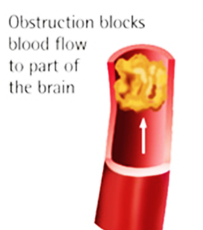
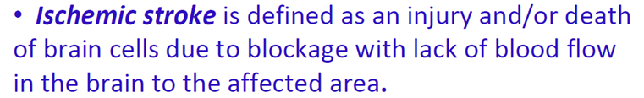
BASICS OF A STROKE
There are types of stroke:
2
HEMORRHAGIC STROKE
ISCHEMIC STROKE
lamc laboratory
PATHOLOGY, LABORATORY, TRANSFUSION SERVICE,
FLOW CYTOMETRY, medical office buildings
2022 CODE STROKE inservice
6

Slide 9





Code stroke: Communication
OVERHEAD ANNOUNCEMENT:
“Code Stroke” + Patient Location only
CODE STROKE PAGER
Located at the Controller Desk. If removed from this area, this must be returned for the next shift.
Both Controllers are responsible between shifts.
The hand off between controllers for each shift should account for the whereabouts of the pager, and are equally responsible if the pager is missing or there is no documentation or incorrect documentation of the handoff.
The Controller or the Coverage for Controller should know the break and meal assignments of each lab assistant at any given time and is responsible for sending a lab assistant immediately.
A manager should be notified for any issues with receiving a response
Information on pager:
(Name, Medical Record #, Location, Room #)
lamc laboratory
2022 CODE STROKE inservice
9

Slide 10




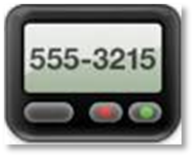



Brain Alert
“BRAIN ALERT”:
NOTIFICATION OF POSSIBLE STROKE DOES MEET THE CRITERIA FOR HAVING A STROKE
CODE STROKE
 OVERHEAD ANNOUNCEMENT / PAGE
 PHLEBOTOMY RESPONSE
 PHONE CALL FOLLOW UP FOR SPECIMEN
 SPECIMEN RECD IN PURPLE BAG
 DOCUMENT IN STROKE LOG BOOK
BRAIN ALERT
 OVERHEAD ANNOUNCEMENT / PAGE
 PHLEBOTOMY RESPONSE
 PHONE CALL FOLLOW UP FOR SPECIMEN
 SPECIMEN RECD IN PURPLE BAG ONLY NOTIFICATION
 DOCUMENT IN STROKE LOG BOOK INDICATE “BRAIN ALERT”. COMPLETE AS MORE INFORMATION IS PROVIDED.

Slide 11


Code stroke: COMMUNICATION
JOINT AND SHARED ACCOUNTABILITY
CONTROLLER
STAT LAB
ASSIGNED LAB
ASSISTANT
SEND MESSAGE BLAST IN KPPI HANDHELD DEVICE TO LAB ASSTS
OVERHEAD
ANNOUNCEMENT
PAGER
DOCUMENT IN STROKE LOGBOOK
DOCUMENT IN STROKE LOGBOOK
lamc laboratory
PATHOLOGY, LABORATORY, TRANSFUSION SERVICE,
FLOW CYTOMETRY, medical office buildings
2022 CODE STROKE inservice
ANY ISSUES MUST BE ADDRESSED IMMEDIATELY –
INVOLVE A MANAGER OR LEAD CLS
11

Slide 12
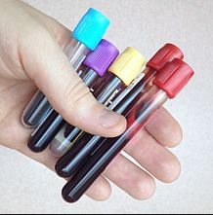


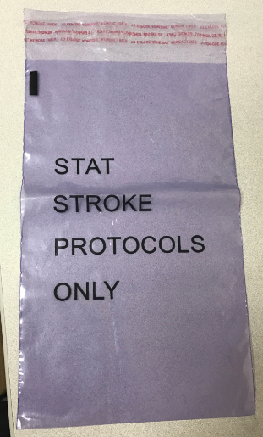
Code stroke: COMMUNICATION
“CODE STROKE”
RECD IN LAB
AND SPECIMENS SHOULD BE IN LAB WITHIN 10 MINUTES OF ANNOUNCEMENT’
SPECIMENS SHOULD COME IN DESIGNATED PURPLE BAG
IMPORTANT: IF NO ORDERS AT THE TIME SPECIMENS ARE RECEIVED, PROCESS AND TEST OFFLINE WHILE WAITING FOR ORDERS
FOLLOW UP
CALL ED / RN
CALL CONTROLLER
CALL LAB ASST ASSIGNED
lamc laboratory
PATHOLOGY, LABORATORY, TRANSFUSION SERVICE,
FLOW CYTOMETRY, medical office buildings
2022 CODE STROKE inservice
12

Slide 13
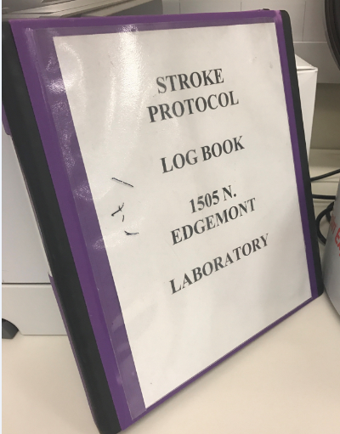
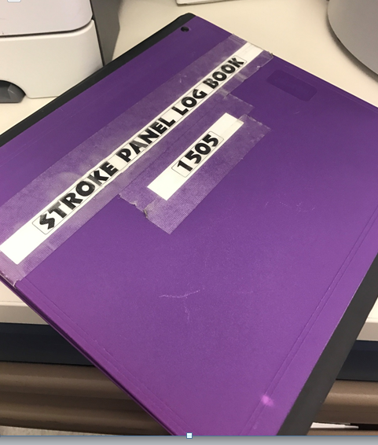
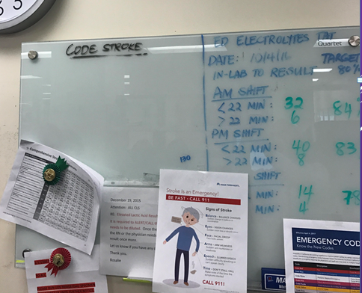

Code stroke: COMMUNICATION
DOCUMENTATION
CODE STROKE BINDER – STAT LAB
COMMUNICATE / DISCUSS
IDENTIFY PATIENT NAME
ARRIVAL OF SPECIMEN
HAND OFF TO CLS
STAT LAB – “WHITE BOARD”
lamc laboratory
PATHOLOGY, LABORATORY, TRANSFUSION SERVICE,
FLOW CYTOMETRY, medical office buildings
2022 CODE STROKE inservice
13

Slide 14
Code stroke: BARRIERS
ISSUES AND EXCEPTIONS:
NOTIFY IMMEDIATELY
CONTROLLER/ INPATIENT LAB ASSTS | PROCESSING – STAT LAB LAB ASSTS / REPS / CLS | STAT LAB CLS CALL RN/MD PROVIDER
LAB ASST – CHALLENGES IN OBTAINING SPECIMEN LOCATING PATIENT PATIENT ACCESS BREAK/MEAL COVERAGE CONCERNS (PATIENT CARE FIRST) | SPECIMEN LABEL ISSUES NO LABEL , MISLABELLED SPECIMEN ORDER ISSUES: WRONG ORDER OR INCORRECT ORDER | SPECIMEN HEMOLYZED UNACCEPTABLE FOR TESTING INVALID RESULTS INSTRUMENT DELAY PROCESS DELAY
CONTROLLER – NO RESPONSE FROM PHLEBOTOMIST WORKFLOW CHALLENGES TEAMWORK ISSUES | SPECIMEN ISSUES: QNS HEMOLYZED DAMAGED IN PROCESSING WRONG TUBE COLLECTED MISSING A TUBE | INVALID RESULTS – DO NOT WAIT TO REPEAT
lamc laboratory
PATHOLOGY, LABORATORY, TRANSFUSION SERVICE,
FLOW CYTOMETRY, medical office buildings
2022 CODE STROKE inservice
DO NOT DELAY COMMUNICATION
14

Slide 15
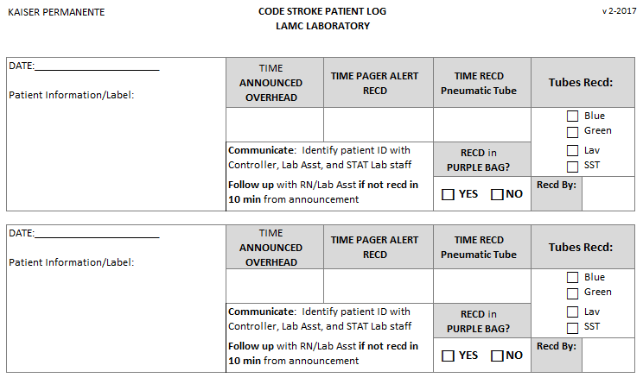
Code stroke: COMMUNICATION
DOCUMENTATION
CODE STROKE LOG
EXAMPLE
lamc laboratory
PATHOLOGY, LABORATORY, TRANSFUSION SERVICE,
FLOW CYTOMETRY, medical office buildings
2022 CODE STROKE inservice
15

Slide 16
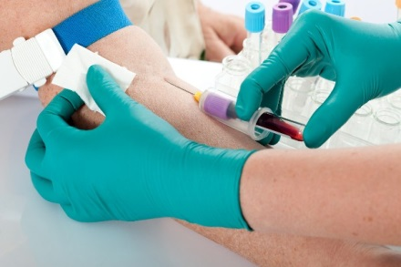
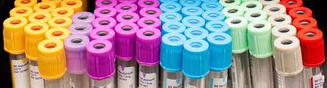
Code stroke: PHLEBOTOMY RESPONSE
JOINT AND SHARED ACCOUNTABILITY
CONTROLLER
LAB ASST assigned
ALL
LAB ASSTS
LAB RESPONSE TO CODE STROKE IS BEING TRACKED & DOCUMENTED
lamc laboratory
PATHOLOGY, LABORATORY, TRANSFUSION SERVICE,
FLOW CYTOMETRY, medical office buildings
2022 CODE STROKE inservice
16

Slide 17

Code stroke: phlebotomy response
REPORTING TO THE CODE STROKE
ANNOUNCE YOUR PRESENCE LOUD AND CLEAR –
MAKE SURE PROVIDERS KNOW THAT YOU ARE FROM THE LABORATORY
PATIENT NOT AVAILABLE? I.E. CT SCAN
FOLLOW UP WITH PROVIDER
FOLLOW THE PATIENT TO COLLECT BLOOD
LAB NOT NEEDED?
OBTAIN THE FULL NAME OF WHO INFORMED YOU
DOCUMENT THAT PROVIDER’S NAME IN KPPI
FOLLOW UP AND MAKE SURE DOCUMENTED IN MEDICOPIA
INFORM CONTROLLER, STAT LAB
STAT LAB DOCUMENTS IN CODE STROKE LOG BOOK
lamc laboratory
PATHOLOGY, LABORATORY, TRANSFUSION SERVICE,
FLOW CYTOMETRY, medical office buildings
2022 CODE STROKE inservice
17

Slide 18
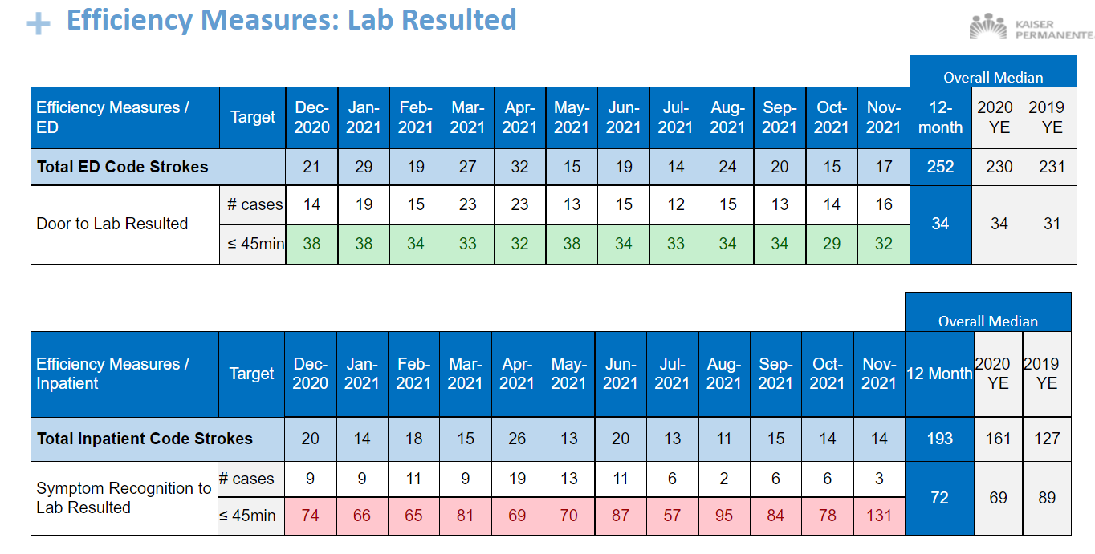
Efficiency Measures - Lab
18
Notes:
ANALYSIS: The Door to order times have decreased overall. The Order to results have met target for one year. Overall Door to result time has met target.
CONCLUSION: Target met.
ACTION: The process to obtain labs in the ED has improved with the use of the Brain Alert. The Lab processes the specimens that are sent in a purple bag. Overall, metric is doing well, continue the existing protocols for ED and Lab.

Slide 19
LAB EFFICIENCY MEASURE:
CODE STROKE TURN AROUND TIME
45 MINUTES
10 MIN
10 MIN
25 MIN
DOOR TO ORDER
ORDER to
COLLECT
    COLLECT to
    RECEIVE
  RECEIVE to
RESULT
SHARED TARGET REGARDLESS OF
ED vs LAB COLLECT
IMPORTANT: IF NO ORDERS AT THE TIME SPECIMENS ARE RECEIVED, PROCESS AND TEST OFFLINE WHILE WAITING FOR ORDERS
The sooner the specimen is collected this increases chance to meet the target and also save a life.
Documentation is imperative when there are delays i.e.
(CT Scan, RN dismissed the lab to collect – obtain the name)
19

Slide 20
CASE STUDY: Timeline
Specimen was left on counter
Not end of shift
01:17 –
RN Collects
00:00 –
Code Stroke Announced
00:35 –
First Response from a Lab Asst
01:40
Specimen Logged In Cerner
01:21 ?
Lab Asst endorses to next shift
2:07
Results
In Cerner
Delayed response from any lab asst
Next lab asst, “I’m not clocked in yet”
SHIFT
SHIFT
00:09 –
Controller sent broadcast message re: Code Stroke
Is this the reason we are in healthcare?
What if this is your family member?
Or yourself one day?
How would you feel if you knew your specimens were not treated with urgency?
Code Stroke is an EMERGENCY!!!
00:40–
Lab Asst assigned Responds
01:23 ?
Lab Asst Documents Code Stroke in Log
Assigned Lab Asst on Break
Specimen not logged in Cerner
“Didnt want to be responsible”

Slide 21


KNOWLEDGE CHECK
True or False:
In the Previous Case Study, what would be your answer to the following statements:
?
T
Controller could have identified a lab asst to collect the specimen and not wait so long for a response
?
T
The Controller could have informed a manager when they are challenged to send a lab asst
?
T
The Lab Assistant should log Code Stroke in the book and receive specimens in Cerner
?
F
The Lab Asst made a good decision in not logging in specimens in Cerner to avoid responsibility
?
It is acceptable not to respond because this was the end of the shift and the next shift would arrive soon
F
?
Communication was acceptable because the information was given to the next shift properly
F
?
Those that are covering the floor where the Code Stroke patient is located while the assigned lab assistant is on their meal period, are not responsible for responding do the Code Stroke
T
?
If a family member or a loved one was in the ED for a Code Stroke, I would feel confident with the same staff involved to handle and process the specimens and I would have done the same thing.
F

Slide 22


KNOWLEDGE CHECK
LOS ANGELES MEDICAL CENTER HAS EARNED THIS DISTINCTION BY THE JOINT COMMISSION, THE FIRST AND ONLY SCAL KAISER PERMANENTE FACILITY TO ACHIEVE THIS?
A
FASTEST TURN AROUND TIME FOR RESULTS
B
RAISED ITS CERTIFICATION FROM PRIMARY STROKE CENTER TO COMPREHENSIVE STROKE CENTER
C
FORMATION OF A STROKE COMMITTEE
D
BEST STROKE EDUCATION PROGRAM

Slide 23


KNOWLEDGE CHECK
AS A REQUIREMENT FOR MAINTAINING COMPREHENSIVE CERTIFICATION, WHICH OF THE FOLLOWING IS TRUE FOR THE LABORATORY?
A
ALL EMPLOYEES SHOULD RECEIVE STROKE EDUCATION ANNUALLY
B
THE TURN AROUND TIME FOR LAB TESTS IS 45 MINUTES FROM DOOR TO RESULT.
C
THE PHLEBOTOMISTS IS REQUIRED TO RESPOND TO LOCATION WHERE THE CODE STROKE IS ANNOUNCED
D
ANY CHALLENGES IN OBTAINING SPECIMEN OR ANY REASON FOR DELAY SHOULD INVOLVE THE MANAGER.

Slide 24


KNOWLEDGE CHECK
COMPLETE THE ACRONYM: BEFAST
B
ALANCE
E
YES
F
ACE
A
RMS
S
PEECH
T
IME

Slide 25




ANY QUESTIONS?
REMEMBER: TIME LOST IS BRAIN LOST
THINK ABOUT IT !!!

