Slide 1
Newborn Screening Bloodspot Collection

Slide 2
What is Newborn Screening?
Newborn screening is a blood test that checks for certain rare disorders that can cause serious health problems, including brain damage or death, if not treated early.
The test identifies most, but not all, of babies who have these disorders.

Slide 3
Why Do Babies Need This Test?
Babies with one of these disorders can look healthy at birth but still have a serious disease.
Making a diagnosis early means treatment can be started before health problems occur.

Slide 4
3 Main Reasons a Newborn Screen Specimen is Collected Outpatient
A baby has never had a Newborn Screening specimen collected – homebirth, out of State delivery, or international adoption.
A baby’s initial Newborn Screen specimen collected in the hospital was deemed inadequate due to collection technique issues or MRN mismatch on the test request form.
A baby’s initial Newborn Screen specimen was presumptive positive for PKU or Biotinidase Deficiency and a repeat specimen is used for confirmatory testing. The initial Newborn Screen results were incomplete.

Slide 5
How is the Test Done?
A few drops of blood are taken from the baby’s heel and put on special filter paper on the bloodspot collection card.
The bloodspot card is then sent to a program approved laboratory for testing (Kaiser NAPS Lab 72).
This is a safe and simple test.

Slide 6
Which Disorders Are Tested for?
Over 80 disorders are screening for, including the following:
Metabolic Disorders
Endocrine Disorders
Sickle Cell Disease/Hemoglobin Disorders
Cystic Fibrosis
Immunological Disorders
Neurological Disorders

Slide 7
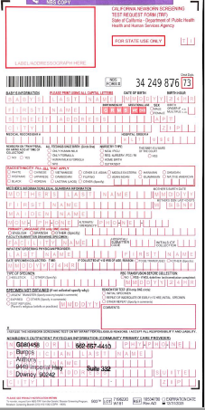
Newborn Screening Test Request Form -
Demographic information completed by pediatric staff prior to arrival at lab

Slide 8
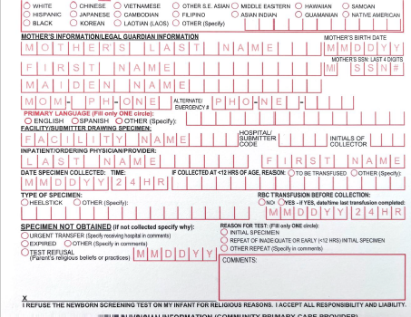
Lab Staff Completes:
Date and Time of Collection
Initials of Collector

Slide 9
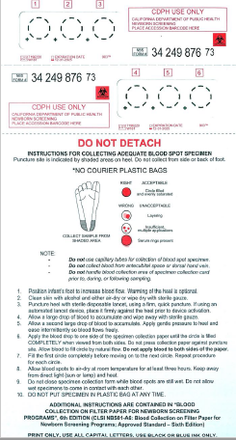
Bloodspot Filter Paper
Collection Instructions

Slide 10
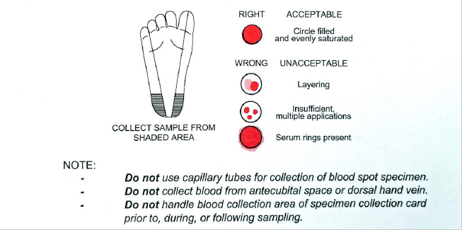

Slide 11
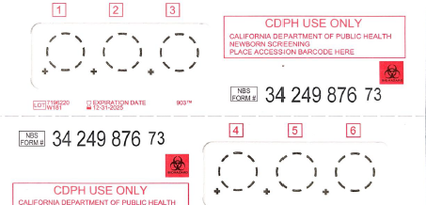

Slide 12
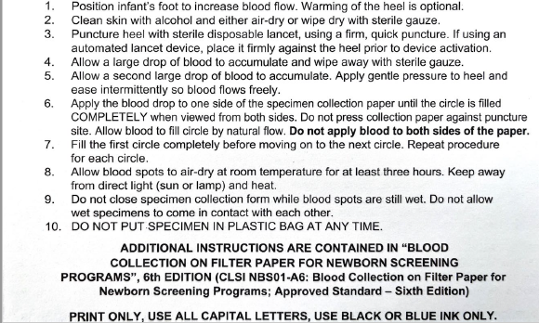

Slide 13
Newborn Screening Bloodspot Collection Video Review
CLSI Newborn Screening DVD | Informational Video (Clip) - YouTube

Slide 14
Instructions for Collection and Handling of Blood Specimens
For Recall Testing for Hemoglobinopathies
***Please Note that there is NO order in Health Connect for this lab
Specimen Collection (for each patient)
Collect 1.5—2 ml whole blood into one 3ml or 5 ml EDTA tube (purple) via venipuncture and immediately invert several times so the blood is mixed well
with the anticoagulant. Label tube with patient’s name and collection date.
Specimen Packing & Handling (Cylinder & pre-addressed envelope enclosed)
Insert the specimen tube into a BIOHAZARD plastic bag with absorbent material (like a paper towel) and seal the bag.
Complete the Intake Form. Insert it into the pouch of the plastic bag.
Insert the sealed plastic bag into the enclosed mailing container.
Place the mailing container in the pre-addressed envelope.
Call General Logistics Systems (GLS) at 1-800-322-5555 to arrange for a “remote pick up” of envelope.
(Kaiser Acct # 53999—account address is 6041 Cadillac Ave. Los Angeles, CA 90034) the same day it is collected:
Specimen is sent to:
Children’s Hospital & Research Center
Hemoglobinopathy Laboratory
747 52nd Street
Oakland, CA 94609-9925
Atten: Mahin Azimi
Notify the Newborn Screening Area Service Center (ASC) when the specimen is collected at: (626) 564-3322 or 8-338-3322
Call the ASC if you have any questions about specimen collection or handling

Slide 15
Contact Information
Newborn Screening Coordinators
844-343-9372
Kara Brink, RN, PHN, MSN – Lead
Allison Pankey, RN, PHN, BSN
Nicole Vandenberg, RN, PHN, BSN

Slide 16
Questions

