Slide 1
Laboratory Ergonomics
Body Mechanics
Notes:
Ergonomist Welcome message:
Introduce the reason for the Body Mechanics training- Why this training?
Did you know that overexertion and repetitive motion harms are the leading cause to pain, discomfort and times disability. The most common injuries/harms are due to strains, and tendonitis.

Slide 2
Medical Center Data
Awkward or Sustained Posture (Bending/Stooping, Reaching)
2
1
1
1
5
3
5
1
1
2
1
1
1
Notes:
Pi Team to develop/create material for data: WLA example
Work with PI team for local data or regional reference on “why” the training is focused on body mechanics.

Slide 3
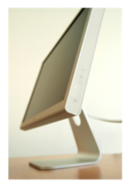
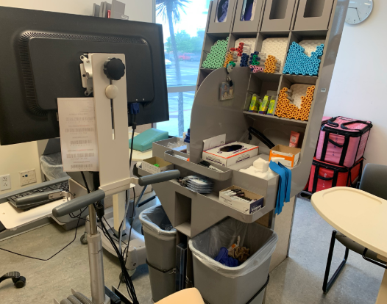

The Ergonomic Process
Tools
Task
Environment
Notes:
Keep in mind Ergonomics is an ONGOING process that fits the tools, tasks and environment to the worker and not the other way around.

Slide 4

Notes:
Lab/Path is a high harm unit so we are looking at areas where the injuries are occurring and how it affects the medical center.

Slide 5

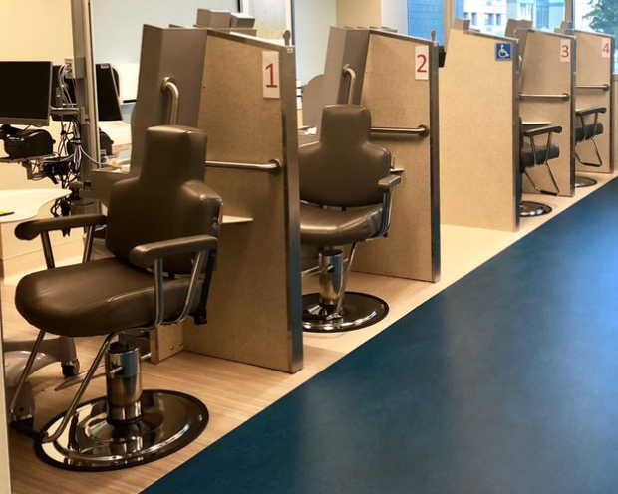
Phlebotomy
Draw Stations
Notes:
Blood draw is area we see the most amount of injuries, overexertion.

Slide 6
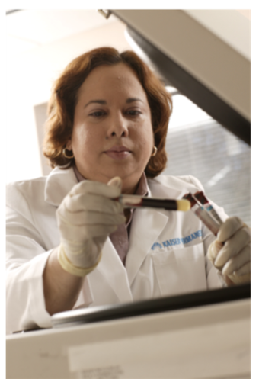
Laboratory Work
Laboratory work can be repetitive and cause musculoskeletal stresses.
Be aware of the following:
Avoid overreaching, excessive forces on your fingers and sharp counter edges
Make sure your forearms are supported and avoid holding positions for long periods of time
Laboratory work can involve very precise work or work that involves high visual demands. Be aware of this and if you feel discomfort, adjust your body position or task
Pay attention to the height of your workstation
Notes:
Common Harm events in Lab over reaching, contact with sharp edges, static postures, awkward postures.

Slide 7
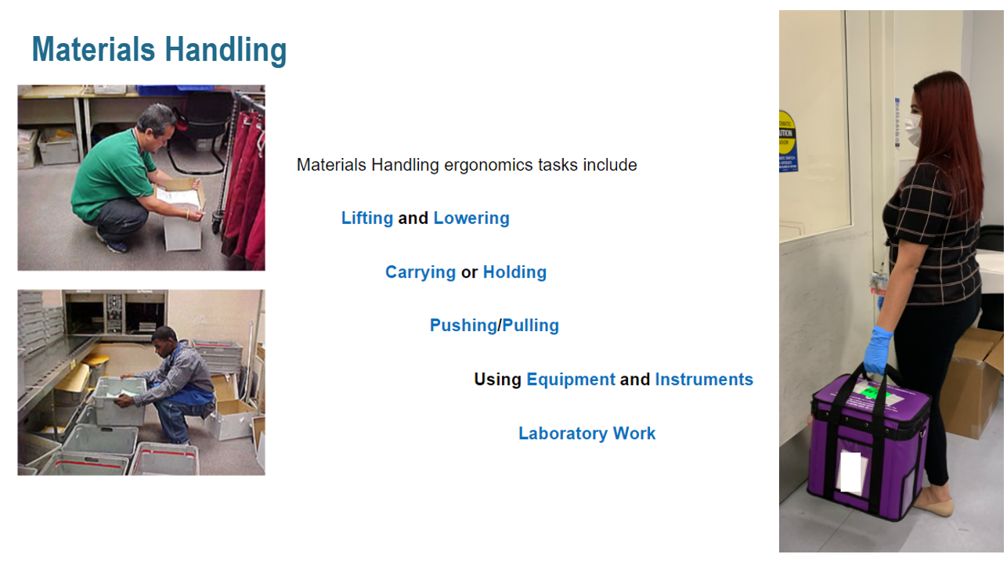
Materials Handling Body Mechanics

Slide 8
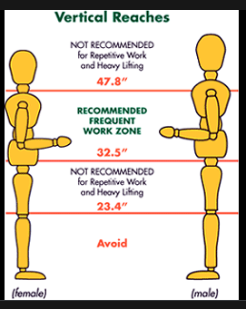
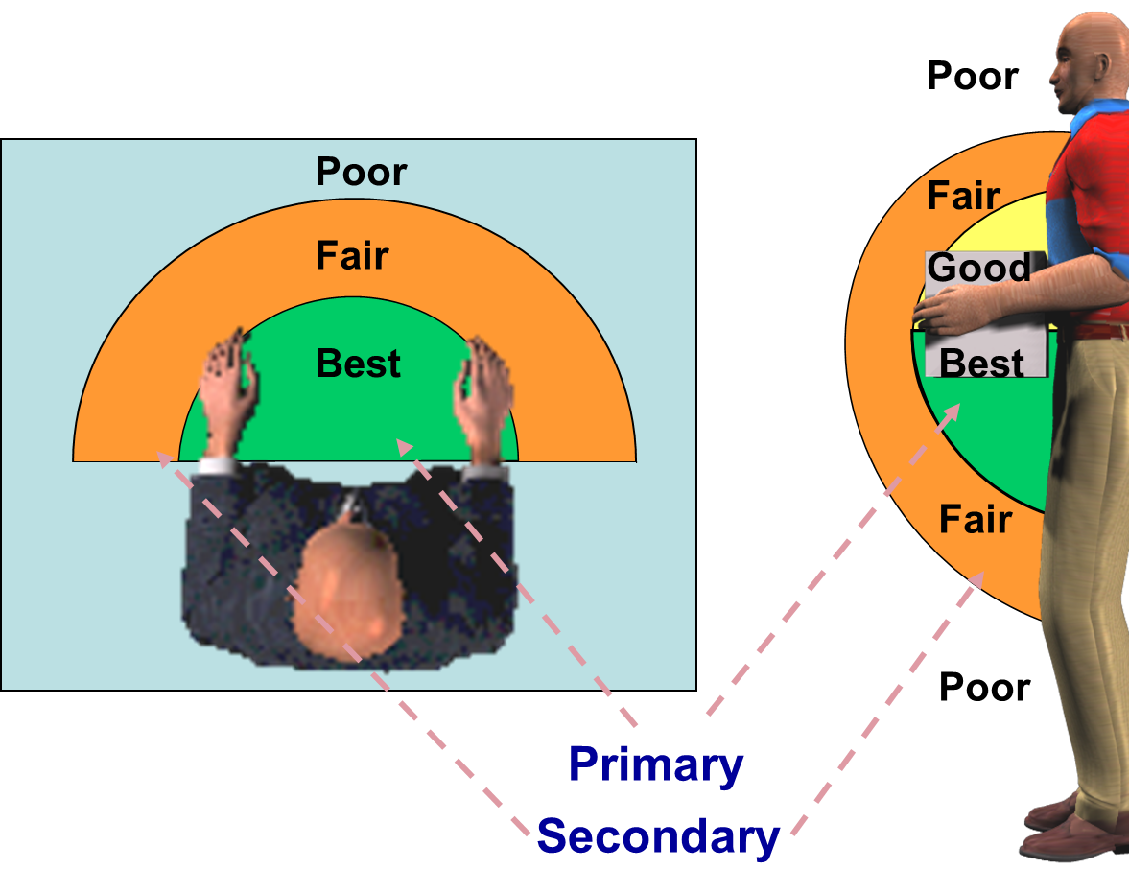
Optimal Work Height & Reach Envelopes
Notes:
Space is between your knees and Refer back to neutral posture exercise

Slide 9
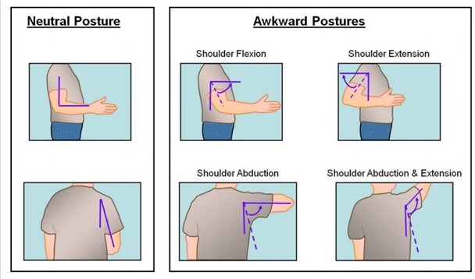
Good Alignment
A neutral spine is important because the “core” muscles are balanced.​
Balanced muscles don’t fatigue easily and don’t hurt.​
You are less likely to get injured when working in good proper alignment or neutral body position.​
Working in awkward postures increases your risk for an injury.​
Notes:
Crop section develop generic slide add lab photos – supplies, lifting , etc. use different images

Slide 10
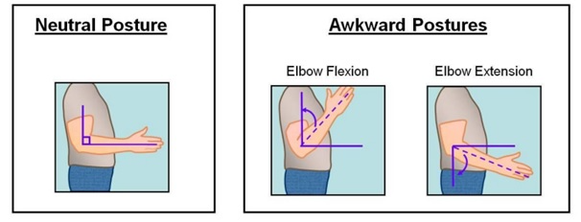
Neutral Postures

Slide 11
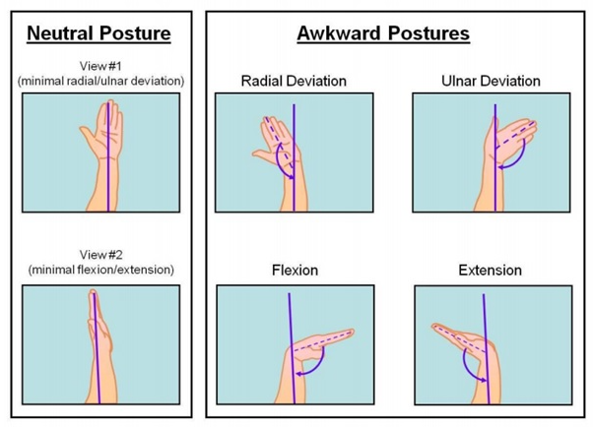
Neutral Postures

Slide 12
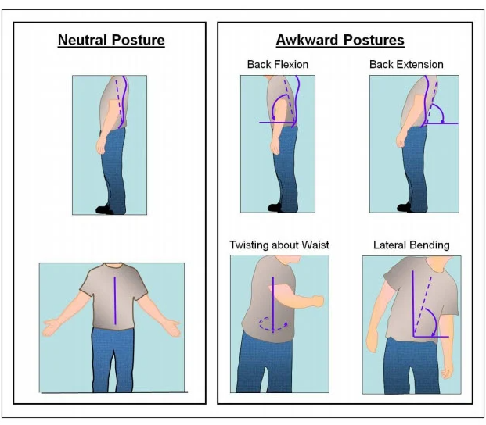
Neutral Postures

Slide 13
Components of Injury
Time/Duration
Force
Repetition
Awkward Postures
Notes:
Force: the amount of physical effort exerted by the body to perform tasks that require more force than the body can safely handle.
Awkward Posture: repeated or prolonged reaching, twisting, bending, working overhead, kneeling, squatting, or pinch grips.
Repetition: movement or series of movements done every few seconds, with little or no variation.
Environment: design and function of workstation to include: lighting, temperature, noise, dust, etc.
Contact Stress: repeated contact or pressure on any body part with hard or sharp objects for an extended period of time
Vibration: continuous or high intensity vibration exposure using vibrating power tools such as sanders, grinders, drills, and circular saws; or sitting or standing on work surfaces that vibrate such as vehicles, equipment or platforms.

Slide 14
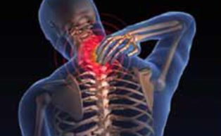
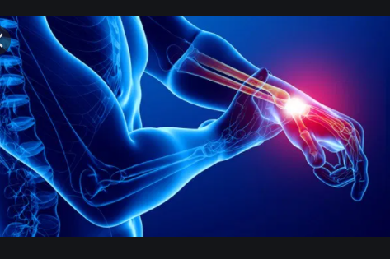
How do you feel today? At the end of shift?
Muscle Fatigue
Discomfort
Swelling
Tingling
Numbness
Pain
Notes:
Ergo team to discuss the discomfort that leads to tingling, numbness and pain to the elbow, wrist, shoulder and neck.
This slide discuss the fatigue

Slide 15
Source of Risks
Position of supplies
Position equipment/tools
Equipment Adjustments
Stationary postures
Awkward postures
Awkward movements
Notes:
Goes into sources of harm events in the draw stations

Slide 16
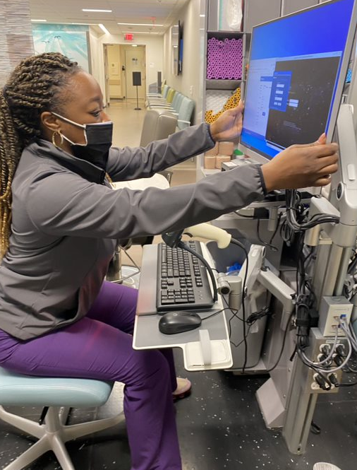
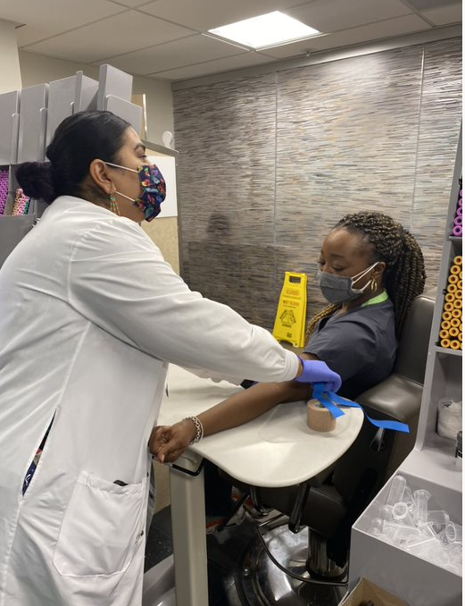
Phlebotomy Workstations
Overexertion Examples:
Reaching above shoulder for supplies
Reaching away from body to grab labels
Leaning over to tie a tourniquet
Twisting to use the computer
Sharps disposal
Notes:
Specific images for each bullet point-
Discussion computer set ups” apollo stations vs fixed or electric tables
Deb to send photos of new remodels stations
Sharps disposal(never recap needles) use as talking point for needle sticks.

Slide 17
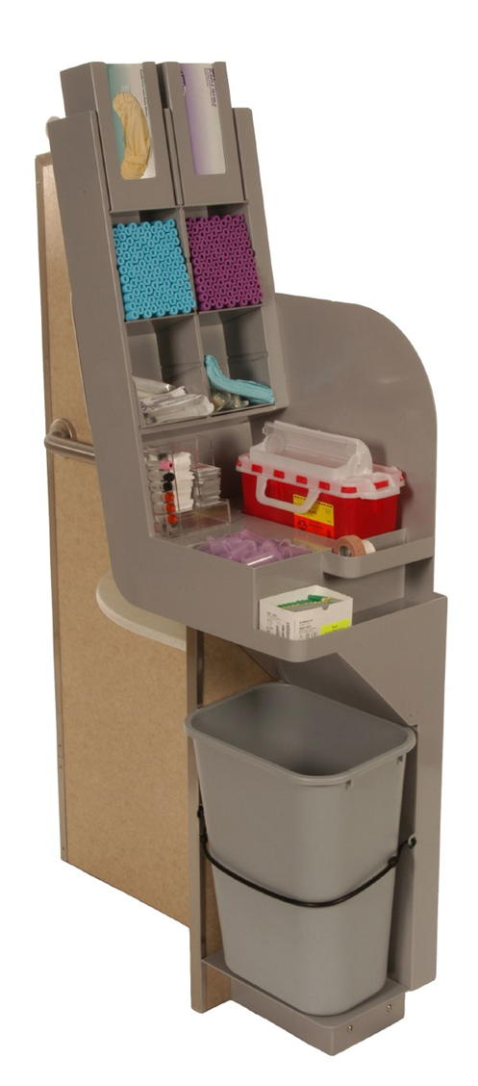
Basic Phlebotomy
Supplies
Gloves
Tourniquets
Needles
Barrel or Syringe
Tubes
Alcohol
Cotton or Gauze
Bandage or Tape
Notes:
*Sanitize before placing gloves add to slide 16
Color of Tubes/ Order high volume usage: commonly used tubes placed in easy reach
What are the colors?
Blood Culture= (red or marbled)
Glucose= Grey
Plasma= Green
Coagulation=Blue
Hematology = Pink
Needles: vary in length and diameter measures gauge. The smaller the gauge the larger the needle.

Slide 18
Let’s Review: Standard Operating Procedure (SOP)
Ensure pathways are clear of trip hazards
Wear PPE (gloves, lab coat, eye protection if needed)
Call patient to station and perform patient verification and validation of tests
Print labels
Set member chair to face sideways
Lock member chair before drawing blood
Move table against member chair
Table height set within staff member “work zone”
Lock table
Stand to retrieve all supplies
Ensure patient's arm and materials are within arms' reach and below shoulder level during venipuncture
Keep neutral spine while performing entire task
Activate safety device prior to disposing needle in sharps containers
Do not cross over body to dispose of sharps
Dispose of sharps immediately after draw
Add labels and log into system
Replace gloves after each patient
Notes:
Spell out “SOP”
General safety practice do not cross your body – all actions.
Reviewed and approved by Downey Lab manager & Labor partner. 3/22/2022
Standard Best Practice: Stand to retrieve all supplies
*When drawing infants ensure the use of a pediatric platform(?) photo review.
First 10 is the set-up: focusing on knowledge of equipment and setting up workstation to minimize risk factors.
Steps 11-17 is to focus on body mechanics. Use opportunity to spell out opportunities for better body mechanics or postures to minimize ergonomic risk during blood draw.
*note for left handed users, recommend setting up workstation to be left-handed for them.

Slide 19
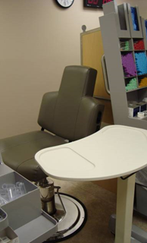
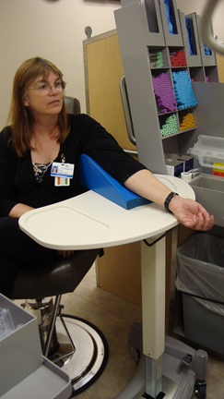
Equipment Adjustment
Adjust Member Chair
Rotate member chair to face sideways
Move table against member chair
Adjust Table Height
Use angled wedges to help maintain straight wrists and bring member's elbow closer
Notes:
*When drawing infants ensure the use of a pediatric platform(?) photo review.
Adjust table to height to neutral posture
Adjust member chair to 25 inches.
Content:
Vacutainers/tubes
Gloves
Height of members arm as it relates to the chair.
Wedge use with table
Standing vs sitting
Petit employee standing elbow height
Retrieve supplies in a standing position

Slide 20
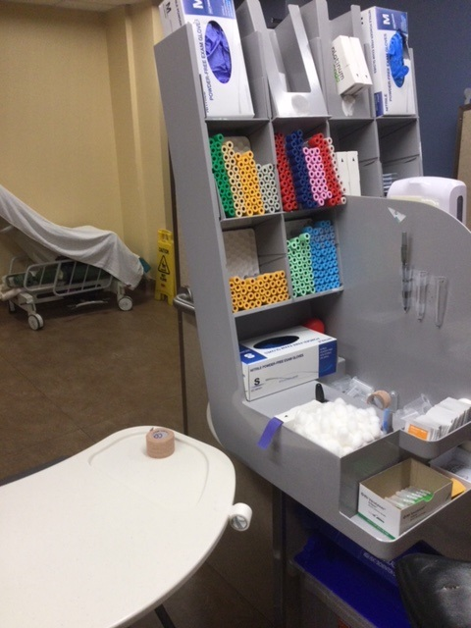
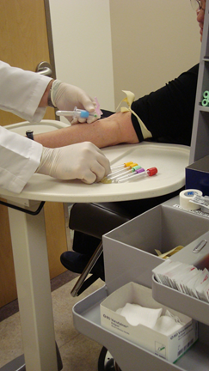
Supplies within Reach
During venipuncture do not reach for tubes or supplies
Keep supplies close to avoid awkward postures
Notes:
Frequently used tubes to be placed on the lower shelf
Color of Tubes/ Order high volume usage: commonly used tubes placed in easy reach
What are the colors?
Blood Culture= (red or marbled)
Glucose= Grey
Plasma= Green
Coagulation=Blue
Hematology = Pink
Needles: vary in length and diameter measures gauge. The smaller the gauge the larger the needle.

Slide 21
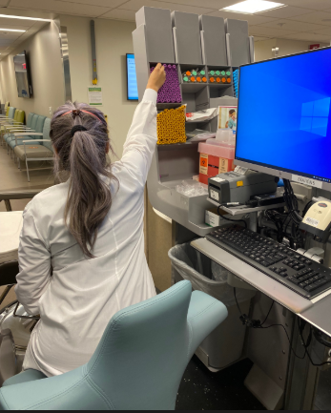
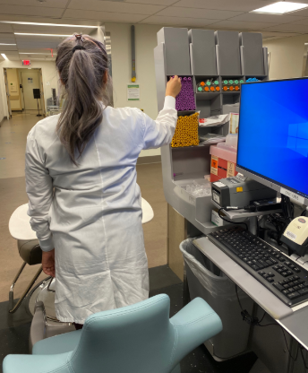
Reaching away from the body- reaching above shoulders
Improper position:
when gathering supplies
Avoid reaching above the shoulders and getting into awkward postures
Proper position:
Stand to gathering supplies
Working within your “Work Zone”
Notes:
Seated position vs standing to gather supplies

Slide 22
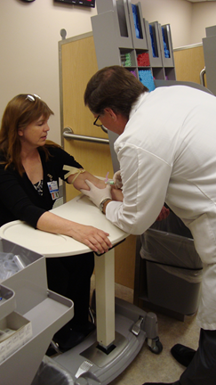
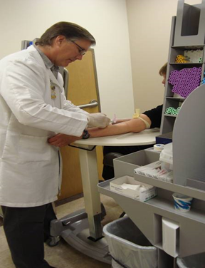
Standing Position
Work Zone
Incorrect Posture
Correct Posture
Notes:
Member facing forward vs facing sideways.
Ask what are the risk factors? What are the potential issues for this awkward postures?
What is your power/strike zone Vertical reaches- recommended frequent work zone
What to look for with in power zone.

Slide 23
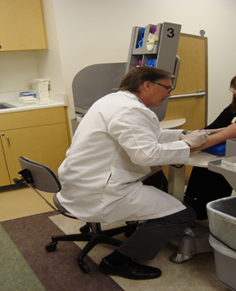
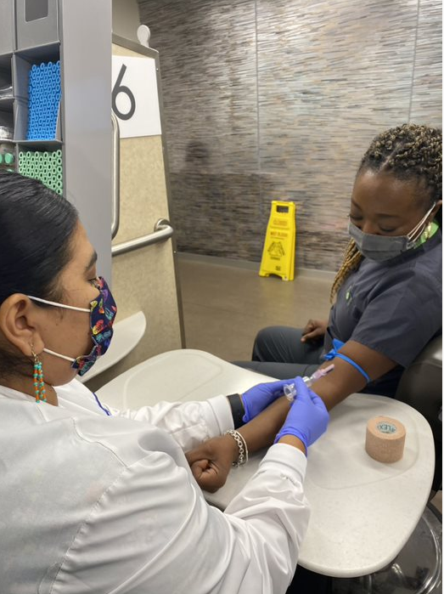
Sitting Position
Improper Positioning
Patient arm and member sitting facing staff
Proper Positioning
Patient arm and member sitting sideways
Notes:
What are potential risk factors?

Slide 24
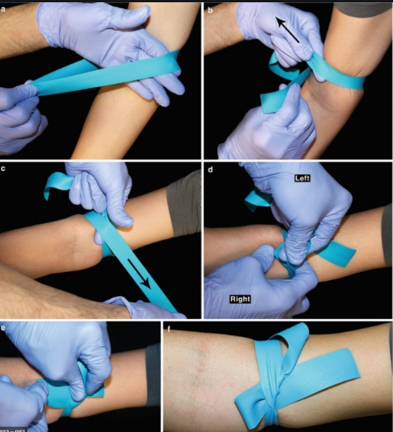
Tourniquet Application for Venipuncture Procedure
Six Steps
Maintain a relaxed shoulder posture and keep hands/wrist in a neutral position
Hold each end of band tightly between thumb and first (index) finger
Stretch band several times to ensure flexibility prior to placement on member’s arm
Place Tourniquet under member/patients arm and cross the two ends
Take “your” dominate hand and gently pull band and tie into a bow
Leave one bow point underneath the tourniquet
Ready to Release- remove by pulling one end to release tourniquet
Left
Right
Ergonomic Guidelines _ Tourniquet Application week 8.pdf

Slide 25
Return Demonstration for validation
Check list
Validation Link
Notes:
Add return demonstration to each sections

Slide 26
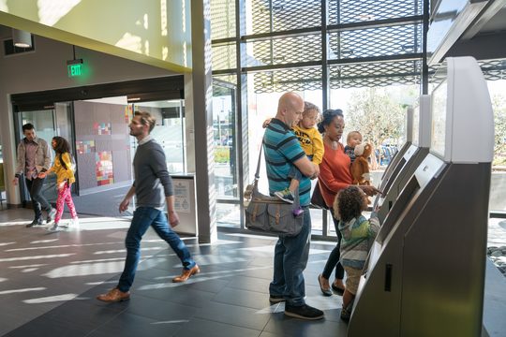






Ergonomic Resources in One Page
Assessment Requests
Need assistance with your Work & Home environment.
Contact your local Ergo Consultant
Contacts - ErgoInfo (kp.org)
SCAL Ergo/Safety Class
Learn the basic fundamentals of ergonomics.
*Scheduled on the 4th Friday of every month
KP SCAL Ergonomic/Safety Class
Workplace Safety Information
Website Link:
SCAL Workplace Safety - Home
Computer
Ergo Class
Learn the fundamentals of computer ergonomics for remote work.
*Scheduled every Wednesday
Computer Ergo Class

Slide 27




KP Learn Module
Notes:
Areas of opportunity: Accessioning, Grossing Station, Aliquoting

Slide 28
Laboratory Ergonomic
Body Mechanics Training
Future Areas of Focus
Inpatient Blood Draw
Specimen Processing

Slide 29

How do you thrive? Movement is the key
Notes:
Personal example of finding ways to move: my example: I’m on the water; picture: dragon boat racing in South Korea

