Slide 1
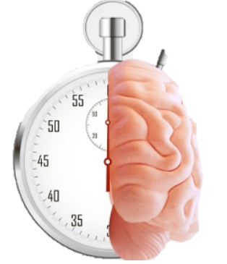
4867 Sunset Boulevard Pathology, Blood Bank, Flow Cytometry, Laboratory Departments 2023 Education
Code stroke
TIME IS BRAIN
Notes:
PATHOLOGY AND LABORATORY ANNUAL CODE STROKE TRAINING 2023 TIME IS BRAIN

Slide 2
CODE STROKE is an
EMERGENCY
NOTIFICATION
PAGE CODE STROKE
NEUROLOGIST 279-1000
HOSPITAL PATIENT
VISITOR OR EMPLOYEE
CALL CODE BLUE x 3-3000
OUTSIDE HOSPITAL
CALL 911
2023 CODE STROKE INSERVICE
LAMC
4867 LABORATORY
Notes:
CODE STROKE IS CONSIDERED AN EMERGENCY. A HOSPITAL INPATIENT HAVING A STROKE, A “CODE STROKE” IS PAGED OVERHEAD. THE NEUROLOGIST IS ALSO PAGED 279-1000 visitors or employees , a code Blue IS announced by calling 3-3000 outside the medical center, dial 911

Slide 3
SIGNS OF STROKE
B
E
F
A
S
T
Notes:
The acronym BEFAST

Slide 4
B
E
F
A
S
T

Slide 5
B

Slide 6
B
E

Slide 7
B
E

Slide 8
B
E
F

Slide 9
B
E
F

Slide 10
B
E
F
A

Slide 11
B
E
F
A

Slide 12
B
E
F
A
S

Slide 13
B
E
F
A
S

Slide 14
B
E
F
A
S
T

Slide 15
B
E
F
A
S
T

Slide 16
Lab Assistant Joint Responsibility
Dispatcher
Lab Asst Assigned to Another Floor
Lab Asst Assigned
Lab Assts in Main Lab
Dispatcher may assign any Lab Asst from another floor, from Main Lab
Patient Care Comes First!!!
Issues and Concerns during a Code Stroke can be addressed later
Breaks/Meal Coverage – Take care of the patient, inform dispatcher and management
Document any issues and present to management or Lead CLS
LAB RESPONSE TO CODE STROKE IS BEING TRACKED & DOCUMENTED

Slide 17
LOS ANGELES MEDICAL CENTER
COMPREHENSIVE STROKE CENTER
2023
PRIMARY STROKE CENTER
Comprehensive Stroke Center
Best Practices
Monitoring Performance
Measurement of lab results from
Order to Result
Staff education and manager review and follow up for every stroke case
Data for the efficiency measure provided through the Stroke Committee
Staff education regarding Stroke and Stroke-related workflows 1 hour / year
Daily department review of the Stroke Log to ensure appropriate documentation and compliance
Case review of outliers with Stroke Coordinator
lamc laboratory PATHOLOGY, LABORATORY, TRANSFUSION SERVICE,
FLOW CYTOMETRY, medical office buildings 2023 CODE STROKE inservice

Slide 18
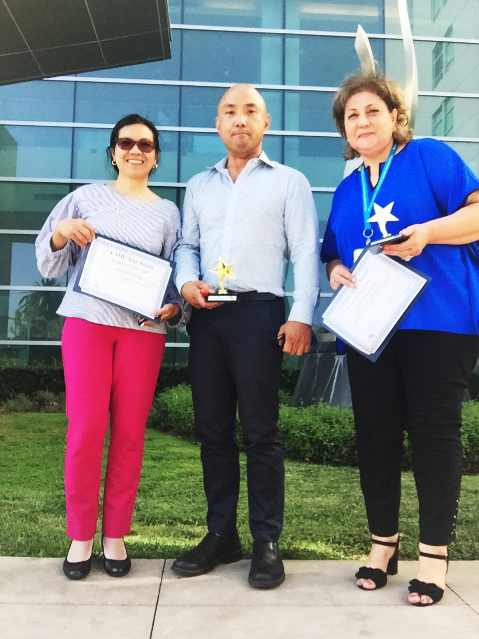
TRUE STORY
LAMC LAB EMPLOYEE RECOGNIZES
CODE STROKE IN A PATIENT …. A LIFE SAVED
2023 CODE STROKE INSERVICE
LAMC – 4867 SUNSET BLVD
LABORATORY

Slide 19
BASICS OF A STROKE
Stroke occurs when blood flow to the brain is interrupted by blocked or burst vessel.
There are types of stroke:
2
HEMORRHAGIC STROKE
ISCHEMIC STROKE
Occurs when blood vessels burst and cause bleeding into the brain.
Is defined as an injury and/or death of brain cells due to blockage with lack of blood flow in the brain to the affected area.

Slide 20
Code stroke: Communication
OVERHEAD ANNOUNCEMENT:
“Code Stroke” + Patient Location only
CODE STROKE PAGER
Located at the Dispatcher Desk. If removed from this area, this must be returned for the next shift.
Both Dispatchers are responsible between shifts.
The hand off between Dispatchers for each shift should account for the whereabouts of the pager, and are equally responsible if the pager is missing or there is no documentation or incorrect documentation of the handoff.
The Dispatcher or the Coverage for Dispatcher should know the break and meal assignments of each lab assistant at any given time and is responsible for sending a lab assistant immediately.
A manager should be notified for any issues with receiving a response
Information on pager:
(Name, Medical Record #, Location, Room #)

Slide 21
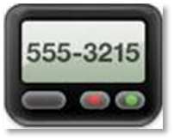
Brain Alert
“BRAIN ALERT”:
NOTIFICATION OF POSSIBLE STROKE DOES MEET THE CRITERIA FOR HAVING A STROKE
CODE STROKE
 OVERHEAD ANNOUNCEMENT / PAGE
 PHLEBOTOMY RESPONSE
 PHONE CALL FOLLOW UP FOR SPECIMEN
 SPECIMEN RECD IN PURPLE BAG
 DOCUMENT IN STROKE LOG BOOK
BRAIN ALERT
 OVERHEAD ANNOUNCEMENT / PAGE
 PHLEBOTOMY RESPONSE
 PHONE CALL FOLLOW UP FOR SPECIMEN
 SPECIMEN RECD IN PURPLE BAG ONLY NOTIFICATION
 DOCUMENT IN STROKE LOG BOOK INDICATE “BRAIN ALERT”. COMPLETE AS MORE INFORMATION IS PROVIDED.

Slide 22
Code stroke: COMMUNICATION
JOINT AND SHARED ACCOUNTABILITY
DISPATCHER
STAT LAB
ASSIGNED LAB
ASSISTANT
SEND MESSAGE BLAST IN KPPI HANDHELD DEVICE TO LAB ASSTS
OVERHEAD
ANNOUNCEMENT
PAGER
DOCUMENT IN STROKE LOGBOOK
DOCUMENT IN STROKE LOGBOOK
ANY ISSUES MUST BE ADDRESSED IMMEDIATELY –
INVOLVE A MANAGER OR LEAD CLS

Slide 23
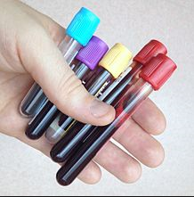
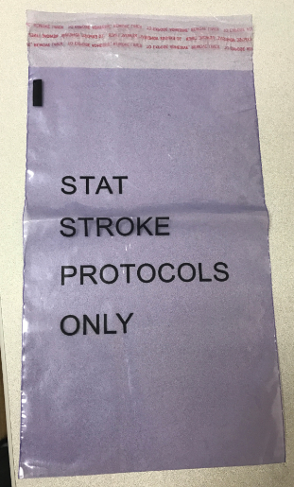
Code stroke: COMMUNICATION
“CODE STROKE”
RECD IN LAB
SPECIMENS SHOULD BE IN LAB WITHIN 10 MINUTES OF ANNOUNCEMENT
SPECIMENS SHOULD COME IN DESIGNATED PURPLE BAG
FOLLOW UP
CALL ED /RN
CALL DISPATCHER
CALL LAB ASST ASSIGNED
11

Slide 24
LAB EFFICIENCY MEASURE:
CODE STROKE TURN AROUND TIME
45
10 MIN
10 MIN
25 MIN
DOOR TO ORDER
ORDER to
COLLECT
COLLECT to
RECEIVE
RECEIVE to RESULT
SHARED TARGET
The sooner the specimen is collected this increases chance to meet the target and also save a life.
Documentation is imperative when there are delays i.e.
(CT Scan, RN dismissed the lab to collect – obtain the name)

Slide 25
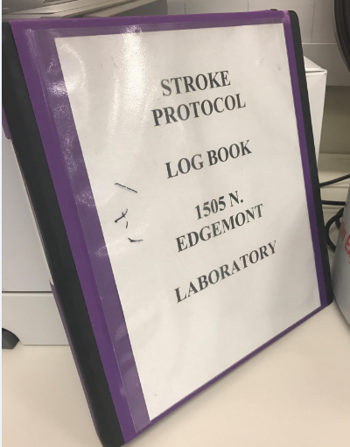
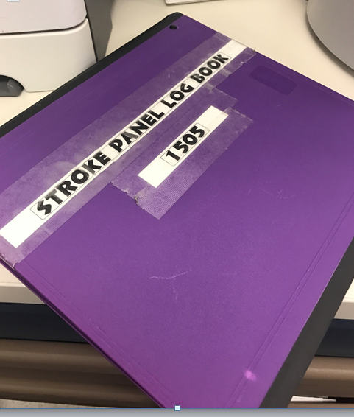
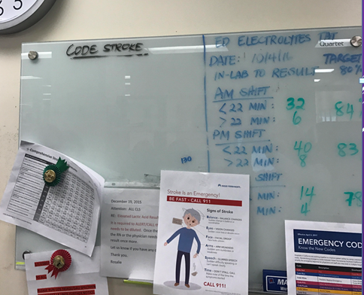
Code stroke: COMMUNICATION
DOCUMENTATION
CODE STROKE BINDER – STAT LAB
COMMUNICATE / DISCUSS
IDENTIFY PATIENT NAME
ARRIVAL OF SPECIMEN
HAND OFF TO CLS
STAT LAB – “WHITE BOARD”
lamc laboratory PATHOLOGY, LABORATORY, TRANSFUSION SERVICE,
FLOW CYTOMETRY, medical office buildings 2023 CODE STROKE in-service

Slide 26
Code stroke: BARRIERS
ISSUES AND EXCEPTIONS:
NOTIFY IMMEDIATELY
Dispatcher/ INPATIENT LAB ASSTS | PROCESSING – STAT LAB LAB ASSTS / REPS / CLS | STAT LAB CLS CALL RN/MD PROVIDER
LAB ASST – CHALLENGES IN OBTAINING SPECIMEN LOCATING PATIENT PATIENT ACCESS BREAK/MEAL COVERAGE CONCERNS (PATIENT CARE FIRST) | SPECIMEN LABEL ISSUES NO LABEL , MISLABELLED SPECIMEN ORDER ISSUES: WRONG ORDER OR INCORRECT ORDER | SPECIMEN HEMOLYZED UNACCEPTABLE FOR TESTING INVALID RESULTS INSTRUMENT DELAY PROCESS DELAY
Dispatcher – NO RESPONSE FROM PHLEBOTOMIST WORKFLOW CHALLENGES TEAMWORK ISSUES | SPECIMEN ISSUES: QNS HEMOLYZED DAMAGED IN PROCESSING WRONG TUBE COLLECTED MISSING A TUBE | INVALID RESULTS – DO NOT WAIT TO REPEAT
lamc laboratory PATHOLOGY, LABORATORY, TRANSFUSION SERVICE,
FLOW CYTOMETRY, medical office buildings 2023 CODE STROKE inservice
DO NOT DELAY COMMUNICATION
13

Slide 27
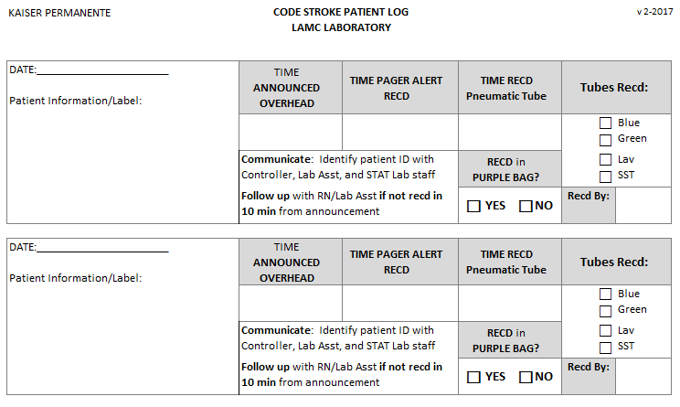
Code stroke: COMMUNICATION
DOCUMENTATION
CODE STROKE LOG
EXAMPLE
lamc laboratory PATHOLOGY, LABORATORY, TRANSFUSION SERVICE,
FLOW CYTOMETRY, medical office buildings 2023 CODE STROKE inservice
Download the most current version in Master Control

Slide 28
Code stroke: phlebotomy response
REPORTING TO THE CODE STROKE
ANNOUNCE YOUR PRESENCE LOUD AND CLEAR –
MAKE SURE PROVIDERS KNOW THAT YOU ARE FROM THE LABORATORY
PATIENT NOT AVAILABLE? I.E. CT SCAN
FOLLOW UP WITH PROVIDER
FOLLOW THE PATIENT TO COLLECT BLOOD
LAB NOT NEEDED?
OBTAIN THE FULL NAME OF WHO INFORMED YOU
DOCUMENT THAT PROVIDER’S NAME IN KPPI
FOLLOW UP AND MAKE SURE DOCUMENTED IN MEDICOPIA
INFORM Dispatcher, STAT LAB
STAT LAB DOCUMENTS IN CODE STROKE LOG BOOK
lamc laboratory PATHOLOGY, LABORATORY, TRANSFUSION SERVICE,
FLOW CYTOMETRY, medical office buildings 2023 CODE STROKE inservice

Slide 29
LABORATORY ROLE
START
Code Stroke Announced
Lab Reports to Location
Announce your presence LOUD & CLEAR
Yes
No
Proceed with Draw
Patient Available?
Lab still needed?
Yes
No
Locate patient and collect specimens
Document name of person that turned you away
END

Slide 30
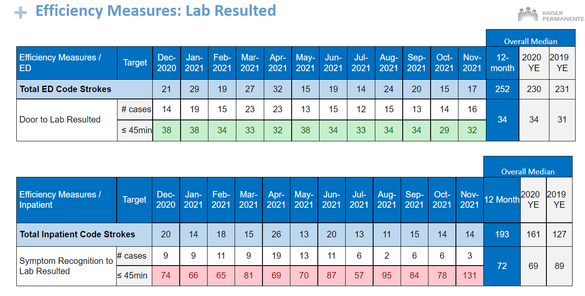
Efficiency Measures - Lab
Notes:
ANALYSIS: The Door to order times have decreased overall. The Order to results have met target for one year. Overall Door to result time has met target.
CONCLUSION: Target met.
ACTION: The process to obtain labs in the ED has improved with the use of the Brain Alert. The Lab processes the specimens that are sent in a purple bag. Overall, metric is doing well, continue the existing protocols for ED and Lab.

Slide 31
CASE STUDY: Timeline
Not end of shift
Specimen was left on counter
01:17 –
RN Collects
00:00 –
Code Stroke Announced
00:35 –
First Response from a Lab Asst
01:40
Specimen Logged In Cerner
01:21 ?
Lab Asst endorses to next shift
2:07
Results
In Cerner
Delayed response from any lab asst
Next lab asst, “I’m not clocked in yet”
SHIFT
Next SHIFT
00:09 –
Dispatcher sent broadcast message re: Code Stroke
Is this the reason we are in healthcare?
What if this is your family member?
Or yourself one day?
How would you feel if you knew your specimens were not treated with urgency?
Code Stroke is an EMERGENCY!!!
00:40–
Lab Asst assigned Responds
01:23 ?
Lab Asst Documents Code Stroke in Log
Assigned Lab Asst on Break
“Didnt want to be responsible”
Specimen not logged in Cernerz

Slide 32
KNOWLEDGE REVIEW
LAMC HAS EARNED THIS DISTINCTION BY THE JOINT COMMISSION, THE FIRST AND ONLY SCAL KAISER PERMANENTE FACILITY TO ACHIEVE THIS?
A
FASTEST TURN AROUND TIME FOR RESULTS
B
RAISED ITS CERTIFICATION FROM PRIMARY STROKE CENTER TO COMPREHENSIVE STROKE CENTER
C
FORMATION OF A STROKE COMMITTEE
D
BEST STROKE EDUCATION PROGRAM

Slide 33
KNOWLEDGE REVIEW
LOS ANGELES MEDICAL CENTER HAS EARNED THIS DISTINCTION BY THE JOINT COMMISSION, THE FIRST AND ONLY SCAL KAISER PERMANENTE FACILITY TO ACHIEVE THIS?
A
FASTEST TURN AROUND TIME FOR RESULTS
B
RAISED ITS CERTIFICATION FROM PRIMARY STROKE CENTER TO COMPREHENSIVE STROKE CENTER
C
FORMATION OF A STROKE COMMITTEE
D
BEST STROKE EDUCATION PROGRAM

Slide 34
KNOWLEDGE CHECK
AS A REQUIREMENT FOR MAINTAINING COMPREHENSIVE CERTIFICATION, WHICH OF THE FOLLOWING IS TRUE FOR THE LABORATORY?
A
ALL EMPLOYEES SHOULD RECEIVE STROKE EDUCATION ANNUALLY
B
THE TURN AROUND TIME FOR LAB TESTS IS 45 MINUTES FROM DOOR TO RESULT.
C
THE PHLEBOTOMISTS IS REQUIRED TO RESPOND TO LOCATION WHERE THE CODE STROKE IS ANNOUNCED
D
ANY CHALLENGES IN OBTAINING SPECIMEN OR ANY REASON FOR DELAY SHOULD INVOLVE THE MANAGER.

Slide 35
KNOWLEDGE CHECK
AS A REQUIREMENT FOR MAINTAINING COMPREHENSIVE CERTIFICATION, WHICH OF THE FOLLOWING IS TRUE FOR THE LABORATORY?
A
ALL EMPLOYEES SHOULD RECEIVE STROKE EDUCATION ANNUALLY
B
THE TURN AROUND TIME FOR LAB TESTS IS 45 MINUTES FROM DOOR TO RESULT.
C
THE PHLEBOTOMISTS IS REQUIRED TO RESPOND TO LOCATION WHERE THE CODE STROKE IS ANNOUNCED
D
ANY CHALLENGES IN OBTAINING SPECIMEN OR ANY REASON FOR DELAY SHOULD INVOLVE THE MANAGER.

Slide 36
KNOWLEDGE CHECK
COMPLETE THE ACRONYM: BEFAST
B
E
F
A
S
T

Slide 37
KNOWLEDGE CHECK
COMPLETE THE ACRONYM: BEFAST
B
ALANCE
E
F
A
S
T

Slide 38
KNOWLEDGE CHECK
COMPLETE THE ACRONYM: BEFAST
B
ALANCE
E
YES
F
A
S
T

Slide 39
KNOWLEDGE CHECK
COMPLETE THE ACRONYM: BEFAST
B
ALANCE
E
YES
F
ACE
A
S
T

Slide 40
KNOWLEDGE CHECK
COMPLETE THE ACRONYM: BEFAST
B
ALANCE
E
YES
F
ACE
A
RMS
S
T

Slide 41
KNOWLEDGE CHECK
COMPLETE THE ACRONYM: BEFAST
B
ALANCE
E
YES
F
ACE
A
RMS
S
PEECH
T

Slide 42
KNOWLEDGE CHECK
COMPLETE THE ACRONYM: BEFAST
B
ALANCE
E
YES
F
ACE
A
RMS
S
PEECH
T
IME

Slide 43
RESOURCES
https://sp-cloud.kp.org/sites/StrokeResources

Slide 44
ANY QUESTIONS?
REMEMBER: TIME LOST IS BRAIN LOST
THINK ABOUT IT !!!

Slide 45
END

