Slide 1

Instrument Manager Job Aid CHEMISTRY
DCW V8

Slide 2
Purpose
To ensure hemolyzed specimen result comments (e.g., "Interpret result with caution due to hemolysis which may affect result") are visible in KP HealthConnect (KPHC) when results are released.

Slide 3
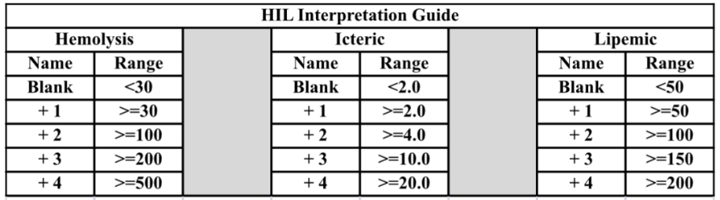
Index Ranges: Hemolysis, Icteria, Lipemia (HILs)
See HIL Interpretation Guide below:

Slide 4
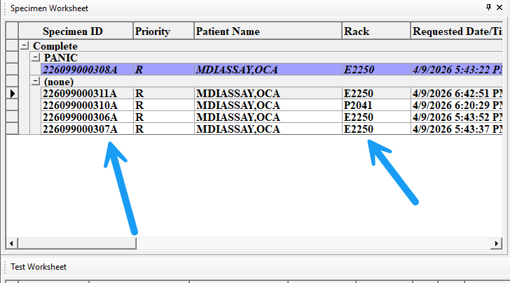
Step 1: Identify Hemolyzed Specimen
Instrument Manager will hold all electrolyte results when the potassium hemolysis index is >= 100. Pull specimen to confirm hemolysis.
Use the “Rack Column” to identify the rack number

Slide 5
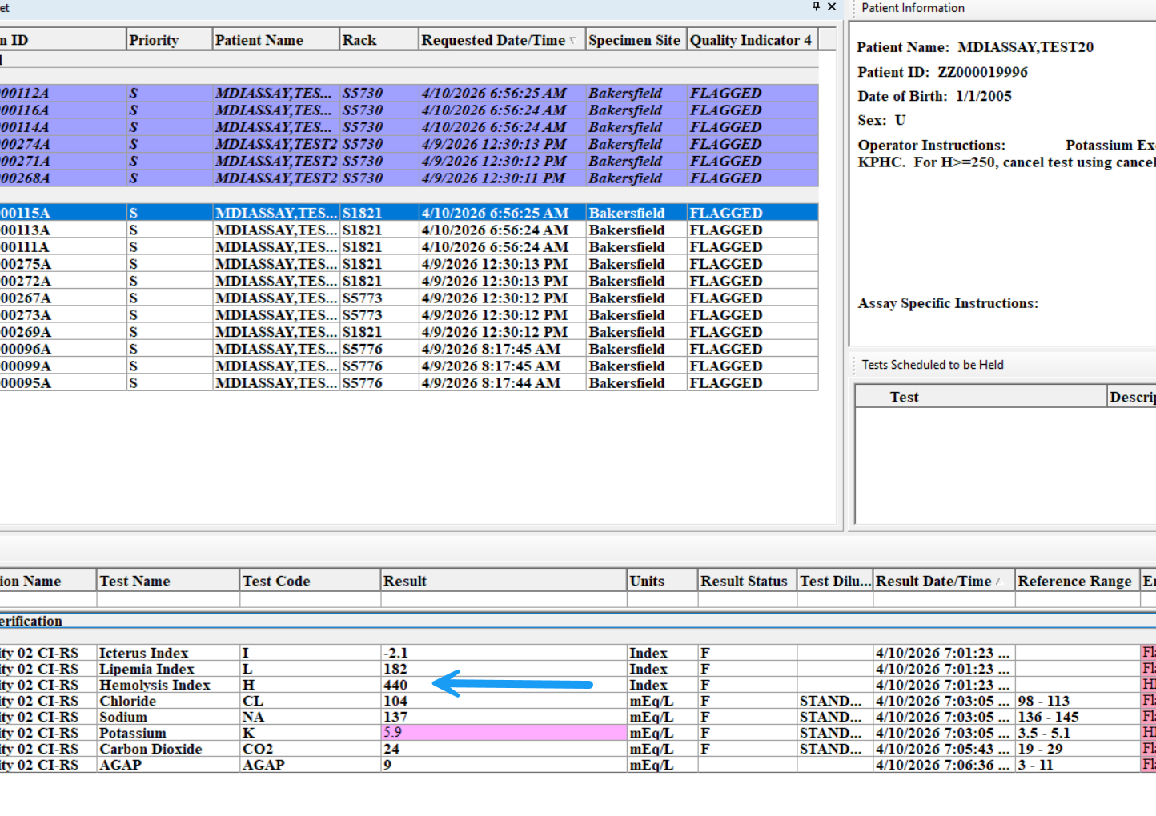
Step 1-2: Identify Hemolyzed Specimen
If specimen is hemolyzed and H>=250, reject specimen in DI and cancel order in Cerner using cancel reason “Hemolyzed Specimen, Test not performed’.

Slide 6
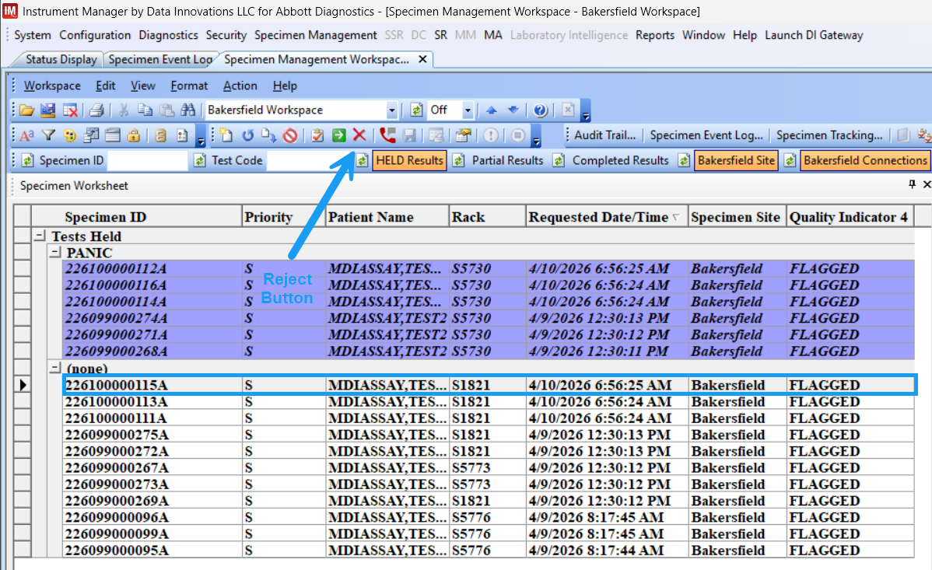
Step 1-2: Identify Hemolyzed Specimen
If specimen is hemolyzed and H>=250, reject specimen in DI and cancel order in Cerner using cancel reason “Hemolyzed Specimen, Test not performed’.

Slide 7
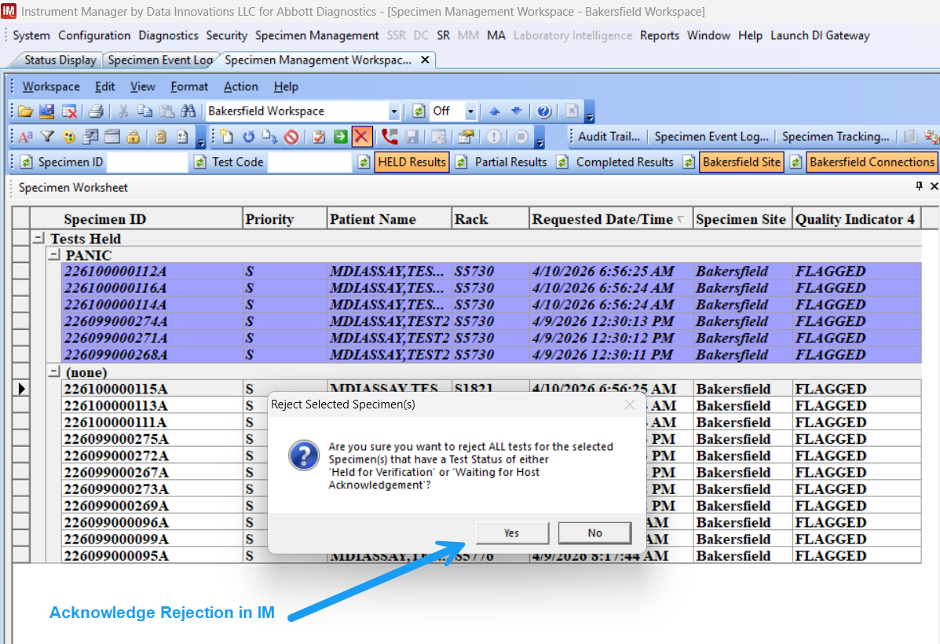
Step 1-2: Identify Hemolyzed Specimen
If specimen is hemolyzed and H>=250, reject specimen in DI and cancel order in Cerner using cancel reason “Hemolyzed Specimen, Test not performed’.

Slide 8
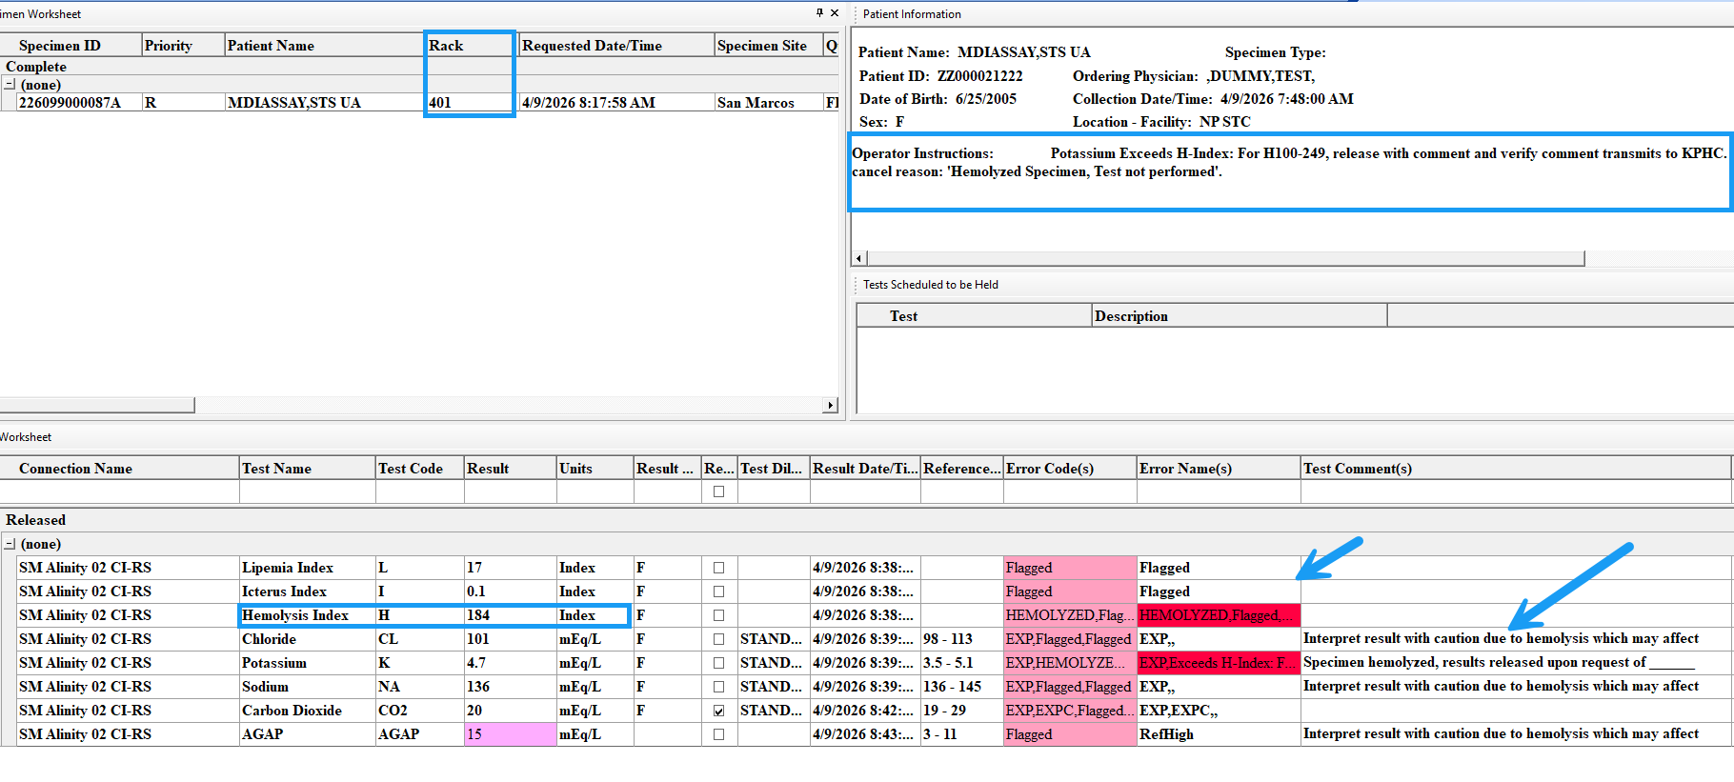
Step 2: If Hemolysis = 100-249
Instrument Manager will hold all electrolyte results when the potassium hemolysis index is >100 and <249. Pull specimen to confirm hemolysis.
Use the “Rack Column” to identify the rack number

Slide 9
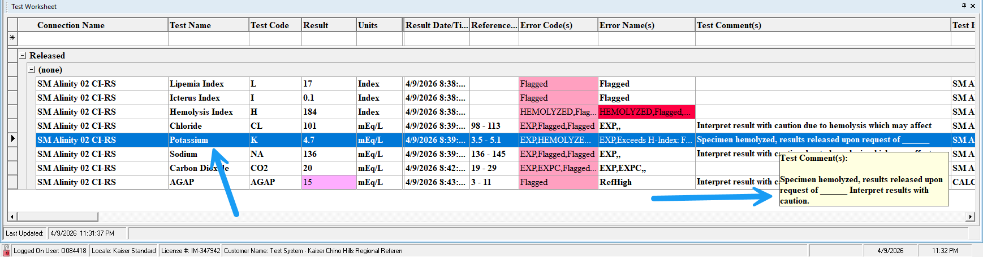
Step 2-1: Update K Result Comment
Select the Potassium (K) row under the test worksheet

Slide 10
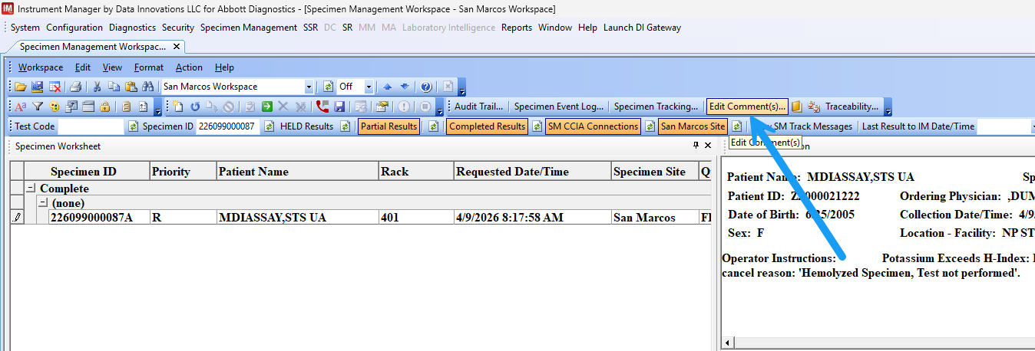
Step 2-2: Update K Result Comment
Click on the “Edit Comment(s)” button

Slide 11
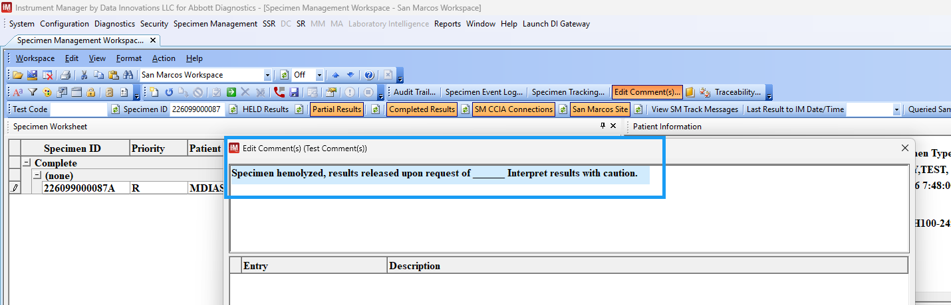
Step 2-3: Update K Result Comment
Select the pre-attached Potassium result comment

Slide 12
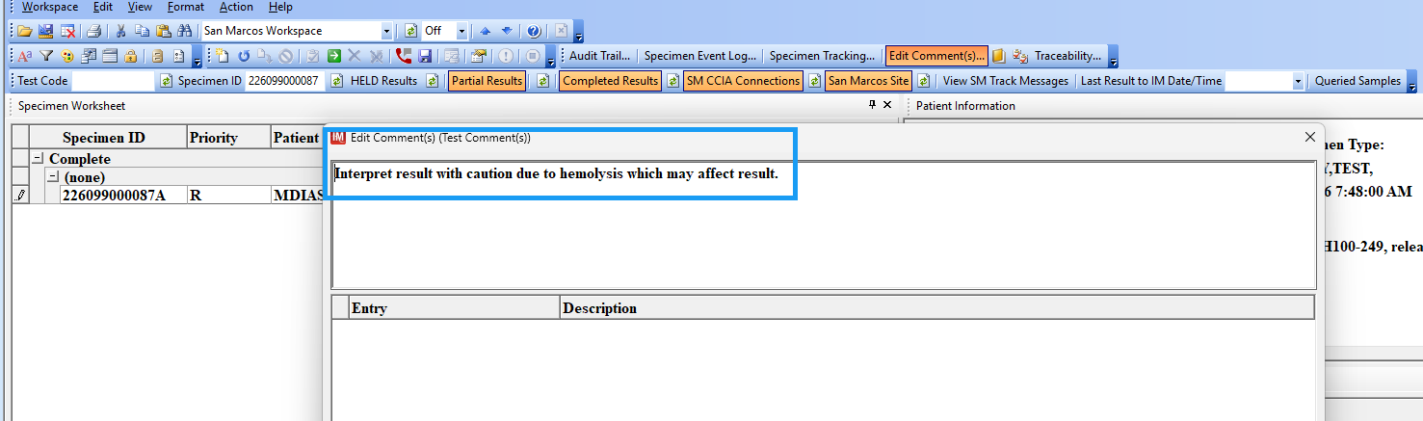
Step 2-4: Update K Result Comment
Enter the approved comment “Interpret result with caution due to hemolysis which may affect result”

Slide 13
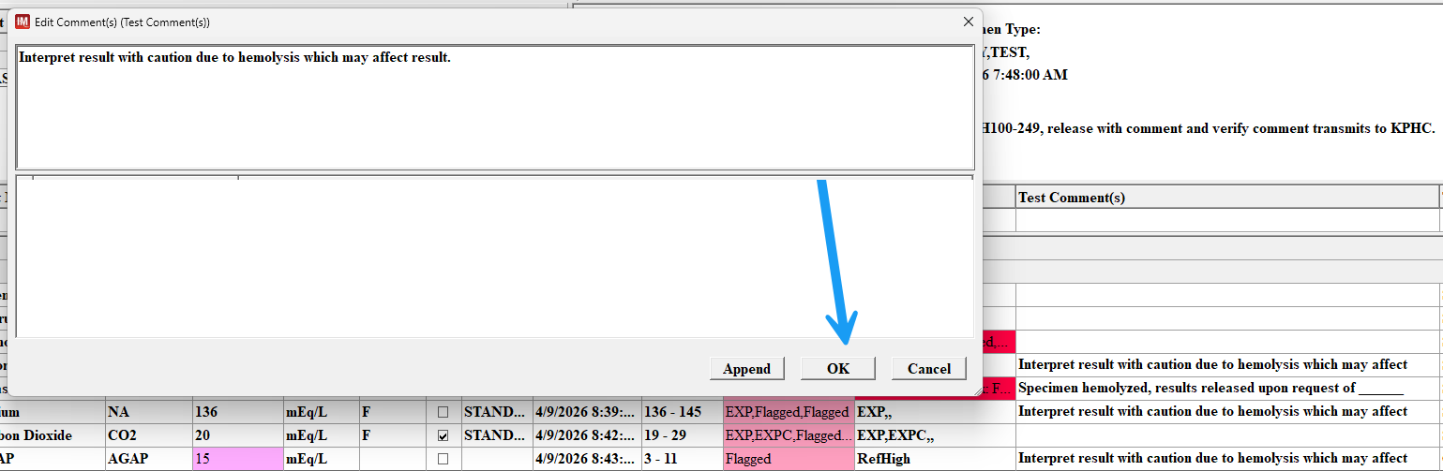
Step 2-5: Update K Result Comment
Click “OK” to proceed with accepting the new result comment

Slide 14
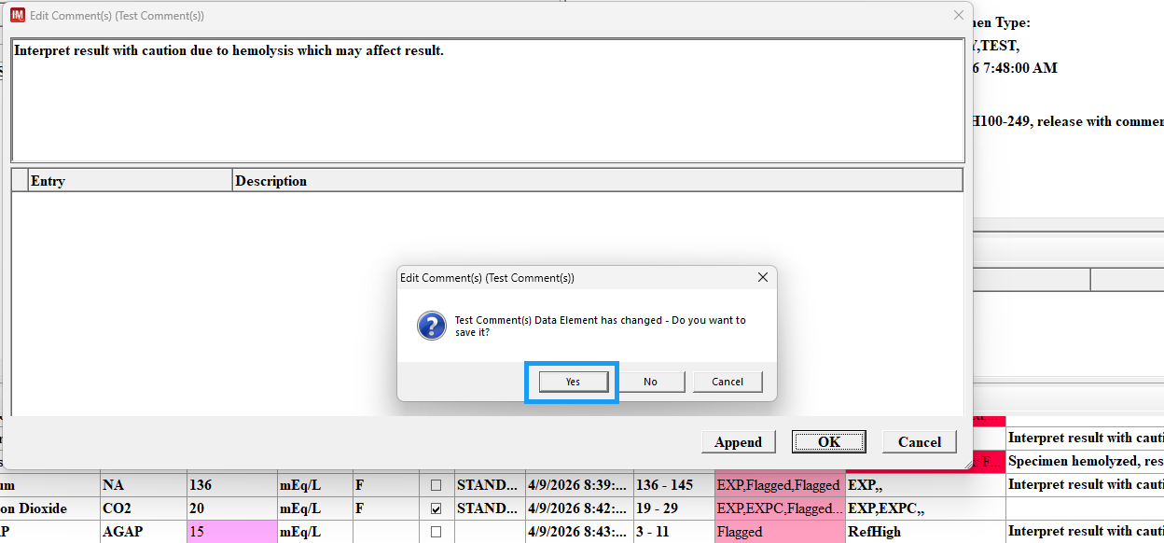
Step 2-6: Update K Result Comment
Click “Yes” to accept the new comment

Slide 15
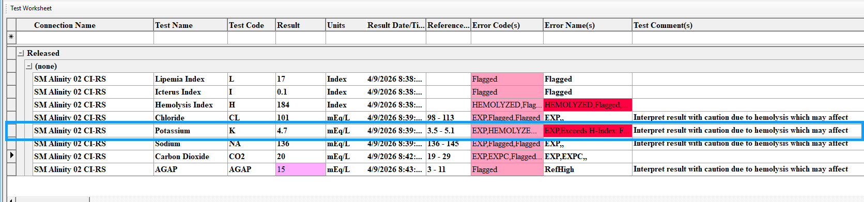
Step 2-7: Update K Result Comment
Verify that the Potassium result comment was updated correctly

Slide 16
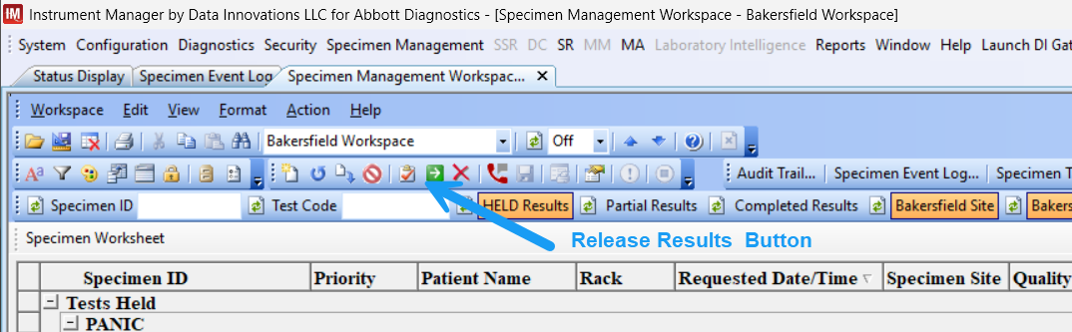
Step 2-8: Update K Result Comment
Release results to Cerner

Slide 17
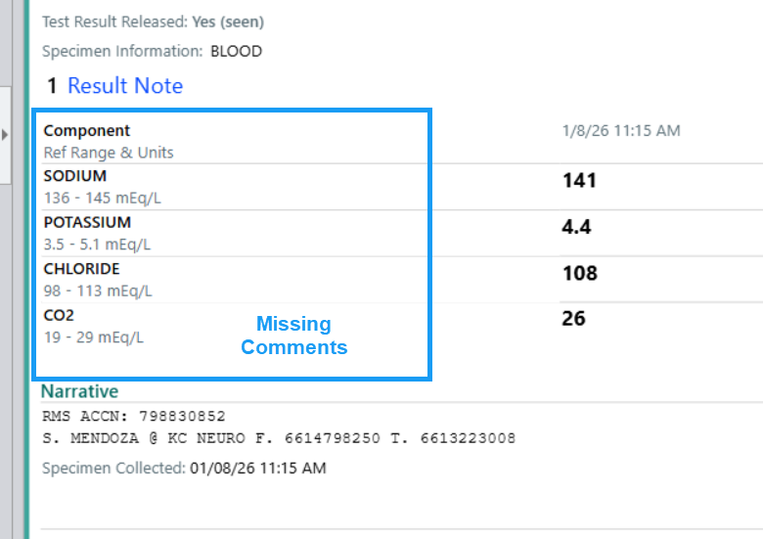
Step 3: Verify in KPHC
Confirm the results and hemolyzed comment are visible in KPHC immediately after releasing.

Slide 18
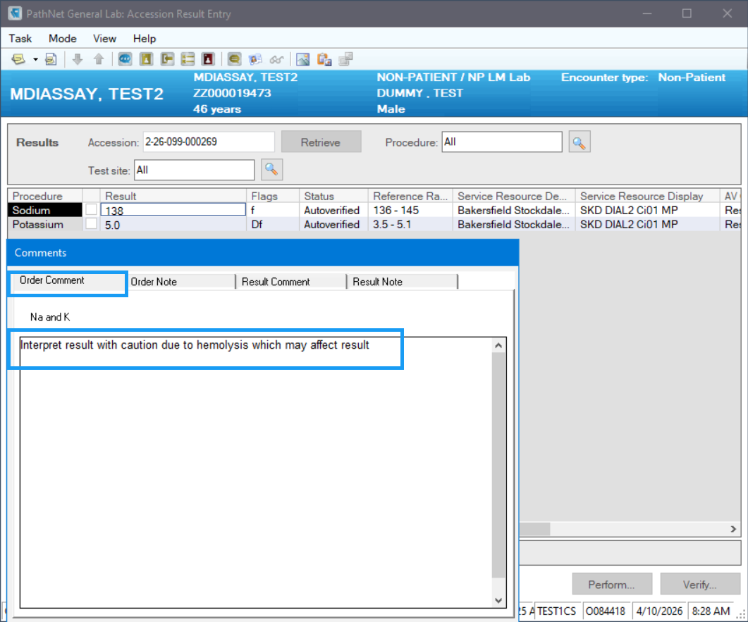
Step 4: If Comment Is Missing in KPHC
Confirm the results and hemolyzed comment are visible in KPHC immediately after releasing.

Slide 19
Key Reminders
Potassium results are the most susceptible to hemolysis (false elevation).
Release order matters, the last test released will have its test comment applied.
Comments may not automatically cross to KPHC
Always review in KPHC after releasing electrolyte results for hemolyzed specimen.

