Slide 1
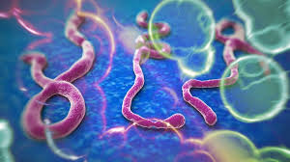
Donning and Doffing PPE
Rev 10/21/2014
Tuyen Nguyen RN, MSN
OCI Critical Service Staff Educator
Lynette Cota RN, BSN
Ancillary Department Staff Educator
Brent Murphy RN, BSN
Emergency Department ADA/Educator

Slide 2
Infection Prevention
CDC Recommendation
Private room with bathroom and closed door
Wear gloves, Tyvek suit, impermeable gown, eye protection and respirator .
Wear double glove, shoe cover, and leg cover if copious amounts of blood and other body fluid present.
Remove PPE without contaminating to eyes, mucous membrane, or clothing.
KPSC Recommendation
Airborne isolation room (For the usage of Anteroom).
Wear double surgical gloves, Tyvek suit, impermeable surgical gown over the Tyvek suit, double shoes cover to the calf, N95, and full face shield cover.
Place patient on Contact and Droplet precaution.
Remove PPE without contaminating yourself.
Dispose of PPE properly in red bags.
Wash hands with soap and water after removal of PPE.

Slide 3
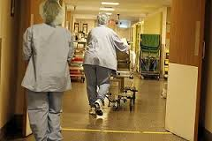
Additional KPSC RECOMMENDATION
Limit the number of staff.
Restrict patient’s movement.
No visitors.
Security log all persons entering the room.
Buddy system on monitoring PPE use.
Use disposable equipment when applicable.
NO MOVEMENT

Slide 4
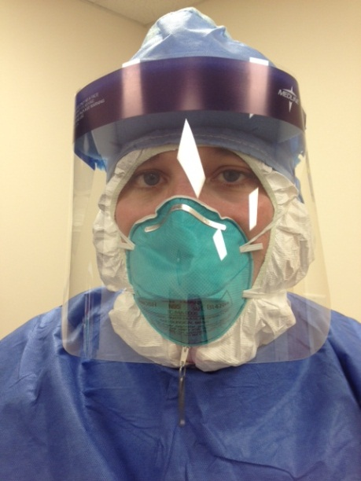
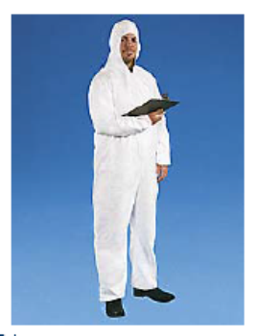
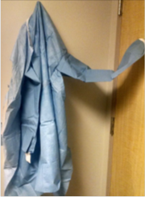
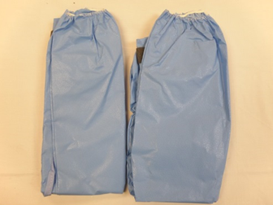
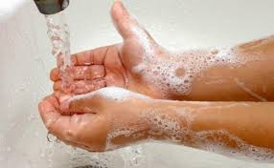
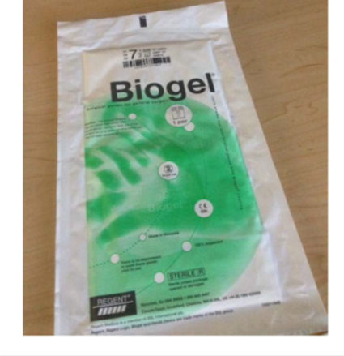
Supplies: Personal Protective Equipment (PPE)
Tyvek Suit with Hood
Blue surgical gown
Surgical Gloves
Non-Latex
Surgical boots

Slide 5
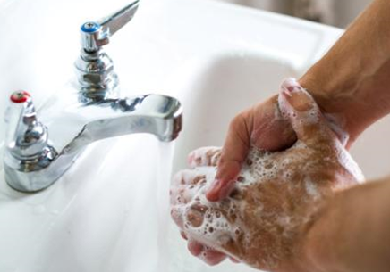
HAND HYGIENE WITH
SOAP AND WATER
Before & after patient contact
After contact with potentially infectious material
Before aseptic task
Before putting on or after removal of PPE
Before putting on or after removal of gloves

Slide 6
PPE Buddy System
Each person entering the room need a spotter to observe the donning and removal of PPE.

Slide 7
KPSC sequence for donning PPE
Change to hospital paper scrubs.
Don PPE in the hallway
Remove jewelry and badge.
Women, tie hair back
Perform hand hygiene with Gel.
Gather all PPE supplies
Inspect integrity of Tyvek suit with spotter.

Slide 8
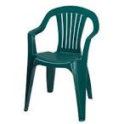
KPSC sequence for donning PPE
Sit down on the chair.
Put on first set of surgical shoes covers.
Put on Tyvek suit ½ way.
Put on second set of surgical shoes cover up to calves.
Note: Large sneakers are not recommended

Slide 9
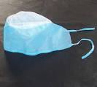
KPSC sequence for donning PPE
Pull the remainder of Tyvek suit up including hood and zip it up.
Spotter does 2nd integrity check of Tyvek suit. Place zipper pull (paper clip).
Put on skull cap.
Put on first pair of surgical gloves under the Tyvek suit cuff.

Slide 10
KPSC sequence for donning PPE
Put on surgical gown with spotter.
Tie surgical gown in the front.
Make sure the Tyvek gown sleeves have been pulled down.
Apply N95 over Tyvek hood.
Put on full length face shield. Spotter to assist.

Slide 11
KPSC sequence for donning PPE
Apply second set of surgical gloves over surgical gown cuff(use larger size).
Spotter to double check for any skin exposed. (360 degree view)
Ready to enter patient room.

Slide 12
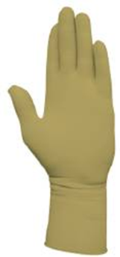
KPSC sequence for removing PPE
Signal Buddy ready to exit the patient room. Buddy is required to be in full PPE.
Buddy with PPE opens the patient door from Anteroom.
Buddy will hand RN a bleach wipe to clean gloves.
Remove first pair of gloves in patient room.

Slide 13
KPSC sequence for removing PPE
Step into the Anteroom. Apply clean pair of nitrile gloves in the Anteroom.
Sit on the chair
Remove outer layer surgical boot without crossing legs.
Clean gloves with bleach wipe.

Slide 14
KPSC sequence for removing PPE
Stand up. Buddy will untie surgical gown from the back.
Peel off surgical gown and gloves like peeling a banana.
Both RN and Buddy clean last pair of gloves with bleach.
Remove face shield from the back.

Slide 15
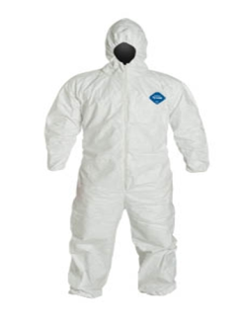
KPSC sequence for removing PPE
Remove N95 from the back. Buddy will cut one string at a time. IMPORTANT- Cut bottom string first! Allow N95 to drop to floor.
Buddy removes skull cap.
Buddy to unzip the Tyvek suit.
Buddy helps peel off Tyvek suit & surgical shoe covers.It is recommended you do not wear sneakers.
Drop them to the floor.

Slide 16
KPSC sequence for removing PPE
Remove last pair of shoe covers.
Clean gloves with bleach wipe. Remove gloves.
Buddy picks up Tyvek suit and dirty PPE. Drops into trash can.
Wash hands with soap and water.

Slide 17
KPSC sequence for removing PPE
At any time your gloves can be cleaned/disinfected with bleach wipe.

Slide 18
Additional Information:
http://www.cdc.gov/ebola

