Slide 1
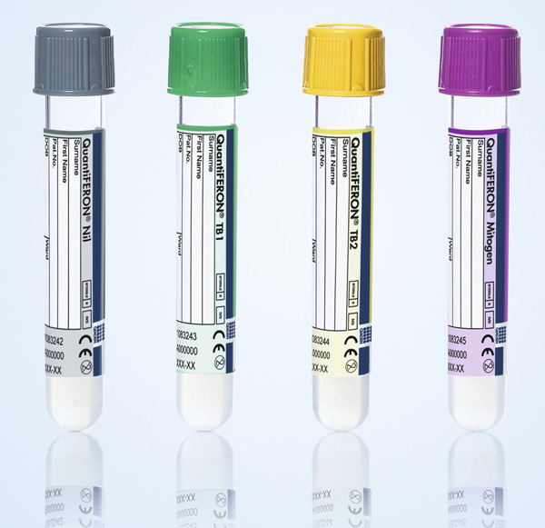
QuantiFERON-TB Gold Plus
Please watch the Instructional video and Complete the Competency quiz.

Slide 2
QFT TB Gold
QFT TB Gold Plus
August 1, 2018
The Go-live date of QFT-TB Gold Plus is August 1, 2018
9.5 2.34 11.84

Slide 3
QuantiFERON –TB Gold Plus
Nil
TB1
TB2
Mitogen
Nil tube (Grey)
Negative control to adjust for background IFN-γ
TB1 tube (Green)
Primarily detects CD4+ T cell response
TB2 tube (Yellow)
Optimized for detection of CD4+ and CD8+ T cell responses
Mitogen tube (Purple)
Positive control to confirm baseline immune status

Slide 4
The black mark on the side of the tube indicates the range of 0.8 to 1.2mL fill volume.
Sample in all 4 tubes MUST BE WITHIN the black mark.
DO NOT send to SWL/CHL if the sample in any of the tubes is above or below the black mark.
Below the
black mark
Above the black mark

Slide 5
Proper shaking of tubes
Mix the tubes by shaking them 10 times (up and down motion) just firmly enough to coat the entire inner surface of the tube with the blood. Note: Over energetic shaking may cause gel disruption and could lead to inaccurate results.
Place tubes upright in a test tube rack. Mixing is required to ensure complete integration of the tube’s contents into the blood.
Label tubes appropriately with TIME and DATE of collection.

Slide 6
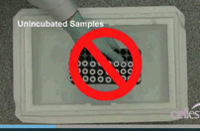
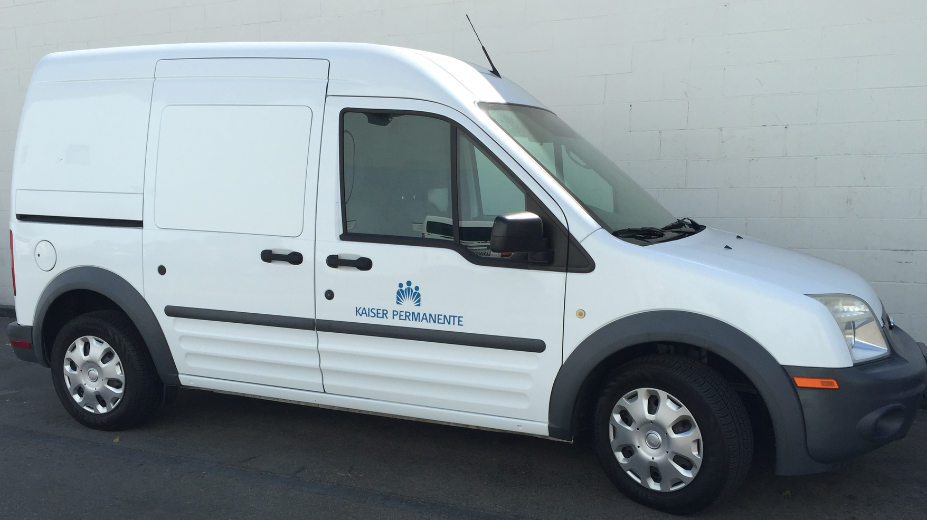
d
DO NOT INCUBATE & CENTRIFUGE
AT THE MEDICAL CENTERS OR MOBS
Blood should be maintained at room temperature (22°C ± 5°C)
Samples must be delivered to Chino Hills RL or
Sherman Way RL within 16 hours of collection
Please send the samples to SWRL or CHRL immediately
Unincubated Samples
Do not freeze
Do not use PCM
Do not store in Ice
Do not refrigerate

