Slide 1
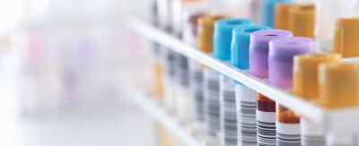
MOB Specimen Processing: Step-by-Step Instructions
Detailed guidance for effective specimen handling procedures
Notes:
AI-generated content may be incorrect. ---

Slide 2
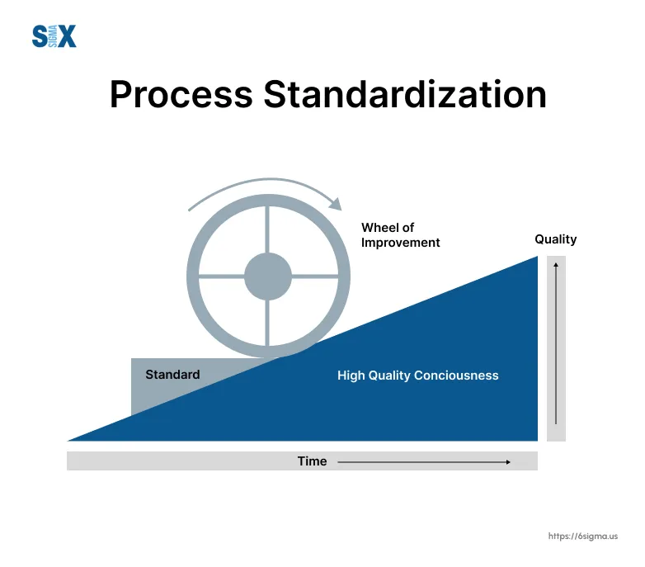
Overview and Workflow Standardization
As part of our ongoing commitment to operational excellence and patient safety, we are rolling out a standardized MOB specimen processing workflow across all draw stations and lab processing areas.
Updated Workflow Standards
Standardized, workflows aim to streamline steps, reduce errors, and improve processing efficiency.
Consistency and Compliance
Staff must familiarize with updates to ensure compliance and maintain consistent, high-quality specimen handling practices. By following clearly defined steps, we can better manage specimen integrity, reduce turnaround time, and enhance overall lab efficiency.
Your role in this process is critical. We appreciate your attention to detail and teamwork as we implement this improved workflow. Training materials and updated instructions will be provided to support you every step of the way.
Notes:
--- This slide references information from the following file: https://sp-cloud.kp.org/sites/KPOCIrvineLaboratoryCentral-KPOCIrvineMOBLabAssistantHQ/_layouts/15/Doc.aspx?sourcedoc=%7B566A7744-0EAC-46AE-89A5-710F2D0DB9DE%7D&file=MOB%20Processing.pptx&action=edit&mobileredirect=true The MVJ section includes visual aids and images that illustrate the specimen processing workflow. These visuals help staff understand the correct procedures and layout of the processing area. Additionally, standardized workflows were updated as of June 23, 2025. These updates aim to streamline the specimen processing steps, reduce errors, and improve efficiency. Staff should familiarize themselves with these updates to ensure compliance with the latest protocols. The standardized workflows serve as a reference for consistent practices across all processing stations and help maintain high-quality standards in specimen handling.

Slide 3
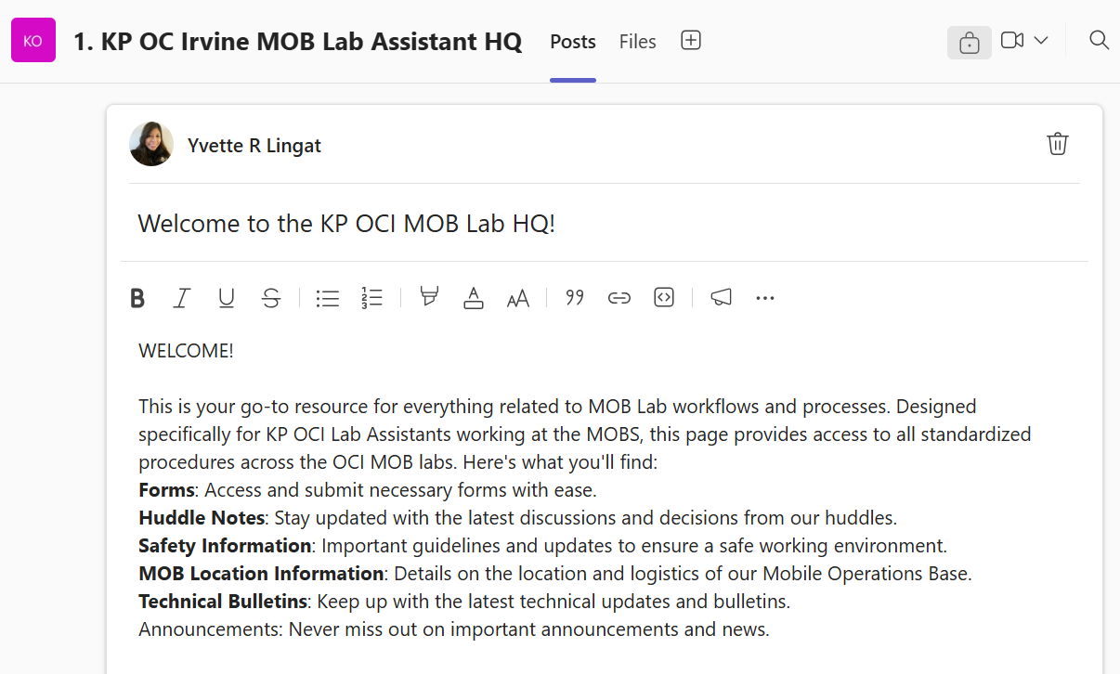
reSOURCES
New TEAMS Channel- please pin as your favorite
Updated Training and Competency Forms with location specific checklist for each MOB.
Power point of New Standardized processing workflow
Delegated trainers for each location
Notes:
AI-generated content may be incorrect. ---

Slide 4
MOB training & workflow matrix
Employee Orientation Packet
Training Schedule
Competency Assessment
MOB Specific Orientation
Administrative Documents / Checklists
Blood Draw / Processing – attachment A
AIDET, Platinum Service
MOB specific responsibilities / Logistics
Onboarding Training for LA
Continuous Training / Knowledge Retention
Annual MTS Competency
Huddle
Lab Assistant Competency Assessment – Blood Draw
Lab Assistant Competency Assessment – Processing
AIDET + Empathy Observation
Platinum Service Observation
MOB Location Specific Orientation
Cytology Tracking Training
Notes:
AI-generated content may be incorrect. ---

Slide 5
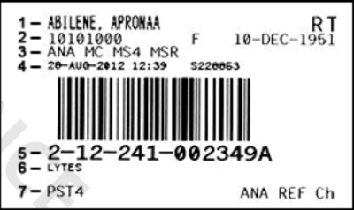
Specimen Labeling and Initial Sorting
1. Surname, First name, Middle Initial
2. MRN Gender Birthdate
3. Location
4. Current Date, time, NUID of collector
5. Accession Number
6. Tests Ordered
7. Sample tube requirement Testing site
Notes:
--- This slide references information from the following file: https://sp-cloud.kp.org/sites/KPOCIrvineLaboratoryCentral-KPOCIrvineMOBLabAssistantHQ/_layouts/15/Doc.aspx?sourcedoc=%7B566A7744-0EAC-46AE-89A5-710F2D0DB9DE%7D&file=MOB%20Processing.pptx&action=edit&mobileredirect=true Draw Station Responsibilities and Initial Sorting

Slide 6
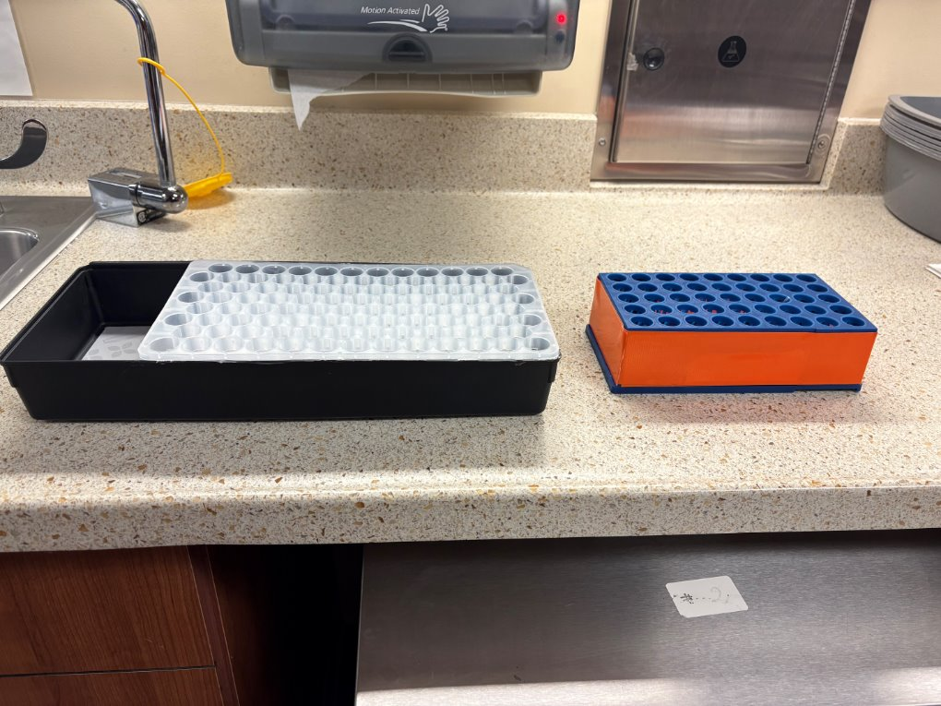
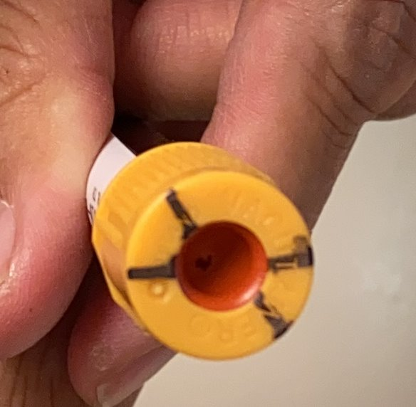
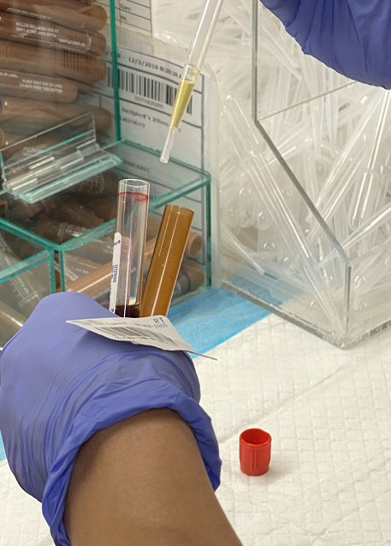
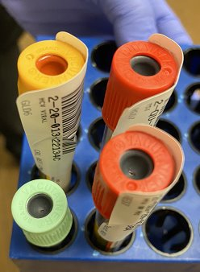
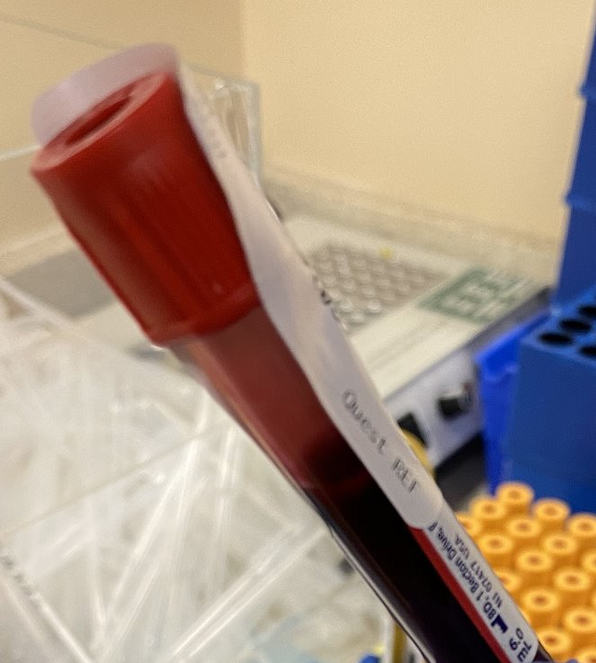
Draw Station
Rack Organization
At the blood draw station, maintain one specimen rack for CRL and one orange specimen rack for OCI. Processors will pick up racks every 30 minutes and replace them to ensure a continuous workflow of samples.
Marking Tubes – "X" Mark for ANY special handling
Draw station personnel are responsible for accurately marking tubes before placing them on racks for processing.
Labeling Gold Top Tubes for OCI and shared samples
Gold tubes designated for OCI testing are marked “X” distinctly to ensure correct processing and identification.
Labeling Shared Samples
Shared Gold top tubes are marked with ‘X”. Shared samples are labeled with the test label having the shortest stability period for proper handling.
Aliquot Tube Labeling - Proper labeling of aliquot tubes ensures samples are accurately processed and routed without confusion.
"X" mark for
Any special handling
Notes:
--- This slide references information from the following file: https://sp-cloud.kp.org/sites/KPOCIrvineLaboratoryCentral-KPOCIrvineMOBLabAssistantHQ/_layouts/15/Doc.aspx?sourcedoc=%7B566A7744-0EAC-46AE-89A5-710F2D0DB9DE%7D&file=MOB%20Processing.pptx&action=edit&mobileredirect=true At the draw station, it is essential to mark OCI tubes before placing them on the racks. This task is the responsibility of the draw station personnel. Once the tubes are marked, they are placed on specimen racks that are organized by hour increments. These racks are centrally located at the MOB draw stations and are picked up hourly by the processor. The processor replaces the used rack with the next hour’s rack to ensure a continuous workflow. In the processing area, samples are sorted based on their destination—OCI versus RRL—and by type, distinguishing between blood and non-blood specimens. This initial sorting is crucial for maintaining the integrity of the samples and ensuring they are processed according to their specific requirements.

Slide 7
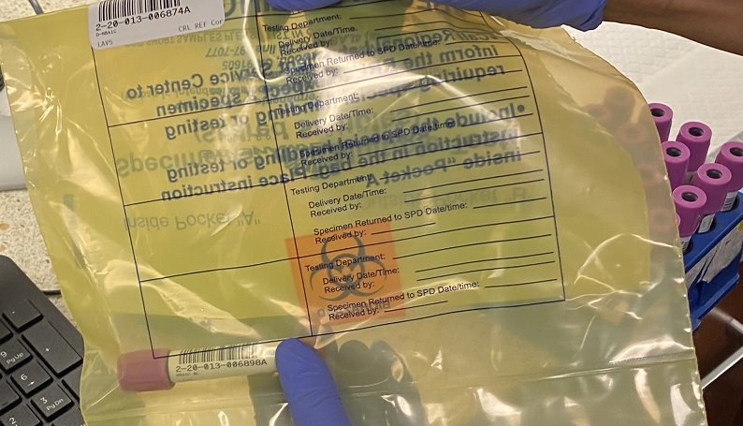
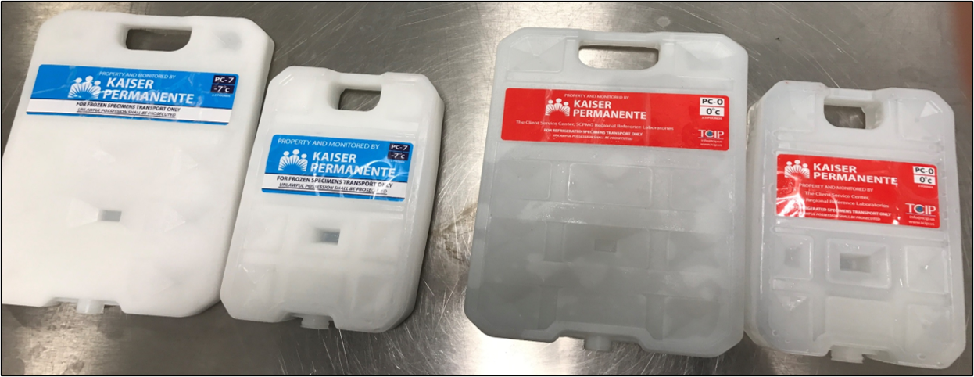
Processing Station
Shared samples: tube labeled with test label that has the shortest stability, All test labels will be affixed outside the yellow bag ​
This is done by staff who collected the sample.
Rack Organization
Collect specimen racks every 30 minutes and replace them. Allow 30 minutes before centrifugation to ensure proper timing for spinning samples. (use timers provided)
Initial Sample Sorting
Samples are initially sorted by destination and type to ensure proper processing and maintain sample integrity. Start with CRL processing then OCI processing.
Temperature-Based Sample Grouping
Samples are grouped and consolidated by temperature to maintain integrity.
Notes:
--- This slide references information from the following file: https://sp-cloud.kp.org/sites/KPOCIrvineLaboratoryCentral-KPOCIrvineMOBLabAssistantHQ/_layouts/15/Doc.aspx?sourcedoc=%7B566A7744-0EAC-46AE-89A5-710F2D0DB9DE%7D&file=MOB%20Processing.pptx&action=edit&mobileredirect=true Quest samples are consolidated by temperature and sent in one bag. Gold tubes that are designated for OCI must be tagged accordingly. For shared samples, the tube should be labeled with the test label that has the shortest stability. All test labels must be affixed outside the yellow bag. This labeling is performed by the staff who collected the sample. For samples requiring aliquoting, proper labeling is essential. The process includes labeling aliquot tubes appropriately and ensuring that all necessary identifiers are present. This step ensures that samples are correctly processed and routed to their respective destinations without confusion or delay.

Slide 8
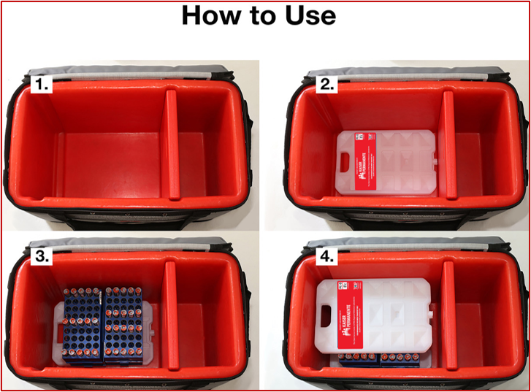
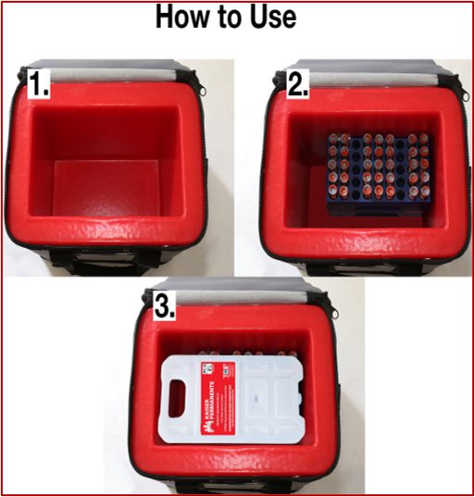
Packing tote
Small Tote
Use 1 PCM on TOP
Large Tote
Use 1 PCM on TOP and 1 PCM at BOTTOM (‘sandwich’)
Small Gray/Purple Tote: Place (1) 3 lbs. blue-labelled PCM-7 on top of specimens
Large Gray/Purple Tote: place (1) 2.5 lbs. Red-labelled PCM-0 below specimens, AND (1) 2.5 lbs. Red-labelled PCM-0 on top of specimens
Notes:
--- This slide references information from the following file: https://sp-cloud.kp.org/sites/KPOCIrvineLaboratoryCentral-KPOCIrvineMOBLabAssistantHQ/_layouts/15/Doc.aspx?sourcedoc=%7B566A7744-0EAC-46AE-89A5-710F2D0DB9DE%7D&file=MOB%20Processing.pptx&action=edit&mobileredirect=true Temperature-Based Consolidation and Labeling

Slide 9
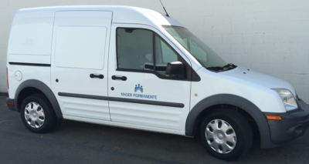
Processing Steps for CRL Samples
Notes:
--- This slide references information from the following file: https://sp-cloud.kp.org/sites/KPOCIrvineLaboratoryCentral-KPOCIrvineMOBLabAssistantHQ/_layouts/15/Doc.aspx?sourcedoc=%7B566A7744-0EAC-46AE-89A5-710F2D0DB9DE%7D&file=MOB%20Processing.pptx&action=edit&mobileredirect=true Detailed CRL Processing Instructions

Slide 10
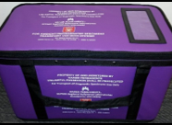
CRL Processing OverView
Initial Sample Handling
Samples are picked up in 30 mins increment, racks replaced, and samples spun while segregating urine and culture samples.
Sample Sorting and Aliquoting
Samples are sorted by temperature and destination; frozen samples aliquoted and stored for shipment.
Scanning and Verification
Samples scanned in batches of five in blue racks, totals verified, and racks labeled after 45 samples.
Final Packing and Shipping
Processed samples placed in blue racks inside purple totes using correct PCM and packing configurations.
Notes:
--- This slide references information from the following file: https://sp-cloud.kp.org/sites/KPOCIrvineLaboratoryCentral-KPOCIrvineMOBLabAssistantHQ/_layouts/15/Doc.aspx?sourcedoc=%7B566A7744-0EAC-46AE-89A5-710F2D0DB9DE%7D&file=MOB%20Processing.pptx&action=edit&mobileredirect=true The processing steps for CRL samples begin with the processor picking up the sample rack at the designated time, which is organized in hour increments. The processor then replaces the rack in the workstation with the next hour’s rack. Samples are spun, and while spinning, urine and culture samples are segregated and set aside. Samples are then sorted by temperature and destination: OCI samples go into the OCI basket, and CRL samples into the CRL basket. These are placed in their corresponding bins. If aliquoting is required, frozen samples are transferred using appropriate tubes and placed in the freezer for the MOB closing lab assistant to send out. Samples must be fully frozen before shipment. CRL processing is prioritized and uses blue racks. The process continues with refrigerated samples being scanned in a specific order: yellow tubes first, followed by purple, other colored tubes, and finally non-blood samples. The manual build option is selected in the transfer list, and the appropriate transfer temperature is chosen. Samples are scanned in batches of five using a vertically positioned blue LOBOTIX rack. After every five samples, the scanned total is verified against the actual samples. Once a rack is filled with 45 samples, a "Chino Hills" purple sticker is placed on top. This process is repeated until all samples are scanned. The total tally of scanned samples is verified, and the transfer list is closed and saved. Samples are then placed in blue racks within a purple tote designated for CRL, using the correct PCM and packing configuration. The same steps are followed for ambient and frozen samples.

Slide 11
Detailed Processing Instructions for crl
1. Processor Pick sample rack by designated time (30-min increments)
- Pick up CRL samples first then OCI samples.
2. Processor Replace the rack in the workstation with a new rack
3. Places samples in centrifuge and set the timer for 30 min. After 30 min, spin samples.
4. While blood tubes are spinning, sort non-blood samples and segregate by temperature and destination: OCI samples in OCI orange rack and CRL samples in CRL basket.
5. Place spun blood specimens in CRL bucket. Aliquot (when required)Frozen samples and use appropriate transfer tube, place sample in the freezer for MOB closing Lab assistant to send out. Samples must be fully frozen before sending out.
6. CRL processing first. Use Blue Racks. Check tube vs label to see if label matches color of tube
7. Start with refrigerated samples, scan yellow tubes first, then purple, other colored tubes then the non-blood samples.
◦ In Build transfer list, select manual build and select appropriate transfer temperature. Scan samples.
◦Position BLUE labotix rack vertically to accommodate scanning 5 samples at a time for ease of tallying your scanned samples in the transfer list vs actual samples in the rack.
◦ After scanning every 5 samples, verify the total number of scanned samples on the screen against the actual samples in the rack. If there is a discrepancy, it will be easier to identify the unscanned sample.
8. When one rack is completely filled (45 samples), check and compare the list to the rack of number of samples, place a "Chino Hills" purple sticker on top and place the complete rack in a PURPLE tote going to CRL. Proceed with the next rack until all samples are scanned.

Slide 12
Detailed Processing Instructions for crl
(cont'd)
*** Ensure tote has appropriate PCM(s) per packing configuration.***
9. Verify total tally of samples in all transfer list vs actual samples in all the racks.
10. Close and save each transfer list when all samples are scanned.
11. Place or refresh appropriate PCMs following correct packing configuration.
12. Follow steps 8-12 for ambient and frozen.
13. Ensure no specimen is left on List Build (pending list).
14. Transfer all CRL Build list
15. Access Smartship to create barcode shipment label. Put in the comment the packing list numbers being shipped in the tote. Create SMARTSHIP only for the totes that are being sent out.
16. Complete Transfer List to outer tub in Cerner Discern Analytics- select transfer list numbers, scan Smartship barcode.
17. Complete the MOB tote check log and have the courier verify and sign on pick up.
18. On Courier pick up: Before signing off on the courier handheld:
Confirm the number of totes matches the log.
Investigate any discrepancies immediately.
For extra SMARTSHIP numbers, cancel any that are not accounted for.
If unable to cancel, contact Dispatch at 1-800-503-6900 and provide the SMARTSHIP number to be canceled.

Slide 13

Processing Steps for OCI Samples
Notes:
--- This slide references information from the following file: https://sp-cloud.kp.org/sites/KPOCIrvineLaboratoryCentral-KPOCIrvineMOBLabAssistantHQ/_layouts/15/Doc.aspx?sourcedoc=%7B566A7744-0EAC-46AE-89A5-710F2D0DB9DE%7D&file=MOB%20Processing.pptx&action=edit&mobileredirect=true Detailed OCI Processing Instructions

Slide 14
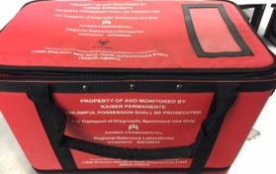
OCI Processing OVERVIEW
Sample Segregation and Rack Use
OCI samples are processed using orange racks, with specialty and non-blood samples segregated by temperature and type.
Batch Scanning and Verification
Samples are scanned in batches of five, with totals verified against actual quantities in the racks for accuracy.
Labeling and Shipment Preparation
Barcode labels are created via Smartship, and samples are packed into designated totes with proper documentation.
Final Verification and Courier Handoff
The MOB tote check log is completed, discrepancies investigated, and courier signs off after verifying totes match the log.
Notes:
--- This slide references information from the following file: https://sp-cloud.kp.org/sites/KPOCIrvineLaboratoryCentral-KPOCIrvineMOBLabAssistantHQ/_layouts/15/Doc.aspx?sourcedoc=%7B566A7744-0EAC-46AE-89A5-710F2D0DB9DE%7D&file=MOB%20Processing.pptx&action=edit&mobileredirect=true OCI sample processing begins after CRL processing is complete. Orange racks are used for OCI samples. Specialty samples, such as those for Quest and ARUP, are segregated into designated racks at the processing station. OCI non-blood samples are picked up and segregated by temperature requirements. Processing starts with refrigerated samples, scanning green tubes first, followed by purple, other colored tubes, and then non-blood samples. In the transfer list, the manual build option is selected, and the appropriate transfer temperature is chosen. Samples are scanned in batches of five using a vertically positioned orange rack to facilitate tallying. After scanning every five samples, the total number of scanned samples is verified against the actual samples in the rack. When an orange rack is filled with 45 samples, an "Irvine Medical Center" sticker is placed on top. This process is repeated until all samples are scanned. The total tally of samples in the transfer list is verified against the actual samples in all racks. The transfer list is then closed and saved. Orange OCI sample racks are placed in the red tote designated for OCI, using the correct PCM and packing configuration. The transfer lists for both OCI and CRL are then transferred. Smartship is accessed to create barcode shipment labels, and the packing list numbers are included in the comments. Labels are created only for totes being sent out. The transfer list is completed in Cerner Discern Analytics by selecting the transfer list numbers and scanning the Smartship barcode. Finally, the MOB tote check log is completed, and the courier verifies and signs upon pickup. Before signing off on the courier handheld, confirm that the number of totes matches the log, investigate any discrepancies, cancel any unaccounted Smartship numbers, and contact Dispatch at 1-800-503-6900 if cancellation is not possible.

Slide 15
Detailed Processing Instructions for OCI
1. Processor Pick OCI sample rack by designated time (30-min increments).
2. Processor Replace the ORANGE RACK in the draw station with a new rack.
3. Place samples in centrifuge and set the timer for 30 min. After 30 min, spin samples.
4. While blood tubes are spinning, sort non-blood samples and segregate by temperature.
5. Start with refrigerated samples, scan green tubes first, then purple, other colored tubes, then the non-blood samples.
◦ In Build transfer list, select manual build and select appropriate transfer temperature. Scan samples.
◦Position ORANGE rack vertically to accommodate scanning 5 samples at a time for ease of tallying your scanned samples in the transfer list vs actual samples in the rack.
◦ After scanning every 5 samples, verify the total number of scanned samples on the screen against the actual samples in the rack. If there is a discrepancy, it will be easier to identify the unscanned sample.
6. When one ORANGE rack is completely filled (45 samples), place an "Irvine Medical Center" sticker on top. Proceed with the next rack until all samples are scanned.
7. Verify total tally of samples in the transfer list vs actual samples in all the racks. (Don’t forget to add the ambient and Specialty samples in the count)
8. Close and Save transfer list.
9. Place Orange OCI sample racks in the RED tote going to OCI with correct PCM following correct packing configuration.
10. Transfer all OCI on Build list.
11. Ensure no specimen is left on List Build (pending list).
12. Access Smartship to create barcode shipment label. Put in the comment the packing list numbers being shipped in the tote. Create Smartship only for the totes that are being sent out.
13. Complete Transfer List to outer tub in Cerner Discern Analytics- select transfer list numbers, scan Smartship barcode.
14. Complete the MOB tote check log and have the courier verify and sign on pick up.
15. On Courier pick up: Before signing off on the courier handheld:
Confirm the number of totes matches the log.
Investigate any discrepancies immediately.
For extra SMARTSHIP numbers, cancel any that are not accounted for.
If unable to cancel, contact Dispatch at 1-800-503-6900 and provide the SMARTSHIP number to be canceled.

Slide 16
Thank you! Our journey continues...
Notes:
--- This slide references information from the following file: https://sp-cloud.kp.org/sites/KPOCIrvineLaboratoryCentral-KPOCIrvineMOBLabAssistantHQ/_layouts/15/Doc.aspx?sourcedoc=%7B566A7744-0EAC-46AE-89A5-710F2D0DB9DE%7D&file=MOB%20Processing.pptx&action=edit&mobileredirect=true Detailed OCI Processing Instructions

